Slide 1

Chittagong University of Engineering & Technology
Department of Electronics & Telecommunication Engineering
Title- BREAST CANCER IMAGE CLASSIFICATION USING EXTERNAL ATTENTION MULTILAYER PERCEPTRON BASED TRANSFORMER
Thesis
Supervisor:
Dr. Md Saiful Islam
Associate Professor
Dept. of Electronics and Telecommunication Engineering
Name - Shemonti Barua
ID - 1708008

Slide 2
Presentation Outline
Introduction
Problem Demonstration
Research Objective
Background Study
Related Work
Research methodology
Results and Discussion
Conclusion
References

Slide 3
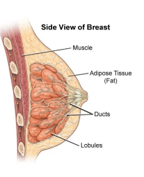
Introduction
What is Breast Cancer?
The breasts are made of fat glands and connective tissue
The breast has several lobes, which are divided into lobules
and end in the milk glands
Tiny ducts run from the many tiny glands. These ducts are
where 78% of breast cancer occur[2].
Cancer developing in the lobules about 10-15%[3]
Figure1:Structure of breast[1]

Slide 4
Introduction(Cont…)
What is Breast Cancer?
An abnormal, uncontrolled cell growth arising in breast tissue
Breast cancer is the second leading cause of death in women[4].
Breast cancer primarily effects women but 1 percent of all cases effect men
One third of women with breast cancer die from breast cancer.

Slide 5
Problem Demonstration
An abnormal, uncontrolled cell growth arising in breast tissue is known as breast cancer
Breast cancer is the second leading cause of death [4] in women.
Detect the breast cancer is essential for early treatment and to save the patient’s life.
Despite the fact that deep learning techniques enhance performance, deep networks and massive inputs come with significant computational costs and parameters, which lengthen the time required for network training and tuning.

Slide 6
Problem Demonstration (Cont…)
To solve this problem self attention based transformer model has been introduced [5]
But employing self-attention has a significant disadvantage due to the tremendous computational complexity of O(N^2*d).
The quadratic complexity of the input pixel count prevents the direct application of self-attention to visuals.
To solve this issue, a lightweight focus on simplifying the model and enhancing performance should be implemented.

Slide 7
Research Objective
External attention, a cutting edge attention mechanism multi layer perceptron(EAMLP) based transformer is proposed to take the role of the self attention in existing design by reducing the complexity to O(n) for the breast images classification.
To implement two linear, small retention units in this model through two linear layers and normalization layers for reducing the complexity.

Slide 8
Research Objective (Cont…)
To compare the model performance, specificity, sensitivity between the state of the art architechtures like original transformers.
To observe the performance of the proposed model for different number of multi layer perceptron on the proposed model and to determine the best model

Slide 9
Background study
Attention
Transformer
Self attention
External attention

Slide 10
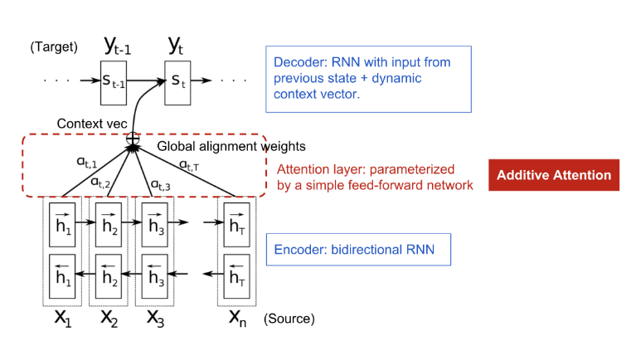
Background study (Cont…)
Attention
Figure 2:attention mechanism[6]

Slide 11
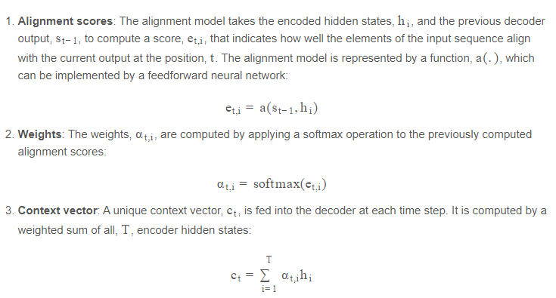
Background study (Cont…)
Attention

Slide 12
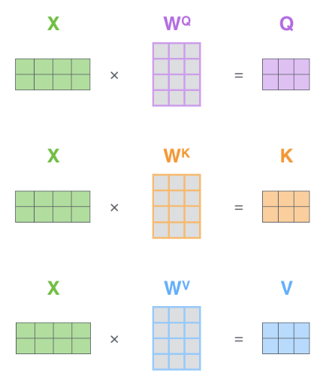
Background study (Cont…)
Self Attention
Figure 3 :Multiplying image vector with weight matrices[7]

Slide 13
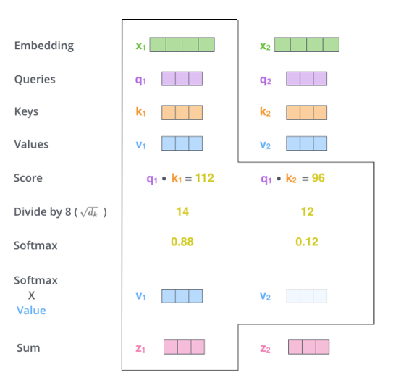
Background study (Cont…)
Self Attention
Figure 4 :Illustration of self attention calculation [7]

Slide 14
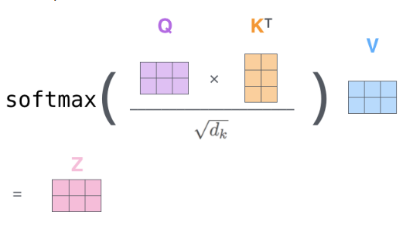
Background study (Cont…)
Self Attention
Figure 5 : Self-attention calculation in matrix form[7]

Slide 15
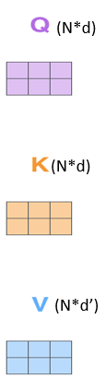


Background study (Cont…)
Limitation of Self attention
self-attention can be formulated as:
Here query matrix Q ∈ R^{N*d}, a key matrix K ∈ R^{N*d}, and a value matrix V ∈ R^{N*d’}
N is the number of patch &
d is the embedding size.
Figure 6 : Shape of Q,K,V vectors

Slide 16
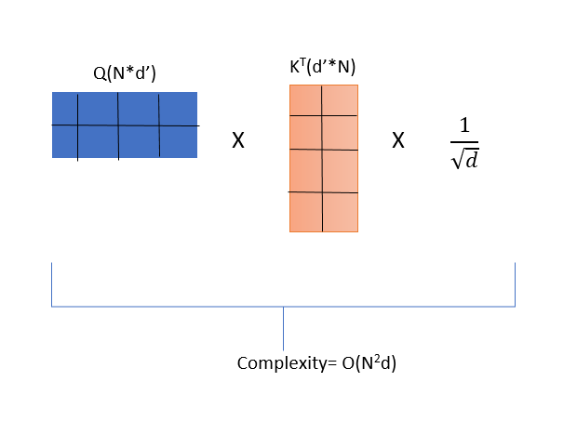
Background study (Cont…)
Limitation of Self attention
calculation of Y=QK T /sqrt(d) takes O(N^2*d).
2) exponentiation and calculation of row sum of N takes O(N^2) time,
3) division of each element of N with the corresponding row sum takes O(N^2), and
4) multiplication of softmax(QKT) and V takes O(N^2d*v) time
Figure 7 : Computational Complexity of self attention

Slide 17
Background study (Cont…)
Limitation of Self attention
If N=3136 & d=64,
There will create a high computational complexity because of N to N matrix multiplication.
The majority of pixels, according to the authors, are tightly connected to only a small number of other pixels, thus an N-to-N attention matrix could be redundant.
Figure 7 : Computational Complexity of self attention

Slide 18
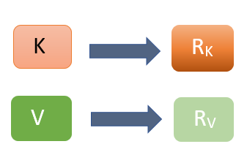
Background study (Cont…)
External attention
It is type of attention which reduces complexity by creating retention unit instead of using key and value vector
Figure 8 : Retention Unit of External attention

Slide 19
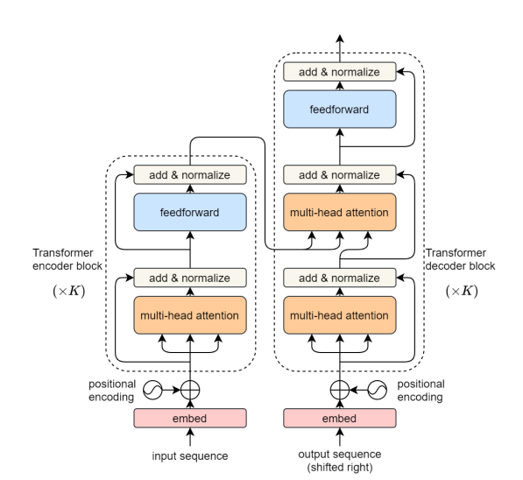
Background study (Cont…)
Transformer Blocks
Figure. 9 : Illustration of Transformer blocks[8]

Slide 20
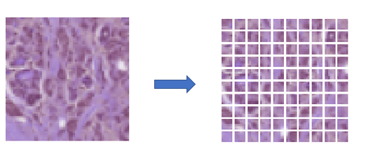
Background study (Cont…)
Transformer Blocks
Patch Embedding
With the use of this patch embedding technique,
the Transformer is able to process the picture
as a series of embeddings that can be processed by
its self-attention mechanism.
Patch embedding therefore serves as a bridge
between image data and the transformer architecture,
allowing the transformer to process images as effectively
as it does sequential data
Figure10 :Patch Embedding

Slide 21
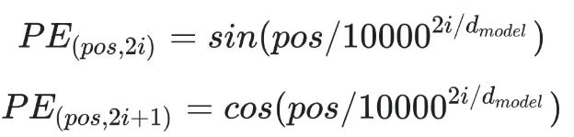
Background study (Cont…)
Transformer Blocks
Positional Embedding:
As the transformer encoder lacks recurrence in contrast to recurrent neural networks, some positional information must be provided in the input embeddings.
Positional encoding is used to achieve this.
Figure 11 :Positional Embedding[9]

Slide 22
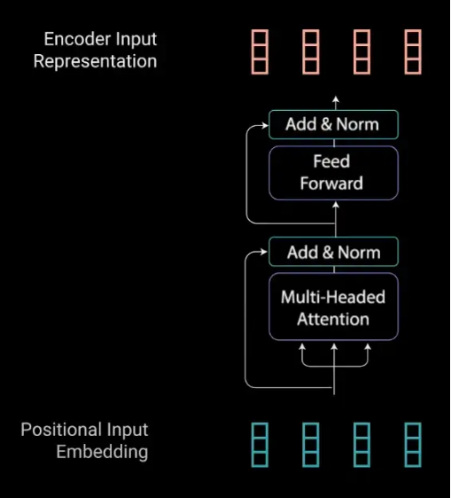
Background study (Cont…)
Transformer Blocks
Encoder Layer:
This consists of two submodules,-
1. several heads of attention
2. an entirely integrated network.
Figure 12 :Encoder Layer[9]

Slide 23
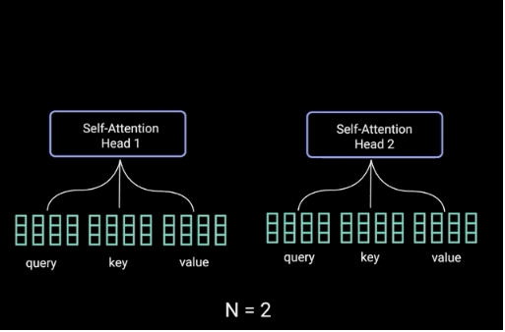
Background study (Cont…)
Transformer Blocks
Multi Head Attention:
Multi-headed attention in the encoder uses a
specific attention mechanism called self-attention.
Mechanisms for self-attention and multi-head
attention have already been covered in the
preceding section.
Figure 13 : Multi Head attention[9]

Slide 24
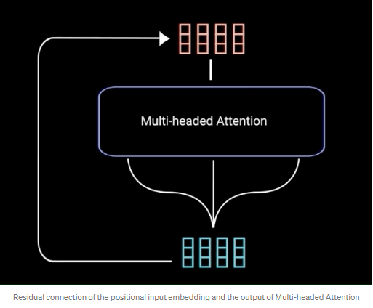
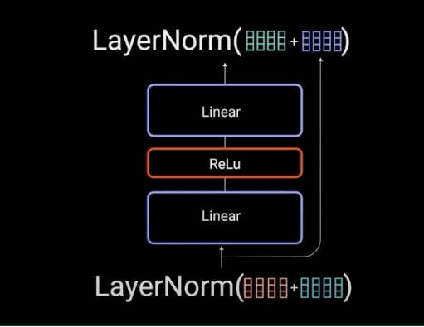
Background study (Cont…)
Transformer Blocks
The Residual Connections, Layer Normalization, and Feed Forward Network:
Figure 14 : Residual Connection[9]
Figure 15: Layer Normalization[9]

Slide 25
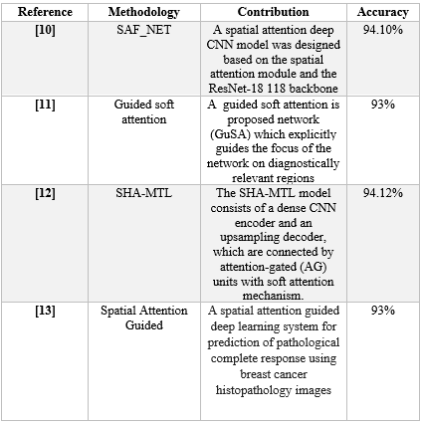
related work

Slide 26
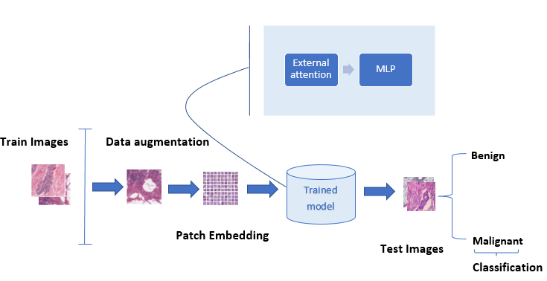
Research Methodology
Figure 16: Flowchart of the proposed model

Slide 27
Research Methodology (Cont…)
Algorithm of proposed method:
Step 1: Loading of Breast cancer dataset of 50 × 50 pixels
Step 2: Performing preprocessing:
(a) Resize the image of 64 × 64 pixels & 112x112 pixels
(b) Performing Data Augmentation -Random Rotation, Random Zoom, Random Flip
Step 3:Performing patch embedding & patch extraction to convert the image into vector
Step 4: Split the augmented data for both training and validation ,test for two data
Step 5: Creating the EAMLP model for feature extraction and train data.
Step 6: Setting network parameters: optimizer = adm, epochs = 50, learning rate = 1e-2 for different number of MLP

Slide 28
Research Methodology (Cont…)
Algorithm of proposed method:
Step 7: Train the proposed deep EAMLP model
Step 8: Observation of accuracy, sensitivity & specificity.

Slide 29
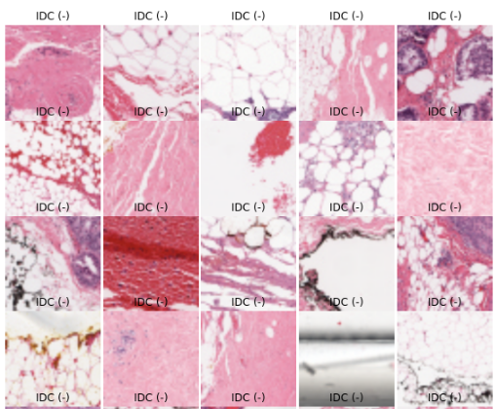
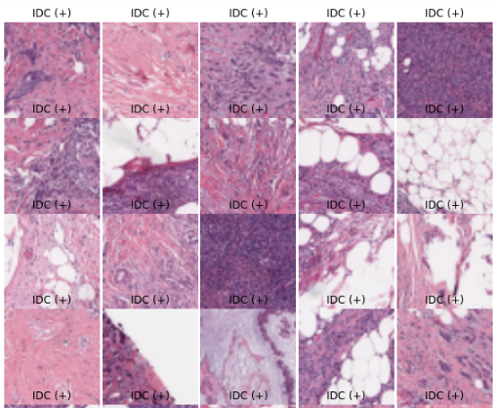
Step-1:Dataset collection
This Dataset is a subset of Kaggle Breast Cancer Histopathology Images [7].
The 7,500 photos used to create the suggested methodology included 3,000 IDC positive images and 4,500 IDC negative images[2].
For this experiment, total 7500 Breast Cancer Histopathology Images were used and all those were of 64 × 64 pixels & 112 x 112 dimension.
Among 7500 images 5250 images were used for training,1575 images were used for validation & 675 images were used testing.
IDC + samples
IDC - samples
Figure 17: Example of image IDC positive and IDC negative of the training set

Slide 30
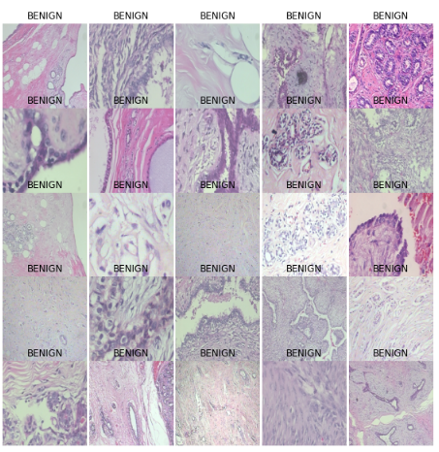
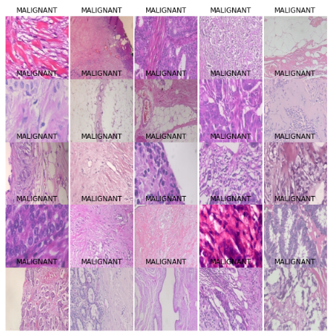
Step-1:Dataset collection(Cont…)
There are 2,480 benign and 5,429 malignant specimens with a resolution of 700x460 pixels among 82 people.
1000 photos out of 7909 were utilized just for testing.
Benign
Malignant
Figure 18: Example of image of benign and Malignant of BreakHis datasets

Slide 31
Step-2:Image preprocessing
❑ Image Resizing
✓ One dataset can be compressed with different size of images.
✓ The images were resized to 64x 64 dimensions in order to resolve the problem of the images' low resolution.
❑ Data augmentation
✓ Data augmentation is capable of reducing the overfitting problem.
✓ Augmentation performs the task of generating new images from original one and increase the dataset.
✓ Data augmentation to enhance the network flexibility.
✓ The applied augmentation techniques include Random Rotation, RandomZoom, RandomFlip.

Slide 32
Step-2:Image preprocessing(CONT…)
❑ Patch Embedding
✓ . In the transformer for image classification, the input image is divided into non-overlapping, fixed-size patches that are then flattened into a collection of vectors.
With the use of this patch embedding technique, the Transformer is able to process the picture as a series of embeddings that can be processed by its self-attention mechanism.
In this work, patch size 2×2 has been used for patch embedding.

Slide 33
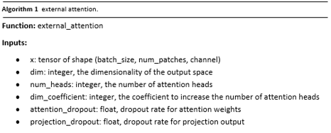
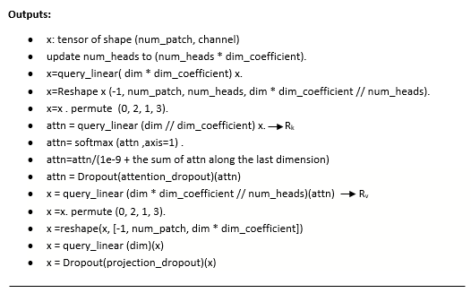
Proposed EAMLP model

Slide 34
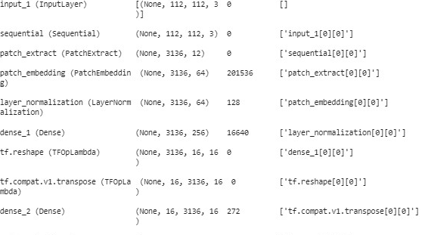
Proposed EAMLP model

Slide 35
Proposed EAMLP model
Advantages of External attention
Reduces complexity
Double normalization
Increasing Multi layer perceptron

Slide 36
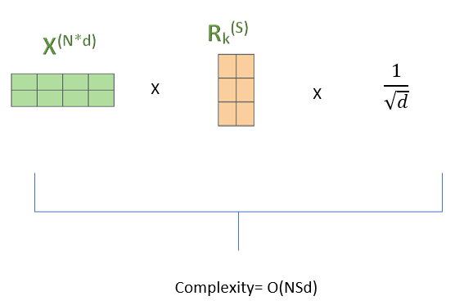

Proposed EAMLP model
Reduces complexity:
The computational complexity of external attention is O(NSd);
where d and S are hyper-parameters;
Thus it can replace self-attention in existing architectures, where d is the number of feature dimensions.
Figure 19 : Computational Complexity of external attention

Slide 37

Proposed EAMLP model
Advantage of double normalization:
The normalized feature map and retention(Rk) vectors' scaled dot-product is the first term in the double normalization equation, which is then used to compute the attention map through the softmax function.
The attention map is dependent on the scale of the input features, in contrast to cosine similarity. For avoiding this problem, double normalization has been applied[80] on the attention map.

Slide 38

Proposed EAMLP model
Advantage of double normalization:
One advantage of double normalization over normalization in the softmax function is that it can help mitigate the problem of vanishing gradients.
Another advantage is that double normalization can make the model more interpretable.
( α’)i,j = XR_{k}^{T}

Slide 39
Proposed EAMLP model
External-attention can be formulated as:
Here an input feature map x ∈ R^{N*d}, an external memory unit M ∈ R^{S*d}
use two different memory units R_{k} and R_{v} as the key and value, to increase the capability of the network.
Compute XR_{k}^{T}: This involves multiplying the input feature map x of size N*d with the transpose of external retention unit R of size S*d. The computational complexity of this step is O(NSd).
Compute the norms of each row of XR_{k}^{T}: This involves computing the Euclidean norm of each row of XR_{k}^{T}. The computational complexity of this step is O(N*S).
Normalize XR_{k}^{T}: This involves dividing each row of XR_{k}^{T} by its norm computed in the previous step. The computational complexity of this step is O(N*S).
Therefore, the total computational complexity of computing A = Norm(FMT) is O(NSd + NS + NS) = O(NSd).

Slide 40
Proposed EAMLP model
Increasing Multi layer perceptron
Increased capacity: Adding more dense layers increases the capacity of the model, allowing it to learn more complex representations and relationships between input features. This can lead to better performance on a wide range of tasks, such as language translation and image classification.[9]
Improved generalization: By adding more dense layers, the model can learn higher-level abstractions of the input data, which can improve its ability to generalize to new examples. This can also lead to better performance on tasks such as sentiment analysis and text classification.[8]
Fine-tuning for specific tasks: Adding more dense layers allows for more customization of the model for specific tasks, enabling it to learn task-specific representations that are more relevant to the target task[10]

Slide 41

Result and discussion
Accuracy=$\frac{TP+TN}{TP+TN+FP+FN}$ (1)
Sensitivity=$\frac{TP}{TP+FN}$ (2)
Specificity=$\frac{TN}{TN+FP}$ (3)
Here, TN= True Negative, TP= True Positive, FN= False Negative, FP= False Positive.

Slide 42
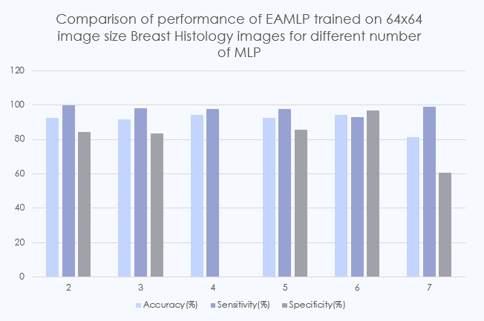
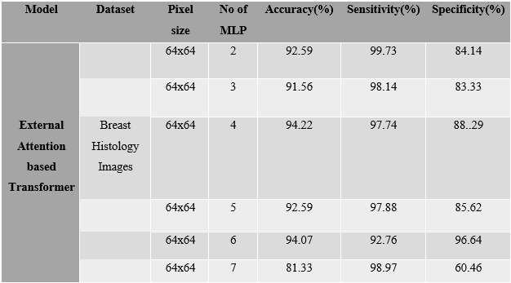

Result and discussion (Cont…)
TABLE I.
PERFORMANCE MEASURES OF PROPOSED MODEL USING
BREAST HISTOLOGY IMAGES FOR 64$×$64 PIXEL SIZE
Figure 20 : Performance of EAMLP trained on 64x64 image size Breast Histology Images for different number of MLP

Slide 43
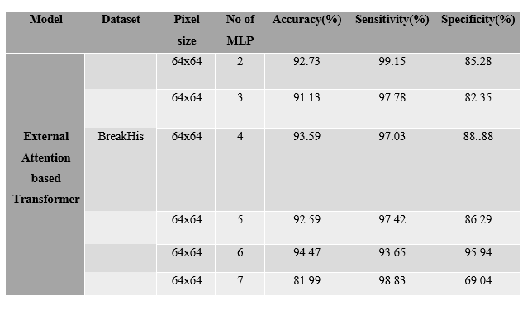
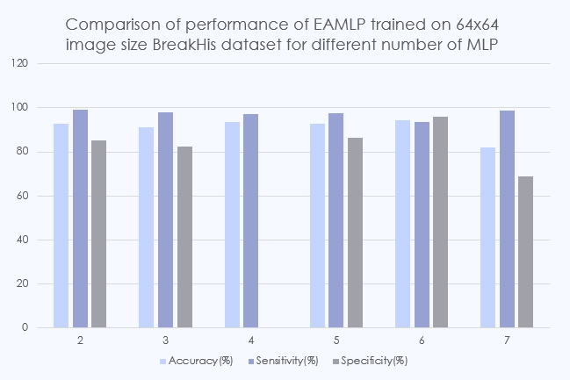

Result and discussion (Cont…)
TABLE II.
PERFORMANCE MEASURES OF PROPOSED MODEL USING
BREAKHIS DATASET FOR 64$×$64 PIXEL SIZE
Figure 21 : Performance of EAMLP trained on 64x64 image size BreakHis datasets for different number of MLP

Slide 44
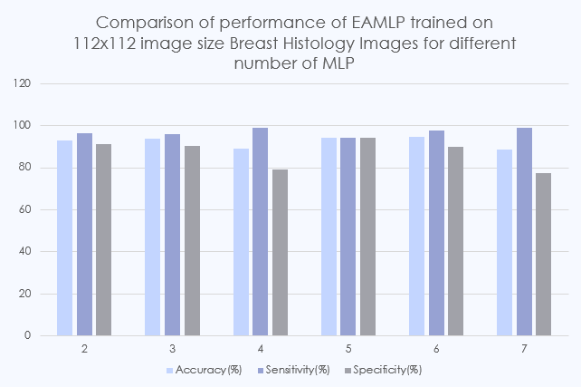
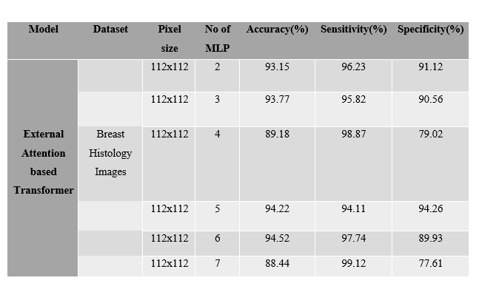

Result and discussion (Cont…)
TABLE III.
PERFORMANCE MEASURES OF PROPOSED MODEL USING
BREAST HISTOLOGY IMAGES FOR 112$×$112 PIXEL SIZE
Figure 22 : Performance of EAMLP trained on 112x112 image size Breast Histology Images for different number of MLP

Slide 45
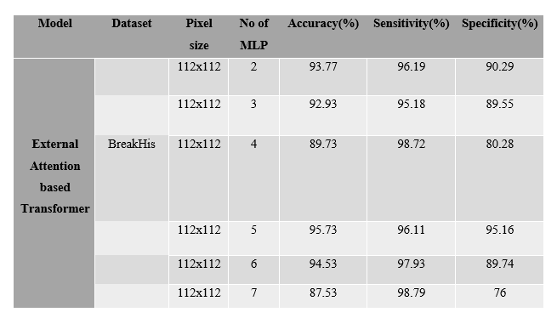
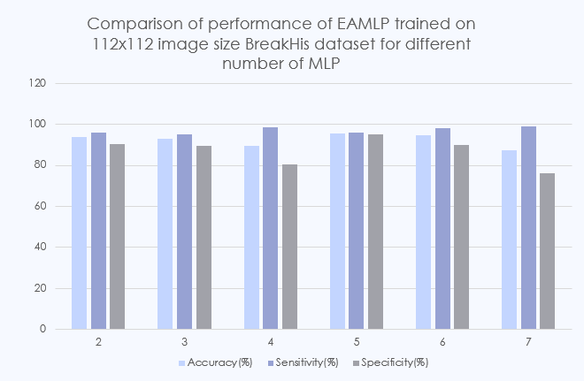

Result and discussion (Cont…)
TABLE IV.
PERFORMANCE MEASURES OF PROPOSED MODEL USING
BREAKHIS DATASET FOR 112$×$112 PIXEL SIZE
Figure 23 : Performance of EAMLP trained on 112x112 image size BreakHist datasets for different number of MLP

Slide 46
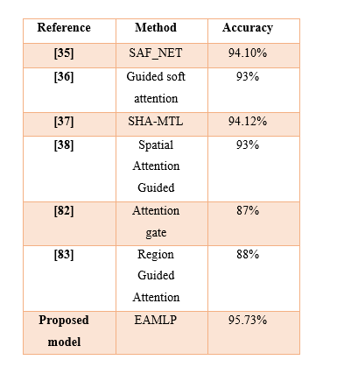
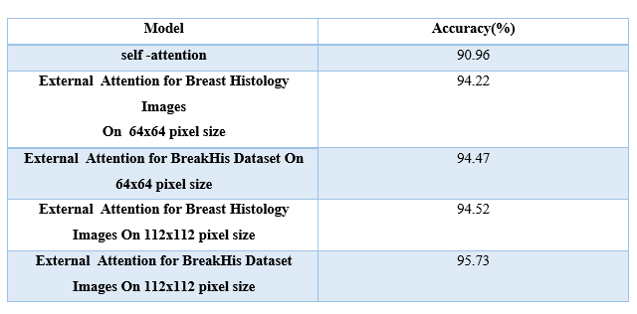
Result and discussion (Cont…)
TABLE VI.
COMPARISON OF THE PROPOSED METHOD WITH EXISTING WORK
TABLE V.
PERFORMANCE MEASURES OF PROPOSED MODELWITH TRADITIONAL APPROACH

Slide 47
Conclusion
Breast cancer is a hazard to women all over the world and is to blame for the rise in the death rate of women.
Convolutional Neural Networks (CNNs) in particular and Deep Learning models & various attention based transformer models in general have achieved significant success.
Although this improves performance, deep networks and various self attention mechanisms have high computational complexity and requirements, which extend the time needed for network training and tuning.
A lightweight neural network model named External Attention based Multi Layer Perceptron(EAMLP) is proposed using the Breast Cancer datasets.
that external attention with MLP having 5 layer of 112x112 pixel size has given the better accuracy 95.73% compare with the other model and state of the art.

Slide 48
reference
[1] https://www.stanfordchildrens.org/en/topic/default?id=anatomy-of-the-breasts-85-P00132
[2] Feng, Yixiao, et al. "Breast cancer development and progression: Risk factors, cancer stem cells, signaling pathways, genomics, and molecular pathogenesis." Genes & diseases 5.2 (2018): 77-106.
[3] https://www.bcrf.org/blog/invasive-lobular-carcinoma-lobular-breast-cancer/.
[4] https://www.cancer.org/cancer/breast-cancer/about/how-common-is-breast-cancer.html
[5] Chen, Dehua, and Orlando Mayugi. "Breast tumor diagnosis via phrase level self-attention mechanism." International Conference on Biomedical and Intelligent Systems (IC-BIS 2022). Vol. 12458. SPIE, 2022.

Slide 49
reference
[6] Dzmitry Bahdanau, Kyunghyun Cho, and Yoshua Bengio. Neural machine translation by jointly learning to align and translate. In Yoshua Bengio and Yann LeCun, editors, 3rd International Conference on Learning Representations, ICLR 2015, San Diego, CA, USA, May 7-9, 2015, Conference Track Proceedings, 2015.
[7] http://jalammar.github.io/illustrated-transformer/
[8] Ashish Vaswani, Noam Shazeer, Niki Parmar, Jakob Uszkoreit, Llion Jones, Aidan N Gomez, Łukasz Kaiser, and Illia Polosukhin. Attention is all you need. Advances in neural information processing systems, 30, 2017
[9]https://towardsdatascience.com/illustrated-guide-to-transformers-step-by-step-explanation-f74876522bc0

Slide 50
reference
[10] Lu, Si-Yuan, Shui-Hua Wang, and Yu-Dong Zhang. "SAFNet: A deep spatial attention network with classifier fusion for breast cancer detection." Computers in Biology and Medicine 148 (2022): 105812.
[11] Yang, Heechan, et al. "Guided soft attention network for classification of breast cancer histopathology images." IEEE transactions on medical imaging 39.5 (2019): 1306-1315.
[12] Zhang, Guisheng, et al. "SHA-MTL: soft and hard attention multi-task learning for automated breast cancer ultrasound image segmentation and classification." International Journal of Computer Assisted Radiology and Surgery 16 (2021): 1719-1725.
[13] Duanmu, Hongyi, et al. "A spatial attention guided deep learning system for prediction of pathological complete response using breast cancer histopathology images." Bioinformatics 38.19 (2022): 4605-4612.

