Slide 1
IOT BASED HEALTH MONITORING SYSTEM
GROUP MEMBERS
SEME SARKAR-1708006
SHEMONTI BARUA-1708008
HUMAYRA MEHZABIN-1708009
BARNA GHOSH-1708010
SHEMANA BARUA-1708030

Slide 2
CONTENTS
Introduction
Simulation & Coding
Hardware Implementation
Result
Conclusion & Future Work

Slide 3
INTRODUCTION
In such areas where the epidemic is spread, heart diseases become main concern, it is a better idea to monitor these patients using remote health monitoring technology
In this aspect, an IoT based health monitoring system is the best solution
(IOT) based smart health monitoring system will help to measure various health-related parameters
The core objective of this project is the design and implementation of a smart patient health tracking system.
This monitoring systems can be used for reducing health care costs

Slide 4
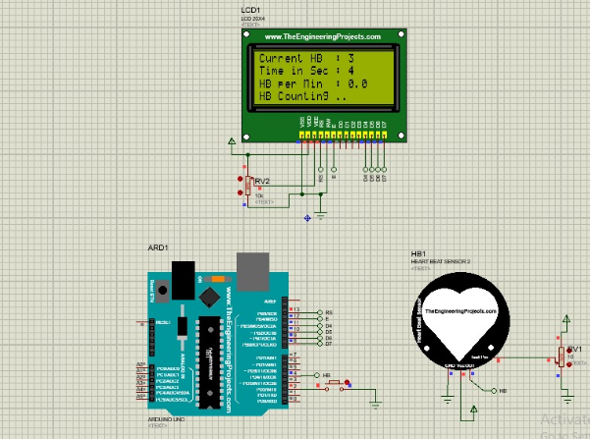
SIMULATION
In proteus simulation here Lcd display, heart beat sensor and aurduino Uno are taken for proceeding the simulation.
In the simulation part, as ESP8266 module was not available in proteus software, the simulation has been conducted by using Aurduino uno.
The heart beat rate could not be send to the server due to not using ESP8266.Because integrated support for wifi network is in built in ESP8266 module which is not present in aurduino uno.

Slide 5
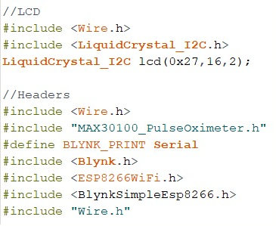
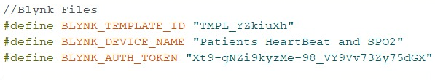
CODE EXPLANATION
The following portion of the code is used to connect and communicate with the Blynk. AuthToken is a unique identifier generated by Blynk cloud. Device name can be set by the wiser’s will.
This portion of the code is mainly about header files of different library. Wire.h and MAX30100_PulseOximeter.h will be required for the MAX30100 sensor’s functionality.LiquidCrystal_I2C is used set the LCD address to 0x27 for a 16 chars and 2 line display.

Slide 6
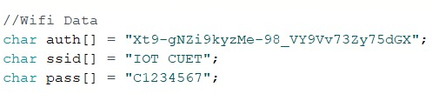
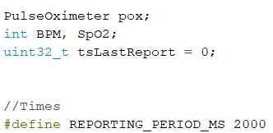
CODE EXPLANATION
This portion of code is used for wifi credential. This line helps to work with a WiFi-enabled device. These variables are used to set the password and ssid of personal wifi network.
In this portion, first line of the code indicates creating an object ‘pox’ of PulseOximeter. Two variables (BPM and SpO2) of type int is declared to hold the heart rate and SPO2 readings respectively. The variable (tsLastReport) holds the time when the last beat occurred. The REPORTING_PERIOD_MS defines the reporting time in milliseconds between the samples.

Slide 7
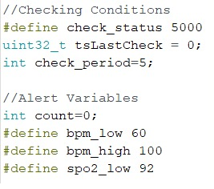
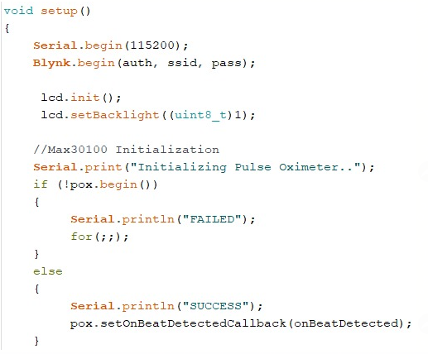
CODE EXPLANATION
Check_status is used to check the value for alert of patient condition in each five second.Initially tsLastCheck and check_period is declared 0 & 5 repectively.For the alerting condition bpm_low,bpm_high & spo2_low are set to 60,100 and 92 respectively.
Inside the setup() function, the serial communication is opened at a baud rate of 115200.Blynk.begin() function is used to configure the blynk cloud by using ssid, authentication and the password.lcd.init() function is used to initialize the LCD display.setBacklight function is basically used to turn on the back light of LCD display.

Slide 8
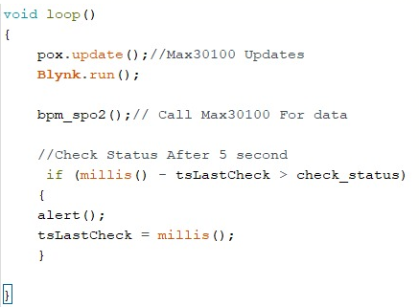
CODE EXPLANATION
Inside the loop() function, it will be read from the sensor using pox.update().Blynk. run() is a main Blynk routine responsible for keeping connection alive, sending data, receiving data, etc. Then bpm_spo2() function is used to call the sensor for data.By using the following condition,it checks the status of alert condition in every five second.

Slide 9
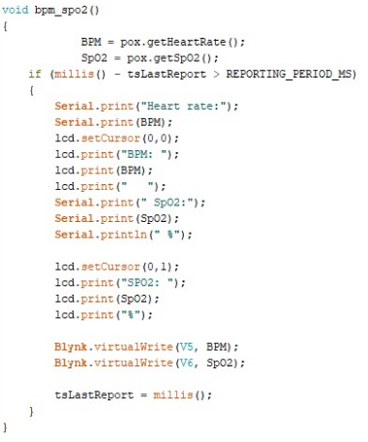
CODE EXPLANATION
Inside the bpm_spo2() function, the readings for the heart rate (saved in BPM) and the blood oxygen concentration (saved in SpO2) is obtained and print them in the serial monitor after two second. To obtain the heart rate reading, use the PulseOximeter object on the getHeartRate() method. Similarly, to obtain the blood oxygen concentration, use the PulseOximeter object on the getSpO2() method. The mills() function returns the number of milliseconds passed since running the current program. The esp8266 is used to send data to the Blynk cloud of V5,V6 pin using Blynk.virtualWrite(pin, value) function. Then tsLastReport is updated to the every last value of millis().

Slide 10
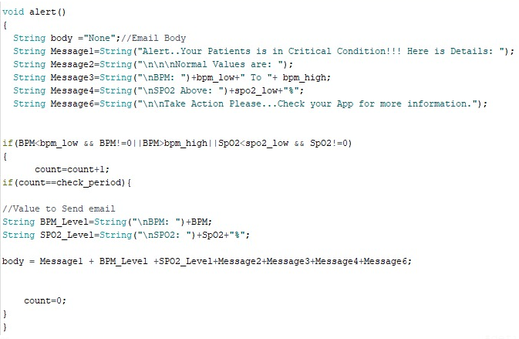
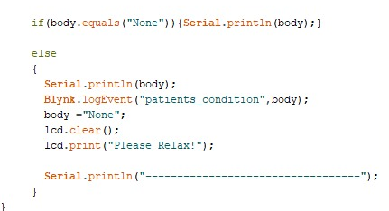
CODE EXPLANATION
Inside the alert function, these following message variables are basically used to show notification on the Blynk app. The data is sent over blynk if bpm and spo2 cross the range. Then a notification is delivered containing message “ critical condition, take action” .
In the following portion, alert message will deliver to event called ‘patients_condition’ of Blynk server if the body condition is not satisfied.

Slide 11
HARDWRE IMPLEMENTATION
This section is divided into two portion
Components
i. ESP8266
ii. I2C LCD Display
iii. Max30100 Pulse Oximeter
iv. LM 7805 Voltge Regulator
v. 9V Battery
2. Connection

Slide 12
MAX30100
COMPONENT
I2C LCD DISPLAY
ESP8266
VOLTAGE REGULATOR

Slide 13
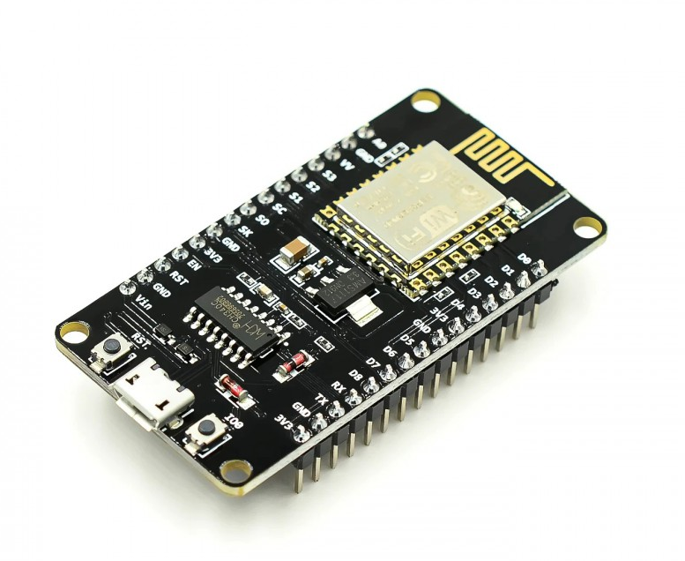
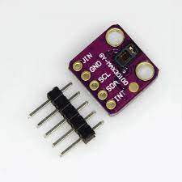
COMPONENT EXPLANATION
ESP8266
Max 30100
It is also called ESP8266 Wireless Transceiver
cost-effective, easy-to-operate, compact-sized & low-powered WiFi module, designed by Espressif Systems,
supports both TCP/IP and Serial Protocol.
used in IOT cloud based embedded projects and
considered the most widely used WiFi module beacuse of its low cost and small size.
It is a pulse oximetry and heart rate monitor sensor
can be powered by 1.8 V or 3.3 V power supply.
A host microcontroller uses the I2C interface to communicate.
It combines two LEDs, a photo detector, optimized optics, and low-noise analog signal processing to detect pulse oximetry and heart-rate signals.
It is ultra-low-powered, making it suitable for systems operating on batteries.

Slide 14
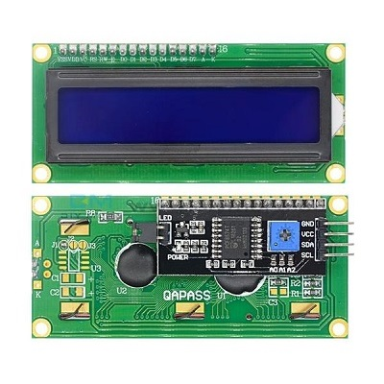
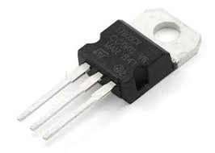
COMPONENT EXPLANATION
I2C LCD display
LM 78705 Voltage Regulator
A 16 × 2 LCD display with I2C can show 16 characters in 2 lines.
Four pins for the LCD display: VCC, GND, and SDA, as well as SCL.
The output voltage is kept constant using a voltage regulator integrated circuit (IC).
A common voltage regulator integrated circuit is the 7805 Voltage Regulator, which is part of the 78xx series of fixed linear voltage regulators used to maintain such variations (IC).

Slide 15
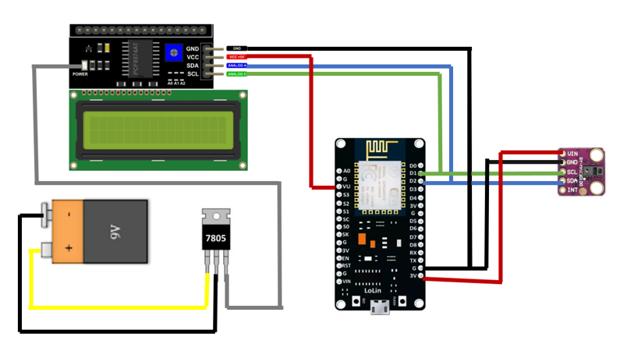
CONNECTIONS
Connections-
MAX30100 to ESP8266-
Vin to 3v3
SCL to D1
SDA to D2
GND to GND
I2C LCD Display to LM 7805 Voltage Regulator-
LED to Output
9v Battery to LM 7805 Voltage Regulator-
Posative terminal to Input
Negative terminal to Output
I2C LCD Display to ESP8266-
VCC to VV
GND to GND
SCL to D1
SDA to D2

Slide 16
RESULT
This projects completes 3 IoT layers-
Perception Layer
Communication Layer
Application Layer

Slide 17
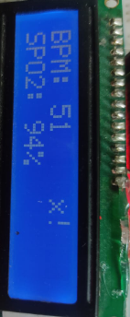
RESULT
Perception
This is the physical layer of the architecture. This is where the sensors and connected devices come into play as they gather various amounts of data.
MAX30100 sensors are used to sense the oxygen saturation level(SPO₂) and Heart beat(BPM).Then , these data are transferred to ESP8266 by using serial communication . These values are visible on the LED display of the device.

Slide 18
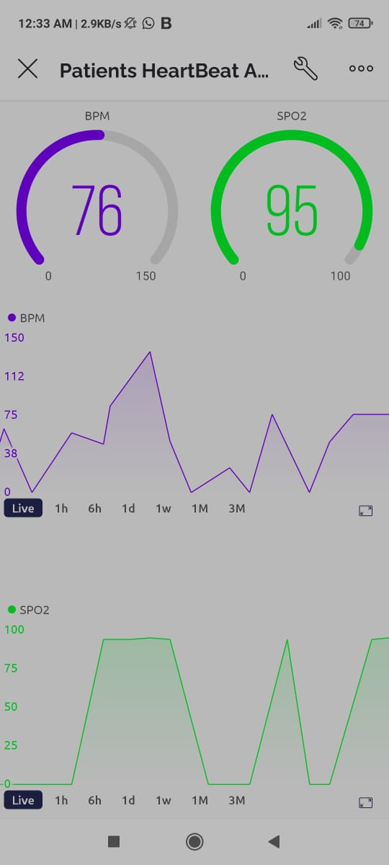
RESULT
Communication
The data that's collected by all of these devices needs to be transmitted and processed.
ESP8266 is sent the data of heart beat rate and oxygen saturation over communication portal of blynk cloud using wifi module. These values will be displayed on blynk website which can be accessed by using IP address. Then, these values can be seen on the phone using blynk App.

Slide 19
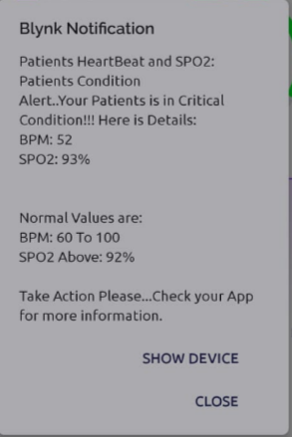
RESULT
Application
The application layer is what the user interacts with. It's what is responsible for delivering application specific services to the user
The data is sent over blynk cloud is controlled through a threshold condition that if the bpm rate is between 60-100 it is set to be the normal heart beat rate range. If the bpm rate is not in between the range a notification is delivered containing message “ critical condition take help” .

Slide 20
RESULT
The case study is done by taking the readings from IOT system and then taking the readings of different person that are shown in the following table:
Table 5: Reading of Spo2 and Bpm of different persons.
Person | Spo2(%) | BPM | Showing alert
Person1 | 94 | 51 | Yes
Person2 | 94 | 37 | Yes
Person3 | 95 | 76 | No
Person4 | 93 | 52 | Yes
Person5 | 95 | 45 | Yes

Slide 21
CONCLUSION
The system will measure a patient’s body heartbeat, and the SpO2 levels in the blood and send the data to blynk app via hotspot.
This information is also transmitted to the LCD panel and users device as well as allowing the patient to see their current health state quickly.
The readings taken daily can be sent to doctors via mail and enable them to suggest the medicine and physical exercise routine that enable them to improve the quality of life and overcome such diseases.
This work is concentrated to execute the internet technology to establish a system which would communicate through internet for better heal

Slide 22
FUTURE WORK
Sensor used in the system can be improved.
We can measure several other health parameters when additional sensors are added.
For the system’s security, new algorquickly.ay be integrated with the whole system.

Slide 23
THANK YOU

