Slide 1
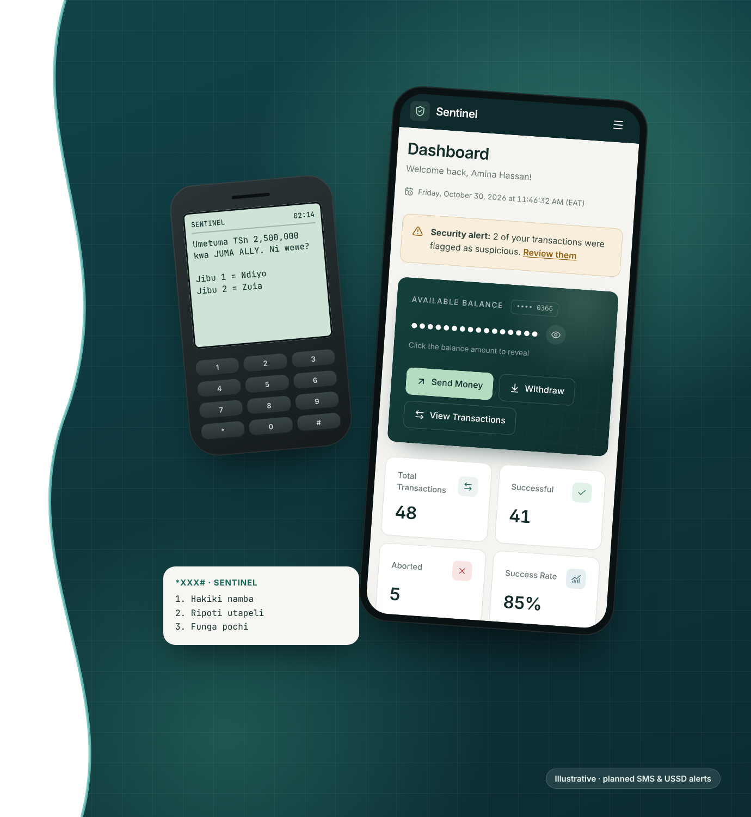
SENTINEL · TANZANIA
Sentinel
Fraud Detection
Stop fraud before the money moves.
Zuia utapeli kabla pesa haijatoka.
Real-time fraud screening for Tanzania's 87 million mobile money accounts, with alerts that reach any phone.
Web
SMS · USSD
Voice AI
English · Kiswahili
Notes:
Sentinel screens every mobile money transfer in real time and tells the customer on any phone. The web platform (risk engine, admin console, receipts, bilingual UI) is built; SMS, USSD and voice alerts via Africa's Talking are the next step. The phone screens on the right are illustrative of the planned alerts.

Slide 2
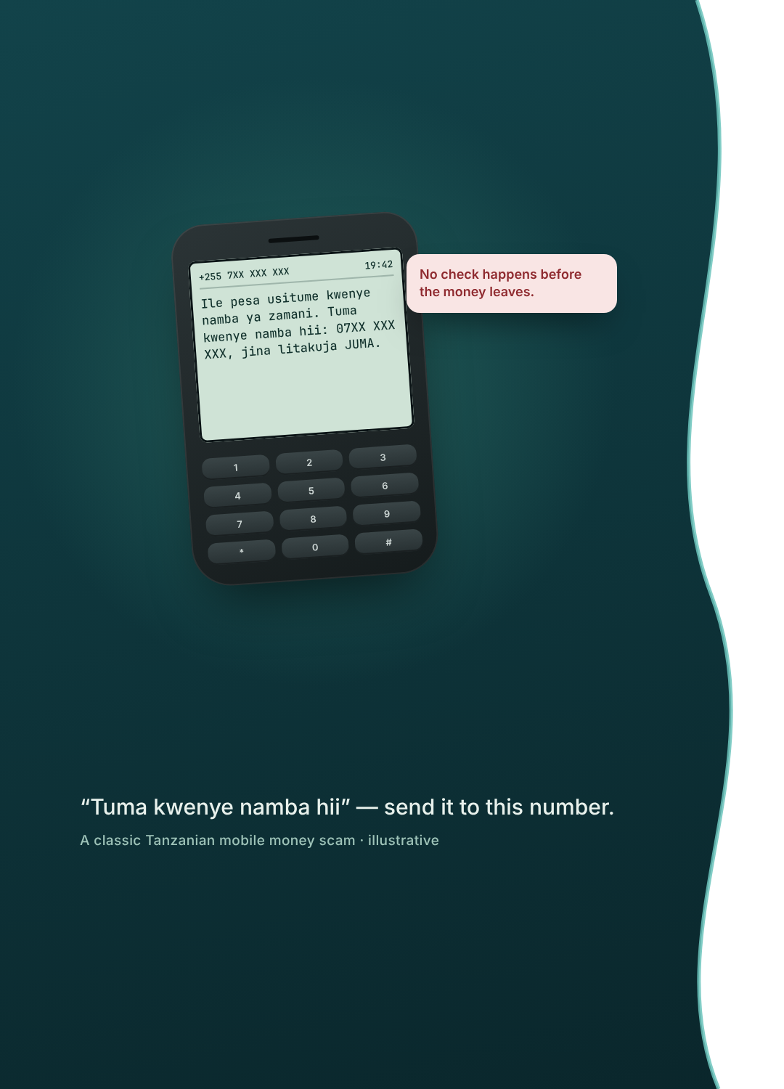
THE PROBLEM
87 million wallets, protected after the fact
Mobile money is how Tanzania pays. Protection still depends on victims reporting a scam once the money has gone.
87M
2.1B
active mobile money accounts (June 2026)
mobile money transactions in a single quarter
7,334
44.7%
fraud attempts reported in one quarter (reports only)
smartphone penetration: most people use basic phones
Today victims text 15040 after the money has moved.
What's missing is a check at the moment of transfer, and an alert that reaches every phone.
Source: TCRA Communications Statistics, quarter ending June 2026.
Notes:
Figures: TCRA quarterly communications statistics for the quarter ending June 2026, as reported by TanzaniaInvest, Daily News and The Citizen: 87.05M active mobile money accounts; 2,098,706,145 mobile money transactions in the quarter; 7,334 reported mobile fraud attempts (down from 9,816 in March 2026 and 23,328 in September 2023); smartphone penetration 44.74%. 15040 is the toll-free SMS short code for reporting fraud. Reported attempts measure reports, not losses. The scam message on the left is illustrative.

Slide 3
Every transfer checked before the money moves
THE SOLUTION
“
THE QUESTION WE ANSWER FOR EVERY TRANSFER
Should this transfer go through right now, and if not, who needs to know in the next 60 seconds?
1 · Screen
2 · Decide
3 · Alert
Rules and an XGBoost model score each transfer on 11 signals: bursts of transfers, many recipients, location jumps, night-time large amounts, failed withdrawals.
Clear it, block it, or flag it for review (scores 40–70). Every decision carries its reasons, so nothing is a black box.
The customer hears about it on any phone: SMS, a USSD menu or an AI voice call in Kiswahili. Admins review in the console.
Notes:
Screen and Decide are built: the rule engine mirrors the velocity patterns (large-volume bursts, many receivers, many senders), location scoring, night-time and extreme-amount rules, plus an XGBoost model trained on 11 features. Scores between 40 and 70 are flagged for administrator review. The Alert channels beyond the web app (SMS, USSD, voice) are planned on Africa's Talking APIs.

Slide 4



Three things lined up at once
WHY NOW
2026
TCRA
OPEN APIs
The scale
The regulator
The rails
87 million active accounts and 6.3 billion transactions in 2025, up 68.7% on 2024. Every new wallet is a new target.
TCRA has convened experts on using AI to protect digital financial services. The Sitapeliki campaign and 15040 show the appetite, but they act after the fact.
Africa's Talking provides SMS, USSD and Voice APIs across Tanzania's networks, so alerts reach basic phones with no app to install.
SO WHAT
Checking every transfer, and telling every customer on any phone, is finally affordable to build, and the regulator is asking for it.
Sources: TCRA statistics 2025–2026; TCRA news, "Experts Propose AI to Protect Digital Financial Services"; africastalking.com.
Notes:
Scale: 6,306,767,827 mobile money transactions in 2025 vs 3,737,202,434 in 2024 (+68.7%), TCRA via TanzaniaInvest. Regulator: TCRA published "Experts Propose AI to Protect Digital Financial Services"; the Sitapeliki awareness campaign and the 15040 reporting code are credited with falling reported fraud. Rails: Africa's Talking offers SMS, USSD and Voice APIs in Tanzania; confirm current rates from the Africa's Talking dashboard before quoting costs.

Slide 5
Free for customers. Institutions pay
MARKET & BUSINESS MODEL
TAM · ALL ACTIVE WALLETS
SAM · INSTITUTION-HELD ACCOUNTS
SOM · YEAR ONE, THREE PARTNERS
US$21.8M / yr
US$4.4M / yr
US$48.3k
87M accounts × US$0.25 / yr
~20% of accounts × US$0.25 / yr
150k accounts × US$0.25 + 3 × US$300 / mo
THREE PARTNERS, ONE YEAR (US$)
≈59%
contribution margin
US$28.5k on US$48.3k revenue, before central costs
+$37,500
$48,300
−$9,000
WHO PAYS
−$4,800
$28,500
−$6,000
US$0.25 per account per year + US$300 / month, paid by SACCOs, microfinance, lenders and fintech wallets. Customers use it free.
+$10,800
ON TOP, LATER
Shared scam-number intelligence across partners
Agent-network float fraud monitoring
Risk API for insurers and lenders
Illustrative: prices, the 20% share and costs are assumptions to validate in the pilot.
Notes:
All business-model numbers are assumptions, not market data. TAM: 87.05M active accounts (TCRA, June 2026) x US$0.25 per account per year = US$21.8M. SAM assumes ~20% of accounts are held through institutions that can integrate (SACCOs, microfinance, digital lenders, fintech wallets) = US$4.4M. SOM year one: 3 partners, 150,000 accounts: licences 3 x US$300 x 12 = US$10,800; per-account 150,000 x US$0.25 = US$37,500; revenue US$48,300. Costs: phone channels (SMS, USSD sessions, voice minutes) US$9,000; hosting and model US$4,800; support US$6,000. Contribution US$28,500 (59%). Replace with your own pricing before presenting.

Slide 6
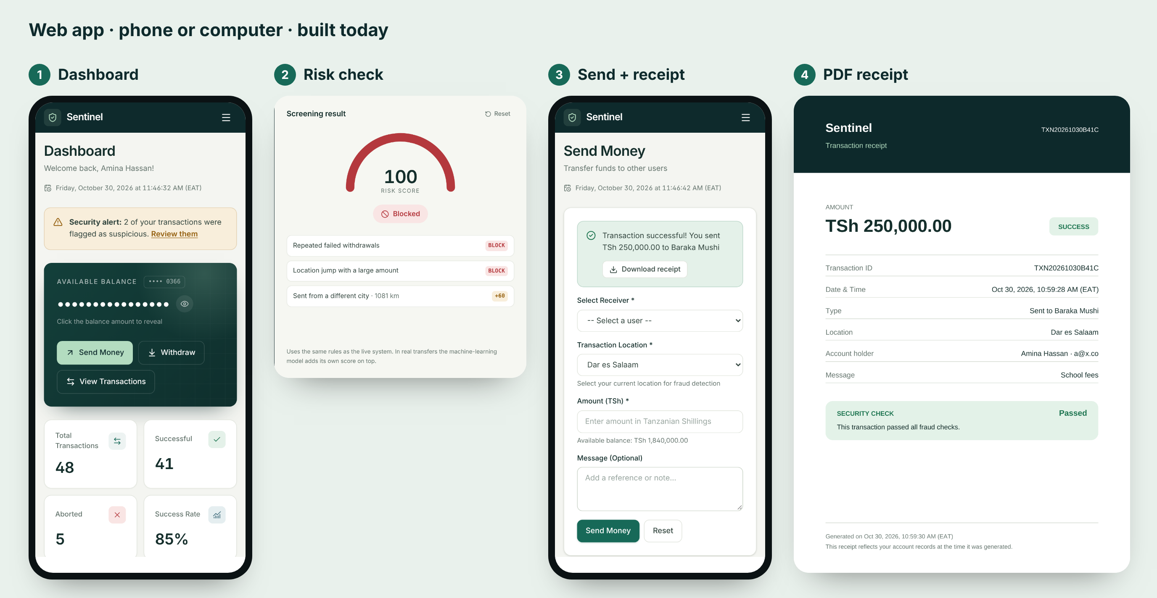




Four ways in: web, SMS, USSD and an AI voice line
PRODUCT · HOW IT WORKS
ANY PHONE · AFRICA'S TALKING
SMS · USSD · Voice
Planned next. No app or smartphone needed.
1
A held transfer sends an SMS: reply 1 if it was you, 2 to block.
2
A USSD menu: check a number, report a scam or freeze the wallet.
3
High-risk transfers get an AI voice call in Kiswahili or English.
4
Every reply is logged as a labelled outcome for the model.
Risk in plain words
Score, level and the reasons for every decision.
Admin console
Fraud alerts, review queue, users and adjustments.
“Umetuma TSh 2,500,000 kwa Juma Ally. Ni wewe?”
Receipts & records
PDF receipts for customers; an admin copy for audits.
Private by default
Hidden balance, locked history, sign-in lockout.
Notes:
Left: real screenshots of the working web app (customer dashboard, landing-page risk check, send with receipt download, PDF receipt). Right: planned phone channels on Africa's Talking SMS, USSD and Voice APIs; these are not built yet. The quoted SMS is an example alert in Kiswahili: "You sent TSh 2,500,000 to Juma Ally. Was it you?"

Slide 7
The real competitor is finding out too late
COMPETITION & MOAT
TODAY PEOPLE RELY ON… | Before money moves | Explains why | Reaches basic phones | Built for SACCOs & lenders
Reporting scams to 15040 afterwards | ○ No | ○ No | ● Yes | ○ No
Awareness campaigns (Sitapeliki) | ◐ Partly | ○ No | ● Yes | ○ No
Manual review by staff | ◐ Partly | ◐ Partly | ○ No | ◐ Partly
Sentinel | ● Yes | ● Yes | ● Yes | ● Yes
THE MOAT · A LABELLED RECORD OF REAL FRAUD OUTCOMES
transfer pattern
+
location
+
risk score
+
reasons
+
customer reply
+
confirmed outcome
Rules are easy to copy. Knowing which alerts were real fraud is created only through use, and every customer reply makes the model sharper.
Notes:
Comparison is against what people and institutions rely on today, not against named vendors. The moat is a consented, labelled dataset linking each transfer pattern and risk score to the customer's reply and the confirmed outcome; it only exists through use.

Slide 8
What exists today, and what we prove next
TRACTION & MILESTONES
THEN
PILOT
Scale to three institutions and about 150,000 accounts.
NEXT
One SACCO or microfinance partner, 1,000–5,000 accounts, three months.
BUILT TODAY
SMS alerts and a USSD menu on Africa's Talking, then the AI voice line.
Web platform: rules + XGBoost risk engine, admin console, PDF receipts, English & Kiswahili. 188 automated tests.
PILOT TARGETS · PRE-REGISTERED, NOT PROMISED
≤60 s
≥70%
≤2%
30–50%
from a held transfer to the customer's alert
of alerts answered by the customer within 15 minutes
of legitimate transfers wrongly held
fewer confirmed fraud losses than the prior period
Risk scores, reasons and review status are already recorded per transaction and visible in the admin console.
Notes:
Built today is verifiable in the repository: 49 web tests, 128 API integration tests against PostgreSQL, 11 shared-package tests (188 total). Pilot targets are proposals to agree with the partner before launch; they are not results.

Slide 9
We're raising US$60,000 for the pilot
THE ASK · USE OF FUNDS
USE OF FUNDS (US$)
PILOT RAISE
Phone channels
SMS, USSD and voice on Africa's Talking
$15,000
25%
US$60,000
1
2
Pilot & onboarding
Integrate one partner; train staff and agents
$12,000
20%
~6 months runway
From phone-channel launch through a measured pilot and the first paid licence.
3
Security & compliance
Penetration test and data-protection review
$10,000
17%
4
Model validation
Label outcomes; tune rules and the model
$9,000
15%
WHAT IT UNLOCKS
Live results from real accounts
First paid institution licence
Evidence to scale to three partners
5
Messaging & call credits
Pilot SMS, USSD sessions and voice minutes
$8,000
13%
6
Contingency
Buffer for the pilot period
$6,000
10%
Total ask
US$60,000
Notes:
The raise amount and the split are a proposal; adjust to your plan. Messaging and call credits should be priced from the Africa's Talking rate card in your dashboard (SMS per message, USSD per session, voice per minute) for the pilot volume.

Slide 10

ASANTE · THANK YOU
Every Tanzanian should be able to send money without fear, on any phone.
See the live risk check: [demo link]
Sentinel · [Team name]
[email address] · [phone]
Notes:
Replace [demo link], [Team name], [email address] and [phone] before presenting.

