Slide 1

BAHARI OPS
MWANI MLINZI AI
Early warning and harvest advice for Zanzibar's seaweed farmers on any phone.
salhak653@gmail.com
Notes:
Cover: MwaniMlinzi AI by Bahari Ops — early warning and harvest advice for Zanzibar's seaweed farmers on any phone.

Slide 2
25,000 seaweed farmers carry the ocean's risk alone
PROBLEM
About 25,000 Zanzibar seaweed farmers — roughly 80% women — face warming seas, disease and price swings with no farm-specific advice. Output is back (19,716 t in 2024 → 20,075 t in 2025); the value isn't.
82.9%
~40%
5.7%
94.3%
keep no production records
dry seaweed directly on the ground
know the common diseases well
do no value addition
Ocean forecasts and expertise exist. What's missing is the step from information to a farm action.

Slide 3
One farm-level question, answered every day
SOLUTION
THE QUESTION WE ANSWER FOR EVERY FARM
“Given my farm, crop stage and today's ocean, what should I do in the next 24–72 hours to cut loss and raise the value of my harvest?”
1
Predict
2
Recommend
3
Deliver
Separate, explainable risk scores — heat & disease, storm & line damage, harvest window — from ocean signals, crop age and farmer reports.
Actions come only from an extension-approved library — inspect, retie, harvest early. No AI-invented farming advice.
Short Kiswahili SMS and USSD for farmers; risk and supply views for cooperatives, extension officers and buyers.

Slide 4
Three things changed in the past year
WHY NOW
AUG 2025
The funding
UN / Joint SDG Fund programme: US$1.965M Phase I for 15,000 seaweed households in N. Unguja and Pemba — investing in co-ops, value addition, finance and markets.
2026
The data rails
The Ministry of Blue Economy & Fisheries is rolling out SAMAKI digital monitoring and began a fisheries census.
OPEN & FREE
The ocean signal
Copernicus marine data — sea temperature, waves, currents — supplies the key environmental inputs at zero cost.
SO WHAT
All three landed together — farm-specific advice is finally affordable to build, and a funded programme is ready to pay for it.

Slide 5
Bottom-up: farmers × a realistic annual fee
MARKET SIZE
TAM
TAM
All Zanzibar seaweed farmers
25,000 farmers × US$10 / yr
US$250k / yr
SAM
Households in the UN / Joint SDG programme
15,000 households × US$10 / yr
SAM
US$150k / yr
SOM
Beachhead: one co-op cluster in N. Unguja or Pemba
500 farmers × US$10 + 1 processor × US$400 / month
SOM · YEAR 1
US$9.8k
ON TOP Buyer intelligence (US$300–600 / month per processor), institutional licences (US$10k–25k / yr), then other marine aquaculture such as sea cucumber.

Slide 6
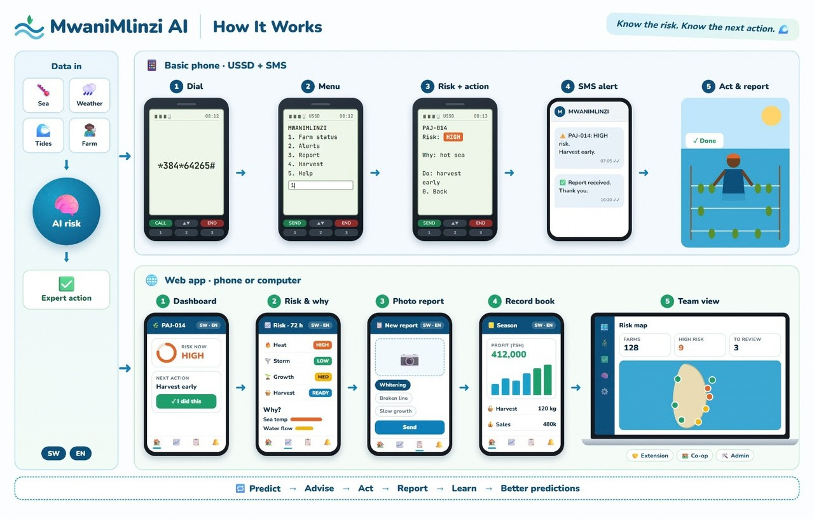
Dial, check, act — on a basic phone
PRODUCT · HOW IT WORKS
1
Dial *XXX#
Any GSM phone, no data plan: Hali ya shamba, Tahadhari, Ripoti tatizo…
2
See the risk
Location and level — e.g. Pemba · MODERATE: warmer sea, changing waves.
3
Get one approved action
“Kagua mwani kesho asubuhi” — inspect lines & anchors, watch for 72 h.
4
Report back
Symptoms, action taken, harvest kg & quality — the loop that trains the model.

Slide 7
Free for farmers. The value chain pays.
BUSINESS MODEL
CORE STREAM AT SEED
ONE CLUSTER, ONE YEAR
Programme / co-op licence
500 farmers × US$10
US$5,000
US$8–12 per active farmer per year
Paid by NGOs, donor programmes and cooperatives — farmers use it free.
1 processor × US$400 × 12
US$4,800
Comms, data, hosting
– US$1,750
Support & field servicing
– US$2,000
LATER STREAMS
Buyer intelligence: US$300–600 a month per processor
Institutional licence: US$10k–25k a year
Sponsored access; risk data for insurers & lenders
≈62%
contribution margin — US$6,050 on US$9,800 revenue, before central costs

Slide 8
The real competitor is the status quo
COMPETITION & MOAT
Today a farmer relies on… | Farm-specific | Timely (24–72 h) | Clear action | Builds a record
Memory & word of mouth | Partly | No | Partly | No
Regional weather alerts (radio, TMA) | No | Yes | No | No
Extension officer visits | Yes | Partly | Yes | Partly
MwaniMlinzi AI | Yes | Yes | Yes | Yes
THE MOAT
A consented, longitudinal dataset linking micro-location + ocean conditions + crop stage + action recommended + action taken + outcome. Satellite data is open to everyone; this dataset is created only through use — and needs no IoT, drones or hardware to start.

Slide 9


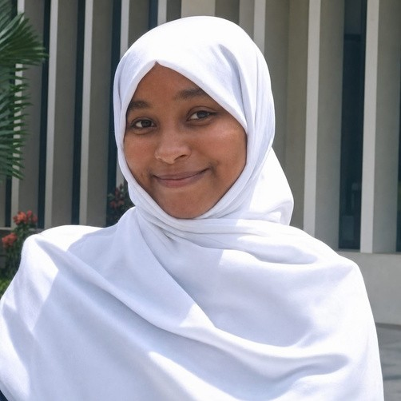
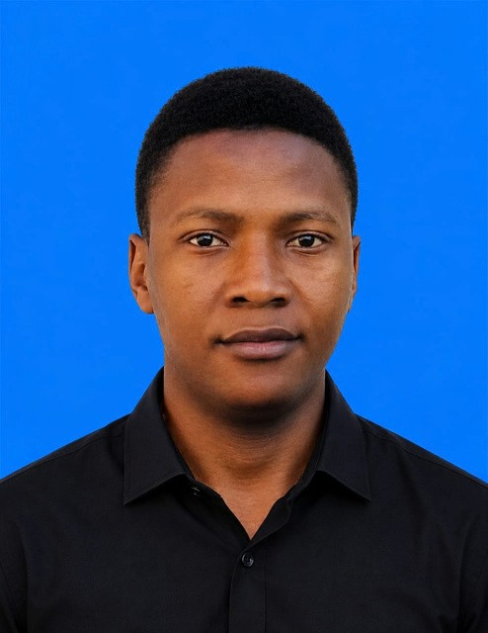
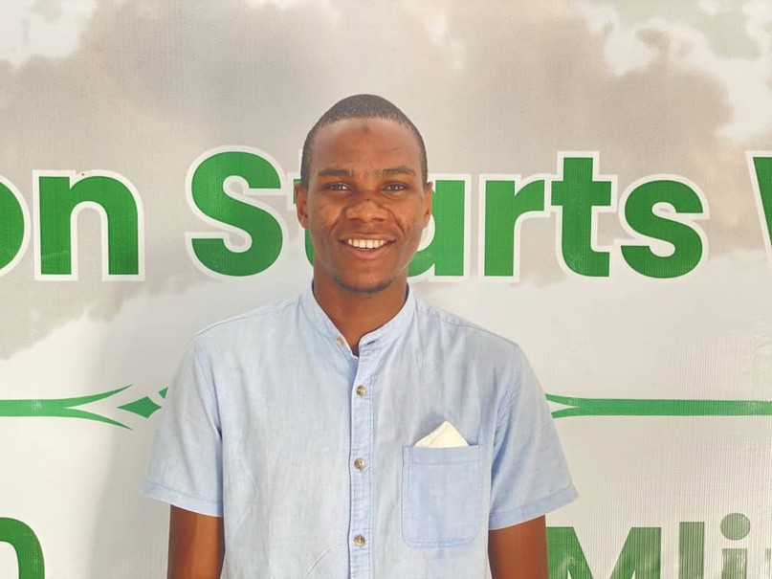
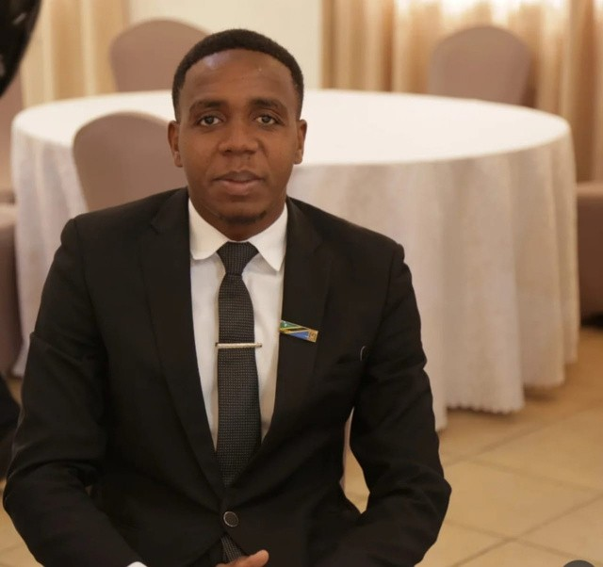
Meet Our Team
Salha Shamim Khamis
Samira Hilal Mohammed
Shemsa Nassor Amin
Mohammed Hashim Sharif
Abdillah Mshamata
Ishaka Dhamir
Founder/CEO
Research lead
CTO
Growth lead
Field operations lead
Data engineer

Slide 10
What exists today, and what we prove next
TRACTION & MILESTONES
NEXT
One live risk flow with 20–50 farmers in one cooperative, 1–2 risk types
BUILT TODAY
Interactive prototype: USSD menu, risk check, approved advice, SMS alert, co-op dashboard
Runs on simulated ocean data and a basic risk model — not yet live with farmers
Research report and implementation plan for the production stack
SEASON ONE
Measure results against the pre-registered pilot targets below
THEN
Scale to 1–2 cooperative clusters in N. Unguja or Pemba — once farmers trust it
SEASON-ONE PILOT TARGETS — PRE-REGISTERED, NOT PROMISED
≥70%
≥75%
≥60%
10–20%
farmers with usable production records
high-priority alerts acknowledged
alerts acted on within 48 hours
fewer avoidable losses vs. a matched control

Slide 11
THE ASK & USE OF FUNDS
We're raising US$50,000 for season one
1
2
Field pilot — $12,000
SMS, USSD & data — $9,000
Onboard 20–50 farmers in one co-op, then the first cluster
Africa's Talking messaging, Copernicus pipeline, hosting
3
4
Validation — $8,000
Build — $14,000
Seaweed specialists review every action, label outcomes
Move the prototype to the production risk service
Budget breakdown
Field pilot
$12,000
SMS, USSD & data
$9,000
Validation
$8,000
Build
$14,000
Runway & contingency
$7,000
Total ask
$50,000
~6 months runway
From pilot launch through validated results and first paid co-op licence.
Unlocks: live farmer results, the first paid co-op or programme licence, and ~6 months of runway.
"Every seaweed farmer in Zanzibar should know what the sea will do — and what to do about it."

Slide 12
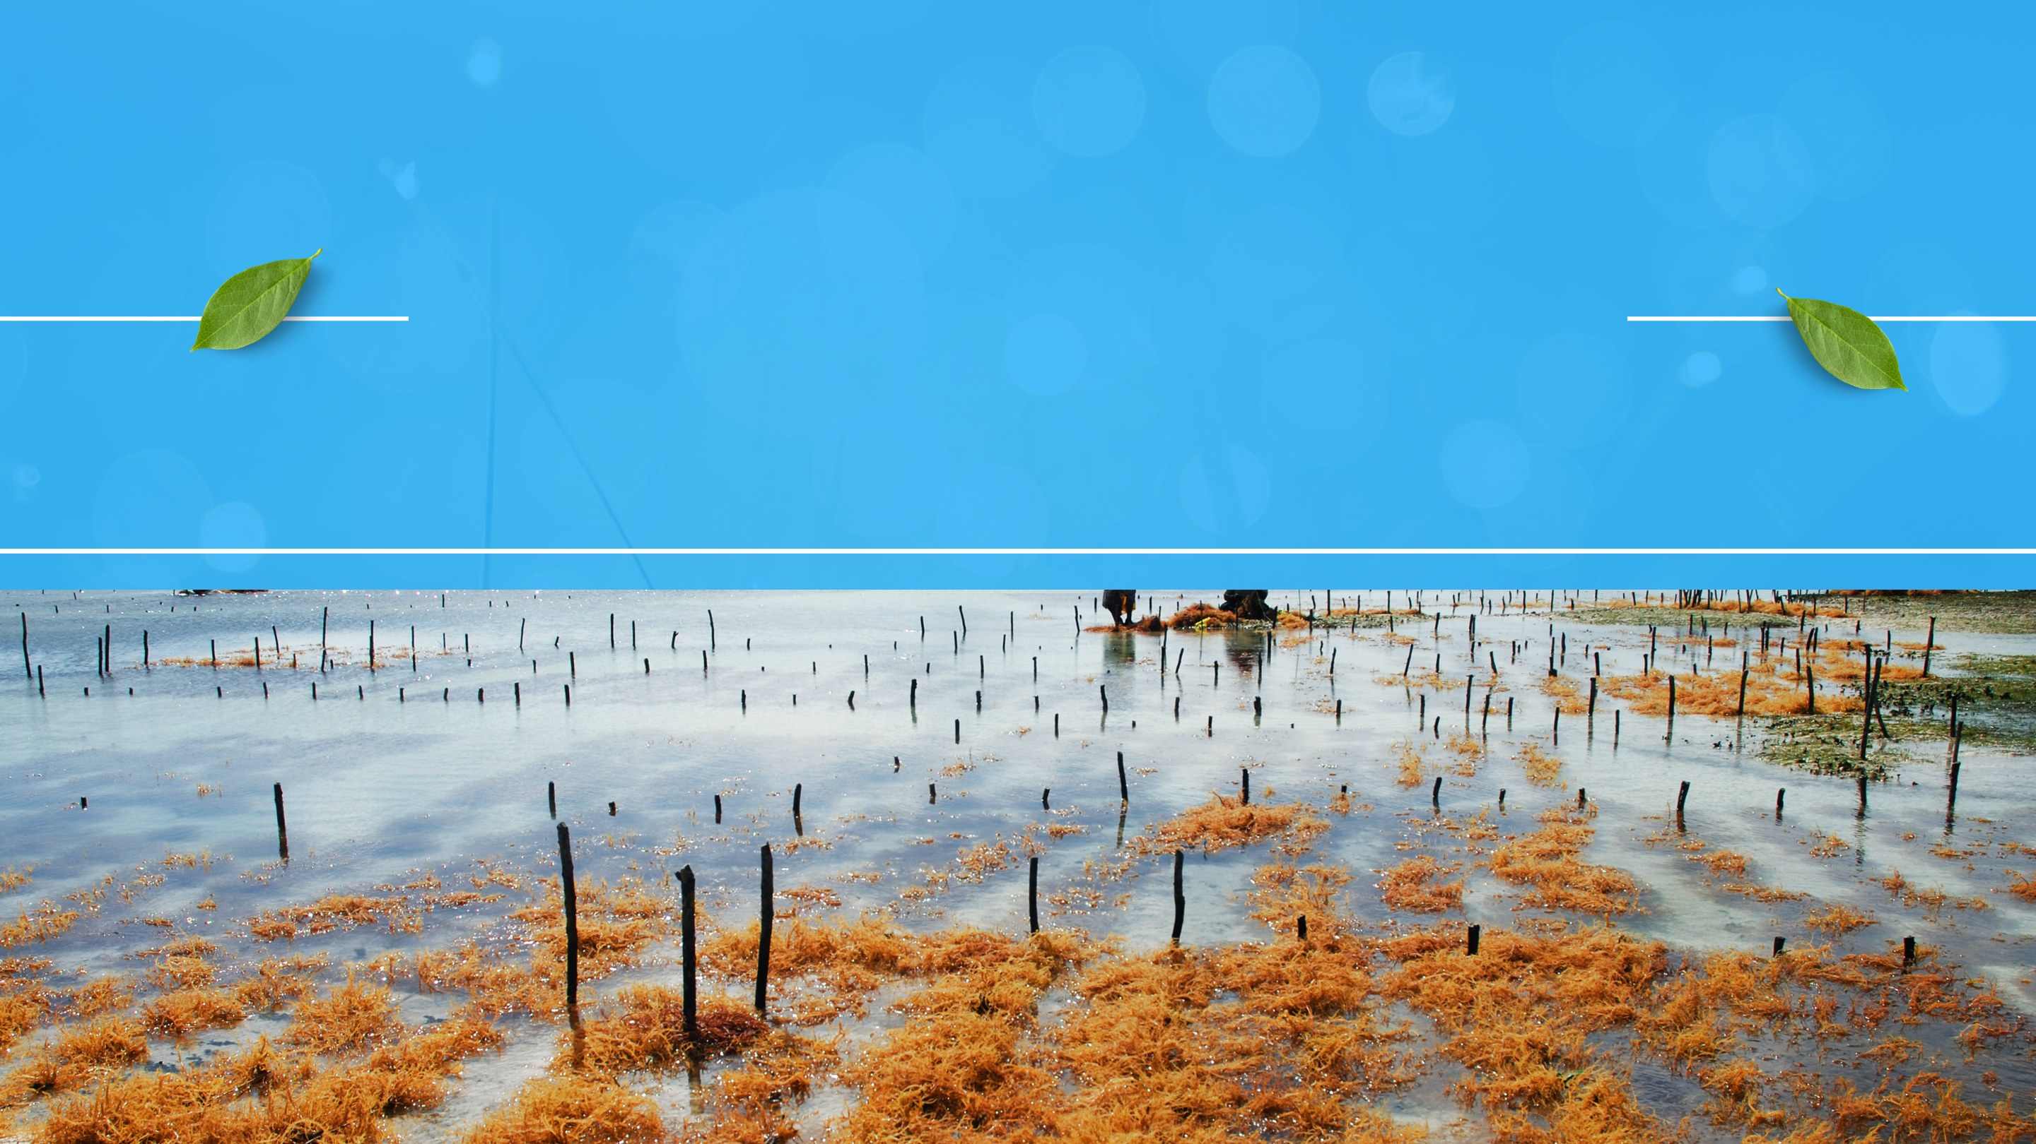
Thank you

