Slide 1
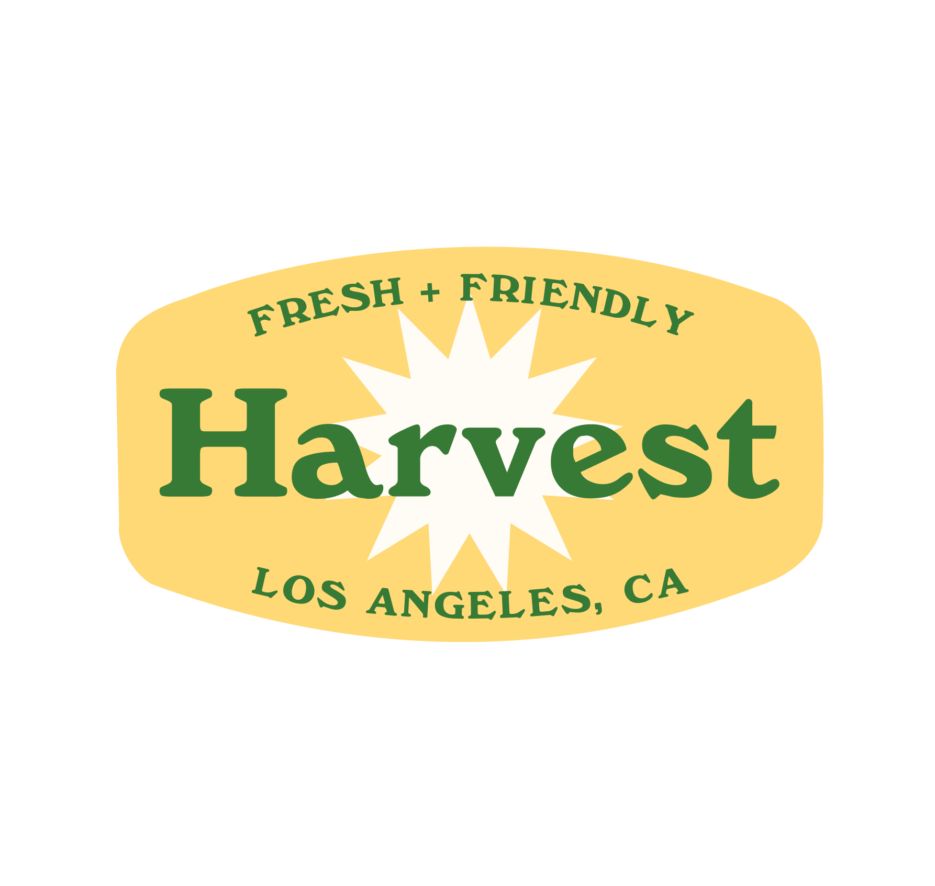
Harvest
Farmer’s Market Delivery Service
Zixuan Li, Lihan Zhu, Denny Shen, Jiayang Li

Slide 2


Quick Intro About Our TEAM
Harvest is an iOS app that provides farm produce delivery service, similar to other popular apps such as “Postmates” and “DoorDash.” Harvest was founded by 4 Iovine and Young Academy students at USC.
As the Harvest development team, we, 4 Viterbi students, designed and developed two applications for Harvest--customer side and business side--where the business version provides service to the farm vendors and the drivers.
Notes:
Skills & Tools: What software or other tools did you need to complete the project? (10pts) Denny

Slide 3
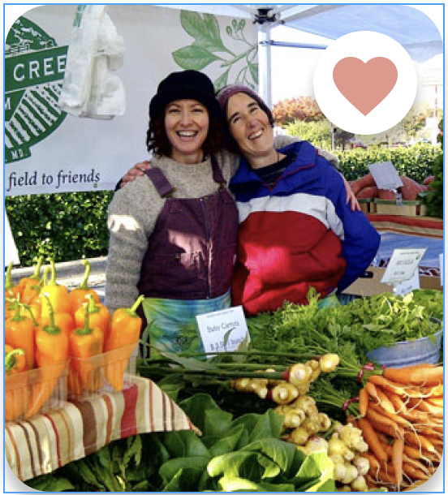
GOALS & IMPACTS
LOCAL
Angelenos can order fresh and local produce as easily as any take-out meal.
Angelenos can enjoy best quality produce no matter the weather, location or time.
We provide more job opportunities to local drivers and vendors.
GLOBAL
More job opportunities as drivers could be provided if our APP is promoted to all over the world.
Vendors have one more convenient and secure way to sell their fresh produces. They can focus more on their products instead of marketing.
Coleman Farm
Notes:
Local and Global Impact: How will the project affect the organization, society, or others? (5pts) Denny

Slide 4
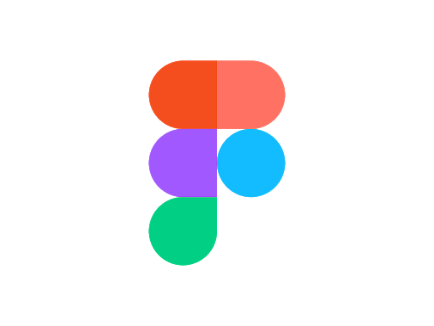
EXTERNAL TOPICS
IDEA GENERATION
Recognized stakeholders’ demands
Offered suggestions based on real world situations
Designed drivers’ order delivery system
DESIGN WORK
UI design w/ Figma
Intuitive user experience
Database Structure
FUNCTIONALITY
Firebase
Address Auto-Complete
Shopping Cart
UI animation
Map Navigation
Chat
Notes:
Continuing Professional Development: What topics outside of the curriculum did you need to complete the project?(10pts) Jiayang Li
Hello I am Jiayang, a computer science senior student from Viterbi.
In terms of idea generation, we recognized our stakeholders’ demands and they offered us suggestions based on real world situations.
We designed our drivers’ order delivery system based on existing delivery apps like Uber and Doordash.
We designed our user interface with our stakeholders using Figma and we provide intuitive user experience for our users. We also designed our database structure.
Our main functionality includes using Firebase to authenticate our users and store the related data. Using auto-complete search functionality to allow users to
store their address. Customers can shop using a shopping cart to add and remove items from their shopping cart and also see the delivery fees, taxes and total costs.
We also use some UI animation to increase the user experience. We use the map navigation to allow customers to see their drivers’ position and their own positions.
They can also chat with the driver.

Slide 5




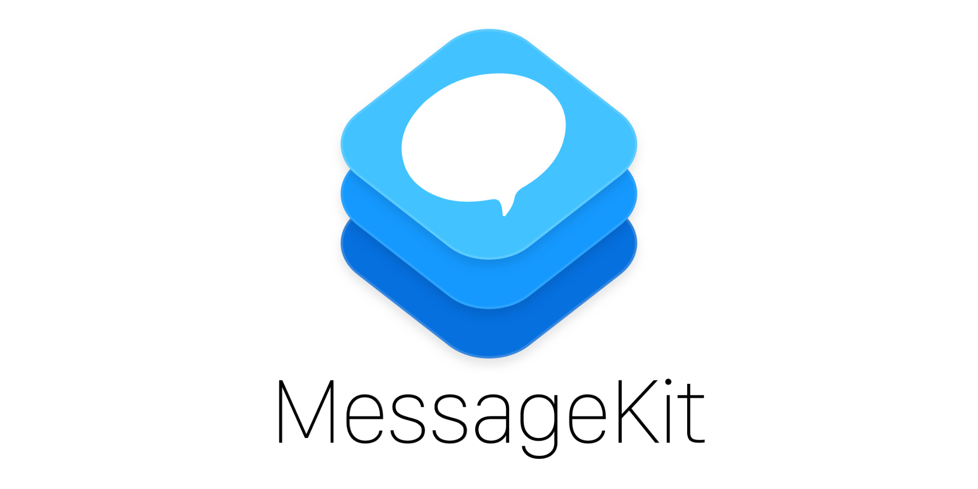

SKILLS & TOOLS
Xcode with Swift
Firestore
Firebase Authentication
Firebase Storage
Stripe
Google Sign In
MessageKit
Figma
Notes:
Skills & Tools: What software or other tools did you need to complete the project? (10pts) Jiayang Li
We use Swift as our main programming language and Xcode as our main development tools.
We also use Firebase as our backend to store the related information in this project. Specifically, we use firestore to store our data structures and firebase authentication to authenticate the users.
We use stripe for our payment systems and google signIn to allow users to sign in with their google account.
We use messagekit to allow the customers to talk with the drivers and even call the drivers.
We use Figma to develop our user interface with our stakeholders.

Slide 6


Pattern of Development
Agile development: using Sprint
Designs
Design
Apps / Pages / Features
Discussion
Implement
Developer 1
Developer 2
Developer 3
Stakeholder
Developer
Front-end
Back-end
Test & Debug
Notes:
Architecture: What architecture and design patterns did you use and why?(5pts)
Throughout the semester, we used Agile development pattern.
We had one meeting each two weeks with stakeholders to get feedbacks
We also had weekly meetings with teammates to discuss design choices and assign tasks
The way we divide tasks was to separate screens in app and assign them to teammates
Went through test and debug

Slide 7
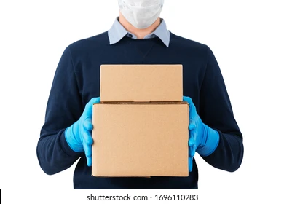
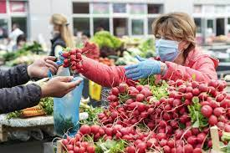
Non-tech Aspects
During Pandemic
Support farmers market
More job opportunities
Safety and Health
Touch free delivery
Notes:
Non-tech discussion: What legal, professional, ethical, security, and/or social issues needed to be addressed? (5pts) 2 NEEDED
Because designed during the pandemics, goal was to help local farmers market and provide more job opportunities
Using our app, customer can still buy products from their favorite markets
Our app also makes sure the safety and health of drivers and customers
We have the option of touch free delivery

Slide 8
Knowledge Cooperated Outside of this Class
CSCI 104: Concept of Data Structure
CSCI 201: Use of database
CSCI 310: Agile development model, git workflow
CSCI 170: Runtime analysis for code optimization
CSCI 270: Design/Algorithm of retrieving data including orders, produces, etc.
ITP 342: Swift programming language, UIKit, and Firebase
ITP 344: Swift programming and iOS development
Math Courses: Calculating the distance and the total costs etc.
Notes:
Outside Classes: What math and CS classes were used in the project? (5pts)
We cooperated a lot of knowledge outside of this class
Most important: CS foundation classes
Benefited a lot from ITP iOS development classes: for example, we chose MVC design pattern and firebase.

Slide 9
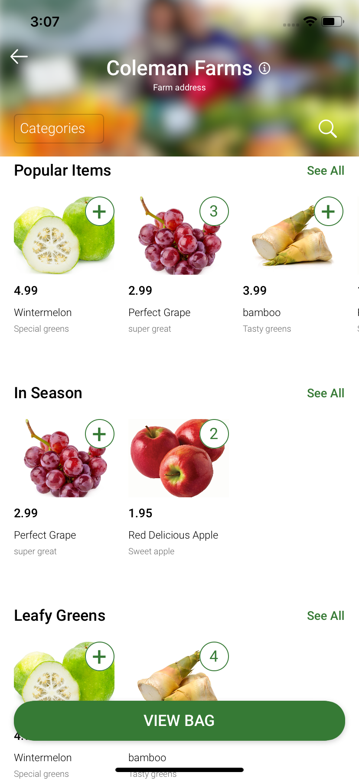
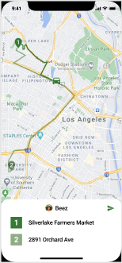
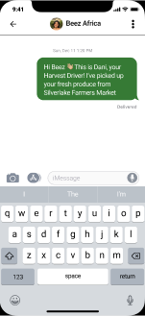
PROJECT DESIGN: Good and Bad
The Good
Display favorite and nearest markets
Filter and display produces of vendors with 3 types: Popular, In season, Leafy greens
Shopping Cart w/ scheduled delivery
Payment system with Stripe
Orders tracking system
Delivery system
Chat system
The Bad
Order might be skipped if no drivers are available in customer’s scheduled delivery time
Customer can only place one order at a time
Driver can only chat with one customer at a time
Notes:
We successfully developed a lot of useful features, eg.
filter/display, you can filter by your preference and choose your fav in a sec
Payment with Stripe, secure and convenient
Chat system so you can stay tuned with your order status and talk to drivers if needed
However, we do have some improvements need to be done.
If there’s not enough drivers, there would be a starving problem and we would miss orders placed during this period
The customer can only place one order at a time cuz our order tracking system could only keep track of the most recent order
Driver can only talk to one customer since there’s no place to enter chat system for other customers

Slide 10
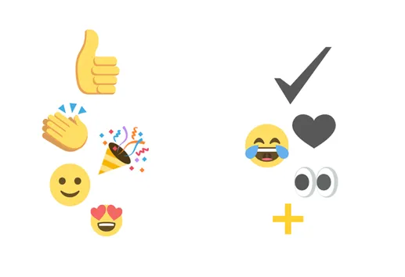

TEAM WORK: Good and Bad
The Good
Communications and cooperations
High efficiencies when working together
Understand more and improve skills with each other’s help
Learn new knowledge from other group members
Bouncing ideas off of each other when brainstorming projects
The Bad
Merge conflict (only once though :D)
Repetitive data structure when two working on the same side
Notes:
4 months of working together helps all of us become better programmers
we had pretty efficient communication and cooperations
we’re willing to help each others debug when encountering technical difficulties
We sometimes reused each others’ code like UI presets/collection view/animation for a better UI look
We did get a few of problems but luckily not too many
We got a merge conflict once since two of us were pushing together, but we resolved it in 10 mins
Me and Lihan wrote repetitive data structure for driver orders when working on different parts of business side and we both got our parts working before realizing this problem. Fortunately it’s an easy fix.
We would communicate and design data structure together before actual implementation for a more efficient work flow.

Slide 11
Demo
Notes:
We would describe/explain each of our parts in the demo.

