Slide 1
VBA
TT

Slide 2
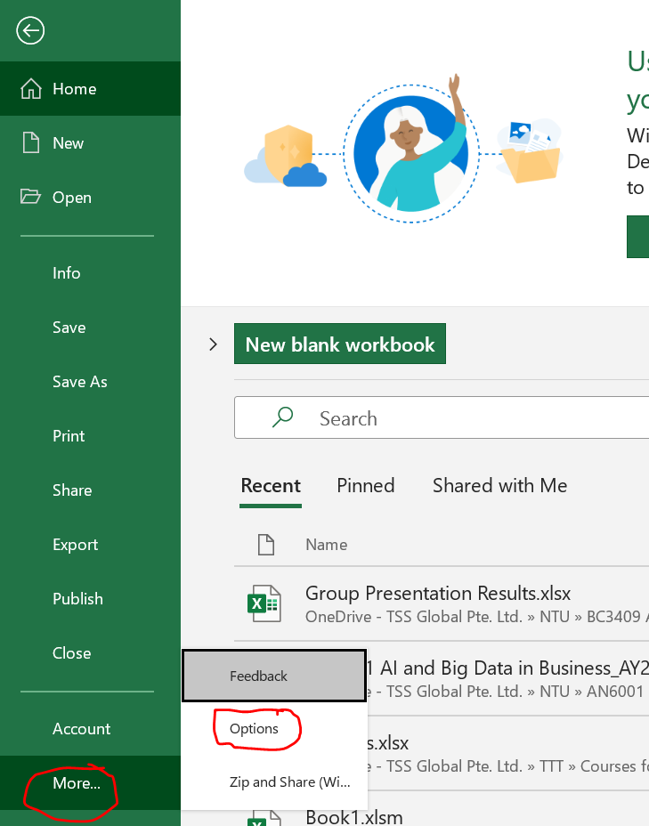
Install Developer

Slide 3
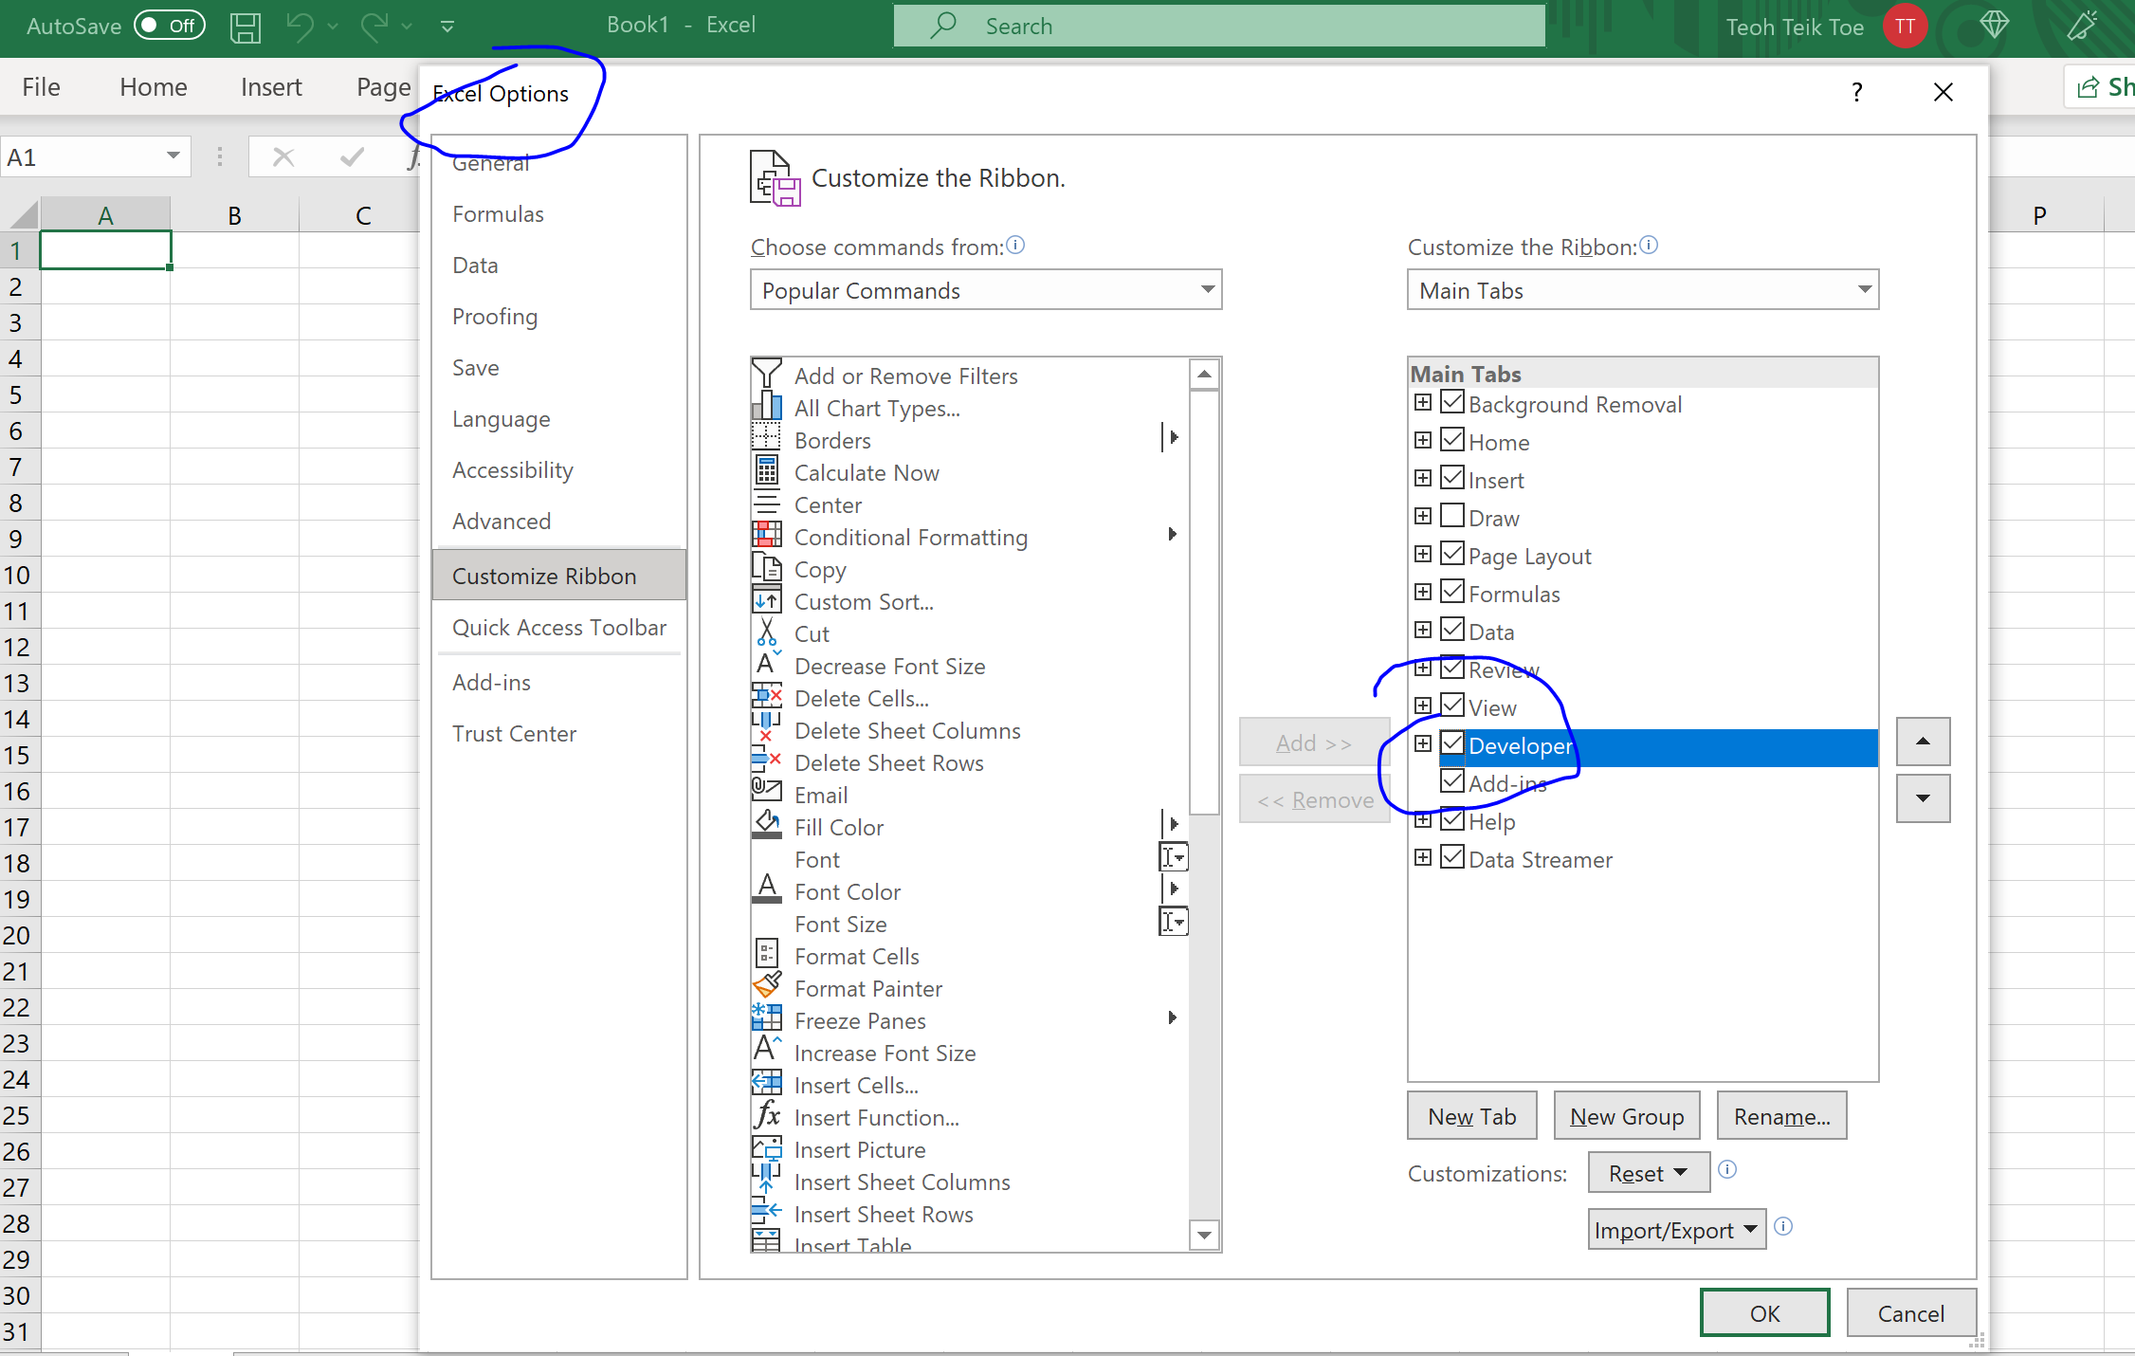

Slide 4
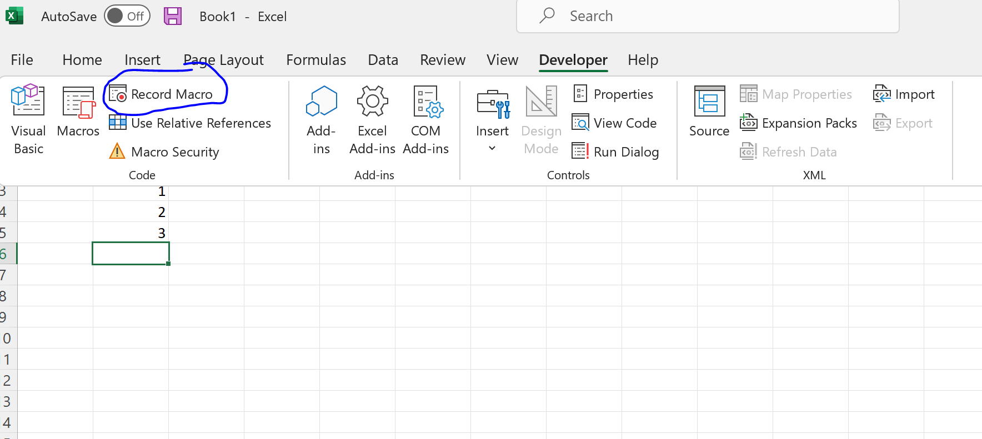
Record Macro
=sum($C$1:$C$3)

Slide 5
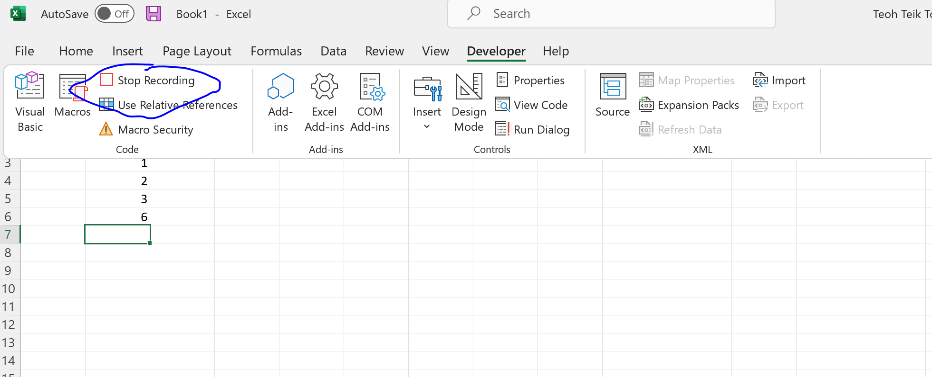
Type =sum(b3:b5) then top recording

Slide 6
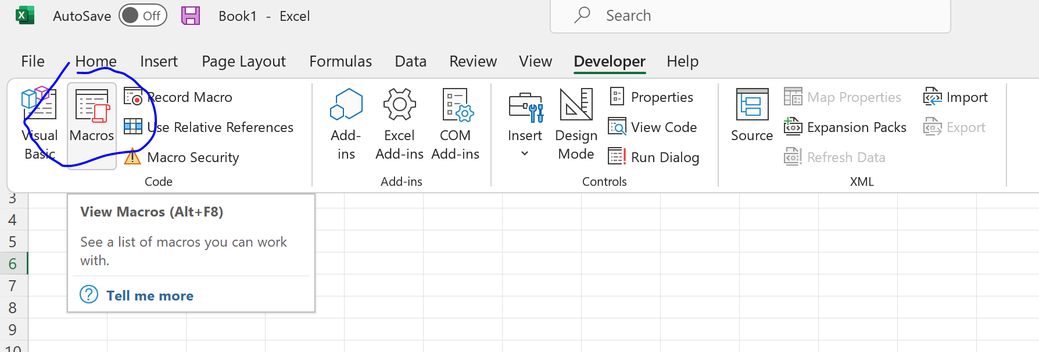
Run Marco (must be same position)

Slide 7
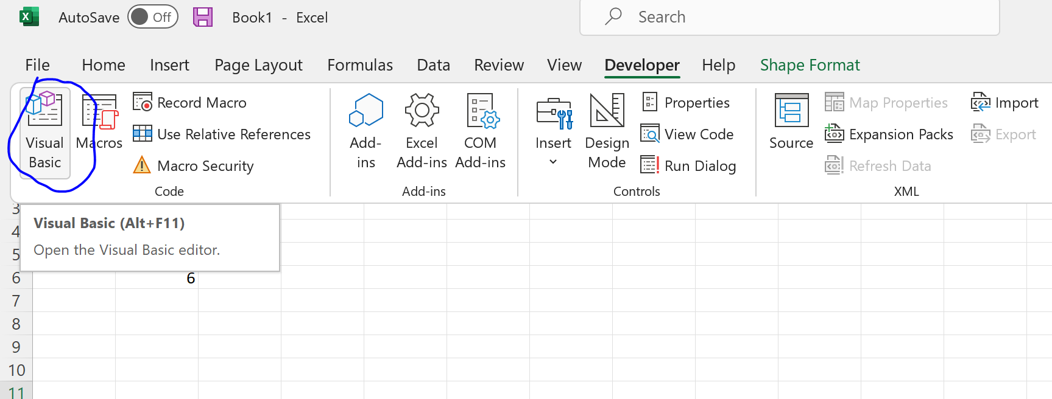
Create first VBA (print hello)

Slide 8
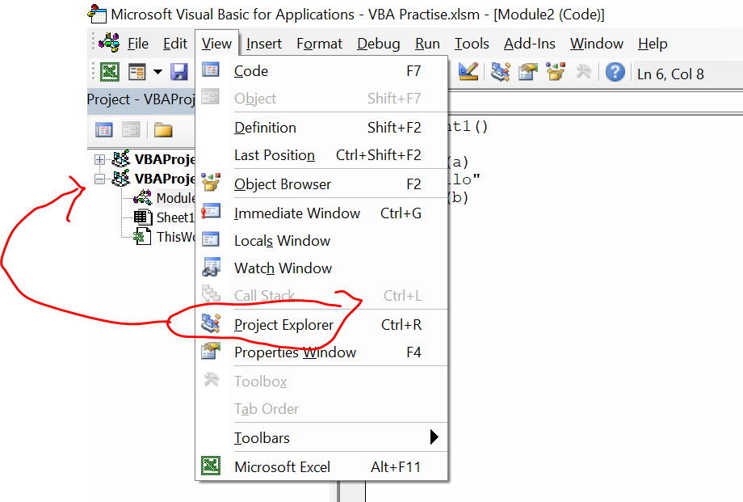
View Project Explorer

Slide 9
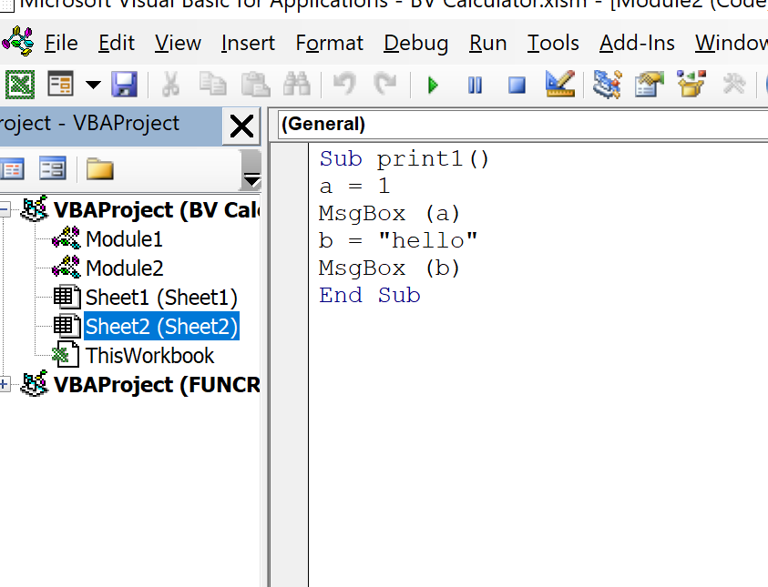
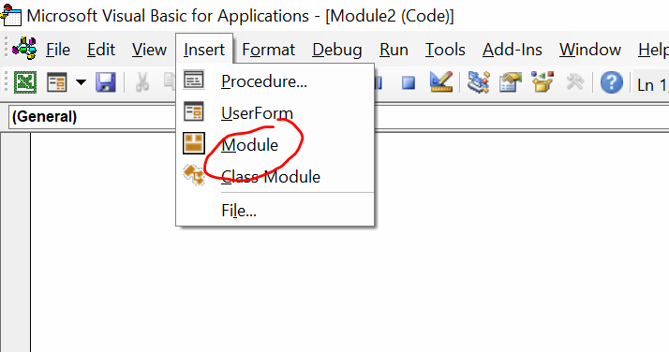
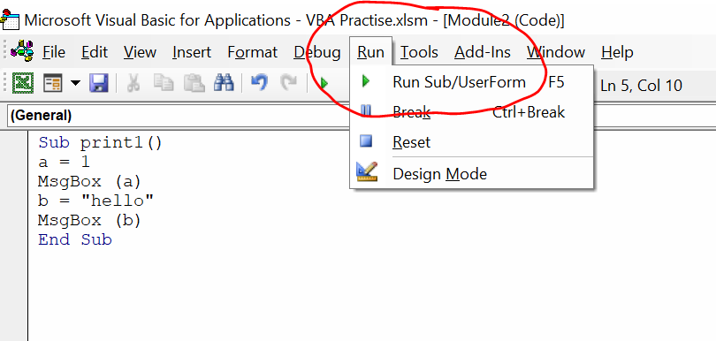
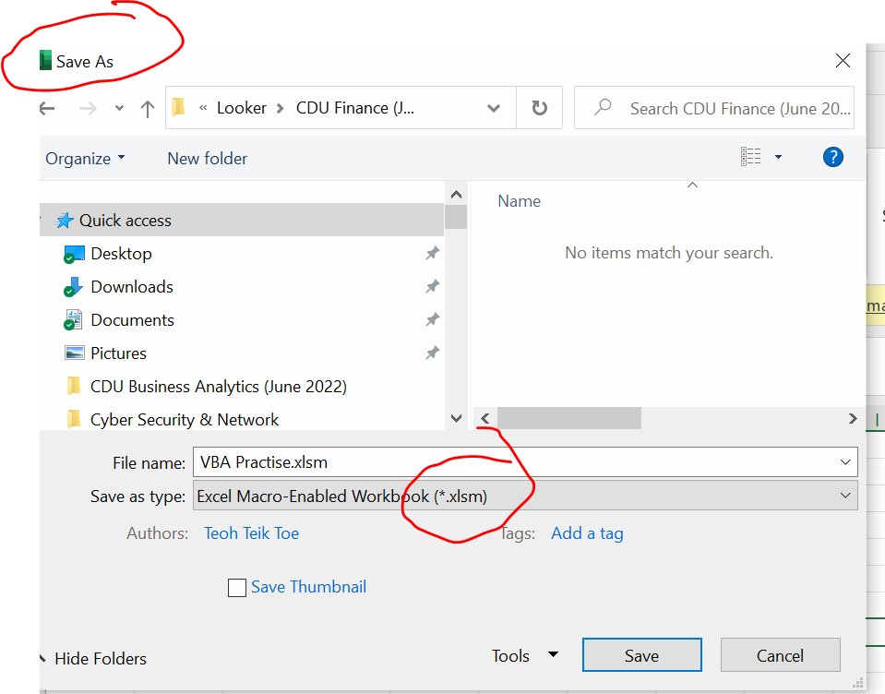
Create Module
Save as xlsm
Sub print1()
a = 1
MsgBox (a)
b = "hello"
MsgBox (b)
End Sub

Slide 10
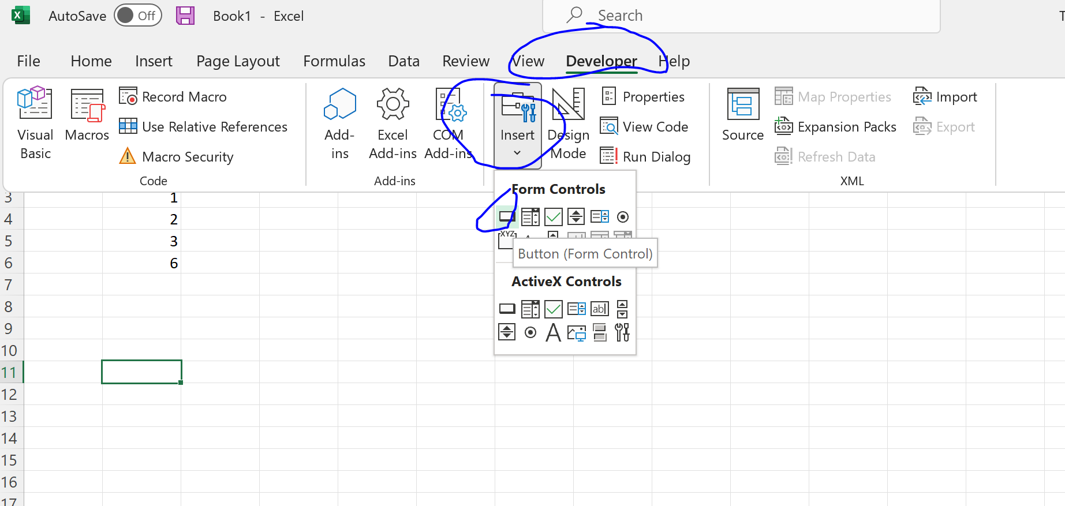
Create Buttons

Slide 11
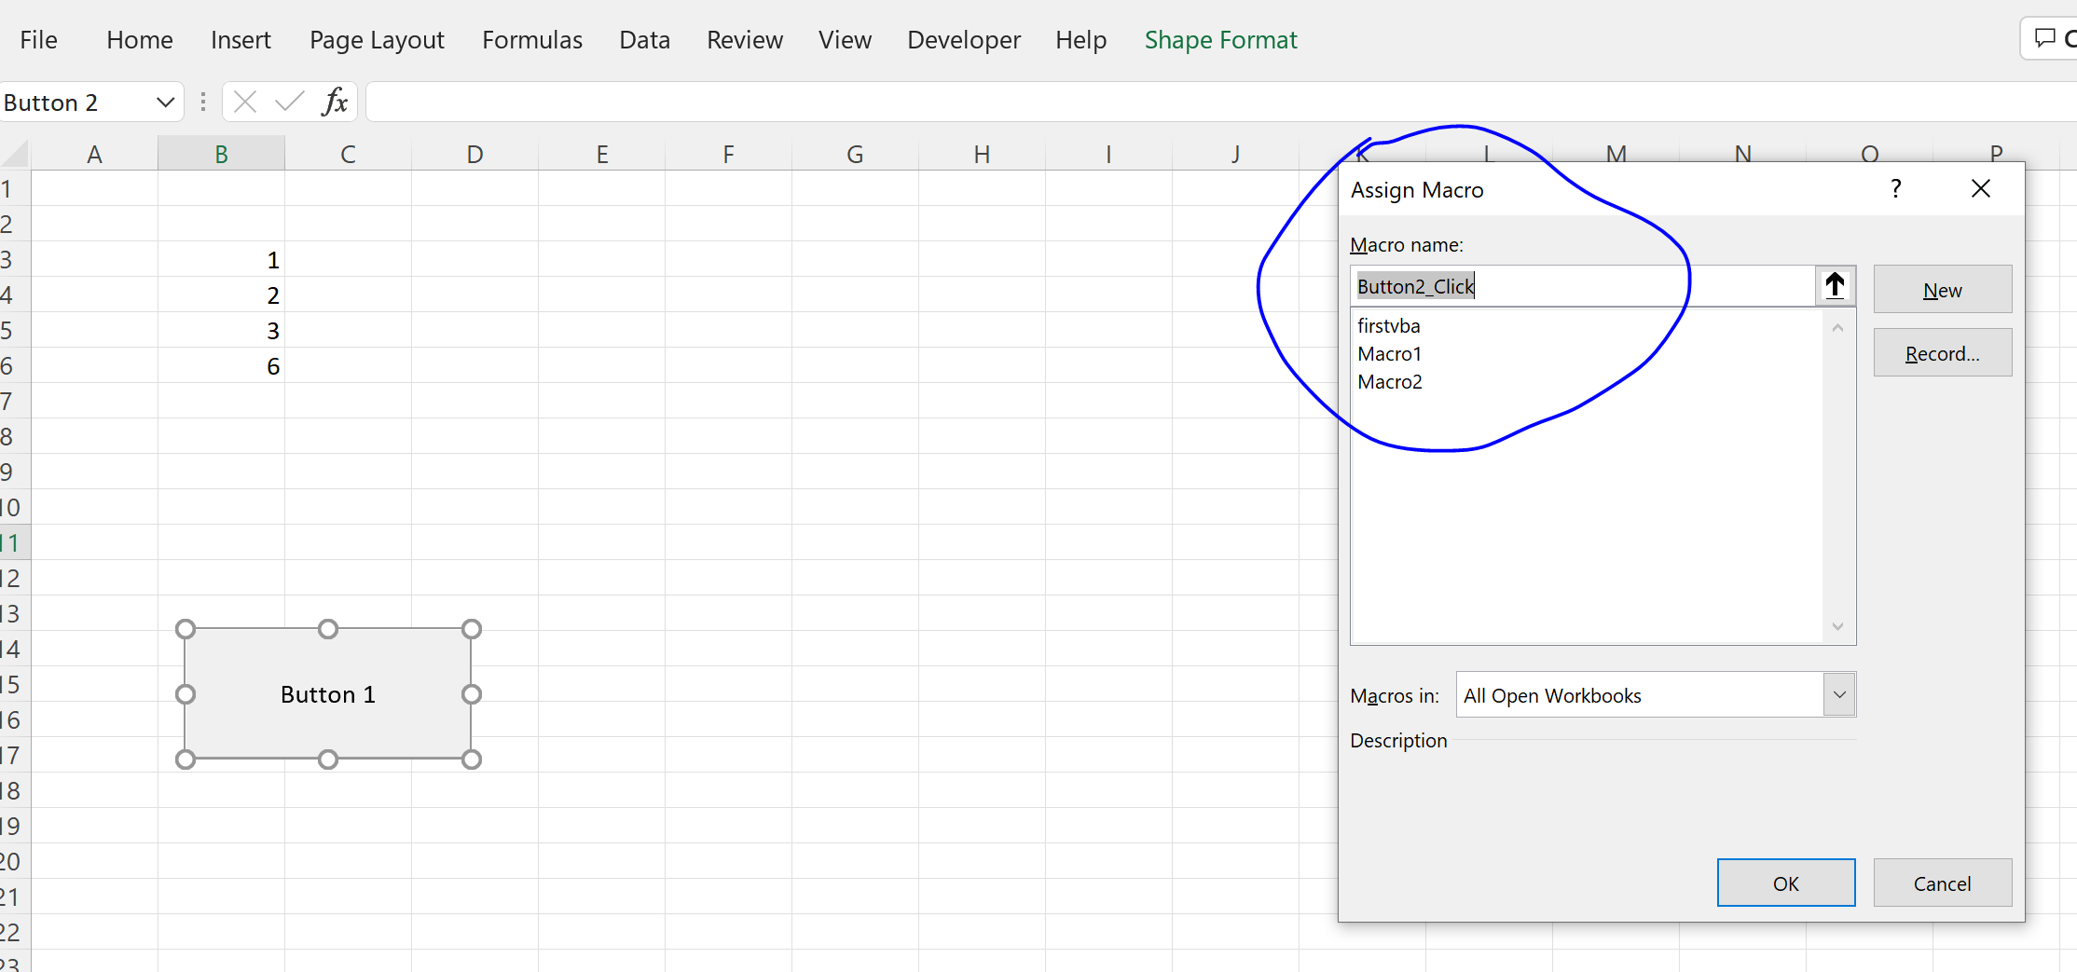
Assign Macro

Slide 12
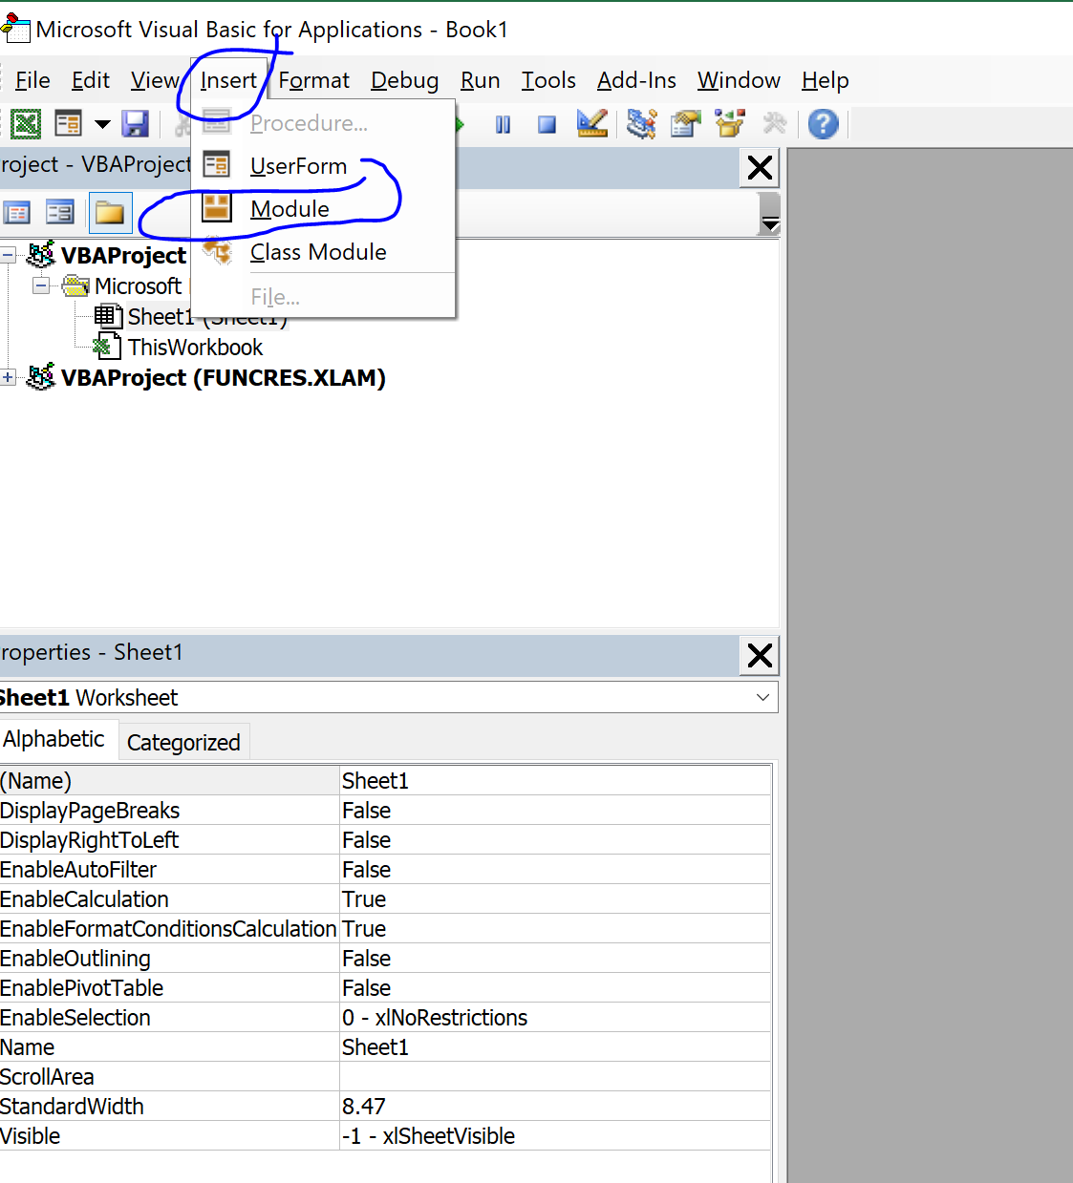
Insert Module

Slide 13
VBA
'my first vba
Sub MyfirstVBA()
a = 1
MsgBox (a)
b = "hello"
MsgBox (b)
c = InputBox("please enter your name:")
MsgBox ("you name is " & c & " Thank you")
End Sub
'My Third VBA
Sub myThirdVBA()
a = 1
While a <= 5
MsgBox (a)
a = a + 1
Wend
End Sub
'My second VBA
Sub mySecondVBA()
a = 3
If a = 1 Then
MsgBox ("a is 1")
ElseIf a = 2 Then
MsgBox ("a is 2")
Else
MsgBox ("a is not 1 or 2")
End If
End Sub
'My fourth VBA
Sub myfourthVBA()
Range("d10") = 2021
Range("d11").Value = Range("b5").Value
End Sub

Slide 14
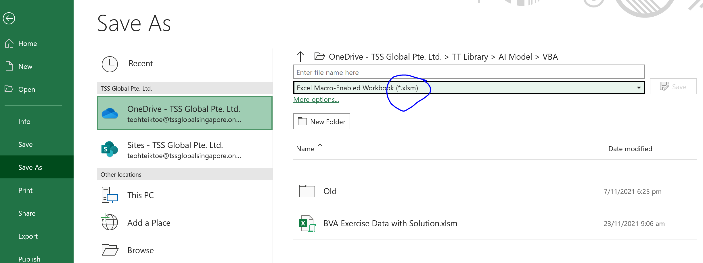
Save as xlsm (macro)

Slide 15
Practice 1
Company incorporate in 2021
All activity is to start in Jan 2021.
The valuation is based on Nov 2021.
Tax Rate 17%
Sales for 2021 is 700,000 yearly growth by 22.5% for 5 years
Expense for 2021 is 200,000 yearly growth by 22.5% for 5 years
Working Capital at 10% of revenue
Capital Expenditure at 20% of revenue and depreciation same at Capex
WACC 25%

Slide 16
Assumption
5 years
Since is Nov, the value in 2021 is not counted
Capex is same as depreciation

Slide 17
BV

Slide 18
Range("e5").Value = Range("b3").Value
Range("f5") = Range("e5").Value * (GR + 1)
Range("g5") = Range("f5").Value * (GR + 1)
Range("h5") = Range("g5").Value * (GR + 1)
Range("i5") = Range("h5").Value * (GR + 1)
Range("j5") = Range("i5").Value * (GR + 1)
Range("e7") = Range("e3") - Range("e5")
Range("f7") = Range("f3") - Range("f5")
Range("g7") = Range("g3") - Range("g5")
Range("h7") = Range("h3") - Range("h5")
Range("i7") = Range("i3") - Range("i5")
Range("j7") = Range("j3") - Range("j5")
Range("e8") = Range("e7") * Range("b7")
Range("f8") = Range("f7") * Range("b7")
Range("g8") = Range("g7") * Range("b7")
Range("h8") = Range("h7") * Range("b7")
Range("i8") = Range("i7") * Range("b7")
Range("j8") = Range("j7") * Range("b7")
Range("e9") = Range("e3") * Range("b5")
Range("f9") = Range("f3") * Range("b5")
Range("g9") = Range("g3") * Range("b5")
Range("h9") = Range("h3") * Range("b5")
Range("i9") = Range("i3") * Range("b5")
Range("j9") = Range("j3") * Range("b5")
Range("e11") = Range("e3") * Range("b5")
Range("f11") = Range("f3") * Range("b5")
Range("g11") = Range("g3") * Range("b5")
Range("h11") = Range("h3") * Range("b5")
Range("i11") = Range("i3") * Range("b5")
Range("j11") = Range("j3") * Range("b5")
Sub calEV()
Range("e1") = 2021
Range("f1") = 2022
Range("g1") = 2023
Range("h1") = 2024
Range("i1") = 2025
Range("j1") = 2026
Range("k1") = "Terminal Value"
Range("d3") = "Sales"
Range("d5") = "Expenses include Depreciation"
Range("d7") = "Profit Before Tax"
Range("d8") = "Tax"
Range("d9") = "Add Back Depreciation"
Range("d11") = "Capital Expenditure"
Range("d13") = "Change in Working Capital"
Range("d15") = "Free Cash Flow"
Range("d17") = "Discounting Factor"
Range("d18") = "Present Value of FCF"
Range("d19") = "EV"
Range("d22") = "Working"
Range("d24") = "Working Capital"
GR = InputBox("Please enter the growth rate : ")
Range("e3") = Range("b2")
Range("f3") = Range("e3") * (GR + 1)
Range("g3") = Range("f3") * (GR + 1)
Range("h3") = Range("g3") * (GR + 1)
Range("i3") = Range("h3") * (GR + 1)
Range("j3") = Range("i3") * (GR + 1)

Slide 19
Range("e24") = Range("e3") * Range("b6")
Range("f24") = Range("f3") * Range("b6")
Range("g24") = Range("g3") * Range("b6")
Range("h24") = Range("h3") * Range("b6")
Range("i24") = Range("i3") * Range("b6")
Range("j24") = Range("j3") * Range("b6")
‘Change in WC
Range("f13") = Range("f24") - Range("e24")
Range("g13") = Range("g24") - Range("f24")
Range("h13") = Range("h24") - Range("g24")
Range("i13") = Range("i24") - Range("h24")
Range("j13") = Range("j24") - Range("i24")
Range("f15") = Range("f7") - Range("f8") + Range("f9") - Range("f11") - Range("f13")
Range("g15") = Range("g7") - Range("g8") + Range("g9") - Range("g11") - Range("g13")
Range("h15") = Range("h7") - Range("h8") + Range("h9") - Range("h11") - Range("h13")
Range("i15") = Range("i7") - Range("i8") + Range("i9") - Range("i11") - Range("i13")
Range("j15") = Range("j7") - Range("j8") + Range("j9") - Range("j11") - Range("j13")
'TV
Range("k15") = (Range("j15") * (1 + GR)) / (Range("b8") - GR)
Range("f17") = 1 / (1 + Range("b8"))
Range("g17") = 1 / ((1 + Range("b8")) ^ 2)
Range("h17") = 1 / ((1 + Range("b8")) ^ 3)
Range("i17") = 1 / ((1 + Range("b8")) ^ 4)
Range("j17") = 1 / ((1 + Range("b8")) ^ 5)
Range("k17") = 1 / ((1 + Range("b8")) ^ 5)
Range("f18") = Range("f15") * Range("f17")
Range("g18") = Range("g15") * Range("g17")
Range("h18") = Range("h15") * Range("h17")
Range("i18") = Range("i15") * Range("i17")
Range("j18") = Range("j15") * Range("j17")
Range("k18") = Range("k15") * Range("k17")
Range("e19") = WorksheetFunction.Sum(Range("f18:k18"))
End Sub

Slide 20
Optional

Slide 21
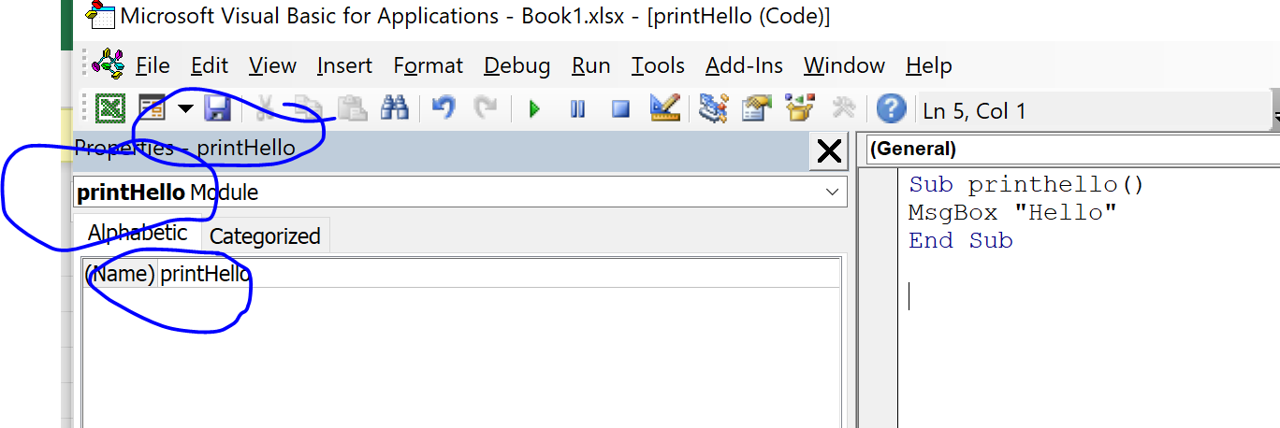
Print hello – Save as PrintHello module
Sub printhello()
MsgBox "Hello"
End Sub

Slide 22
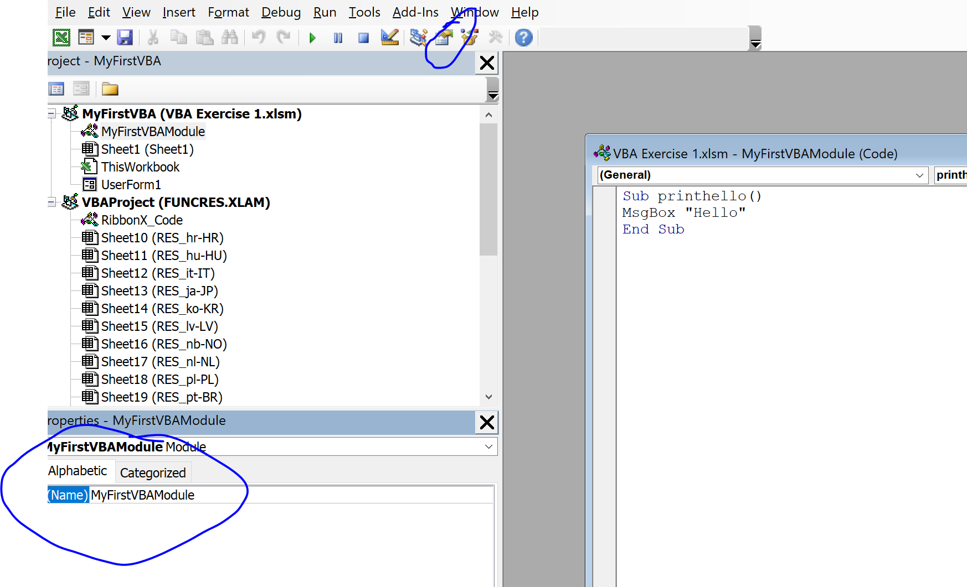
Change Module Name

Slide 23
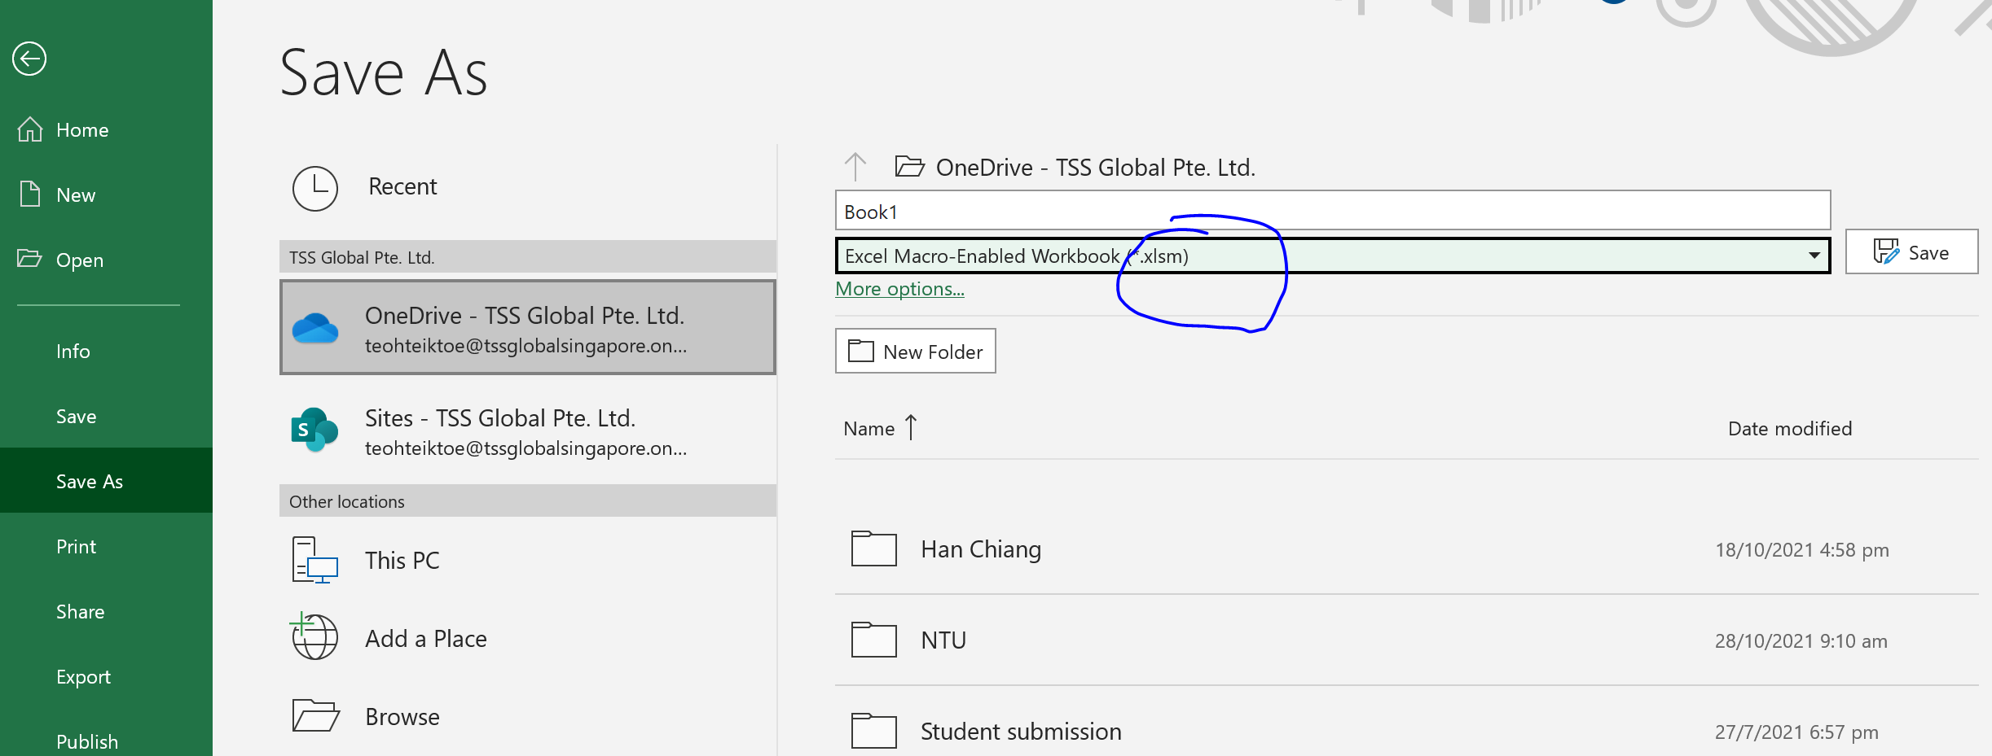
Save as xlsm

Slide 24
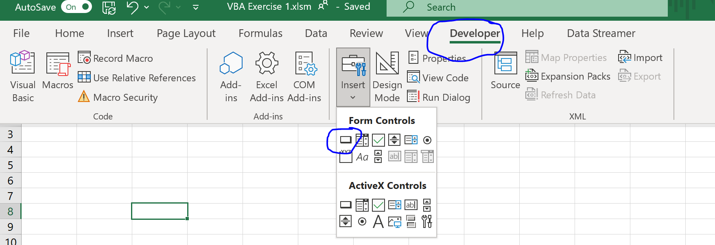
Developer – Insert Button

Slide 25
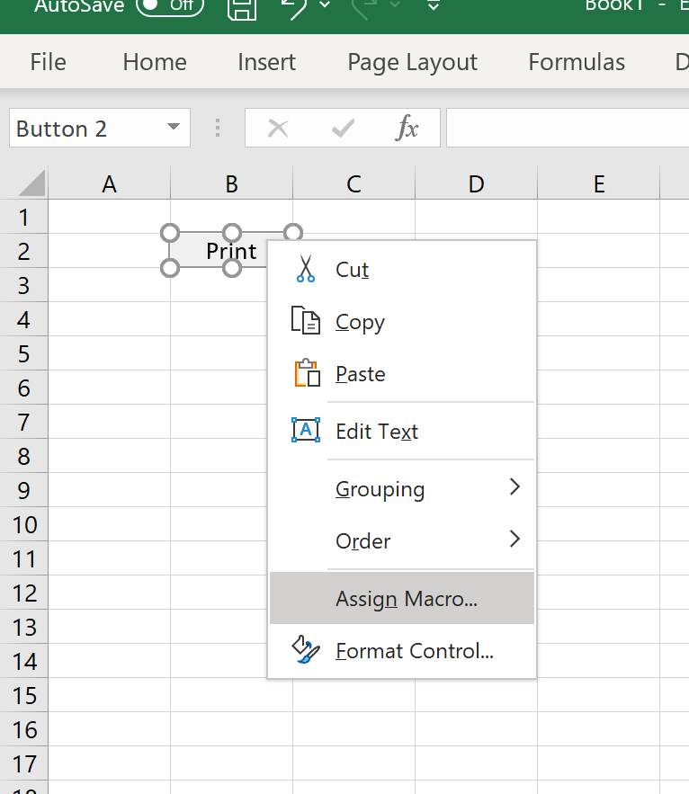
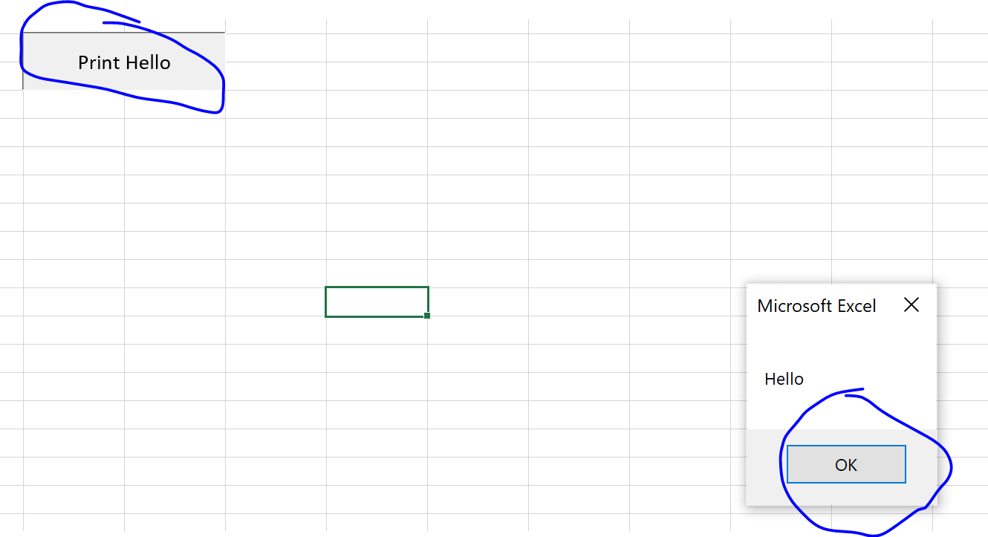
Add button and module

Slide 26
Change Value in cell – Repeat the process
Sub ChangeValue()
Range("f3").Value = Range("f3").Value + 2
End Sub

Slide 27
Basic VBA
https://www.tutorialspoint.com/vba/vba_variables.htm

Slide 28
Variable
Sub a()
Dim a As Integer
a = 5.4
MsgBox a
Dim b As String
b = "123"
MsgBox b
Dim c As Double
c = 3.142
MsgBox c
End Sub

Slide 29
Variable
Sub say_helloworld_Click()
Dim password As String
password = "Admin#1"
Dim num As Integer
num = 1234
Dim BirthDay As Date
BirthDay = DateValue("30 / 10 / 2020")
'chr(10) is line feed => next line
MsgBox "Passowrd is " & password & Chr(10) & "Value of num is " & num & Chr(10) & "Value of Birthday is " & BirthDay
End Sub

Slide 30
MsgBox
Sub MessageBox_Demo()
'Message Box with just prompt message
MsgBox ("Welcome")
'try 1 2 and 3
Dim a As Integer
a = MsgBox("Do you like blue color?", 1)
' Assume that you press No Button
MsgBox ("The Value of a is " & a)
End Sub

Slide 31
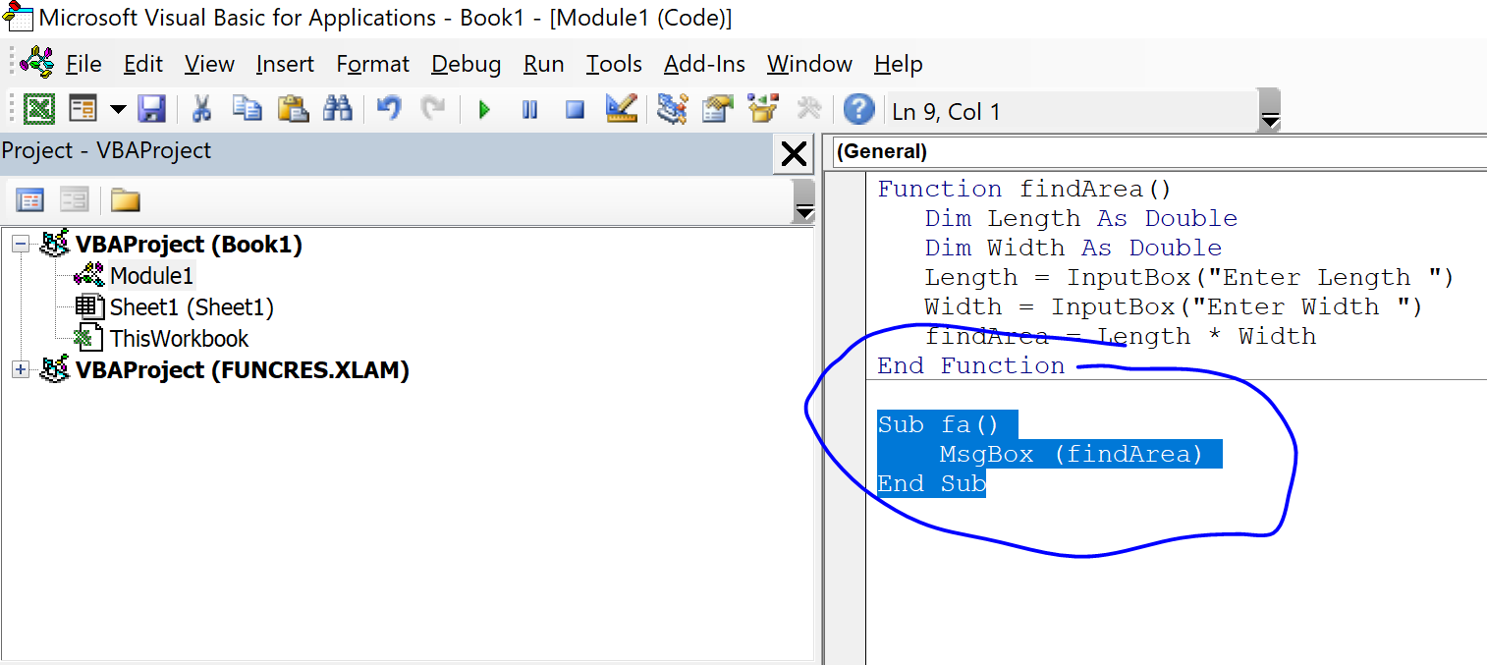
Find Area using Function – only highlight fa()
Function findArea()
Dim Length As Double
Dim Width As Double
Length = InputBox("Enter Length ")
Width = InputBox("Enter Width ")
findArea = Length * Width
End Function
Sub fa()
MsgBox (findArea)
End Sub

Slide 32
If statement
Sub if_demo_Click()
Dim x As Integer
Dim y As Integer
x = 234
y = 32
If x > y Then
MsgBox "X is Greater than Y"
End If
End Sub

Slide 33
If then else
Sub a()
Dim a As Integer
a = InputBox("please enter a value ")
If a = 5 Then
MsgBox "a is 5"
ElseIf a = 6 Then
MsgBox "a=6"
Else
MsgBox "a is not 5 or 6"
End If
End Sub

Slide 34
For Loop
Sub b()
For a = 1 To 5
MsgBox a
Next
End Sub
Sub Constant_demo_Click()
Dim a As Integer
a = 10
For i = 0 To a Step 2
MsgBox "The value is i is : " & i
Next
End Sub

Slide 35
While loop
Sub While_Loop_Example()
Dim LTotal As Integer
LTotal = 1
While LTotal < 5
MsgBox (LTotal)
LTotal = LTotal + 1
Wend
End Sub

Slide 36
VBA in Business Valuation

Slide 37
Macros can be created in two ways:
Recording
plan actions you need to automate
Tools>Record a new macro
perform actions you need to automate
stop recording
Writing macros in VBA
Tools>macros

Slide 38
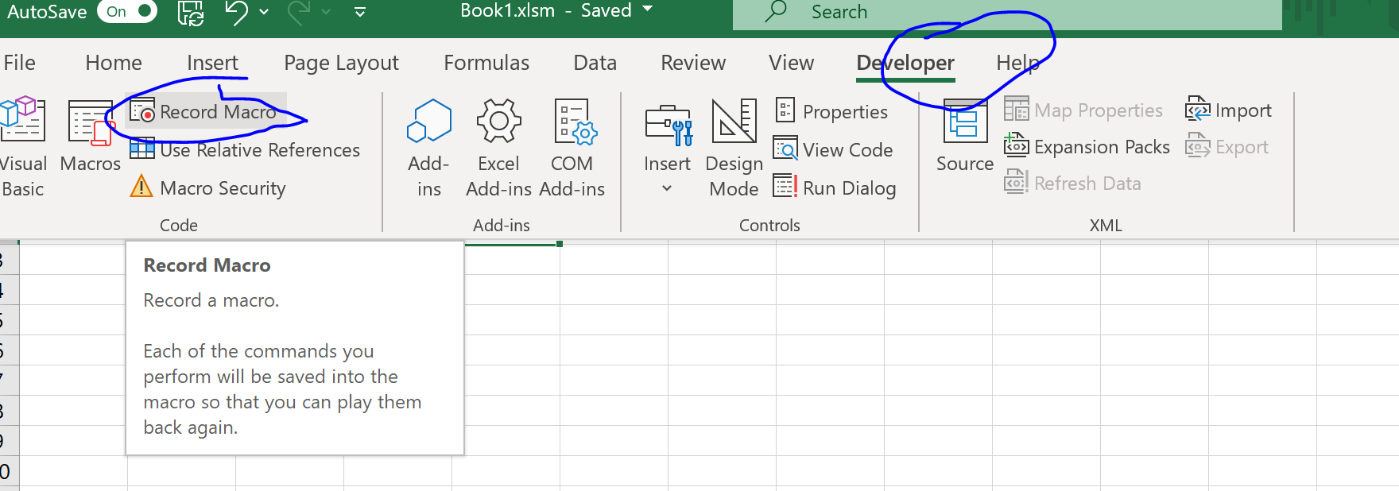
Recording

Slide 39
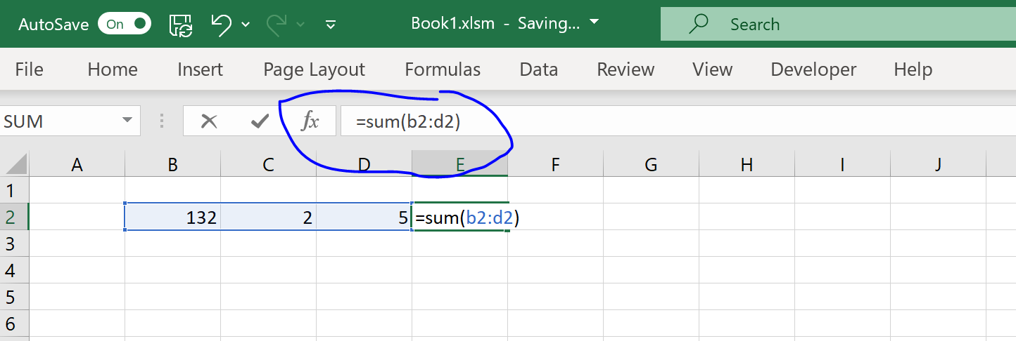
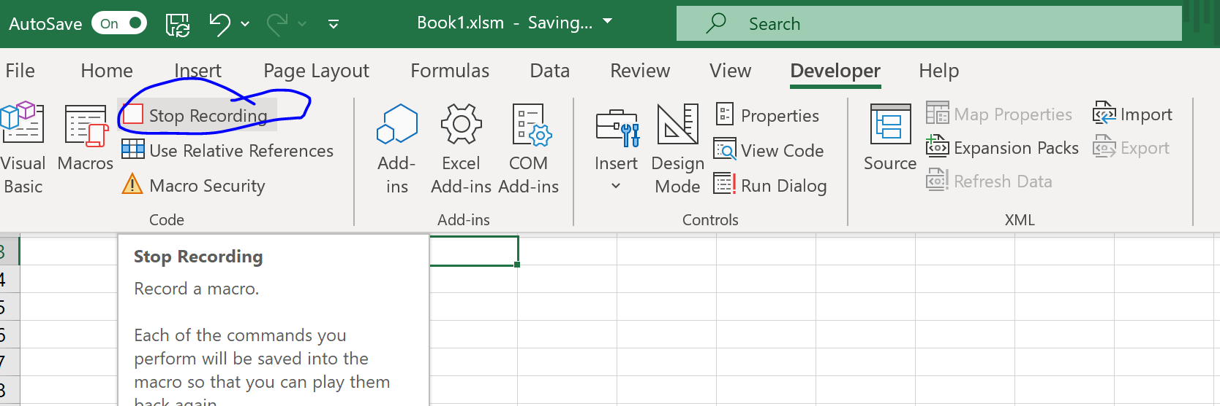

Slide 40
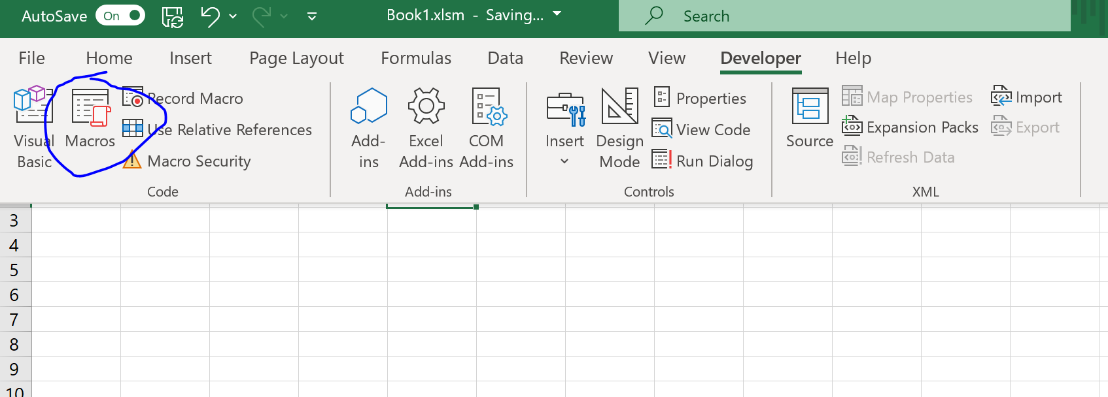
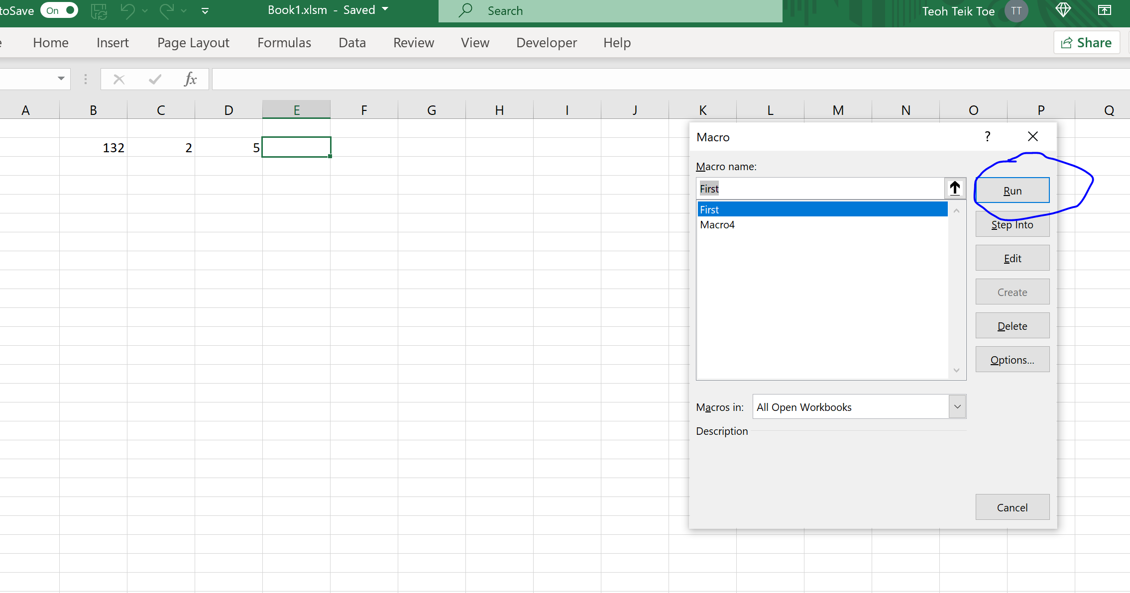
Delete and run

