Slide 1
一場思辨之旅
之 game jam 可能做不出來

Slide 2
美好與殘酷

Slide 3
如果美好的背後是殘酷

Slide 4


It seems to need water...

Slide 5

The forest today is very peaceful...

Slide 6
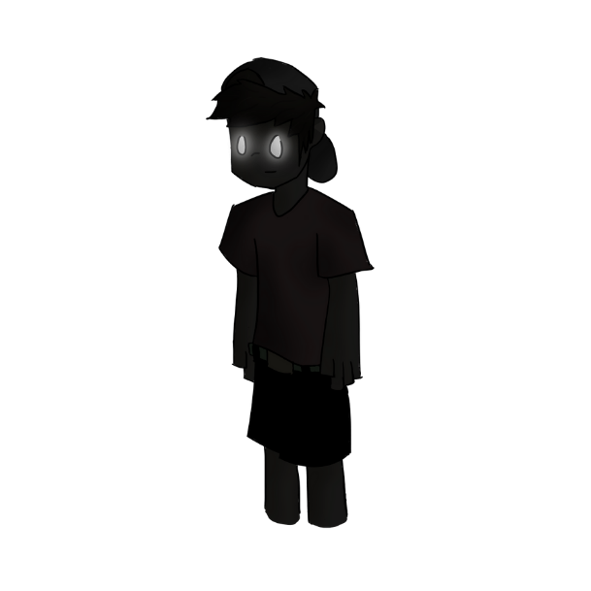
I believe you
But...
I am hurt...

