Slide 1
How to build: https://percy.readthedocs.io/en/latest/installation.html
Input files:
Primitives.txt
truth_tables.txt
Synthesis_Settings.txt
Output Files:
Synthesis_log.txt
Synthesis_result.txt
Commands to build project in Ubuntu:
sudo apt install gcc
cd /mnt/your_path/percy-linux/build
mkdir build
Cd build
cmake -DPERCY_TEST=ON –G
make
make test
The generated exe file ‘synthesis_LUT’ is located in ./build/test/

Slide 2
Primitives.txt
Operator Name | TRUTH TABLE (BINARY) | TRUTH TABLE (HEX) | SET
AND | 1000 | 8 | Set1
OR | 1110 | E14 | Set1
XOR | 0110 | 6 | Set1
NAND | 0111 | 7 | Set1
NOR | 0001 | 1 | Set1
XNOR | 1001 | 9 | Set1
X | 1010 | A10 | Set12
Y | 1100 | C12 | Set12
-X | 0101 | 5 | Set12
-Y | 0011 | 3 | Set12
X&-Y | 0010 | 2 | Set7
-X&Y | 0100 | 4 | Set7
-X||Y | 1011 | B11 | Set7
X||-Y | 1101 | D13 | Set7
7 // number of primitives(operators) in library
2 // truth table of the library
4 // truth table of the library
6 // truth table of the library
8 // truth table of the library
A // truth table of the library
C // truth table of the library
E // truth table of the library
2 // fanins number of the operator
2 // fanins number of the operator
2 // fanins number of the operator
2 // fanins number of the operator
2 // fanins number of the operator
2 // fanins number of the operator
2 // fanins number of the operator
X | Y | O
1 | 1 | 0
0 | 1 | 0
1 | 0 | 1
0 | 0 | 0
Bit 3
Bit 2
Bit 1
Bit 0
X&-Y = 2

Slide 3









Synthesis_Settings.txt
6 3 3 9 // InputNum LUTOutputWidth OutputNum(real functions to be synthesized) NodeNum
// following are Vertices (Nodes) of Dag (with an order)
// which defines the topology of the LUT
0 0 // input0 = 1 onput1 = 2
0 0 // 0 means unknown primary input
0 0
1 2 // input0 = 1 onput1 = 2
2 3
1 3
4 5
5 6
4 6

Slide 4
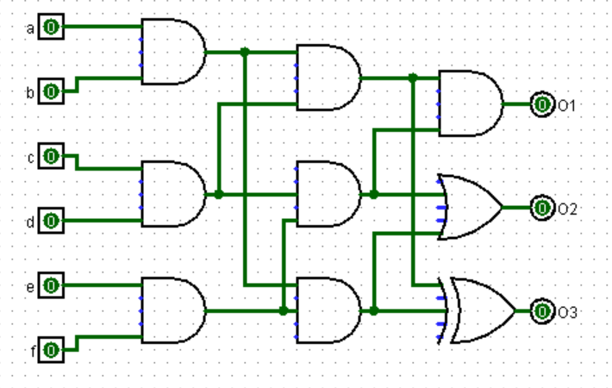
Test 1
Synthesis_log.txt
Synthesis succeeded
(inv) means this output should be inversed, you may add an inverter or simply integrate the inversion to the operator of a node, for example, change the operator of node 14 from OR(tt=14) to NOR(tt=1). Note that this is not applicable if both inversed and none-inversed output of this node are required by another node or an output, for example:
Outputs: 2
13(inv) 13
Synthesis_result.txt
Truth Table:
0000000000000001
0001000100010001
000000000000111E
Input number: 6
Inputs:
2 3 6
0 1 7
4 5 8
6 7 9
7 8 10
6 8 11
9 10 12
10 11 13
9 11 14
Operators:
14 14 14 14 14 14 10 6 14
Outputs: 3
14(inv) 12(inv) 13
Primitives.txt
7
2
4
6
8
A
C
E
2
2
2
2
2
2
2
Synthesis_settings.txt
6 3 3 9
0 0
0 0
0 0
1 2
2 3
1 3
4 5
5 6
4 6
execute
truth_tables.txt
0000000000000001
0001000100010001
000000000000111E

Slide 5
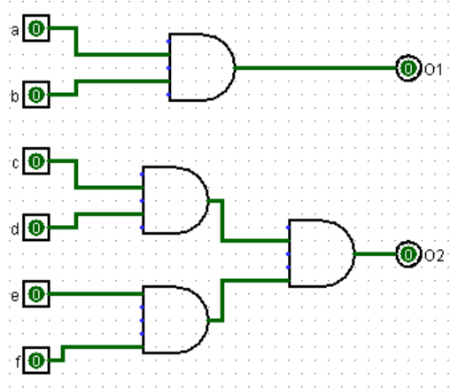
Test 2
Synthesis_log.txt
Synthesis succeeded
Synthesis_result.txt
Truth Table:
000000000000FFFF
0001000100010001
Input number: 6
Inputs:
1 2 6
4 5 7
0 3 8
6 7 9
7 8 10
6 8 11
9 10 12
10 11 13
9 11 14
Operators:
14 14 14 8 10 14 2 10 14
Outputs: 2
13(inv) 14(inv)
Primitives.txt
7
2
4
6
8
A
C
E
2
2
2
2
2
2
2
Synthesis_settings.txt
6 3 2 9
0 0
0 0
0 0
1 2
2 3
1 3
4 5
5 6
4 6
execute
truth_tables.txt
000000000000FFFF
0001000100010001

Slide 6
The synthesizer skips synthesizing trivial functions because they don't need to be synthesized.
if all target functions are trivial, the synthesis_log.txt would say "All functions are trivial" and lists the index of trivial functions.
if some of the target functions are trivial, the synthesis_log.txt would list the index of trivial functions. In synthesis_result.txt, the output of the trivial function will be allocated a 0.

Slide 7
















