Slide 1
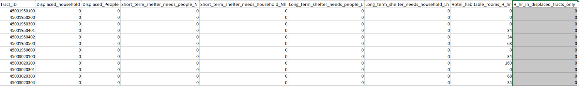
Demand
Adish provides 10 scenarios data (the following is a table for 1 scenario).
I assume the demand distribution follows the Normal Distribution (using sample avg and sample std as parameters). While the realization is less than 0, set it to be 0. (Using short_term_household + long_term_househould)

Slide 2
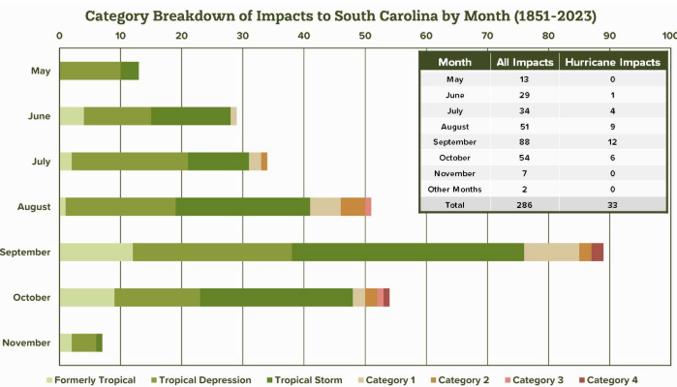
For each month, we treat the number of hurricanes happening in a month as a Poisson distribution, and the mean parameter as number of tract go through SC from 1851.
(ref:https://www.dnr.sc.gov/climate/sco/hurricanes/pdfs/SCHurricanesExecutiveSummary.pdf)

