Slide 1
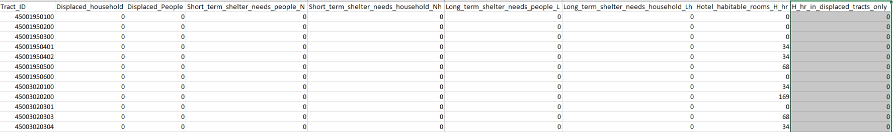
Demand
Adish provides 10 scenarios data in tract-level (the following is a table for 1 scenario).
I assume the demand distribution follows the Normal Distribution (using sample avg and sample std as parameters). While the realization is less than 0, set it to be 0. (Using short_term_household + long_term_househould)

Slide 2
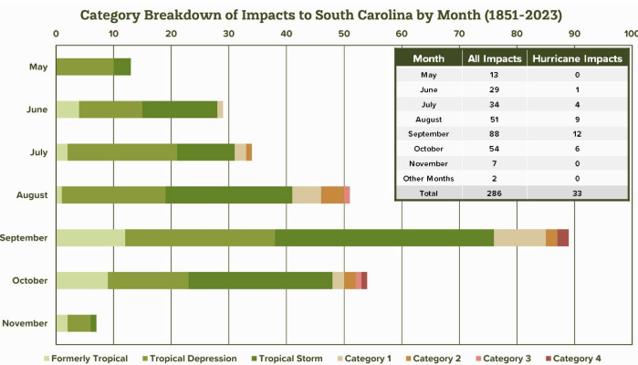
Demand
For each month, we treat the number of hurricanes happening in a month as a Poisson distribution, and the mean parameter as number of tract go through SC from 1851.
(ref:https://www.dnr.sc.gov/climate/sco/hurricanes/pdfs/SCHurricanesExecutiveSummary.pdf)

Slide 3
Demand
[1] Poverty Level
HDPulse: An Ecosystem of Minority Health and Health Disparities Resources. National Institute on Minority Health and Health Disparities. Created 4/8/2024. Available from https://hdpulse.nimhd.nih.gov
[2] Household Structure
U.S. Census Bureau. "Selected Social Characteristics in the United States." American Community Survey, ACS 5-Year Estimates Data Profiles, Table DP02, 2022, https://data.census.gov/table/ACSDP5Y2022.DP02?q=family&g=040XX00US45,45$0500000&moe=false&tp=false. Accessed on April 8, 2024.
Household Type:
  Attributes
    Couple/Single
    w/o Children under 18yr
    Ages 65
    Household under Poverty Level
The percentage structure of attributes 1,2,3 in each county can be found in [2]. The organized data can be found in excel Household_structure. Each column is defined by:
The percentage of attribute 4 can be found in [1].

Slide 4
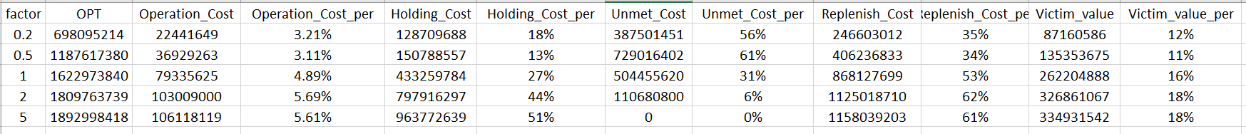
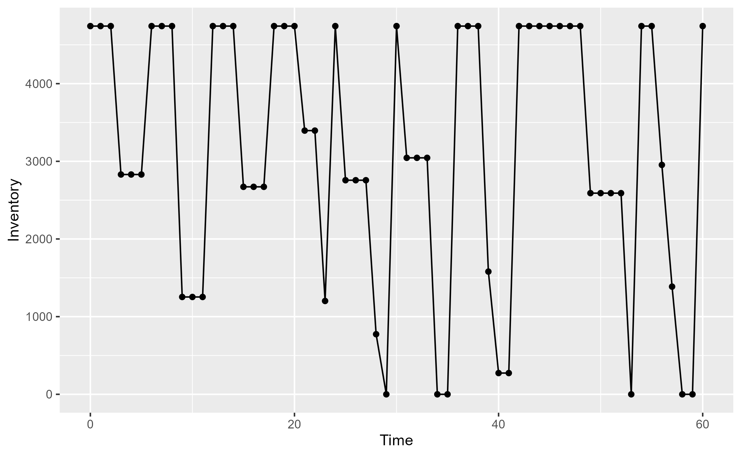
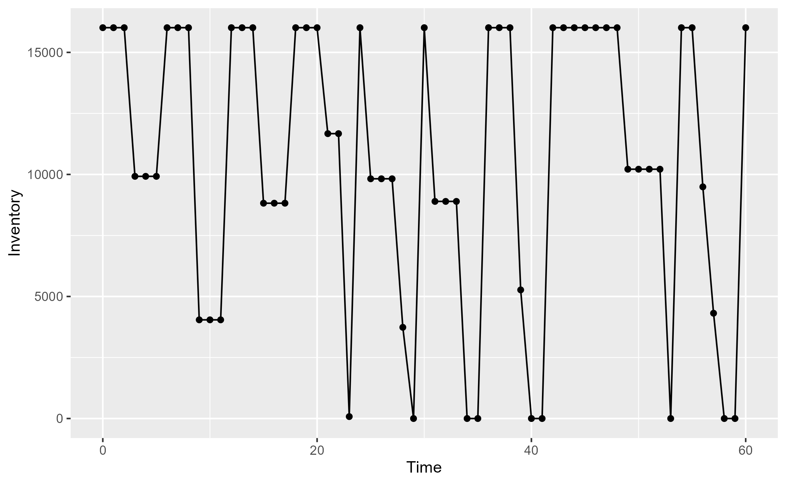
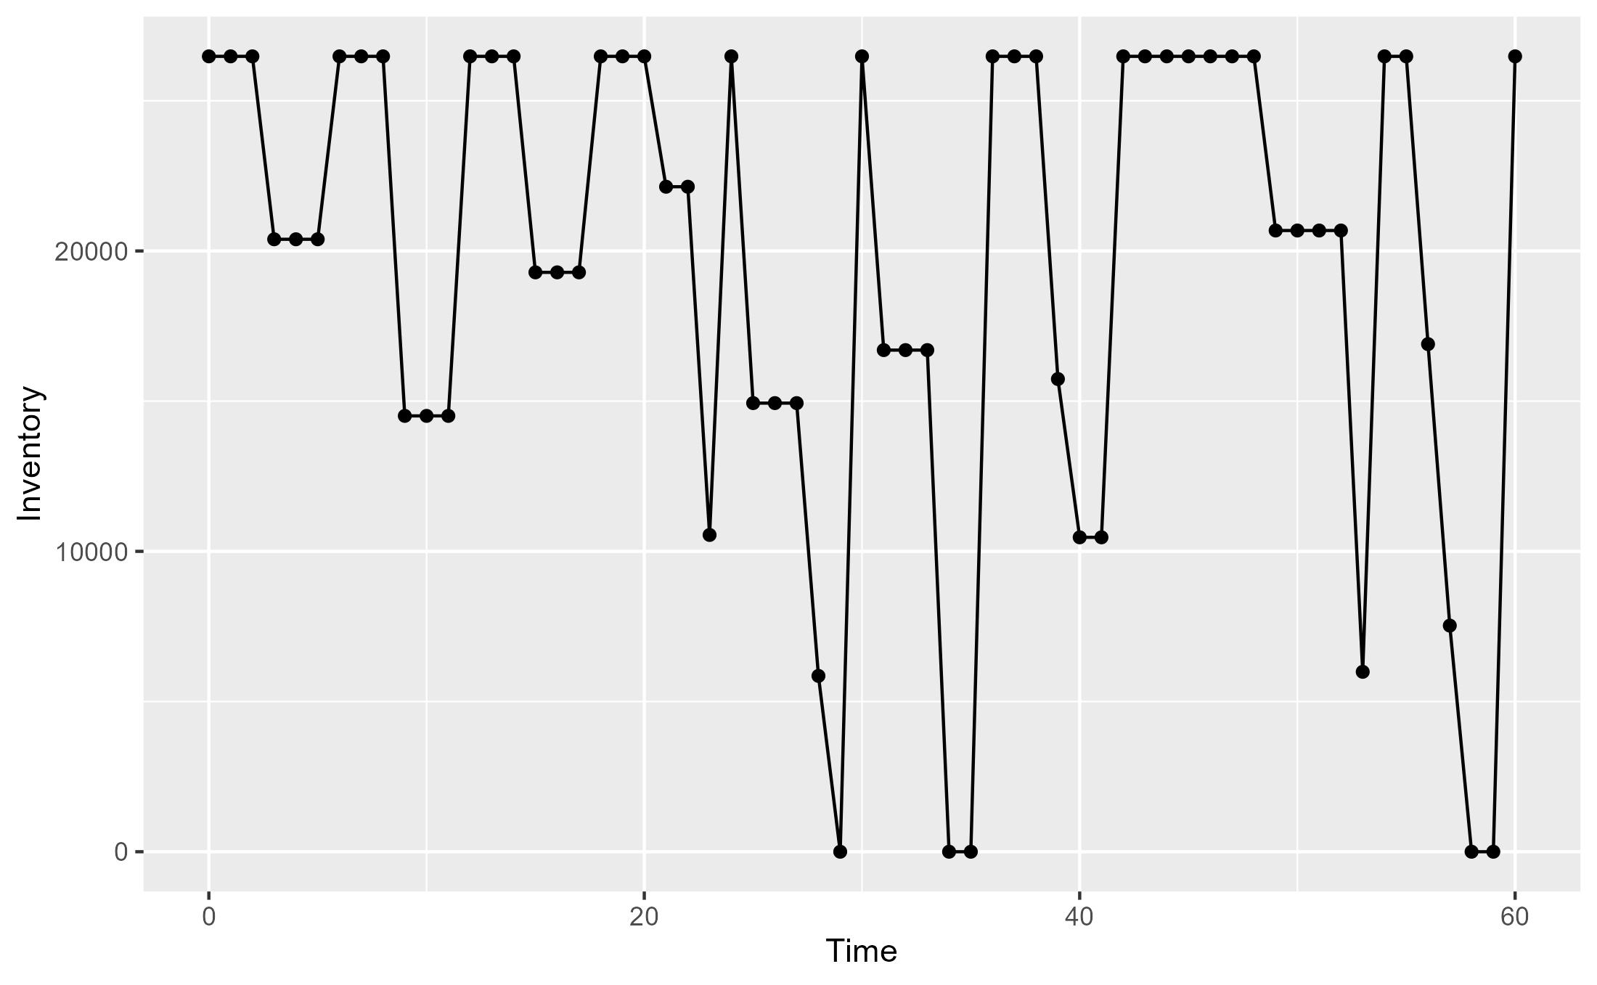
Result
Unmet_Shortage
Factor: 0.2
Factor: 1
Factor: 2

