Slide 1
HW3
Yichen Sheng

Slide 2
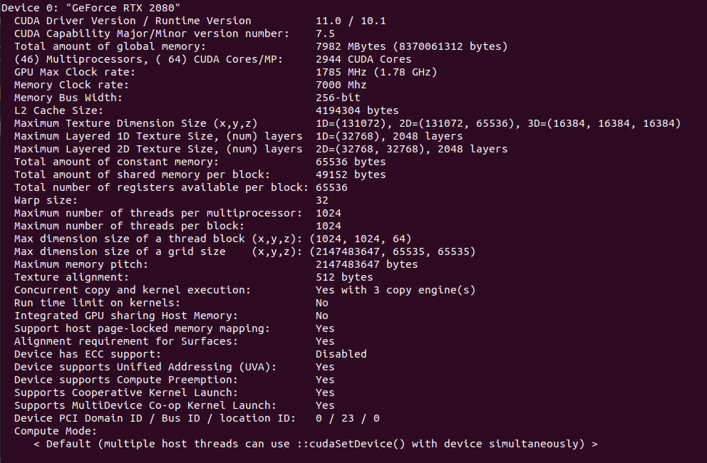
Device

Slide 3
Experiments
Vector add:
vector size range: [2^7, 2^28]
uniformly sample
# of samples: 20
Bonus comparisions:
fixed (grid, thread) v.s. dynamic (grid, thread)

Slide 4
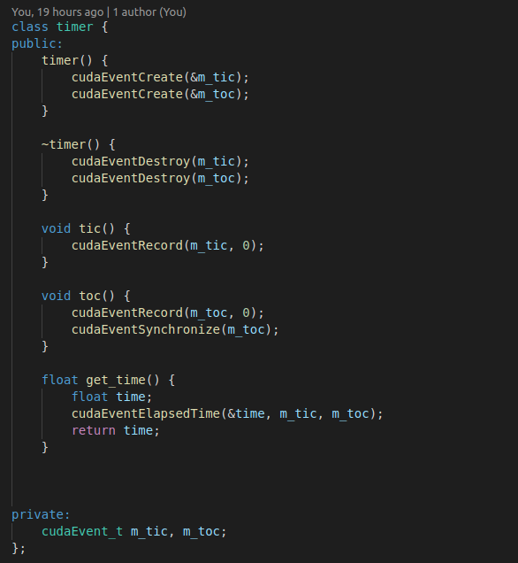
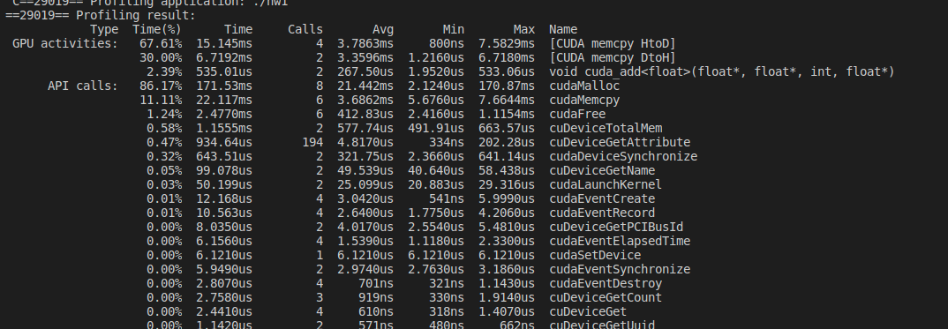
Codes
Cuda timer
Note:
For avg performance, use nvprof command.

Slide 5
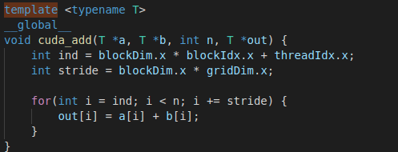
Codes

Slide 6
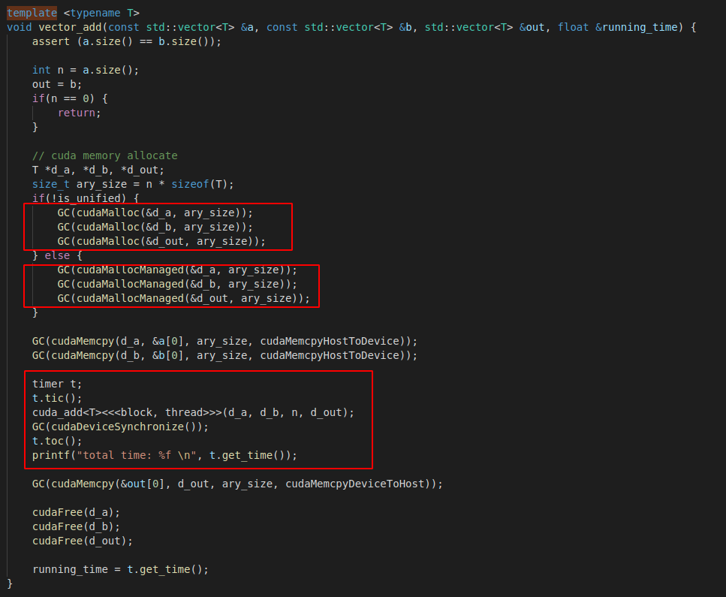
Codes
Different memory type
Note: no need for unified memory.

Slide 7
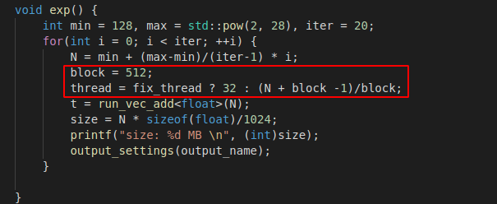
Codes

Slide 8
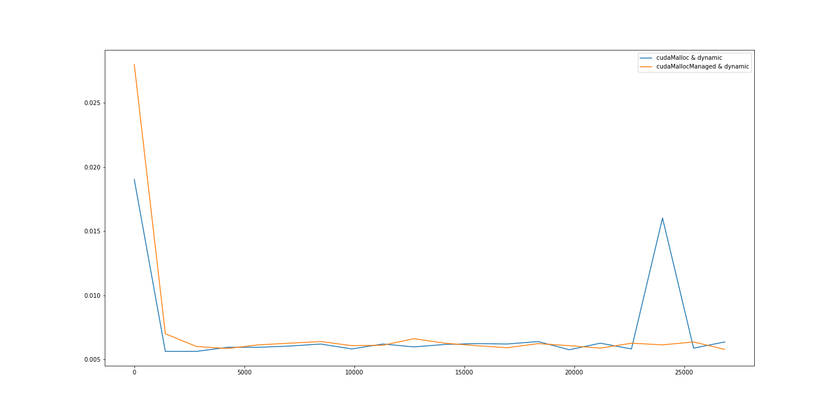
Results & Conclusions
Dynamic assinged threads:
No big difference.
Unified memory a "little" slower.

Slide 9
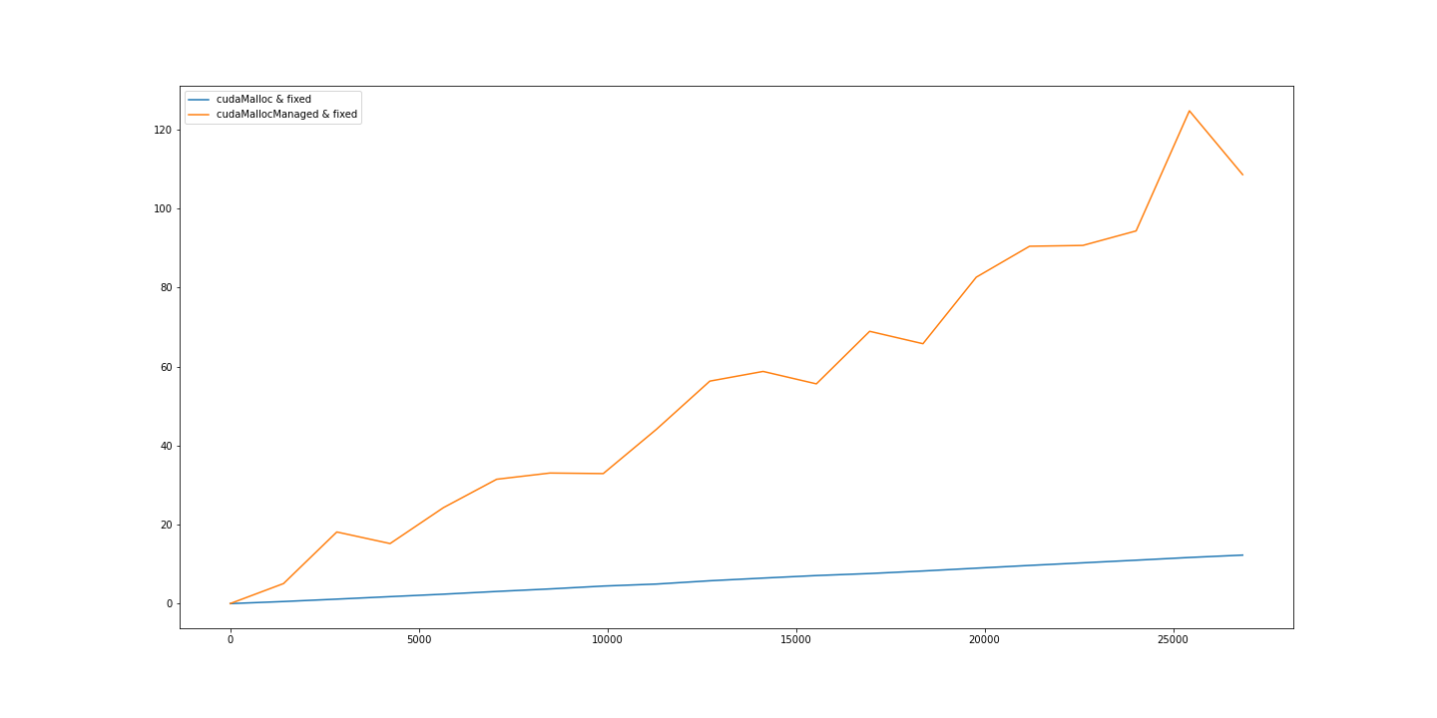
Results & Conclusions
Fixed threads:
Unified memory is much slower.
Relative difference grows larger when the size of array grows.

