Slide 1
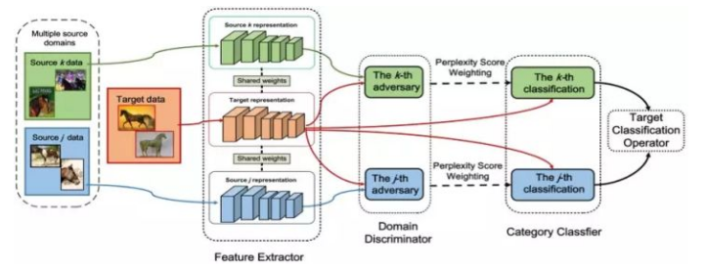
DCTN
Needs (in our cases) :
Feature Extractor * 1
Domain Discriminator * 3
Category Classifier * 3
How to train :
Put target images into Fix Feature Extractor
Set perplexity scores weighting are 1/3 for each classifier
Put Features into three Category Classifiers and get the predict labels
Pseudo predict labels = sum (each perplexity score * each predict labels)
Put Source images and Target images into Feature Extractor and get Features
For each Category Classifiers : concatenate each source features with target features and get predict labels , count loss and train with predict labels and ground truth labels(target’s ground truth labels are the pseudo labels)
Put Source images and Target images into Feature Extractor again and get Features
Put Features into each Discriminators and get weight loss , and train the discriminators
Recomputing perplexity scores weighting by weight loss

Slide 2
DCTN
How to use :
Put Target images into Feature Extractor to get Features
Put Features into each Category Classifiers to get Predict labels
Summary Predict labels = sum(each domain’s perplexity score weight * each predict labels)
Problems in this case :
Training in this algorithm takes a lot of time (one epoch may takes one day)
Performance is not good in this case (need to tune the training skills about discriminators)
Conclusion :
We do implement this algorithm , but we give up due to the time consuming training .
We learn a new approach to solve the MDA problem and know the pro and cons by implementing this DCTN model .

