Slide 1
Introduction
Lecture slides for Chapter 1 of Deep Learning
www.deeplearningbook.org
Ian Goodfellow
2016-09-26

Slide 2
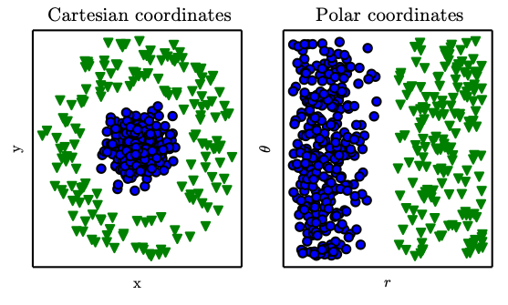
Representations Matter
Figure 1.1

Slide 3
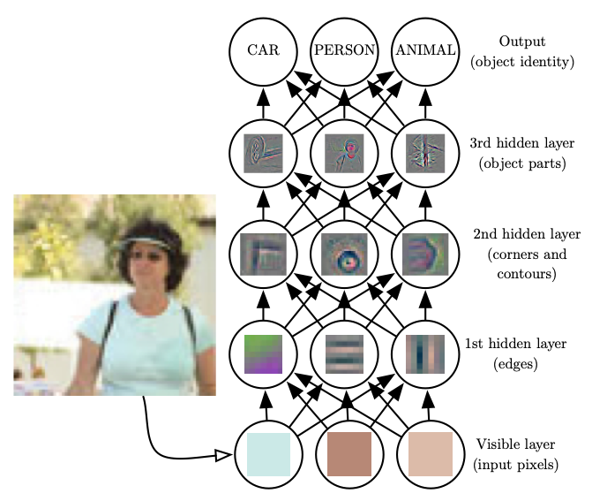
Depth: Repeated Composition
Figure 1.2

Slide 4
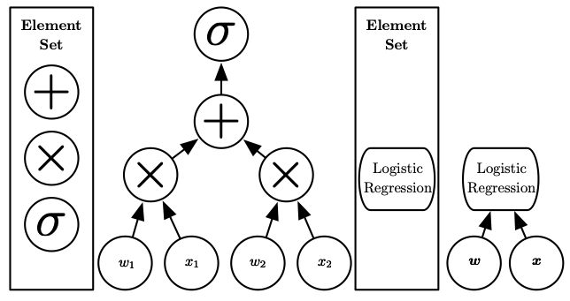
Computational Graphs
Figure 1.3

Slide 5
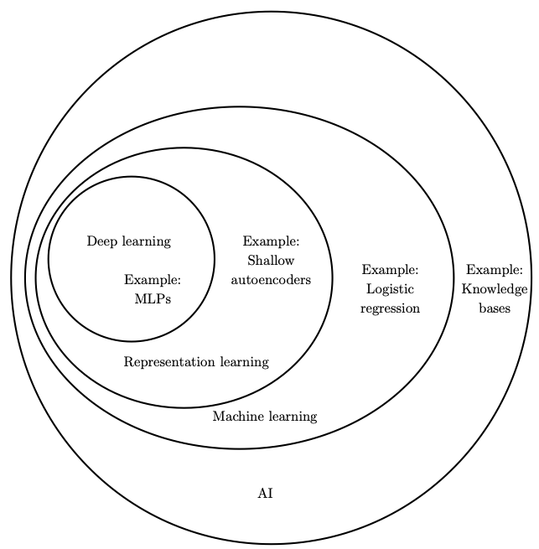
Machine Learning and AI
Figure 1.4

Slide 6
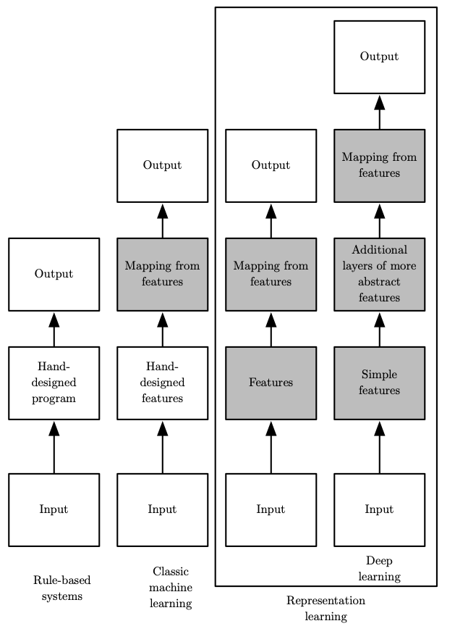
Learning Multiple Components
Figure 1.5

Slide 7
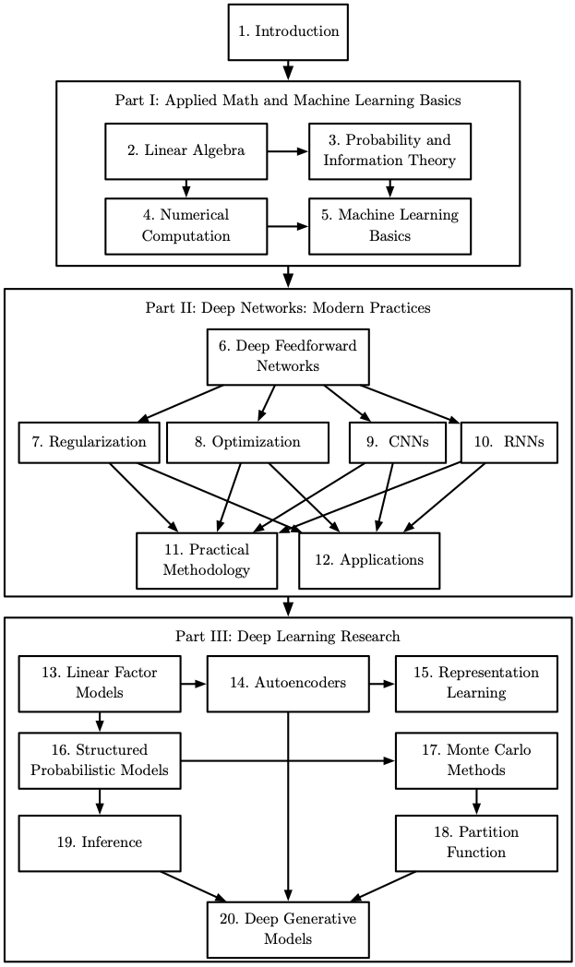
Organization of the Book
Figure 1.6

Slide 8
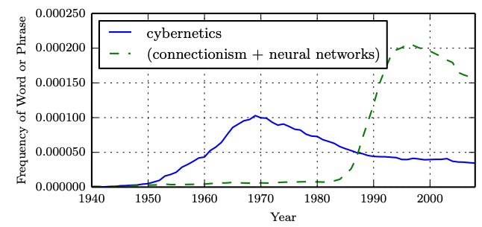
Historical Waves
Figure 1.7

Slide 9
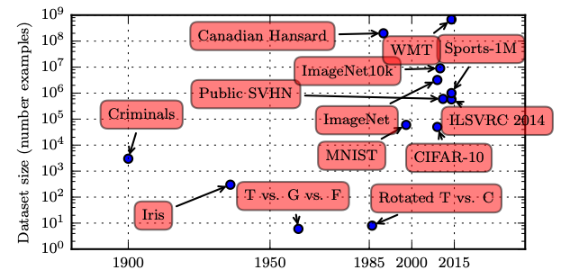
Historical Trends: Growing Datasets
Figure 1.8

Slide 10
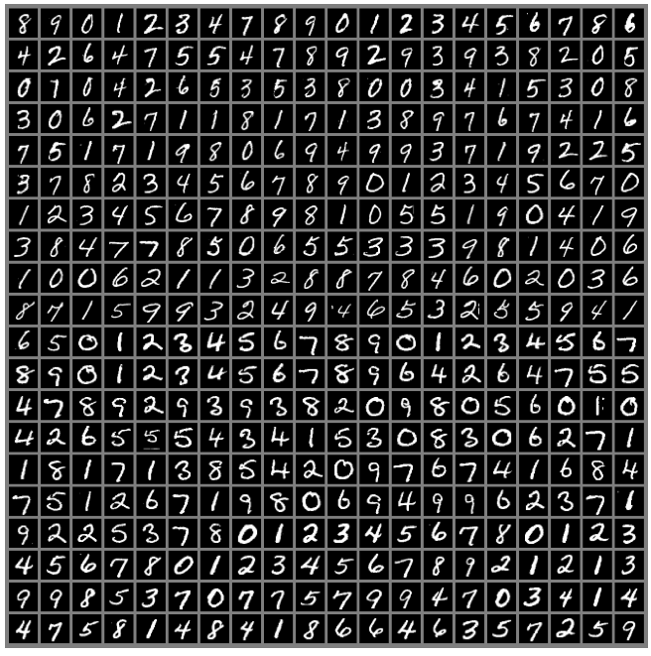
The MNIST Dataset
Figure 1.9

Slide 11
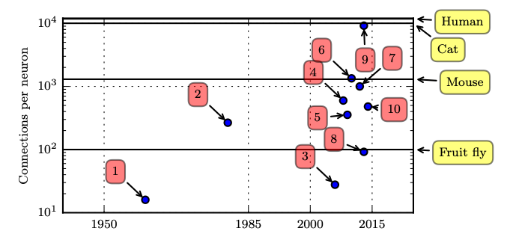
Connections per Neuron
Figure 1.10

Slide 12
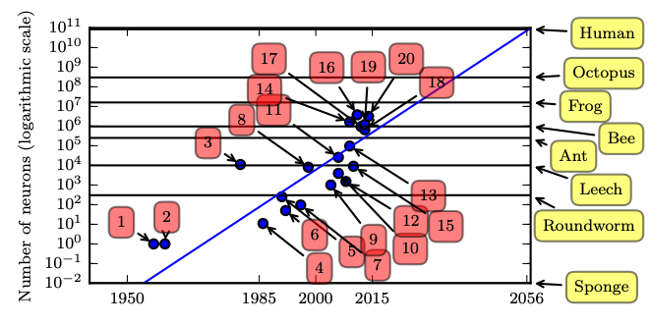
Number of Neurons
Figure 1.11

Slide 13
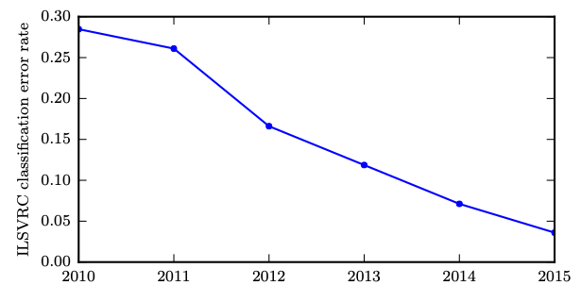
Solving Object Recognition
Figure 1.12

