Slide 1
Probability and Information Theory
Lecture slides for Chapter 3 of Deep Learning
www.deeplearningbook.org
Ian Goodfellow
2016-09-26

Slide 2
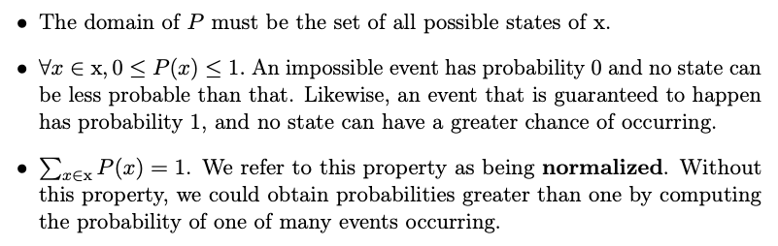

Probability Mass Function
Example: uniform distribution:

Slide 3
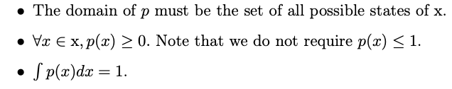

Probability Density Function
Example: uniform distribution:

Slide 4

Computing Marginal Probability with the Sum Rule

Slide 5

Conditional Probability

Slide 6
Chain Rule of Probability

Slide 7
Independence

Slide 8
Conditional Independence

Slide 9


Expectation
linearity of expectations:

Slide 10
Variance and Covariance
Covariance matrix:

Slide 11
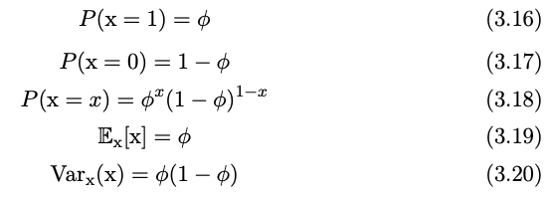
Bernoulli Distribution

Slide 12


Gaussian Distribution
Parametrized by variance:
Parametrized by precision:

Slide 13
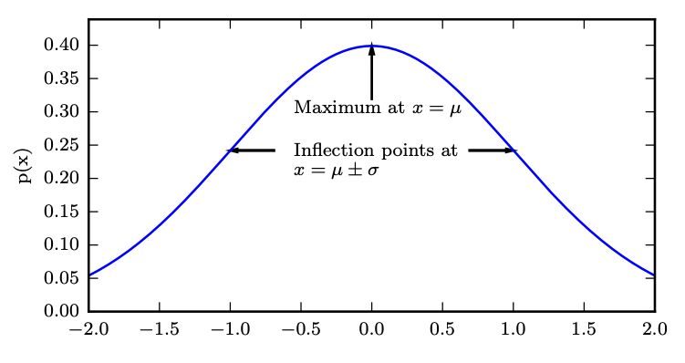
Gaussian Distribution
Figure 3.1

Slide 14


Multivariate Gaussian
Parametrized by covariance matrix:
Parametrized by precision matrix:

Slide 15

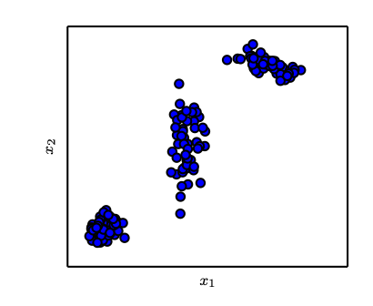
Mixture Distributions
Gaussian mixture with three components
Figure 3.2

Slide 16
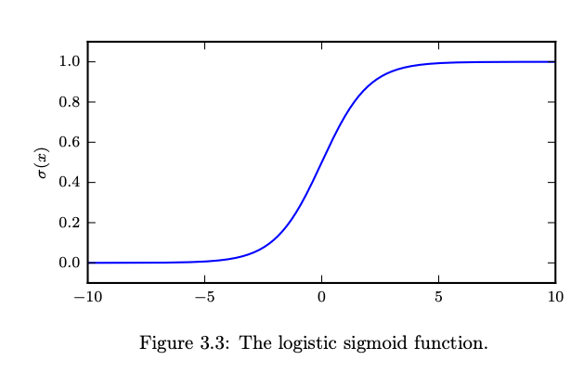
Logistic Sigmoid
Commonly used to parametrize Bernoulli distributions

Slide 17
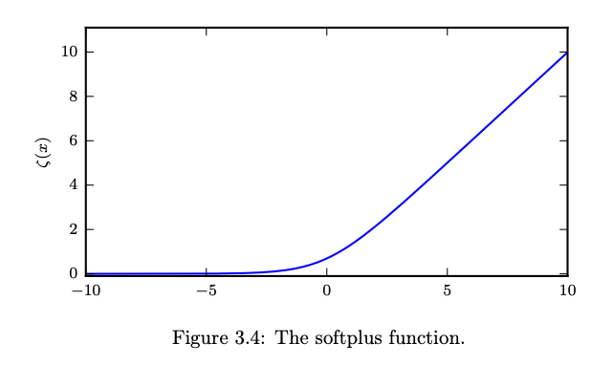
Softplus Function

Slide 18

Bayes’ Rule

Slide 19

Information Theory
Information:
Entropy:
KL divergence:

Slide 20
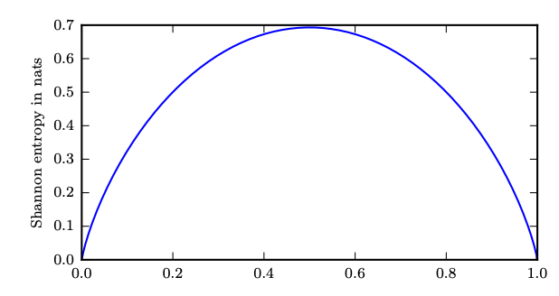
Entropy of a Bernoulli Variable
Bernoulli parameter
Figure 3.5

Slide 21
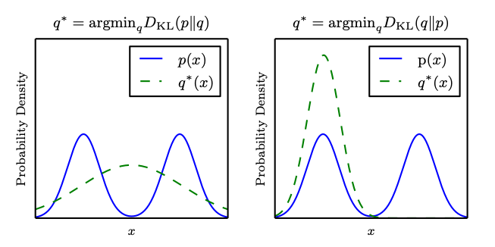
The KL Divergence is Asymmetric
Figure 3.6

Slide 22
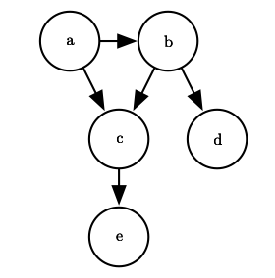
Directed Model
Figure 3.7

