Slide 2
One more thing: Transfer Learning
“You need a lot of a data if you want to train/use CNNs”

Slide 3
One more thing: Transfer Learning
BUSTED
“You need a lot of a data if you want to train/use CNNs”

Slide 4
Transfer Learning with CNNs
Donahue et al, “DeCAF: A Deep Convolutional Activation Feature for Generic Visual Recognition”, ICML 2014 Razavian et al, “CNN Features Off-the-Shelf: An Astounding Baseline for Recognition”, CVPR Workshops 2014
1. Train on Imagenet
FC-1000
FC-4096
FC-4096
MaxPool
Conv-512
Conv-512
MaxPool
Conv-512
Conv-512
MaxPool
Conv-256
Conv-256
MaxPool
Conv-128
Conv-128
MaxPool
Conv-64
Conv-64
Image

Slide 5

Transfer Learning with CNNs
Donahue et al, “DeCAF: A Deep Convolutional Activation Feature for Generic Visual Recognition”, ICML 2014 Razavian et al, “CNN Features Off-the-Shelf: An Astounding Baseline for Recognition”, CVPR Workshops 2014
1. Train on Imagenet
2. Small Dataset (C classes)
FC-1000
FC-4096
FC-4096
 | FC-C
 | FC-4096
 | FC-4096
Reinitialize this and train
MaxPool
Conv-512
Conv-512
MaxPool
Conv-512
Conv-512
MaxPool
Conv-512
Conv-512
MaxPool
Conv-512
Conv-512
MaxPool
Conv-256
Conv-256
MaxPool
Conv-256
Conv-256
Freeze these
MaxPool
Conv-128
Conv-128
MaxPool
Conv-128
Conv-128
MaxPool
Conv-64
Conv-64
MaxPool
Conv-64
Conv-64
Image
Image

Slide 6
Transfer Learning with CNNs
Donahue et al, “DeCAF: A Deep Convolutional Activation Feature for Generic Visual Recognition”, ICML 2014 Razavian et al, “CNN Features Off-the-Shelf: An Astounding Baseline for Recognition”, CVPR Workshops 2014
3. Bigger dataset
1. Train on Imagenet
2. Small Dataset (C classes)
FC-1000
FC-4096
FC-4096
 | FC-C
 | FC-4096
 | FC-4096
FC-C
FC-4096
FC-4096
Reinitialize this and train
Train these
MaxPool
Conv-512
Conv-512
MaxPool
Conv-512
Conv-512
MaxPool
Conv-512
With bigger dataset, train more layers
Conv-512
MaxPool
Conv-512
Conv-512
MaxPool
Conv-512
Conv-512
MaxPool
Conv-512
Conv-512
MaxPool
Conv-256
Conv-256
MaxPool
Conv-256
Conv-256
Freeze these
MaxPool
Conv-256
Conv-256
Freeze these
Lower learning rate when finetuning; 1/10 of original LR is good starting point
MaxPool
Conv-128
Conv-128
MaxPool
Conv-128
Conv-128
MaxPool
Conv-128
Conv-128
MaxPool
Conv-64
Conv-64
MaxPool
Conv-64
Conv-64
MaxPool
Conv-64
Conv-64
Image
Image
Image

Slide 7
 | very similar dataset | very different dataset
very little data | ? | ?
quite a lot of data | ? | ?
FC-1000
FC-4096
FC-4096
MaxPool
Conv-512
Conv-512
MaxPool
Conv-512
Conv-512
More specific
More generic
MaxPool
Conv-256
Conv-256
MaxPool
Conv-128
Conv-128
MaxPool
Conv-64
Conv-64
Image

Slide 8
 | very similar dataset | very different dataset
very little data | Use Linear Classifier on top layer | ?
quite a lot of data | Finetune a few layers | ?
FC-1000
FC-4096
FC-4096
MaxPool
Conv-512
Conv-512
MaxPool
Conv-512
Conv-512
More specific
More generic
MaxPool
Conv-256
Conv-256
MaxPool
Conv-128
Conv-128
MaxPool
Conv-64
Conv-64
Image

Slide 9
 | very similar dataset | very different dataset
very little data | Use Linear Classifier on top layer | You’re in trouble… Try linear classifier from different stages
quite a lot of data | Finetune a few layers | Finetune a larger number of layers
FC-1000
FC-4096
FC-4096
MaxPool
Conv-512
Conv-512
MaxPool
Conv-512
Conv-512
More specific
More generic
MaxPool
Conv-256
Conv-256
MaxPool
Conv-128
Conv-128
MaxPool
Conv-64
Conv-64
Image

Slide 10
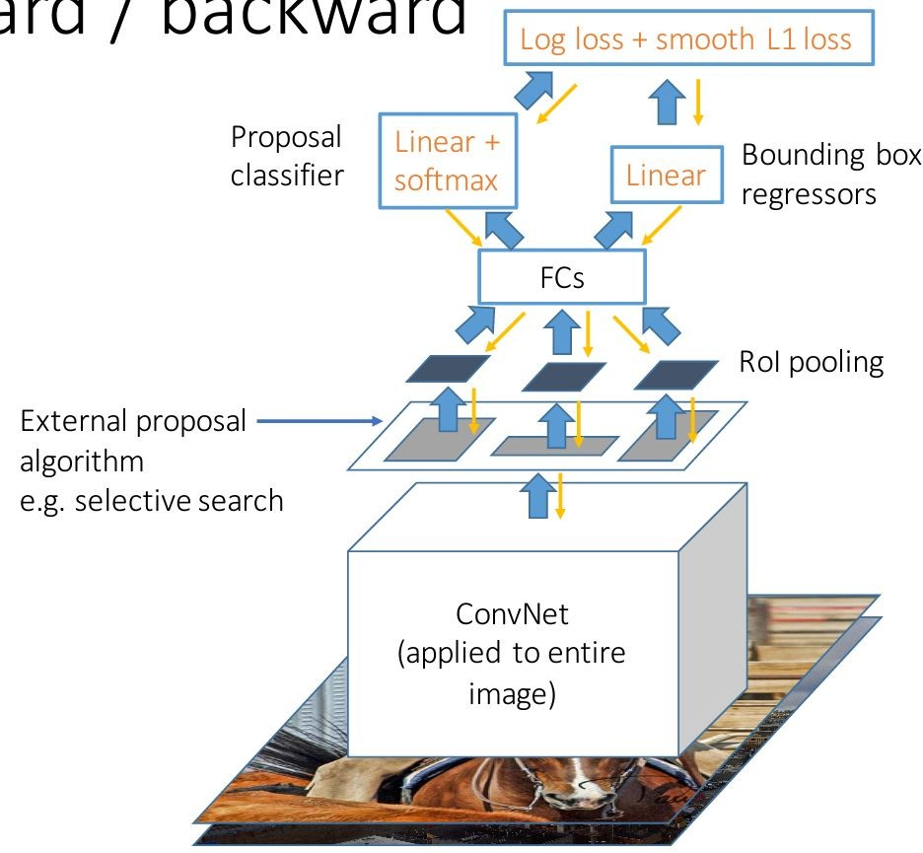
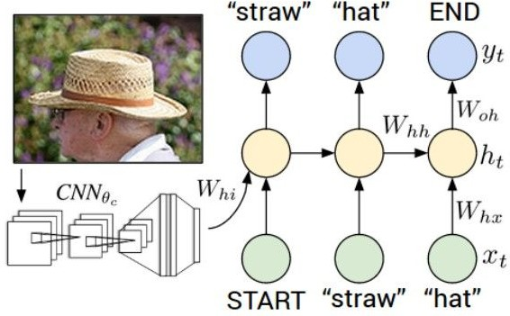
Transfer learning with CNNs is pervasive…
(it’s the norm, not an exception)
Object Detection
(Fast R-CNN)
Image Captioning: CNN + RNN
Karpathy and Fei-Fei, “Deep Visual-Semantic Alignments for Generating Image Descriptions”, CVPR 2015
Figure copyright IEEE, 2015. Reproduced for educational purposes.
Girshick, “Fast R-CNN”, ICCV 2015
Figure copyright Ross Girshick, 2015. Reproduced with permission.

Slide 11
Transfer learning with CNNs is pervasive…
(it’s the norm, not an exception)
Object Detection
CNN pretrained on ImageNet
(Fast R-CNN)
Image Captioning: CNN + RNN
Karpathy and Fei-Fei, “Deep Visual-Semantic Alignments for Generating Image Descriptions”, CVPR 2015
Figure copyright IEEE, 2015. Reproduced for educational purposes.
Girshick, “Fast R-CNN”, ICCV 2015
Figure copyright Ross Girshick, 2015. Reproduced with permission.

Slide 12
Transfer learning with CNNs is pervasive…
(it’s the norm, not an exception)
Object Detection
CNN pretrained on ImageNet
(Fast R-CNN)
Image Captioning: CNN + RNN
Word vectors pretrained
with word2vec
Karpathy and Fei-Fei, “Deep Visual-Semantic Alignments for Generating Image Descriptions”, CVPR 2015
Figure copyright IEEE, 2015. Reproduced for educational purposes.
Girshick, “Fast R-CNN”, ICCV 2015
Figure copyright Ross Girshick, 2015. Reproduced with permission.

Slide 13
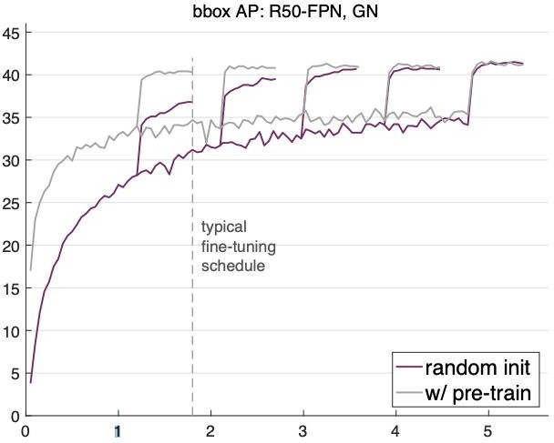
Transfer learning with CNNs is pervasive…
But recent results show it might not always be necessary!
He et al, “Rethinking ImageNet Pre-training”, arXiv 2018

Slide 14
Takeaway for your projects and beyond:
Have some dataset of interest but it has < ~1M images?
Find a very large dataset that has similar data, train a big ConvNet there
Transfer learn to your dataset
Deep learning frameworks provide a “Model Zoo” of pretrained models so you don’t need to train your own
TensorFlow: https://github.com/tensorflow/models PyTorch: https://github.com/pytorch/vision

Slide 15
Today: CNN Architectures
Case Studies
AlexNet
VGG
GoogLeNet
ResNet
Also....
SENet
NiN (Network in Network)
Wide ResNet
ResNeXT
DenseNet
FractalNet
MobileNets
NASNet

Slide 16
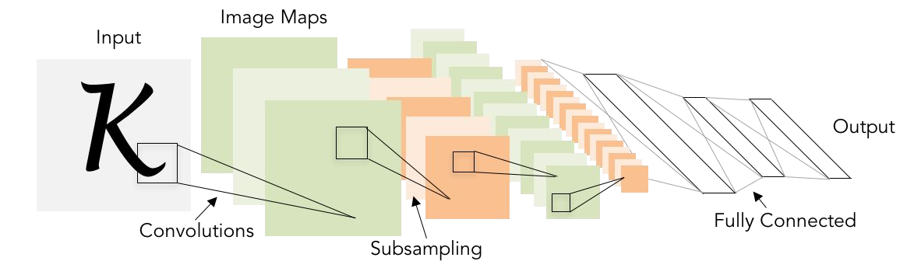
Review: LeNet-5
[LeCun et al., 1998]
Conv filters were 5x5, applied at stride 1
Subsampling (Pooling) layers were 2x2 applied at stride 2
i.e. architecture is [CONV-POOL-CONV-POOL-FC-FC]

Slide 17
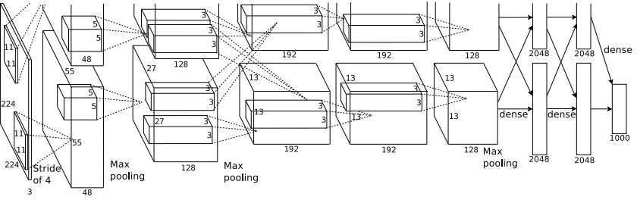
Case Study: AlexNet
[Krizhevsky et al. 2012]
Architecture:
CONV1 MAX POOL1 NORM1 CONV2 MAX POOL2 NORM2 CONV3 CONV4 CONV5
Max POOL3 FC6
FC7 FC8
Figure copyright Alex Krizhevsky, Ilya Sutskever, and Geoffrey Hinton, 2012. Reproduced with permission.

Slide 18
Case Study: AlexNet
[Krizhevsky et al. 2012]
Input: 227x227x3 images
First layer (CONV1): 96 11x11 filters applied at stride 4
=>
Q: what is the output volume size? Hint: (227-11)/4+1 = 55
Figure copyright Alex Krizhevsky, Ilya Sutskever, and Geoffrey Hinton, 2012. Reproduced with permission.

Slide 19
Case Study: AlexNet
[Krizhevsky et al. 2012]
Input: 227x227x3 images
First layer (CONV1): 96 11x11 filters applied at stride 4
=>
Output volume [55x55x96]
Q: What is the total number of parameters in this layer?
Figure copyright Alex Krizhevsky, Ilya Sutskever, and Geoffrey Hinton, 2012. Reproduced with permission.

Slide 20
Case Study: AlexNet
[Krizhevsky et al. 2012]
Input: 227x227x3 images
First layer (CONV1): 96 11x11 filters applied at stride 4
=>
Output volume [55x55x96]
Parameters: (11*11*3)*96 = 35K
Figure copyright Alex Krizhevsky, Ilya Sutskever, and Geoffrey Hinton, 2012. Reproduced with permission.

Slide 21
Case Study: AlexNet
[Krizhevsky et al. 2012]
Input: 227x227x3 images After CONV1: 55x55x96
Second layer (POOL1): 3x3 filters applied at stride 2 Q: what is the output volume size? Hint: (55-3)/2+1 = 27
Figure copyright Alex Krizhevsky, Ilya Sutskever, and Geoffrey Hinton, 2012. Reproduced with permission.

Slide 22
Case Study: AlexNet
[Krizhevsky et al. 2012]
Input: 227x227x3 images After CONV1: 55x55x96
Second layer (POOL1): 3x3 filters applied at stride 2 Output volume: 27x27x96
Q: what is the number of parameters in this layer?
Figure copyright Alex Krizhevsky, Ilya Sutskever, and Geoffrey Hinton, 2012. Reproduced with permission.

Slide 23
Case Study: AlexNet
[Krizhevsky et al. 2012]
Input: 227x227x3 images After CONV1: 55x55x96
Second layer (POOL1): 3x3 filters applied at stride 2 Output volume: 27x27x96
Parameters: 0!
Figure copyright Alex Krizhevsky, Ilya Sutskever, and Geoffrey Hinton, 2012. Reproduced with permission.

Slide 24
Case Study: AlexNet
[Krizhevsky et al. 2012]
Input: 227x227x3 images After CONV1: 55x55x96 After POOL1: 27x27x96
...
Figure copyright Alex Krizhevsky, Ilya Sutskever, and Geoffrey Hinton, 2012. Reproduced with permission.

Slide 25
Case Study: AlexNet
[Krizhevsky et al. 2012]
Full (simplified) AlexNet architecture: [227x227x3] INPUT
[55x55x96] CONV1: 96 11x11 filters at stride 4, pad 0 [27x27x96] MAX POOL1: 3x3 filters at stride 2 [27x27x96] NORM1: Normalization layer
[27x27x256] CONV2: 256 5x5 filters at stride 1, pad 2 [13x13x256] MAX POOL2: 3x3 filters at stride 2 [13x13x256] NORM2: Normalization layer [13x13x384] CONV3: 384 3x3 filters at stride 1, pad 1 [13x13x384] CONV4: 384 3x3 filters at stride 1, pad 1 [13x13x256] CONV5: 256 3x3 filters at stride 1, pad 1 [6x6x256] MAX POOL3: 3x3 filters at stride 2
[4096] FC6: 4096 neurons
[4096] FC7: 4096 neurons
[1000] FC8: 1000 neurons (class scores)
Figure copyright Alex Krizhevsky, Ilya Sutskever, and Geoffrey Hinton, 2012. Reproduced with permission.

Slide 26
Case Study: AlexNet
[Krizhevsky et al. 2012]
Full (simplified) AlexNet architecture: [227x227x3] INPUT
[55x55x96] CONV1: 96 11x11 filters at stride 4, pad 0 [27x27x96] MAX POOL1: 3x3 filters at stride 2 [27x27x96] NORM1: Normalization layer
[27x27x256] CONV2: 256 5x5 filters at stride 1, pad 2 [13x13x256] MAX POOL2: 3x3 filters at stride 2 [13x13x256] NORM2: Normalization layer [13x13x384] CONV3: 384 3x3 filters at stride 1, pad 1 [13x13x384] CONV4: 384 3x3 filters at stride 1, pad 1 [13x13x256] CONV5: 256 3x3 filters at stride 1, pad 1 [6x6x256] MAX POOL3: 3x3 filters at stride 2
Details/Retrospectives:
first use of ReLU
used Norm layers (not common anymore)
heavy data augmentation
dropout 0.5
batch size 128
SGD Momentum 0.9
Learning rate 1e-2, reduced by 10 manually when val accuracy plateaus
L2 weight decay 5e-4
[4096] FC6: 4096 neurons
[4096] FC7: 4096 neurons
[1000] FC8: 1000 neurons (class scores)
- 7 CNN ensemble: 18.2% -> 15.4%
Figure copyright Alex Krizhevsky, Ilya Sutskever, and Geoffrey Hinton, 2012. Reproduced with permission.

Slide 27
Case Study: AlexNet
[Krizhevsky et al. 2012]
Full (simplified) AlexNet architecture: [227x227x3] INPUT
[55x55x96] CONV1: 96 11x11 filters at stride 4, pad 0 [27x27x96] MAX POOL1: 3x3 filters at stride 2
[55x55x48] x 2
[27x27x96] NORM1: Normalization layer
[27x27x256] CONV2: 256 5x5 filters at stride 1, pad 2 [13x13x256] MAX POOL2: 3x3 filters at stride 2 [13x13x256] NORM2: Normalization layer [13x13x384] CONV3: 384 3x3 filters at stride 1, pad 1 [13x13x384] CONV4: 384 3x3 filters at stride 1, pad 1 [13x13x256] CONV5: 256 3x3 filters at stride 1, pad 1
Historical note: Trained on GTX 580 GPU with only 3 GB of memory.
Network spread across 2 GPUs, half the neurons (feature maps) on each GPU.
[6x6x256] MAX POOL3: 3x3 filters at stride 2 [4096] FC6: 4096 neurons
[4096] FC7: 4096 neurons
[1000] FC8: 1000 neurons (class scores)
Figure copyright Alex Krizhevsky, Ilya Sutskever, and Geoffrey Hinton, 2012. Reproduced with permission.

Slide 28
Case Study: AlexNet
[Krizhevsky et al. 2012]
Full (simplified) AlexNet architecture: [227x227x3] INPUT
[55x55x96] CONV1: 96 11x11 filters at stride 4, pad 0 [27x27x96] MAX POOL1: 3x3 filters at stride 2 [27x27x96] NORM1: Normalization layer
[27x27x256] CONV2: 256 5x5 filters at stride 1, pad 2 [13x13x256] MAX POOL2: 3x3 filters at stride 2 [13x13x256] NORM2: Normalization layer [13x13x384] CONV3: 384 3x3 filters at stride 1, pad 1 [13x13x384] CONV4: 384 3x3 filters at stride 1, pad 1 [13x13x256] CONV5: 256 3x3 filters at stride 1, pad 1
CONV1, CONV2, CONV4, CONV5:
Connections only with feature maps on same GPU
[6x6x256] MAX POOL3: 3x3 filters at stride 2 [4096] FC6: 4096 neurons
[4096] FC7: 4096 neurons
[1000] FC8: 1000 neurons (class scores)
Figure copyright Alex Krizhevsky, Ilya Sutskever, and Geoffrey Hinton, 2012. Reproduced with permission.

Slide 29
Case Study: AlexNet
[Krizhevsky et al. 2012]
Full (simplified) AlexNet architecture: [227x227x3] INPUT
[55x55x96] CONV1: 96 11x11 filters at stride 4, pad 0 [27x27x96] MAX POOL1: 3x3 filters at stride 2 [27x27x96] NORM1: Normalization layer
[27x27x256] CONV2: 256 5x5 filters at stride 1, pad 2 [13x13x256] MAX POOL2: 3x3 filters at stride 2 [13x13x256] NORM2: Normalization layer [13x13x384] CONV3: 384 3x3 filters at stride 1, pad 1 [13x13x384] CONV4: 384 3x3 filters at stride 1, pad 1 [13x13x256] CONV5: 256 3x3 filters at stride 1, pad 1 [6x6x256] MAX POOL3: 3x3 filters at stride 2
[4096] FC6: 4096 neurons
[4096] FC7: 4096 neurons
[1000] FC8: 1000 neurons (class scores)
CONV3, FC6, FC7, FC8:
Connections with all feature maps in preceding layer, communication across GPUs
Figure copyright Alex Krizhevsky, Ilya Sutskever, and Geoffrey Hinton, 2012. Reproduced with permission.

Slide 30
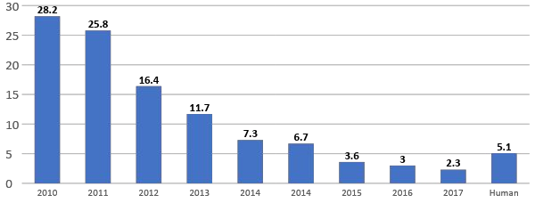
ImageNet Large Scale Visual Recognition Challenge (ILSVRC) winners
152 layers
152 layers
152 layers
19 layers
22 layers
shallow
8 layers
8 layers
Lin et al | Sanchez & | Krizhevsky et al Zeiler & | Simonyan & Szegedy et al | He et al | Shao et al | Hu et al | Russakovsky et al
 | Perronnin | (AlexNet) Fergus | Zisserman (VGG) (GoogLeNet) | (ResNet) |  | (SENet)

Slide 31
ImageNet Large Scale Visual Recognition Challenge (ILSVRC) winners
First CNN-based winner
152 layers
152 layers
152 layers
19 layers
22 layers
shallow
8 layers
8 layers
Lin et al
Sanchez & Perronnin
Krizhevsky et al (AlexNet)
Zeiler & Fergus
Simonyan & Szegedy et al Zisserman (VGG) (GoogLeNet)
He et al (ResNet)
Shao et al
Hu et al (SENet)
Russakovsky et al

Slide 32
ImageNet Large Scale Visual Recognition Challenge (ILSVRC) winners
ZFNet: Improved hyperparameters over AlexNet
152 layers
152 layers
152 layers
19 layers
22 layers
shallow
8 layers
8 layers
Lin et al
Sanchez & Perronnin
Krizhevsky et al (AlexNet)
Zeiler & Fergus
Simonyan & Szegedy et al Zisserman (VGG) (GoogLeNet)
He et al (ResNet)
Shao et al
Hu et al (SENet)
Russakovsky et al

Slide 33
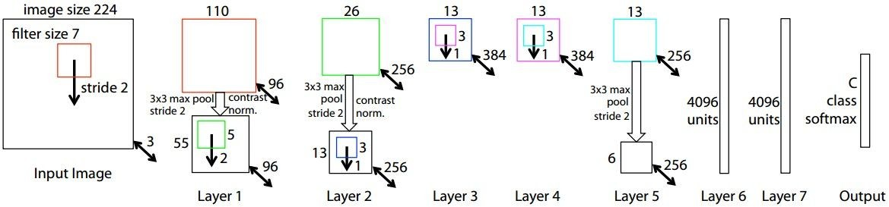
ZFNet
[Zeiler and Fergus, 2013]
AlexNet but:
CONV1: change from (11x11 stride 4) to (7x7 stride 2) CONV3,4,5: instead of 384, 384, 256 filters use 512, 1024, 512
ImageNet top 5 error: 16.4% -> 11.7%

Slide 34
ImageNet Large Scale Visual Recognition Challenge (ILSVRC) winners
Deeper Networks
152 layers
152 layers
152 layers
19 layers
22 layers
shallow
8 layers
8 layers
Lin et al
Sanchez & Perronnin
Krizhevsky et al Zeiler & (AlexNet) Fergus
Simonyan & Szegedy et al Zisserman (VGG) (GoogLeNet)
He et al (ResNet)
Shao et al
Hu et al (SENet)
Russakovsky et al

Slide 35
Case Study: VGGNet
[Simonyan and Zisserman, 2014]
Small filters, Deeper networks
8 layers (AlexNet)
-> 16 - 19 layers (VGG16Net)
Only 3x3 CONV stride 1, pad 1 and 2x2 MAX POOL stride 2
11.7% top 5 error in ILSVRC’13 (ZFNet)
-> 7.3% top 5 error in ILSVRC’14
AlexNet
VGG16
VGG19

Slide 36
Case Study: VGGNet
[Simonyan and Zisserman, 2014]
Q: Why use smaller filters? (3x3 conv)
AlexNet
VGG16
VGG19

Slide 37
Case Study: VGGNet
[Simonyan and Zisserman, 2014]
Q: Why use smaller filters? (3x3 conv)
Stack of three 3x3 conv (stride 1) layers has same effective receptive field as one 7x7 conv layer
Q: What is the effective receptive field of three 3x3 conv (stride 1) layers?
AlexNet
VGG16
VGG19

Slide 38
Case Study: VGGNet
[Simonyan and Zisserman, 2014]
Q: Why use smaller filters? (3x3 conv)
Stack of three 3x3 conv (stride 1) layers has same effective receptive field as one 7x7 conv layer
[7x7]
AlexNet
VGG16
VGG19

Slide 39
Case Study: VGGNet
[Simonyan and Zisserman, 2014]
Q: Why use smaller filters? (3x3 conv)
Stack of three 3x3 conv (stride 1) layers has same effective receptive field as one 7x7 conv layer
But deeper, more non-linearities
And fewer parameters: 3 * (3²C²) vs. 7²C² for C channels per layer
AlexNet
VGG16
VGG19

Slide 40
(not counting biases)
INPUT: [224x224x3] memory: 224*224*3=150K params: 0
CONV3-64: [224x224x64] memory: 224*224*64=3.2M params: (3*3*3)*64 = 1,728 CONV3-64: [224x224x64] memory: 224*224*64=3.2M params: (3*3*64)*64 = 36,864
POOL2: [112x112x64] memory: 112*112*64=800K params: 0
CONV3-128: [112x112x128] memory: 112*112*128=1.6M params: (3*3*64)*128 = 73,728 CONV3-128: [112x112x128] memory: 112*112*128=1.6M params: (3*3*128)*128 = 147,456
POOL2: [56x56x128] memory: 56*56*128=400K params: 0
CONV3-256: [56x56x256] memory: 56*56*256=800K params: (3*3*128)*256 = 294,912 CONV3-256: [56x56x256] memory: 56*56*256=800K params: (3*3*256)*256 = 589,824 CONV3-256: [56x56x256] memory: 56*56*256=800K params: (3*3*256)*256 = 589,824
POOL2: [28x28x256] memory: 28*28*256=200K params: 0
CONV3-512: [28x28x512] memory: 28*28*512=400K params: (3*3*256)*512 = 1,179,648 CONV3-512: [28x28x512] memory: 28*28*512=400K params: (3*3*512)*512 = 2,359,296 CONV3-512: [28x28x512] memory: 28*28*512=400K params: (3*3*512)*512 = 2,359,296
POOL2: [14x14x512] memory: 14*14*512=100K params: 0
CONV3-512: [14x14x512] memory: 14*14*512=100K params: (3*3*512)*512 = 2,359,296 CONV3-512: [14x14x512] memory: 14*14*512=100K params: (3*3*512)*512 = 2,359,296 CONV3-512: [14x14x512] memory: 14*14*512=100K params: (3*3*512)*512 = 2,359,296
POOL2: [7x7x512] memory: 7*7*512=25K params: 0
FC: [1x1x4096] memory: 4096 params: 7*7*512*4096 = 102,760,448 FC: [1x1x4096] memory: 4096 params: 4096*4096 = 16,777,216
FC: [1x1x1000] memory: 1000 params: 4096*1000 = 4,096,000
VGG16

Slide 41
(not counting biases)
INPUT: [224x224x3] memory: 224*224*3=150K params: 0
CONV3-64: [224x224x64] memory: 224*224*64=3.2M params: (3*3*3)*64 = 1,728 CONV3-64: [224x224x64] memory: 224*224*64=3.2M params: (3*3*64)*64 = 36,864
POOL2: [112x112x64] memory: 112*112*64=800K params: 0
CONV3-128: [112x112x128] memory: 112*112*128=1.6M params: (3*3*64)*128 = 73,728 CONV3-128: [112x112x128] memory: 112*112*128=1.6M params: (3*3*128)*128 = 147,456
POOL2: [56x56x128] memory: 56*56*128=400K params: 0
CONV3-256: [56x56x256] memory: 56*56*256=800K params: (3*3*128)*256 = 294,912 CONV3-256: [56x56x256] memory: 56*56*256=800K params: (3*3*256)*256 = 589,824 CONV3-256: [56x56x256] memory: 56*56*256=800K params: (3*3*256)*256 = 589,824
POOL2: [28x28x256] memory: 28*28*256=200K params: 0
CONV3-512: [28x28x512] memory: 28*28*512=400K params: (3*3*256)*512 = 1,179,648 CONV3-512: [28x28x512] memory: 28*28*512=400K params: (3*3*512)*512 = 2,359,296 CONV3-512: [28x28x512] memory: 28*28*512=400K params: (3*3*512)*512 = 2,359,296
POOL2: [14x14x512] memory: 14*14*512=100K params: 0
CONV3-512: [14x14x512] memory: 14*14*512=100K params: (3*3*512)*512 = 2,359,296 CONV3-512: [14x14x512] memory: 14*14*512=100K params: (3*3*512)*512 = 2,359,296 CONV3-512: [14x14x512] memory: 14*14*512=100K params: (3*3*512)*512 = 2,359,296
POOL2: [7x7x512] memory: 7*7*512=25K params: 0
FC: [1x1x4096] memory: 4096 params: 7*7*512*4096 = 102,760,448 FC: [1x1x4096] memory: 4096 params: 4096*4096 = 16,777,216
FC: [1x1x1000] memory: 1000 params: 4096*1000 = 4,096,000
TOTAL memory: 24M * 4 bytes ~= 96MB / image (for a forward pass) TOTAL params: 138M parameters
VGG16

Slide 42
INPUT: [224x224x3] memory: 224*224*3=150K params: 0
CONV3-64: [224x224x64] memory: 224*224*64=3.2M params: (3*3*3)*64 = 1,728 CONV3-64: [224x224x64] memory: 224*224*64=3.2M params: (3*3*64)*64 = 36,864
POOL2: [112x112x64] memory: 112*112*64=800K params: 0
CONV3-128: [112x112x128] memory: 112*112*128=1.6M params: (3*3*64)*128 = 73,728 CONV3-128: [112x112x128] memory: 112*112*128=1.6M params: (3*3*128)*128 = 147,456
POOL2: [56x56x128] memory: 56*56*128=400K params: 0
CONV3-256: [56x56x256] memory: 56*56*256=800K params: (3*3*128)*256 = 294,912 CONV3-256: [56x56x256] memory: 56*56*256=800K params: (3*3*256)*256 = 589,824 CONV3-256: [56x56x256] memory: 56*56*256=800K params: (3*3*256)*256 = 589,824
POOL2: [28x28x256] memory: 28*28*256=200K params: 0
CONV3-512: [28x28x512] memory: 28*28*512=400K params: (3*3*256)*512 = 1,179,648 CONV3-512: [28x28x512] memory: 28*28*512=400K params: (3*3*512)*512 = 2,359,296 CONV3-512: [28x28x512] memory: 28*28*512=400K params: (3*3*512)*512 = 2,359,296
POOL2: [14x14x512] memory: 14*14*512=100K params: 0
CONV3-512: [14x14x512] memory: 14*14*512=100K params: (3*3*512)*512 = 2,359,296 CONV3-512: [14x14x512] memory: 14*14*512=100K params: (3*3*512)*512 = 2,359,296 CONV3-512: [14x14x512] memory: 14*14*512=100K params: (3*3*512)*512 = 2,359,296
POOL2: [7x7x512] memory: 7*7*512=25K params: 0
FC: [1x1x4096] memory: 4096 params: 7*7*512*4096 = 102,760,448
FC: [1x1x4096] memory: 4096 params: 4096*4096 = 16,777,216 FC: [1x1x1000] memory: 1000 params: 4096*1000 = 4,096,000
TOTAL memory: 24M * 4 bytes ~= 96MB / image (only forward! ~*2 for bwd) TOTAL params: 138M parameters
Note:
Most memory is in early CONV
Most params are in late FC

Slide 43
INPUT: [224x224x3] memory: 224*224*3=150K params: 0
CONV3-64: [224x224x64] memory: 224*224*64=3.2M params: (3*3*3)*64 = 1,728 CONV3-64: [224x224x64] memory: 224*224*64=3.2M params: (3*3*64)*64 = 36,864
POOL2: [112x112x64] memory: 112*112*64=800K params: 0
CONV3-128: [112x112x128] memory: 112*112*128=1.6M params: (3*3*64)*128 = 73,728 CONV3-128: [112x112x128] memory: 112*112*128=1.6M params: (3*3*128)*128 = 147,456
POOL2: [56x56x128] memory: 56*56*128=400K params: 0
CONV3-256: [56x56x256] memory: 56*56*256=800K params: (3*3*128)*256 = 294,912 CONV3-256: [56x56x256] memory: 56*56*256=800K params: (3*3*256)*256 = 589,824 CONV3-256: [56x56x256] memory: 56*56*256=800K params: (3*3*256)*256 = 589,824
POOL2: [28x28x256] memory: 28*28*256=200K params: 0
CONV3-512: [28x28x512] memory: 28*28*512=400K params: (3*3*256)*512 = 1,179,648 CONV3-512: [28x28x512] memory: 28*28*512=400K params: (3*3*512)*512 = 2,359,296 CONV3-512: [28x28x512] memory: 28*28*512=400K params: (3*3*512)*512 = 2,359,296
POOL2: [14x14x512] memory: 14*14*512=100K params: 0
CONV3-512: [14x14x512] memory: 14*14*512=100K params: (3*3*512)*512 = 2,359,296 CONV3-512: [14x14x512] memory: 14*14*512=100K params: (3*3*512)*512 = 2,359,296 CONV3-512: [14x14x512] memory: 14*14*512=100K params: (3*3*512)*512 = 2,359,296
POOL2: [7x7x512] memory: 7*7*512=25K params: 0
FC: [1x1x4096] memory: 4096 params: 7*7*512*4096 = 102,760,448 FC: [1x1x4096] memory: 4096 params: 4096*4096 = 16,777,216
FC: [1x1x1000] memory: 1000 params: 4096*1000 = 4,096,000
TOTAL memory: 24M * 4 bytes ~= 96MB / image (only forward! ~*2 for bwd) TOTAL params: 138M parameters
VGG16
Common names

Slide 44
Case Study: VGGNet
[Simonyan and Zisserman, 2014]
Details:
ILSVRC’14 2nd in classification, 1st in localization
Similar training procedure as Krizhevsky 2012
No Local Response Normalisation (LRN)
Use VGG16 or VGG19 (VGG19 only slightly better, more memory)
Use ensembles for best results
FC7 features generalize well to other tasks
AlexNet
VGG16
VGG19

Slide 45
ImageNet Large Scale Visual Recognition Challenge (ILSVRC) winners
Deeper Networks
152 layers
152 layers
152 layers
19 layers
22 layers
shallow
8 layers
8 layers
Lin et al
Sanchez & Perronnin
Krizhevsky et al Zeiler & (AlexNet) Fergus
Simonyan & Szegedy et al Zisserman (VGG) (GoogLeNet)
He et al (ResNet)
Shao et al
Hu et al (SENet)
Russakovsky et al

Slide 46
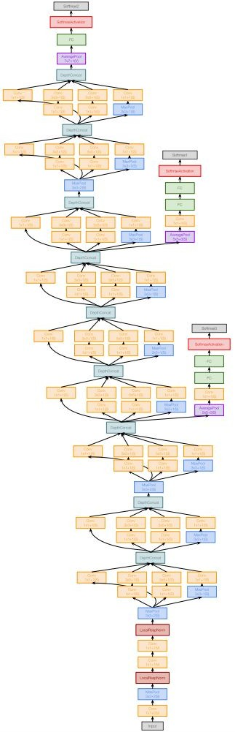
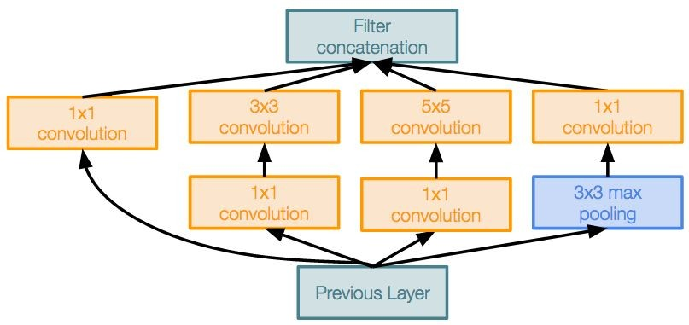
Case Study: GoogLeNet
[Szegedy et al., 2014]
Deeper networks, with computational efficiency
22 layers
Efficient “Inception” module
No FC layers
Only 5 million parameters!
12x less than AlexNet
ILSVRC’14 classification winner (6.7% top 5 error)
Inception module

Slide 47
Case Study: GoogLeNet
[Szegedy et al., 2014]
“Inception module”: design a good local network topology (network within a network) and then stack these modules on top of each other
Inception module

Slide 48
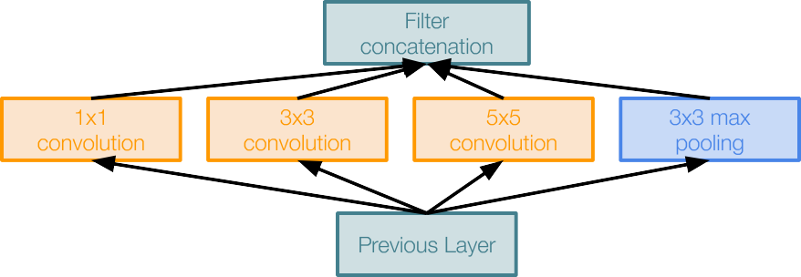
Case Study: GoogLeNet
[Szegedy et al., 2014]
Apply parallel filter operations on the input from previous layer:
Multiple receptive field sizes for convolution (1x1, 3x3, 5x5)
Pooling operation (3x3)
Concatenate all filter outputs together depth-wise
Naive Inception module

Slide 49
Case Study: GoogLeNet
[Szegedy et al., 2014]
Apply parallel filter operations on the input from previous layer:
Multiple receptive field sizes for convolution (1x1, 3x3, 5x5)
Pooling operation (3x3)
Concatenate all filter outputs together depth-wise
Naive Inception module
Q: What is the problem with this? [Hint: Computational complexity]

Slide 50
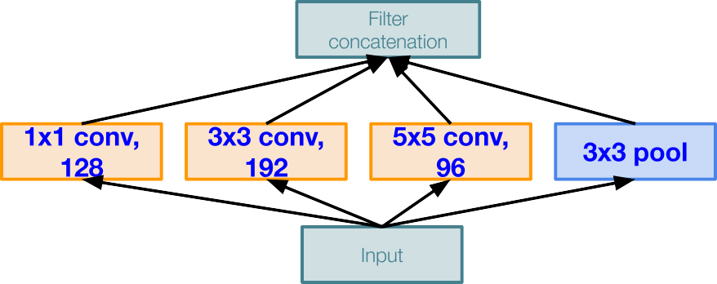
Case Study: GoogLeNet
[Szegedy et al., 2014]
Q: What is the problem with this? [Hint: Computational complexity]
Example:
Module input: 28x28x256
Naive Inception module

Slide 51
Case Study: GoogLeNet
[Szegedy et al., 2014]
Q: What is the problem with this? [Hint: Computational complexity]
Example:
Q1: What is the output size of the 1x1 conv, with 128 filters?
Module input: 28x28x256
Naive Inception module

Slide 52
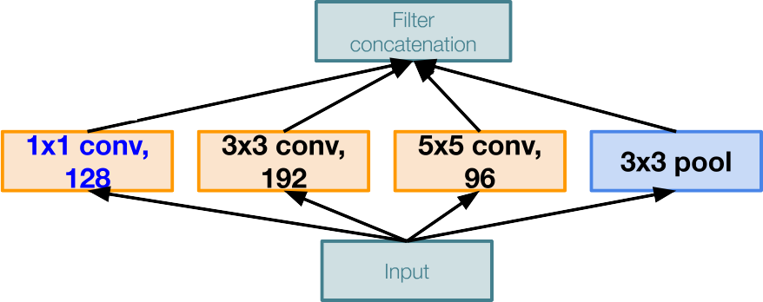
Case Study: GoogLeNet
[Szegedy et al., 2014]
Q: What is the problem with this? [Hint: Computational complexity]
Example:
Q1: What is the output size of the 1x1 conv, with 128 filters?
28x28x128
Module input: 28x28x256
Naive Inception module

Slide 53
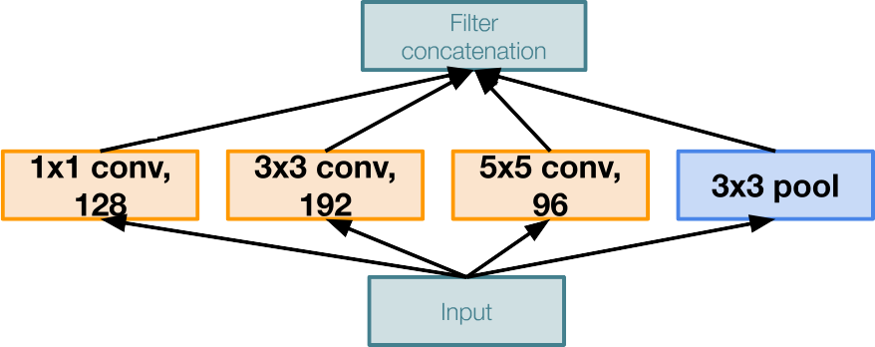
Case Study: GoogLeNet
[Szegedy et al., 2014]
Q: What is the problem with this? [Hint: Computational complexity]
Example:
Q2: What are the output sizes of all different filter operations?
28x28x128
Module input: 28x28x256
Naive Inception module

Slide 54
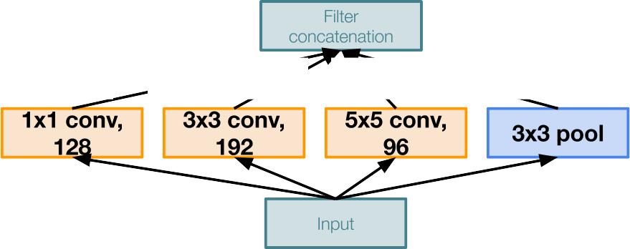
Case Study: GoogLeNet
[Szegedy et al., 2014]
Q: What is the problem with this? [Hint: Computational complexity]
Example:
Q2: What are the output sizes of all different filter operations?
28x28x128
28x28x192
28x28x96
28x28x256
Module input: 28x28x256
Naive Inception module

Slide 55
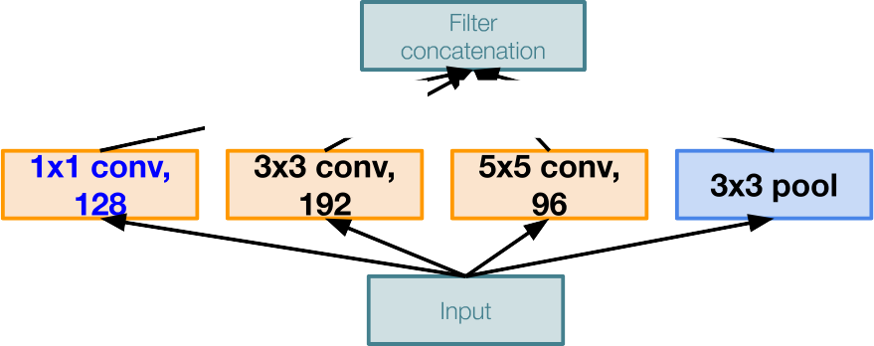
Case Study: GoogLeNet
[Szegedy et al., 2014]
Q: What is the problem with this? [Hint: Computational complexity]
Example:
Q3:What is output size after filter concatenation?
28x28x128
28x28x192
28x28x96
28x28x256
Module input: 28x28x256
Naive Inception module

Slide 56
Case Study: GoogLeNet
[Szegedy et al., 2014]
Q: What is the problem with this? [Hint: Computational complexity]
Example:
Q3:What is output size after filter concatenation?
28x28x(128+192+96+256) = 28x28x672
28x28x128
28x28x192
28x28x96
28x28x256
Module input: 28x28x256
Naive Inception module

Slide 57
Case Study: GoogLeNet
[Szegedy et al., 2014]
Q: What is the problem with this? [Hint: Computational complexity]
Example:
Q3:What is output size after filter concatenation?
Conv Ops:
[1x1 conv, 128] 28x28x128x1x1x256 [3x3 conv, 192] 28x28x192x3x3x256 [5x5 conv, 96] 28x28x96x5x5x256 Total: 854M ops
28x28x(128+192+96+256) = 28x28x672
28x28x128
28x28x192
28x28x96
28x28x256
Module input: 28x28x256
Naive Inception module

Slide 58
Case Study: GoogLeNet
Q: What is the problem with this? [Hint: Computational complexity]
[Szegedy et al., 2014]
Example:
Q3:What is output size after filter concatenation?
Conv Ops:
[1x1 conv, 128] 28x28x128x1x1x256 [3x3 conv, 192] 28x28x192x3x3x256 [5x5 conv, 96] 28x28x96x5x5x256 Total: 854M ops
28x28x(128+192+96+256) = 28x28x672
28x28x128
28x28x192
28x28x96
28x28x256
Very expensive compute
Module input: 28x28x256
Pooling layer also preserves feature depth, which means total depth after concatenation can only grow at every layer!
Naive Inception module

Slide 59
Case Study: GoogLeNet
Q: What is the problem with this? [Hint: Computational complexity]
[Szegedy et al., 2014]
Example:
Q3:What is output size after filter concatenation?
28x28x(128+192+96+256) = 529k
Solution: “bottleneck” layers that use 1x1 convolutions to reduce feature depth
28x28x128
28x28x192
28x28x96
28x28x256
Module input: 28x28x256
Naive Inception module

Slide 60
Reminder: 1x1 convolutions
1x1 CONV
with 32 filters
56
56
(each filter has size 1x1x64, and performs a 64-dimensional dot product)
56
56
64
32

Slide 61
Reminder: 1x1 convolutions
1x1 CONV
with 32 filters
56
56
preserves spatial dimensions, reduces depth!
56
Projects depth to lower dimension (combination of feature maps)
56
64
32

Slide 62

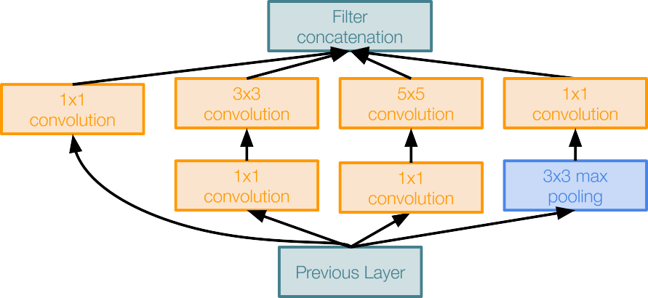
Case Study: GoogLeNet
[Szegedy et al., 2014]
Naive Inception module
Inception module with dimension reduction

Slide 63
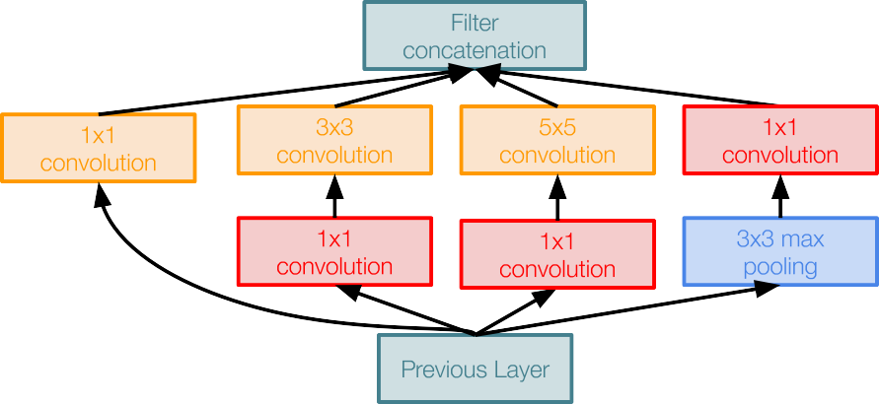
Case Study: GoogLeNet
[Szegedy et al., 2014]
1x1 conv “bottleneck” layers
Naive Inception module
Inception module with dimension reduction

Slide 64
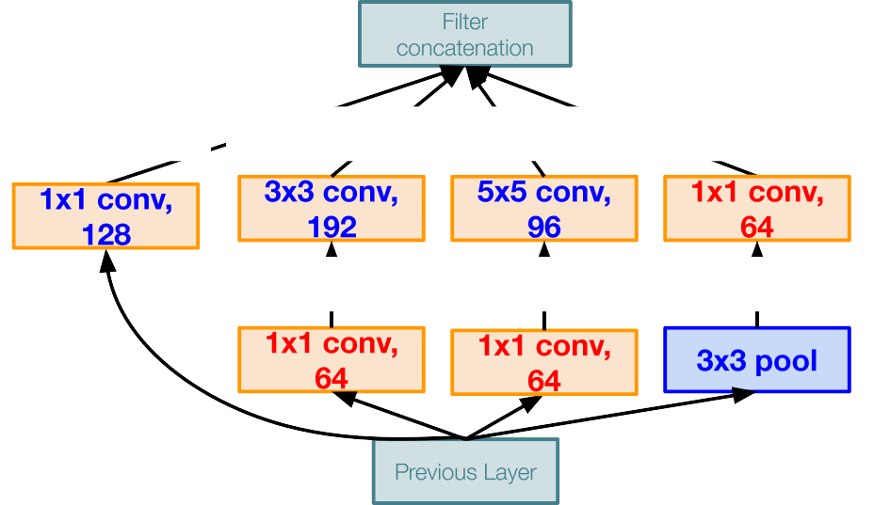
Case Study: GoogLeNet
Using same parallel layers as naive example, and adding “1x1 conv, 64 filter” bottlenecks:
[Szegedy et al., 2014]
28x28x480
Conv Ops:
[1x1 conv, 64] 28x28x64x1x1x256 [1x1 conv, 64] 28x28x64x1x1x256 [1x1 conv, 128] 28x28x128x1x1x256 [3x3 conv, 192] 28x28x192x3x3x64 [5x5 conv, 96] 28x28x96x5x5x64 [1x1 conv, 64] 28x28x64x1x1x256 Total: 358M ops
28x28x128
28x28x192
28x28x96
28x28x64
28x28x64
28x28x64
28x28x256
Module input: 28x28x256
Compared to 854M ops for naive version Bottleneck can also reduce depth after pooling layer
Inception module with dimension reduction

Slide 65
Case Study: GoogLeNet
[Szegedy et al., 2014]
Stack Inception modules with dimension reduction on top of each other
Inception module
Lecture 9 -

Slide 66
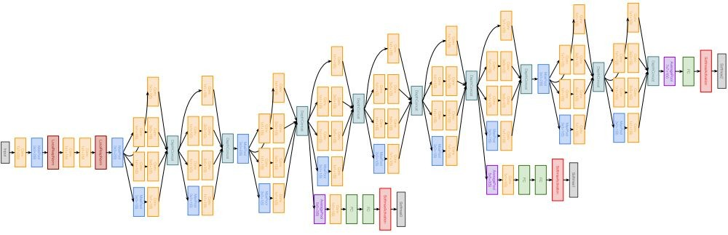
Case Study: GoogLeNet
[Szegedy et al., 2014]
Full GoogLeNet architecture
Stem Network: Conv-Pool- 2x Conv-Pool
Lecture 9 -

Slide 67
Case Study: GoogLeNet
[Szegedy et al., 2014]
Full GoogLeNet architecture
Stacked Inception Modules

Slide 68
Case Study: GoogLeNet
[Szegedy et al., 2014]
Full GoogLeNet architecture
Classifier output

Slide 69
Case Study: GoogLeNet
[Szegedy et al., 2014]
Full GoogLeNet architecture
Note: after the last convolutional layer, a global average pooling layer is used that spatially averages across each feature map, before final FC layer. No longer multiple expensive FC layers!
Classifier output
Lecture 9 -

Slide 70
Case Study: GoogLeNet
[Szegedy et al., 2014]
Full GoogLeNet architecture
Auxiliary classification outputs to inject additional gradient at lower layers (AvgPool-1x1Conv-FC-FC-Softmax)

Slide 71
Case Study: GoogLeNet
[Szegedy et al., 2014]
Full GoogLeNet architecture
22 total layers with weights
(parallel layers count as 1 layer => 2 layers per Inception module. Don’t count auxiliary output layers)
Lecture 9 -

Slide 72
Case Study: GoogLeNet
[Szegedy et al., 2014]
Deeper networks, with computational efficiency
22 layers
Efficient “Inception” module
Avoids expensive FC layers
12x less params than AlexNet
ILSVRC’14 classification winner (6.7% top 5 error)
Inception module
Lecture 9 -

Slide 73
ImageNet Large Scale Visual Recognition Challenge (ILSVRC) winners
“Revolution of Depth”
152 layers
152 layers
152 layers
19 layers
22 layers
shallow
8 layers
8 layers
Lin et al
Sanchez & Perronnin
Krizhevsky et al Zeiler & (AlexNet) Fergus
Simonyan & Szegedy et al Zisserman (VGG) (GoogLeNet)
He et al (ResNet)
Shao et al
Hu et al (SENet)
Russakovsky et al
Lecture 9 -

Slide 74
Case Study: ResNet
[He et al., 2015]
Very deep networks using residual connections
relu
F(x) + x
..
.
152-layer model for ImageNet
ILSVRC’15 classification winner (3.57% top 5 error)
Swept all classification and detection competitions in ILSVRC’15 and COCO’15!
F(x)
X
identity
relu
X
Residual block

Slide 75
Case Study: ResNet
[He et al., 2015]
What happens when we continue stacking deeper layers on a “plain” convolutional neural network?
Fei-Fei Li & Justin Johnson & Serena Yeung Lecture 9 - April 30, 2019

Slide 76
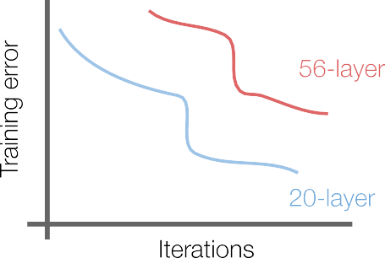
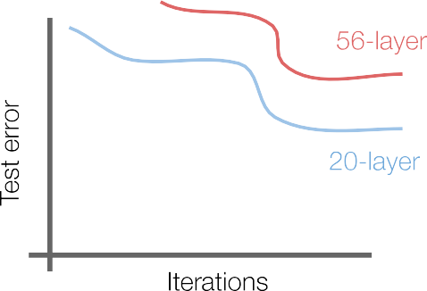
Case Study: ResNet
[He et al., 2015]
What happens when we continue stacking deeper layers on a “plain” convolutional neural network?
Q: What’s strange about these training and test curves? [Hint: look at the order of the curves]

Slide 77
Case Study: ResNet
[He et al., 2015]
What happens when we continue stacking deeper layers on a “plain” convolutional neural network?
56-layer model performs worse on both training and test error
-> The deeper model performs worse, but it’s not caused by overfitting!
Fei-Fei Li & Justin Johnson & Serena Yeung Lecture 9 - April 30, 2019

Slide 78
Case Study: ResNet
[He et al., 2015]
Hypothesis: the problem is an optimization problem, deeper models are harder to optimize

Slide 79
Case Study: ResNet
[He et al., 2015]
Hypothesis: the problem is an optimization problem, deeper models are harder to optimize
The deeper model should be able to perform at least as well as the shallower model.
A solution by construction is copying the learned layers from the shallower model and setting additional layers to identity mapping.
Fei-Fei Li & Justin Johnson & Serena Yeung Lecture 9 - April 30, 2019

Slide 80
Case Study: ResNet
[He et al., 2015]
Solution: Use network layers to fit a residual mapping instead of directly trying to fit a desired underlying mapping
relu
H(x)
F(x) + x
F(x)
X
identity
relu
relu
X
“Plain” layers
X
Residual block
Fei-Fei Li & Justin Johnson & Serena Yeung Lecture 9 - April 30, 2019

Slide 81
Case Study: ResNet
[He et al., 2015]
Solution: Use network layers to fit a residual mapping instead of directly trying to fit a desired underlying mapping
H(x) = F(x) + x
relu
H(x)
F(x) + x
Use layers to fit residual F(x) = H(x) - x
instead of H(x) directly
F(x)
X
identity
relu
relu
X
“Plain” layers
X
Residual block

Slide 82
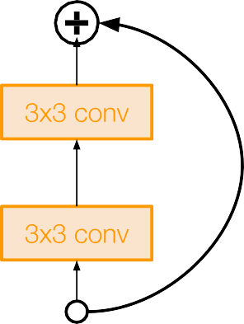
Case Study: ResNet
[He et al., 2015]
Full ResNet architecture:
Stack residual blocks
Every residual block has two 3x3 conv layers
relu
F(x) + x
..
.
F(x)
X
identity
relu
X
Residual block
Fei-Fei Li & Justin Johnson & Serena Yeung Lecture 9 - April 30, 2019

Slide 83
Case Study: ResNet
[He et al., 2015]
Full ResNet architecture:
Stack residual blocks
Every residual block has two 3x3 conv layers
Periodically, double # of filters and downsample spatially using stride 2 (/2 in each dimension)
relu
F(x) + x
..
.
X
identity
3x3 conv, 128 filters, /2 spatially with stride 2
F(x)
relu
3x3 conv, 64 filters
X
Residual block
Fei-Fei Li & Justin Johnson & Serena Yeung Lecture 9 - April 30, 2019

Slide 84
Case Study: ResNet
[He et al., 2015]
Full ResNet architecture:
Stack residual blocks
Every residual block has two 3x3 conv layers
Periodically, double # of filters and downsample spatially using stride 2 (/2 in each dimension)
Additional conv layer at the beginning
relu
F(x) + x
..
.
F(x)
X
identity
relu
X
Residual block
Beginning
conv layer

Slide 85
Case Study: ResNet
No FC layers
besides FC 1000 to output classes
[He et al., 2015]
Full ResNet architecture:
Global average pooling layer after last conv layer
Stack residual blocks
Every residual block has two 3x3 conv layers
Periodically, double # of filters and downsample spatially using stride 2 (/2 in each dimension)
Additional conv layer at the beginning
No FC layers at the end (only FC 1000 to output classes)
relu
F(x) + x
..
.
F(x)
X
identity
relu
X
Residual block
Lecture 9 -

Slide 86
Case Study: ResNet
[He et al., 2015]
Total depths of 34, 50, 101, or 152 layers for ImageNet
..
.

Slide 87
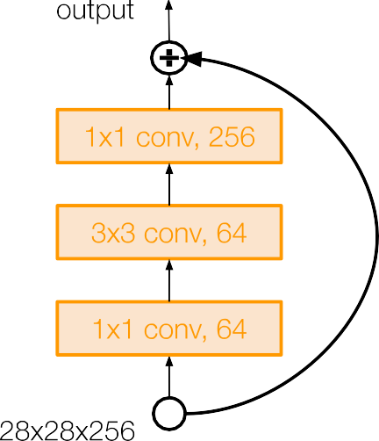
Case Study: ResNet
[He et al., 2015]
For deeper networks
(ResNet-50+), use “bottleneck” layer to improve efficiency (similar to GoogLeNet)

Slide 88
Case Study: ResNet
[He et al., 2015]
1x1 conv, 256 filters projects back to 256 feature maps (28x28x256)
For deeper networks
(ResNet-50+), use “bottleneck” layer to improve efficiency (similar to GoogLeNet)
3x3 conv operates over only 64 feature maps
1x1 conv, 64 filters to project to 28x28x64

Slide 89
Case Study: ResNet
[He et al., 2015]
Training ResNet in practice:
Batch Normalization after every CONV layer
Xavier 2/ initialization from He et al.
SGD + Momentum (0.9)
Learning rate: 0.1, divided by 10 when validation error plateaus
Mini-batch size 256
Weight decay of 1e-5
No dropout used
Fei-Fei Li & Justin Johnson & Serena Yeung Lecture 9 - April 30, 2019

Slide 90
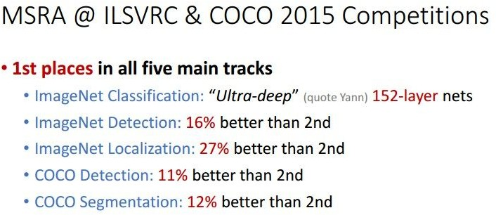
Case Study: ResNet
[He et al., 2015]
Experimental Results
Able to train very deep networks without degrading (152 layers on ImageNet, 1202 on Cifar)
Deeper networks now achieve lowing training error as expected
Swept 1st place in all ILSVRC and COCO 2015 competitions
Fei-Fei Li & Justin Johnson & Serena Yeung Lecture 9 - April 30, 2019

Slide 91
Case Study: ResNet
[He et al., 2015]
Experimental Results
Able to train very deep networks without degrading (152 layers on ImageNet, 1202 on Cifar)
Deeper networks now achieve lowing training error as expected
Swept 1st place in all ILSVRC and COCO 2015 competitions
ILSVRC 2015 classification winner (3.6% top 5 error) -- better than “human performance”! (Russakovsky 2014)
Fei-Fei Li & Justin Johnson & Serena Yeung Lecture 9 - April 30, 2019

Slide 92
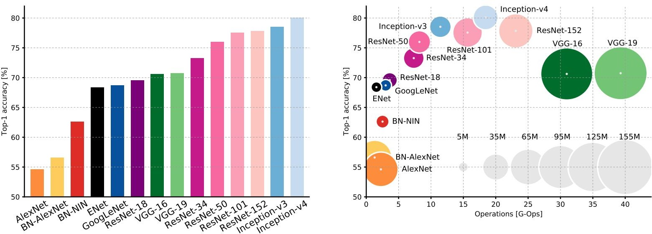
Comparing complexity...
An Analysis of Deep Neural Network Models for Practical Applications, 2017.
Figures copyright Alfredo Canziani, Adam Paszke, Eugenio Culurciello, 2017. Reproduced with permission.
Fei-Fei Li & Justin Johnson & Serena Yeung Lecture 9 - April 30, 2019

Slide 93
Comparing complexity...
Inception-v4: Resnet + Inception!
An Analysis of Deep Neural Network Models for Practical Applications, 2017.
Figures copyright Alfredo Canziani, Adam Paszke, Eugenio Culurciello, 2017. Reproduced with permission.

Slide 94
Comparing complexity...
VGG: Highest memory, most operations
An Analysis of Deep Neural Network Models for Practical Applications, 2017.
Figures copyright Alfredo Canziani, Adam Paszke, Eugenio Culurciello, 2017. Reproduced with permission.

Slide 95
GoogLeNet: most efficient
Comparing complexity...
An Analysis of Deep Neural Network Models for Practical Applications, 2017.
Figures copyright Alfredo Canziani, Adam Paszke, Eugenio Culurciello, 2017. Reproduced with permission.

Slide 96
AlexNet:
Smaller compute, still memory heavy, lower accuracy
Comparing complexity...
An Analysis of Deep Neural Network Models for Practical Applications, 2017.
Figures copyright Alfredo Canziani, Adam Paszke, Eugenio Culurciello, 2017. Reproduced with permission.
Fei-Fei Li & Justin Johnson & Serena Yeung Lecture 9 - April 30, 2019

Slide 97
ResNet:
Moderate efficiency depending on model, highest accuracy
Comparing complexity...
An Analysis of Deep Neural Network Models for Practical Applications, 2017.
Figures copyright Alfredo Canziani, Adam Paszke, Eugenio Culurciello, 2017. Reproduced with permission.

Slide 98
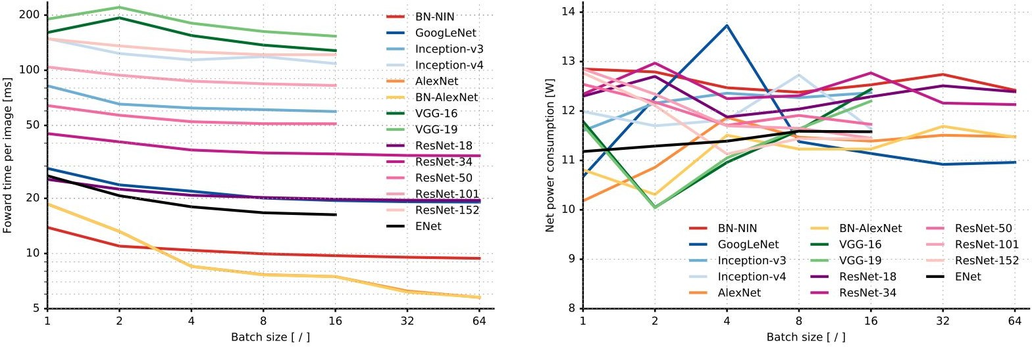
Forward pass time and power consumption
An Analysis of Deep Neural Network Models for Practical Applications, 2017.
Figures copyright Alfredo Canziani, Adam Paszke, Eugenio Culurciello, 2017. Reproduced with permission.

Slide 99
ImageNet Large Scale Visual Recognition Challenge (ILSVRC) winners
Network ensembling
152 layers
152 layers
152 layers
19 layers
22 layers
shallow
8 layers
8 layers
Lin et al | Sanchez & | Krizhevsky et al Zeiler & | Simonyan & Szegedy et al | He et al | Shao et al | Hu et al | Russakovsky et al
 | Perronnin | (AlexNet) Fergus | Zisserman (VGG) (GoogLeNet) | (ResNet) |  | (SENet)

Slide 100
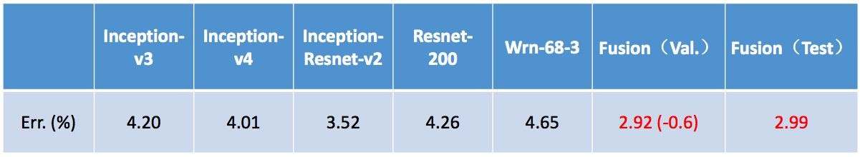
Improving ResNets...
“Good Practices for Deep Feature Fusion”
[Shao et al. 2016]
Multi-scale ensembling of Inception, Inception-Resnet, Resnet, Wide Resnet models
ILSVRC’16 classification winner

Slide 101
ImageNet Large Scale Visual Recognition Challenge (ILSVRC) winners
Adaptive feature map reweighting
152 layers
152 layers
152 layers
19 layers
22 layers
shallow
8 layers
8 layers
Lin et al
Sanchez & Perronnin
Krizhevsky et al Zeiler & (AlexNet) Fergus
Simonyan & Szegedy et al Zisserman (VGG) (GoogLeNet)
He et al (ResNet)
Shao et al
Hu et al (SENet)
Russakovsky et al

Slide 102
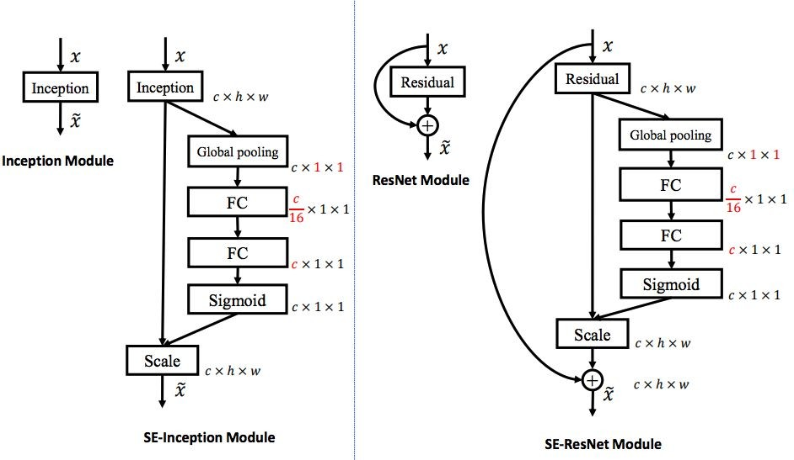
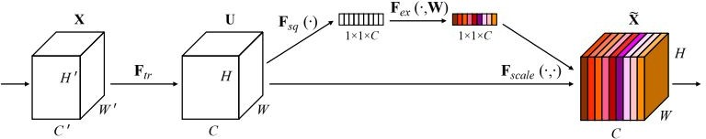
Improving ResNets...
Squeeze-and-Excitation Networks (SENet)
[Hu et al. 2017]
Add a “feature recalibration” module that learns to adaptively reweight feature maps
Global information (global avg. pooling layer) + 2 FC layers used to determine feature map weights
ILSVRC’17 classification winner (using ResNeXt-152 as a base architecture)

Slide 103
ImageNet Large Scale Visual Recognition Challenge (ILSVRC) winners
152 layers
152 layers
152 layers
19 layers
22 layers
shallow
8 layers
8 layers
Lin et al | Sanchez & | Krizhevsky et al Zeiler & | Simonyan & Szegedy et al | He et al | Shao et al | Hu et al | Russakovsky et al
 | Perronnin | (AlexNet) Fergus | Zisserman (VGG) (GoogLeNet) | (ResNet) |  | (SENet)
Fei-Fei Li & Justin Johnson & Serena Yeung Lecture 9 - April 30, 2019

Slide 104
ImageNet Large Scale Visual Recognition Challenge (ILSVRC) winners
152 layers 152 layers 152 layers
19 layers 22 layers
shallow 8 layers 8 layers
Lin et al Sanchez & Krizhevsky et al Zeiler & Simonyan & Szegedy et al He et al Shao et al Hu et al Russakovsky et al Perronnin (AlexNet) Fergus Zisserman (VGG) (GoogLeNet) (ResNet) (SENet)
Completion of the challenge:
Annual ImageNet competition no longer held after 2017 -> now moved to Kaggle.

Slide 105
But research into CNN architectures is still flourishing

Slide 106
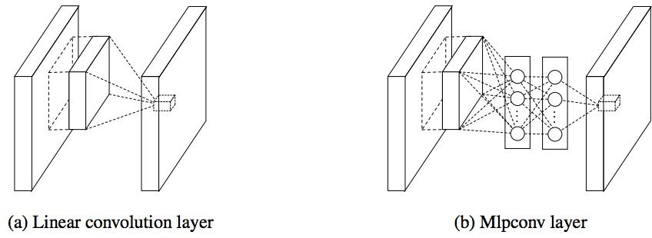
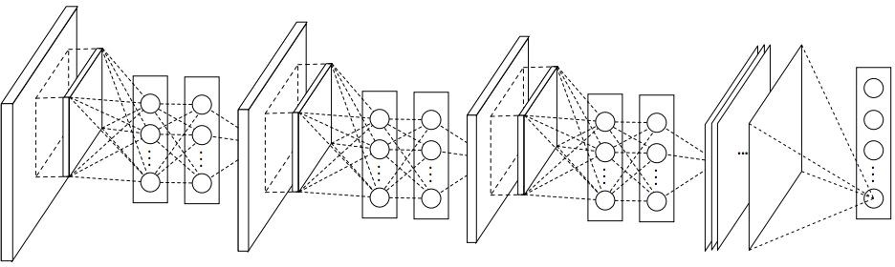
Of historical note...
Network in Network (NiN)
[Lin et al. 2014]
Mlpconv layer with “micronetwork” within each conv layer to compute more abstract features for local patches
Micronetwork uses multilayer perceptron
Precursor to GoogLeNet and ResNet “bottleneck” layers
Philosophical inspiration for GoogLeNet
Figures copyright Lin et al., 2014. Reproduced with permission.
Lecture 9 - 106

Slide 107
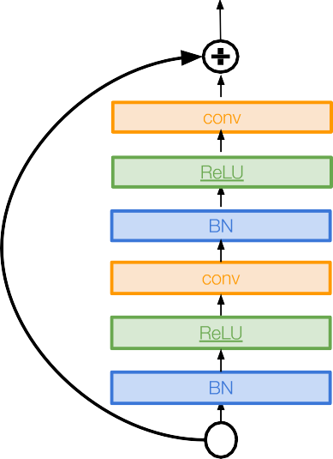
Improving ResNets...
Identity Mappings in Deep Residual Networks
[He et al. 2016]
Improved ResNet block design from creators of ResNet
Creates a more direct path for propagating information throughout network (moves activation to residual mapping pathway)
Gives better performance

Slide 108
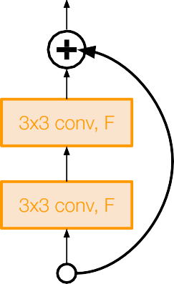
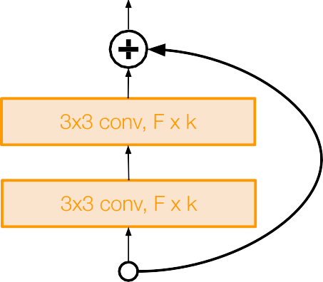
Improving ResNets...
Wide Residual Networks
[Zagoruyko et al. 2016]
Argues that residuals are the important factor, not depth
User wider residual blocks (F x k filters instead of F filters in each layer)
50-layer wide ResNet outperforms 152-layer original ResNet
Increasing width instead of depth more computationally efficient (parallelizable)
Basic residual block
Wide residual block
Lecture 9 - 108

Slide 109
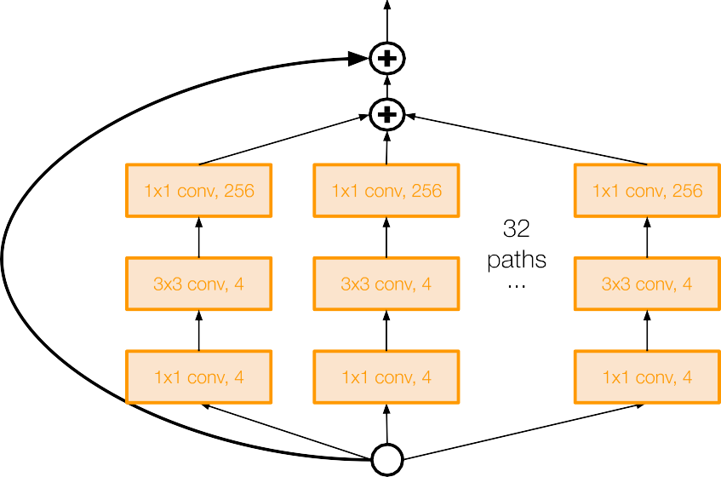
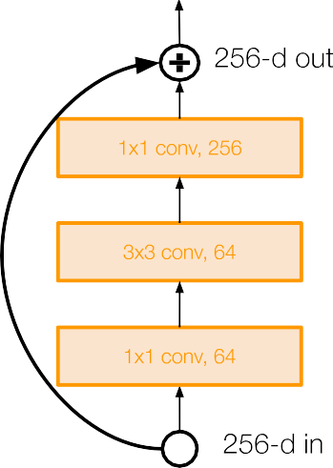
Improving ResNets...
Aggregated Residual Transformations for Deep
Neural Networks (ResNeXt)
[Xie et al. 2016]
Also from creators of ResNet
Increases width of residual block through multiple parallel pathways (“cardinality”)
Parallel pathways similar in spirit to Inception module
Lecture 9 - 109

Slide 110
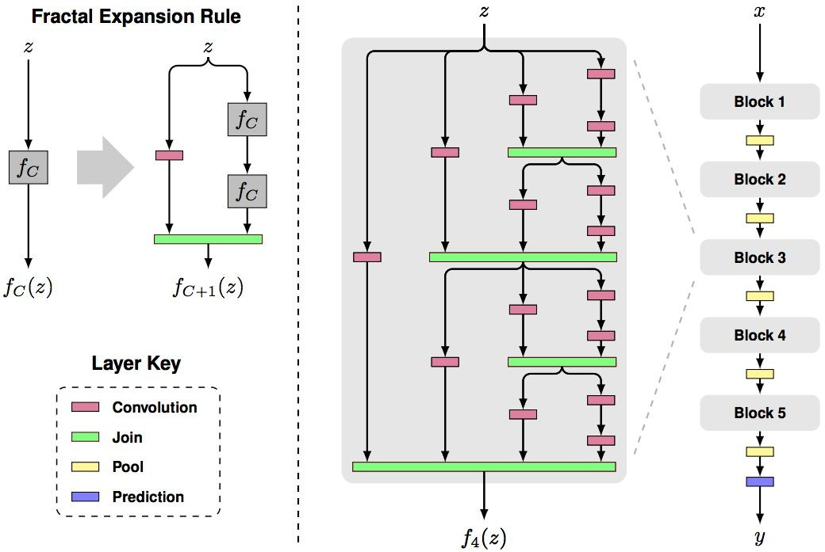
Other ideas...
FractalNet: Ultra-Deep Neural Networks without Residuals
[Larsson et al. 2017]
Argues that key is transitioning effectively from shallow to deep and residual representations are not necessary
Fractal architecture with both shallow and deep paths to output
Trained with dropping out sub-paths
Full network at test time
Figures copyright Larsson et al., 2017. Reproduced with permission.
Lecture 9 - 110

Slide 111
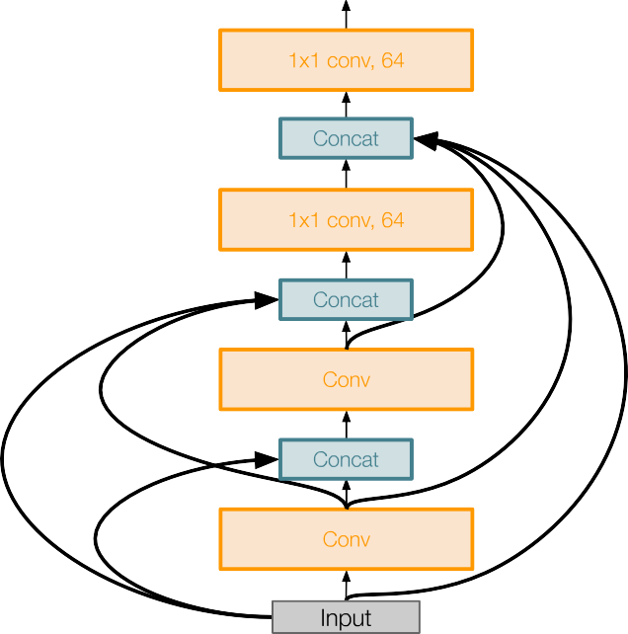
Other ideas...
Densely Connected Convolutional Networks
[Huang et al. 2017]
Dense blocks where each layer is connected to every other layer in feedforward fashion
Alleviates vanishing gradient, strengthens feature propagation, encourages feature reuse
Lecture 9 -

Slide 112
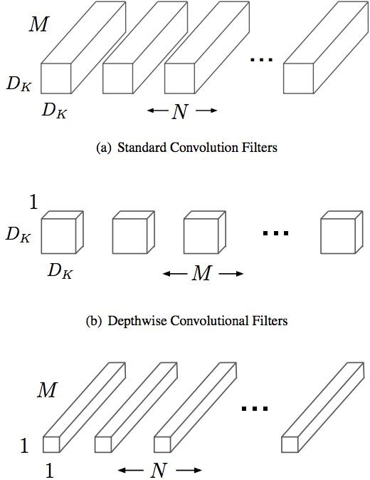
Efficient networks...
MobileNets: Efficient Convolutional Neural Networks for Mobile Applications
[Howard et al. 2017]
Depthwise separable convolutions replace standard convolutions by factorizing them into a depthwise convolution and a 1x1 convolution that is much more efficient
Much more efficient, with little loss in accuracy
Follow-up MobileNetV2 work in 2018 (Sandler et al.)
Other works in this space e.g. ShuffleNet (Zhang et al. 2017)
Lecture 9 -

Slide 113
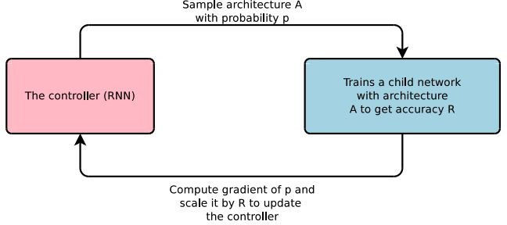
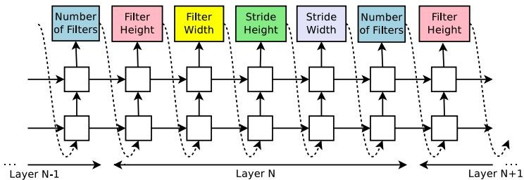
Meta-learning: Learning to learn network architectures...
Neural Architecture Search with Reinforcement Learning (NAS)
[Zoph et al. 2016]
“Controller” network that learns to design a good network architecture (output a string corresponding to network design)
Iterate:
  Sample an architecture from search space
  Train the architecture to get a “reward” R corresponding to accuracy
  Compute gradient of sample probability, and scale by R to perform controller parameter update (i.e. increase likelihood of good architecture being sampled, decrease likelihood of bad architecture)
Lecture 9 -

Slide 114
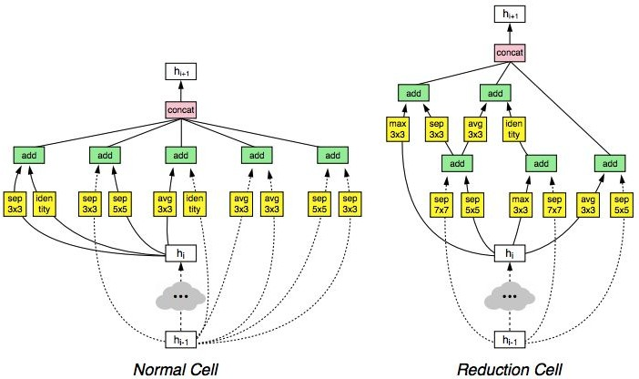
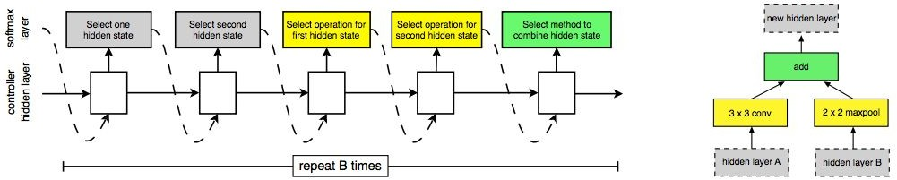
Meta-learning: Learning to learn network architectures... Learning Transferable Architectures for Scalable Image Recognition
[Zoph et al. 2017]
Applying neural architecture search (NAS) to a large dataset like ImageNet is expensive
Design a search space of building blocks (“cells”) that can be flexibly stacked
NASNet: Use NAS to find best cell structure on smaller CIFAR-10 dataset, then transfer architecture to ImageNet
Many follow-up works in this space e.g. AmoebaNet (Real et al. 2019) and ENAS (Pham, Guan et al. 2018)

Slide 115
Summary: CNN Architectures
Case Studies
AlexNet
VGG
GoogLeNet
ResNet
Also....
SENet
NiN (Network in Network)
Wide ResNet
ResNeXT
DenseNet
FractalNet
MobileNets
NASNet
Lecture 9 -
115

Slide 116
Summary: CNN Architectures
Many popular architectures available in model zoos
ResNet and SENet currently good defaults to use
Networks have gotten increasingly deep over time
Many other aspects of network architectures are also continuously being investigated and improved
Even more recent trend towards meta-learning
Next time: Recurrent neural networks
Lecture 9 -
116

