Slide 1
GAN and Sequence Modeling Overview

Slide 2
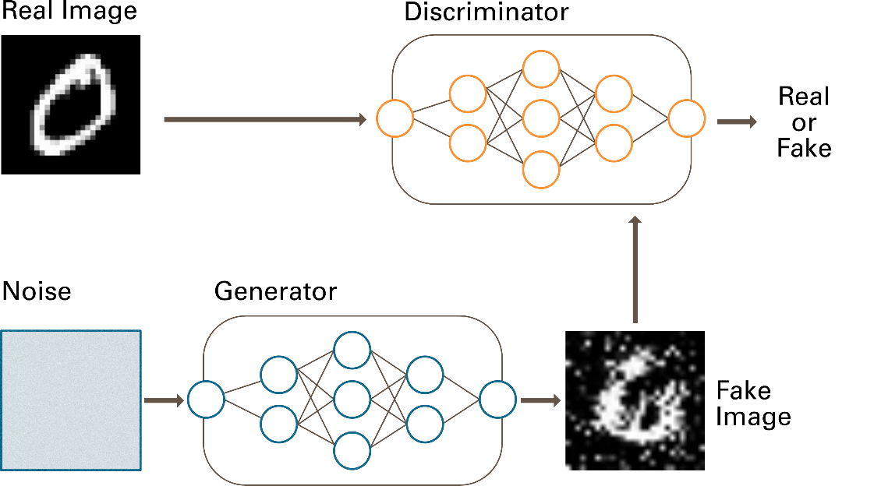
Generative Adversarial Networks (GANs)
Train a network to generate something from a distribution of interest.
Uses two networks in tandem – generator and discriminator
https://towardsdatascience.com/demystifying-gans-in-tensorflow-2-0-9890834ab3d9

Slide 3
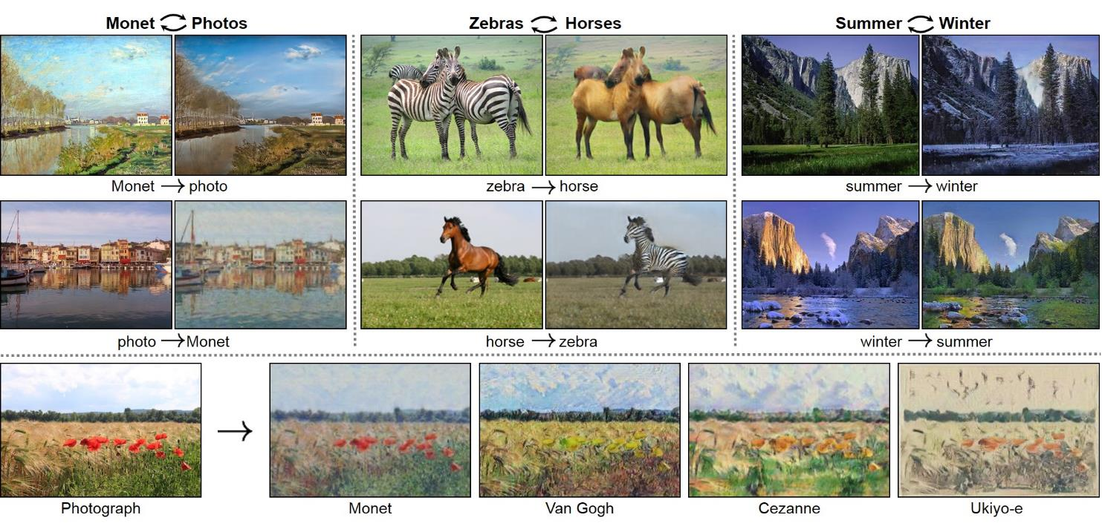
Cycle GAN
Translate an image to an image containing a different class, while minimizing the difference between the input and output

Slide 4
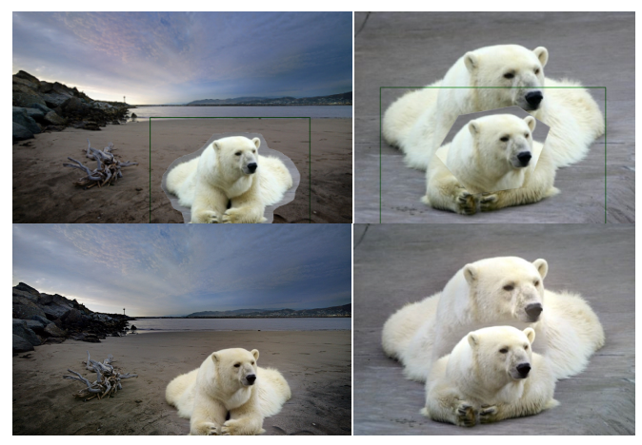
Realistic Image Smoothing (GP-GAN)

Slide 5
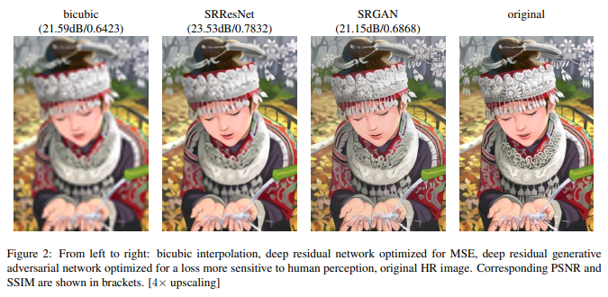
Image Super Resolution

Slide 6
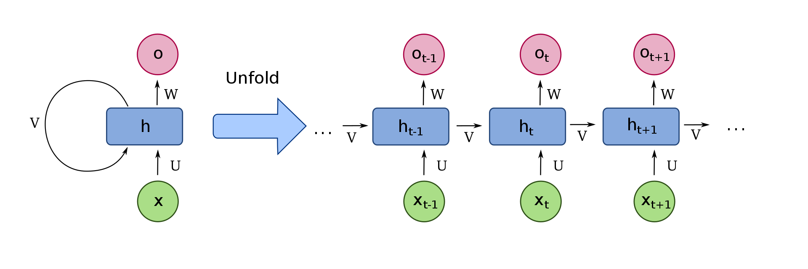
Recurrent Neural Networks
By François Deloche - Own work, CC BY-SA 4.0, https://commons.wikimedia.org/w/index.php?curid=60109157

Slide 7
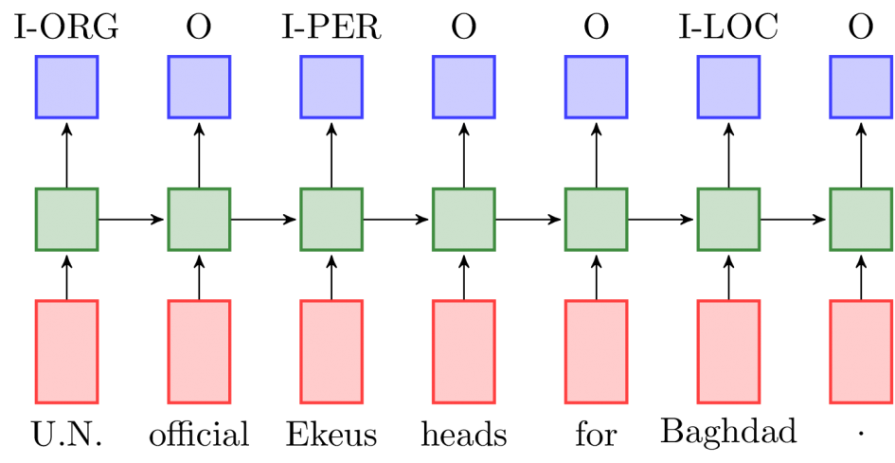
Part of Speech Tagging

Slide 8
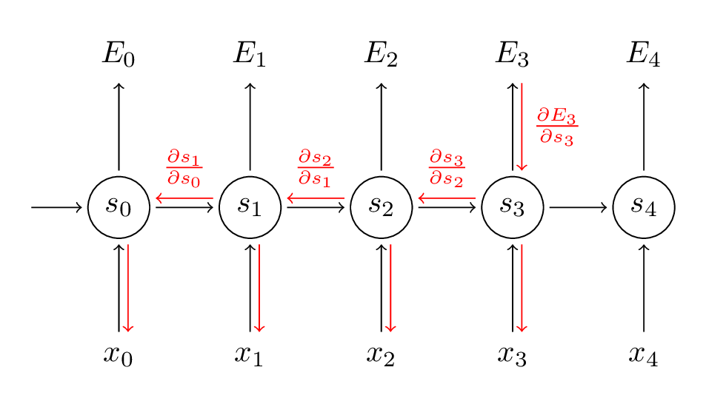
Practical RNNs – Vanishing Gradients

Slide 9
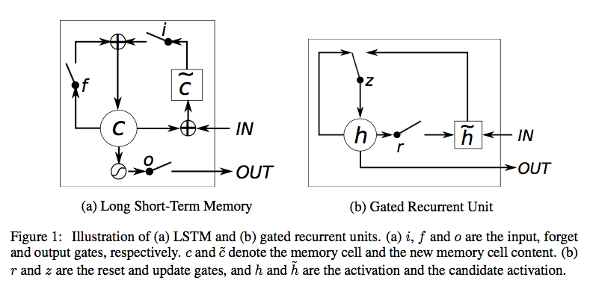
Practical RNNs – LSTMs and GRUs

Slide 10
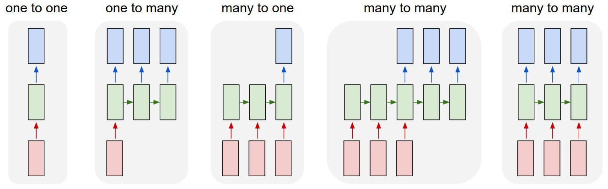
Practical RNNs – types of problems

Slide 11
Writing and search within images

Slide 12
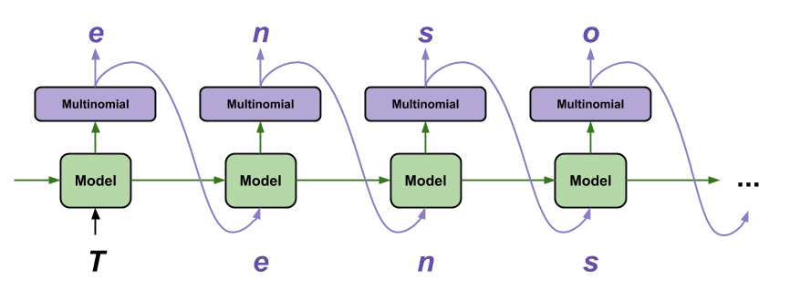
Generating Text
Train model to predict next character/word/etc

Slide 13
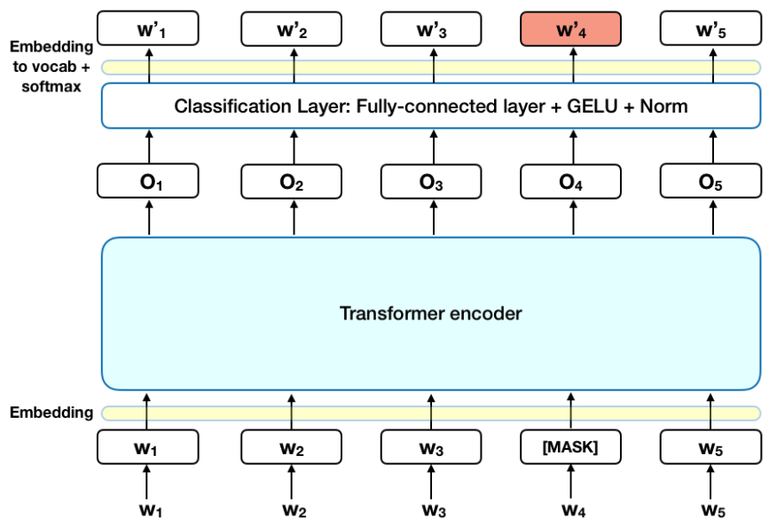
BERT
Uses an “Attention” mechanism to understand the relationship between words
https://towardsdatascience.com/bert-explained-state-of-the-art-language-model-for-nlp-f8b21a9b6270

