Slide 1
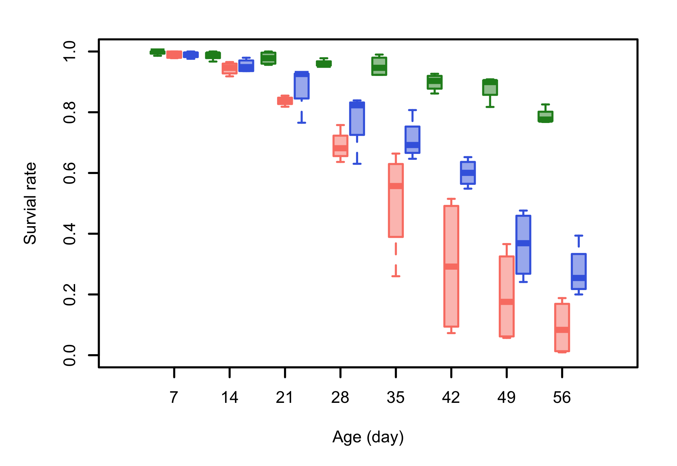
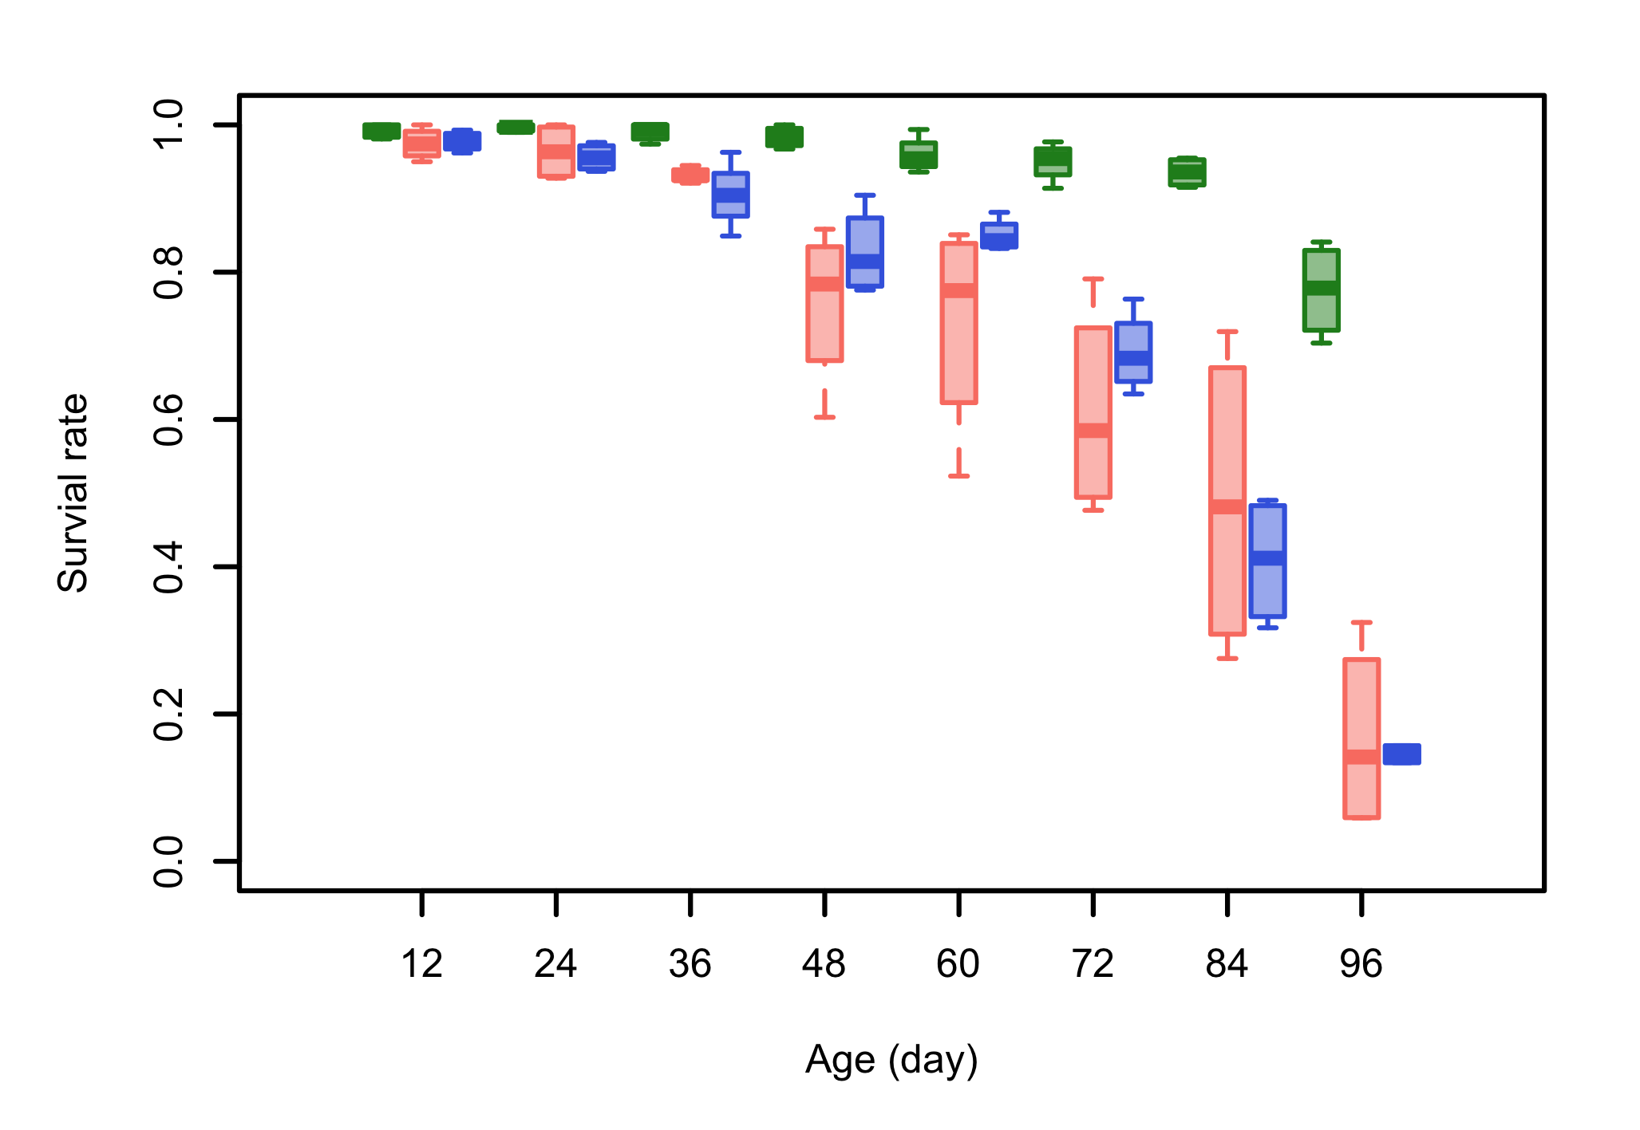
A
Hot CGE (28/18°C)
B
Cold CGE (20/10°C)

