Slide 1
MM’21 Grand Challenge (GC)
ShengMing Tang

Slide 2
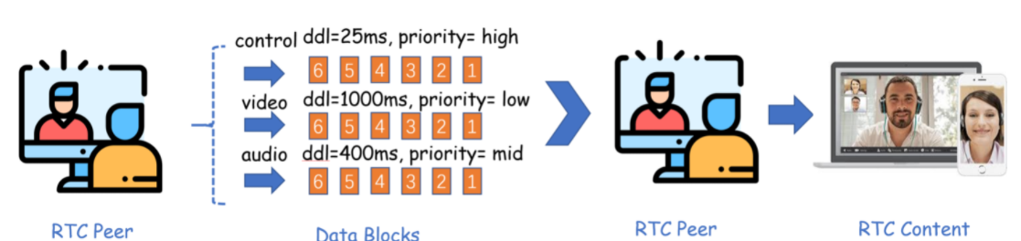
Introduction
GC web
Real Time Communication (RTC) application are popular
Online conferencing
Control (commands, reponse ASAP)
Video (large b/w consumption, stalling is tolerable)
Audio (annoying if sounds are not smooth)
Delay senstitive multimedia challenges
Meet deadline requirements
Can we send everything out once a block is available at highest rate?

Slide 3
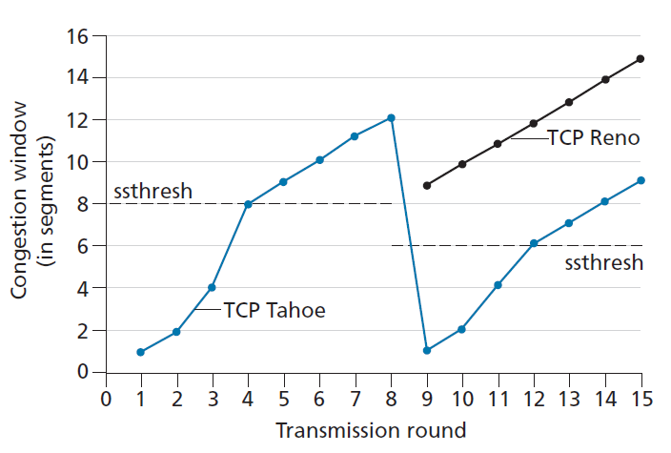
Introduction
Transmission
Application data are in unit of blocks with different priority
Control (high, priority-0)
Video (low, priority-1)
Audio (middle, priority-2)
Blocks are divided into packets to fit into lower network layers
Congestion Control
Send at unlimited speed will congest the link along the way
Congested link will introduce packet losses
Miss a deadline

Slide 4
Introduction (cont’d)
Objective
Serve highest possible QoE, which is composed of
Priority
Meetting the deadline or not
Design congestion control (CC) algorithms
Which block to send
Congestion window control (if your alg. is congestion window based)
At what speed

Slide 5
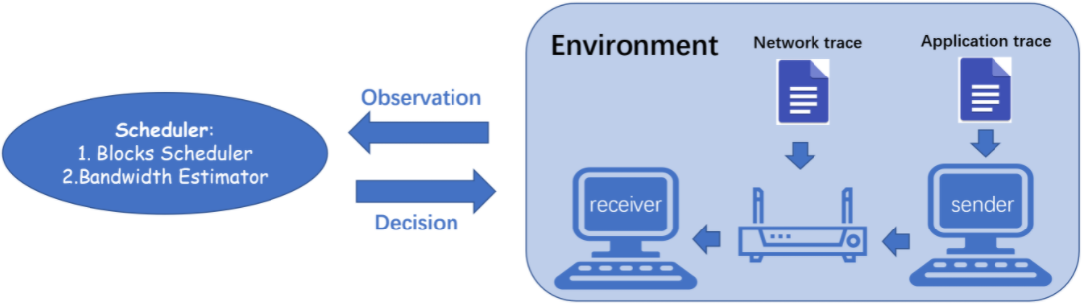
Simulation Platform
Platform
Network trace
Network condition record which can be replayed
Application trace
Block record which also could be replayed
Use the two traces to replay different scenarios

Slide 6
Task description
Block scheduler
select which application block to send
Bandwidth estimator
bandwidth estimation (not necessary if you don’t need this)
congestion controll triggered on packet ACK/loss/sent

Slide 7
Function Explained
def select_block(self, cur_time: float, block_queue: list) -> int:
return block index to be sent relative to the block_queue
def on_packet_sent(self, cur_time: float) -> dict:
called on every packet is sent
state update
return {“cwnd”: int, “send_rate”: float}
def cc_trigger(self, cur_time: float , event_info: dict) -> dict:
called on packet ack-ed or droped
state update (return in the same form as on_packet_sent(...))
Examples are here.
TCP Reno

Slide 8
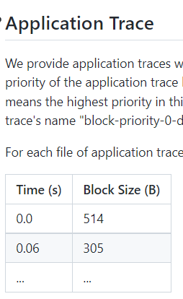
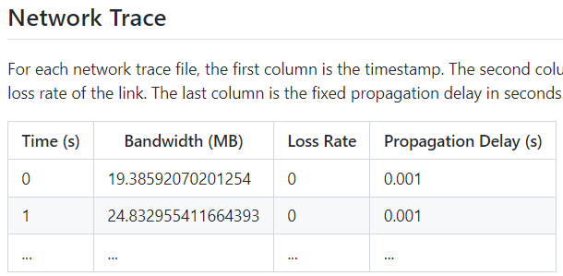
Dataset
Open dataset (on the same Github)

Slide 9
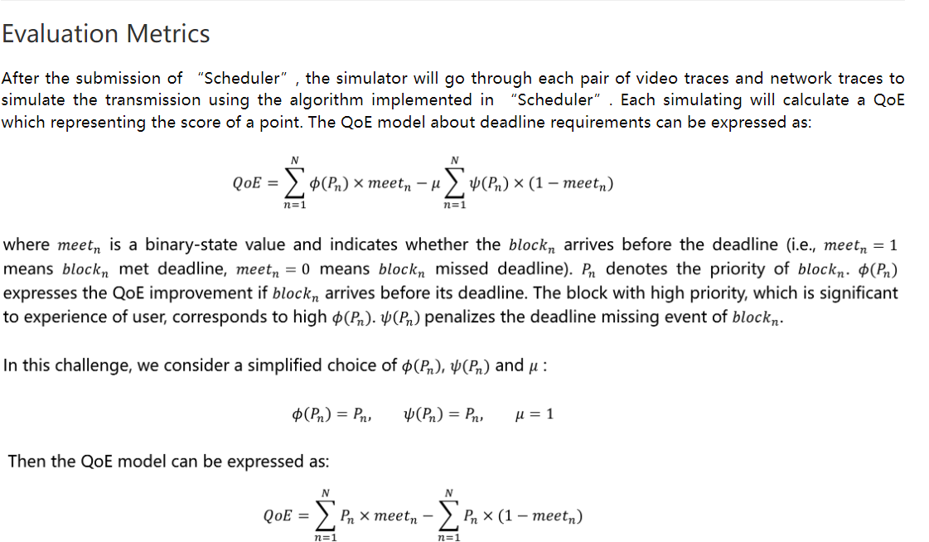
The QoE Model
Pn for meeting the deadline -Pn otherwise

Slide 10
Additional Resources
Grand Challenge paper
Paper that won the first award
Simply reproducing the algorithm will result in zero score
Basics
TCP Reno (congestion control algorithm)
Simulation
Emulator class explained
Instantiation details

Slide 11
File Structure and Self Test
Clone or fork this https://github.com/ShengMingTang/Meet-Deadline-Requirements-Challenge
Put everything you need under CS3570/s{StudentID}
Read the document string in ‘TA_eval.py’ carefully
‘solution.py’, ‘requirements.txt’, and so on
We will change to your directory when evaluating your code
Use relative path when reading/writing files
Run ‘TA_testcaseGen.py’
A small batch of test cases will be generated in ‘hidden/’
Run ‘TA_eval.py’
Some output will logged and qoe.csv will be generated to bookkeep the details

Slide 12
Submission Details (for code)
solution.py
Your code must start from this template (in CS3570/s000000000)
The class must be named ‘MySolution’
sideModule.py
Optional, if you have any code that is separated
requirements.txt
$ pip freeze > requirements.txt
To separate your environment from others’
others
Any of additional files
Model files

Slide 13
Evaluations
Test cases will be released after your submission
We will use exactly the same code as ‘TA_eval.py’ to evaluate your performance
Make sure that your structure is compatible with our requirements
Live demo is required if your code throws any exception
Scores will be heavily deducted if this comes from implementation not setting errors
Make sure that you have passed the self test
Zero score if the team does not show up for makeup demo
Actual run time is limited to 20 sec / test case (maybe extended)
Each test case is of length 20 seconds
Benchmark Scores (summation of QoE overall testcases)
top ⅓: 10 points
next ⅓: 7 points
last ⅓: 4 points

