Slide 1
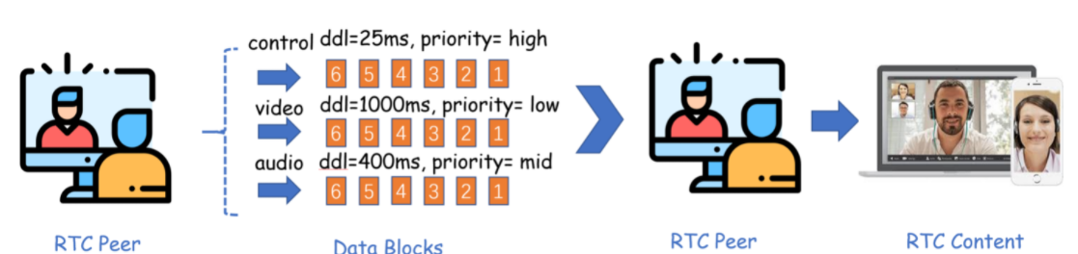
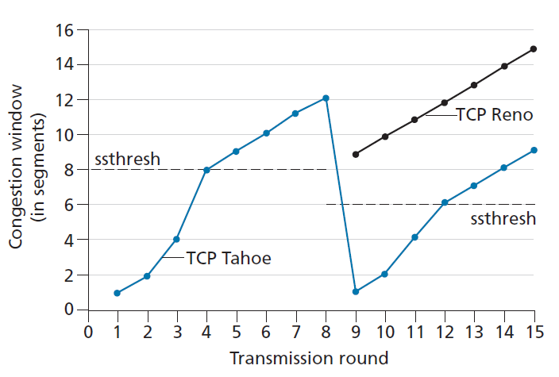
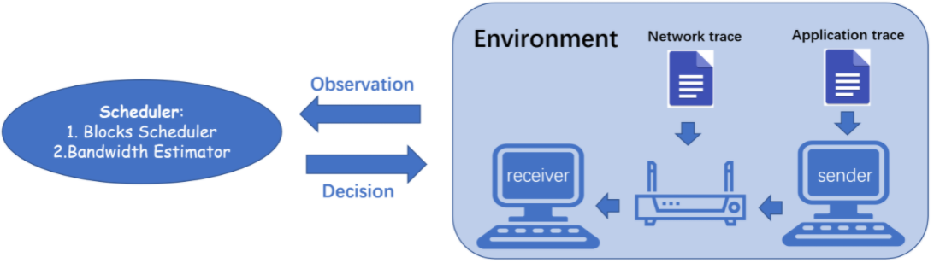
Meet-Deadline-Requirements-Challenge
Delay-sensitive applications (GC web)
Congestion control algorithm design
Determine Which to send
Determine what rate to send
Simulation Platform (Platform)
Application traces (replayed video/audio/control message)
Network traces (replayed network history)
Implement the three functions
select_block(.) , which block to send
on_packet_sent(.) , state update on packet sent
cc_trigger(.) , state update on packet ack-ed or lost
Evaluation
QoE (reward for meeting the deadline)
See Github for evaluation details

