Slide 1
More on DCT
Sheng-Ming Tang

Slide 2
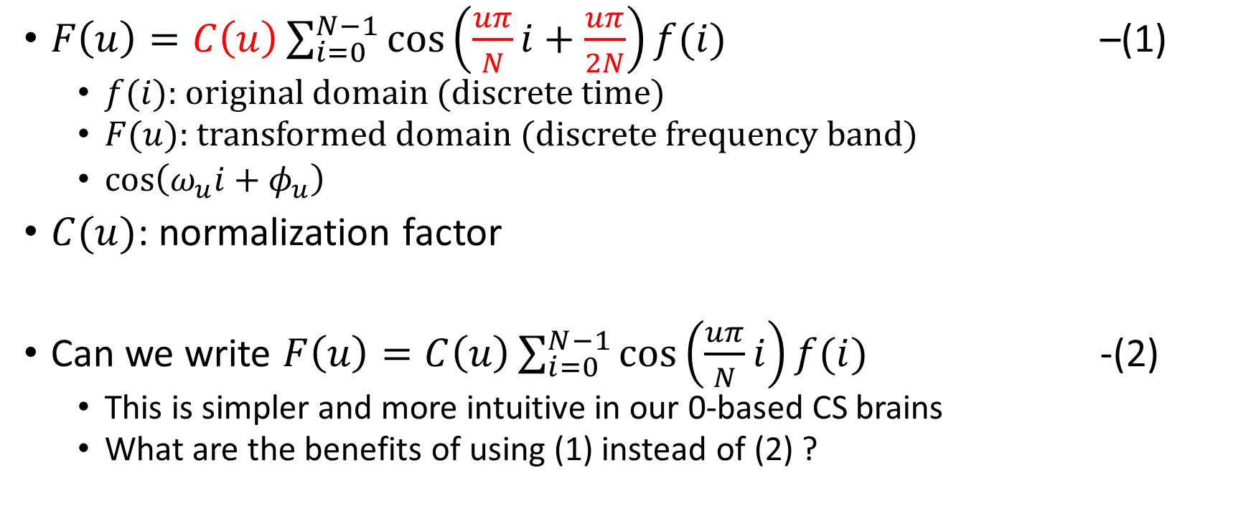
Definition of 1D DCT
$F\left(u\right)=C\left(u\right)\sum_{i=0}^{N−1}{\cos\left(\frac{uπ}{N}i+\frac{uπ}{2N}\right)}f(i)$ –(1)
$f(i)$: original domain (discrete time)
$F(u)$: transformed domain (discrete frequency band)
$\cos\left(ω_{u}i+φ_{u}\right)$
$C(u)$: normalization factor
Can we write $F\left(u\right)=C\left(u\right)\sum_{i=0}^{N−1}{\cos\left(\frac{uπ}{N}i\right)}f(i)$ -(2)
This is simpler and more intuitive in our 0-based CS brains
What are the benefits of using (1) instead of (2) ?

Slide 3
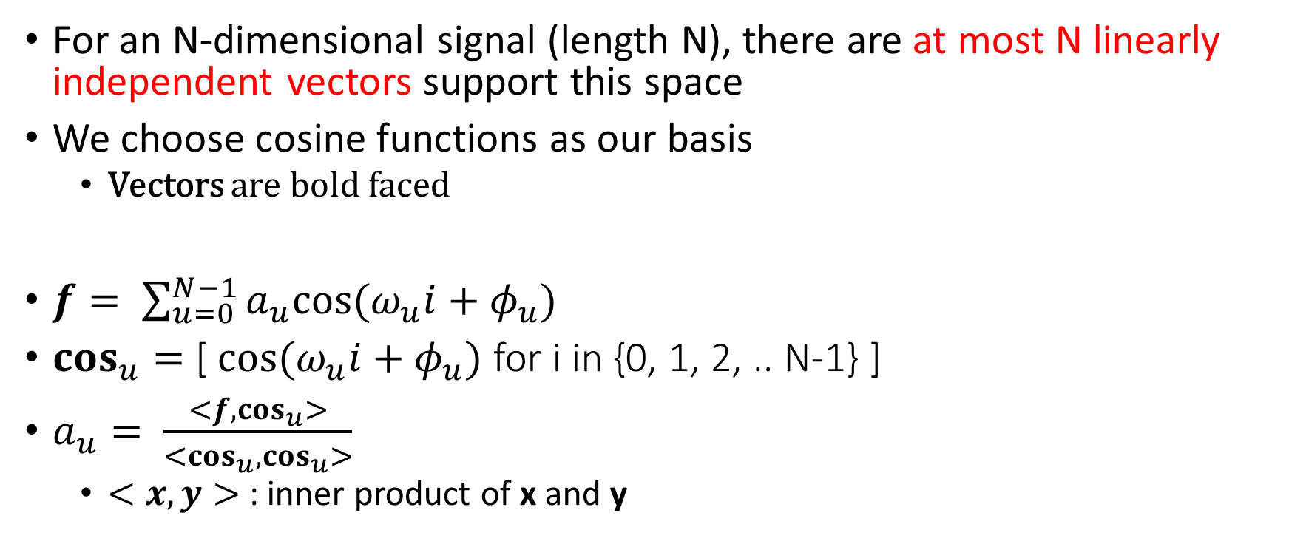
Basic Linear Algebra
For an N-dimensional signal (length N), there are at most N linearly independent vectors support this space
We choose cosine functions as our basis
Vectors are bold faced
$f= \sum_{u=0}^{N−1}{a_{u}cos⁡(ω_{u}i+φ_{u})}$
$\cos_{u}{= }$[$cos⁡(ω_{u}i+φ_{u})$ for i in {0, 1, 2, .. N-1} ]
$a_{u}= \frac{<f,\cos_{u}>}{<\cos_{u},\cos_{u}>}$
$<x, y>$: inner product of x and y

Slide 4


The Normalization Factor, $C(u)$
$<\cos_{u},\cos_{u}>= \sum_{i=0}^{N−1}{{\left[\cos\left(ω_{u}i+φ_{u}\right)\right]}^{2}}$

