Slide 1
12.93
0
12.93
0
12.93
0
用matlab画个类似这样的图
12.93
12.93
12.93
12.11
0
0
12.93
0
12.93
0
0
12.93
0
12.93
12.93
0
0

Slide 2
…
Inputs
Hourly integrated energy system optimisation model
…
Outputs
Weather-dependent renewable generation available capacity
Objective: minimising total operating cost
Constraints:
Offshore wind generation, hydrogen and ammonia productions
Connection point of offshore wind farms and hydrogen platforms
Offshore wind farms
Power network
Natural gas supply
Operating strategies of power-to-gas facilities, gas sources, renewable generations, and other flexible generating units
Power-to-gas facilities
Nodal energy demands (including power, natural gas, hydrogen, and ammonia)
Onshore renewable generations (including solar, wind, and hydro)
Gas-fired power plants
Gas storage
Geo-referenced energy system structures
Thermal generations (including coal, natural gas, oil, gasoil, and waste)
Operating conditions of power and gas networks
Gas network
Hydrogen injection
Physical, economic, and carbon emission parameters of energy system components
Physical constraints (such as power line capacity, and generation capacity)
Flexibility constraints (such as ramping, on-off status, and operating reserves)
Security constraints (such as inertia, must-run-units, and gas interchangeability)
Distribution of hydrogen molar fractions
Operation codes of power and gas systems

Slide 3
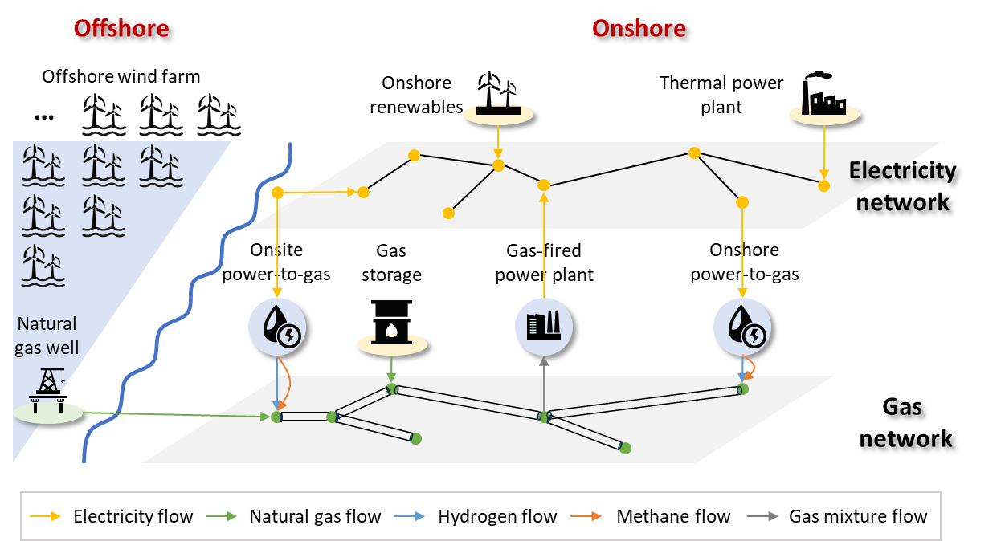
…
Inputs
Hourly integrated energy system optimisation model
…
Outputs
Objective: minimising total operating cost
Constraints:
Weather-dependent renewable generation available capacity
Offshore wind generation, hydrogen and ammonia productions
Connection point of offshore wind farms and hydrogen platforms
Operating strategies of power-to-gas facilities, gas sources, renewable generations, and other flexible generating units
Nodal energy demands (including power, natural gas, hydrogen, and ammonia)
Geo-referenced energy system structures
Operating conditions of power and gas networks
Physical, economic, and carbon emission parameters of energy system components
Physical constraints (such as power line capacity, and generation capacity)
Flexibility constraints (such as ramping, on-off status, and operating reserves)
Security constraints (such as inertia, must-run-units, and gas interchangeability)
Distribution of hydrogen molar fractions
Operation codes of power and gas systems

Slide 4

Offshore
Onshore
Offshore wind farm
Onshore renewables
Thermal power plant
…
Electricity network
Onsite power-to-gas
Gas
storage
Gas-fired power plant
Onshore power-to-gas
Natural gas well
Gas
network
Electricity flow
Natural gas flow
Hydrogen flow
Methane flow
Gas mixture flow

