Slide 1
Quantitative Analysis of Air Conditioner Aggregation
for Providing Operating Reserve
Hongxun Hui, Weidong Liu, Yi Ding, Yonghua Song
June 2016
Notes:
Thanks chairman, Good afternoon everyone. I’m Hongxun Hui, a PhD student studying in Zhejiang University. My advisor is Yi Ding. He is a Professor in the College of Electrical Engineering. Thank him for supporting me to attend this meeting.
Today, my topic is “Quantitative Analysis of Air Conditioner Aggregation for Providing Operating Reserve”.

Slide 2

CONTENTS
ZJU
1
  Introduction
2
  Quantitative Analysis of Air Conditioner Operating Reserve
3
  Quantitative Analysis of Air Conditioner Aggregation Operating Reserve
4
  Case Studies and Discussions
Notes:
This is my contents. There are four sections: Introduction, Quantitative Analysis of Air Conditioner Operating Reserve.
Section 3 is Quantitative Analysis of Air Conditioner Aggregation Operating Reserve. Finally, it’s Case Studies and Conclusions.

Slide 3

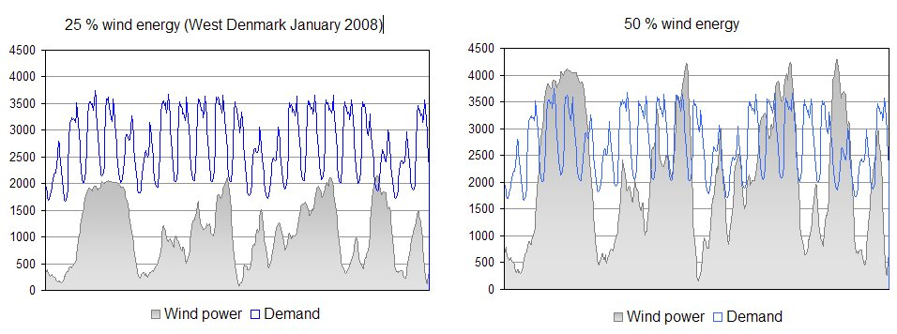
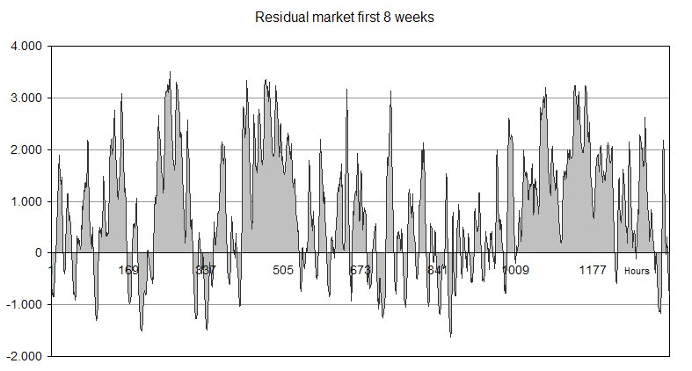
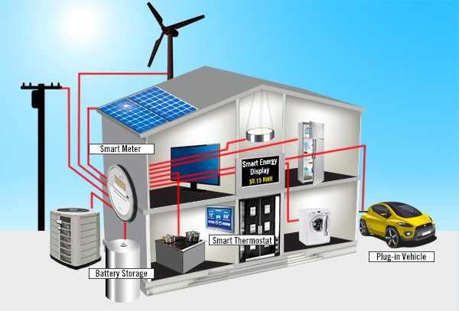
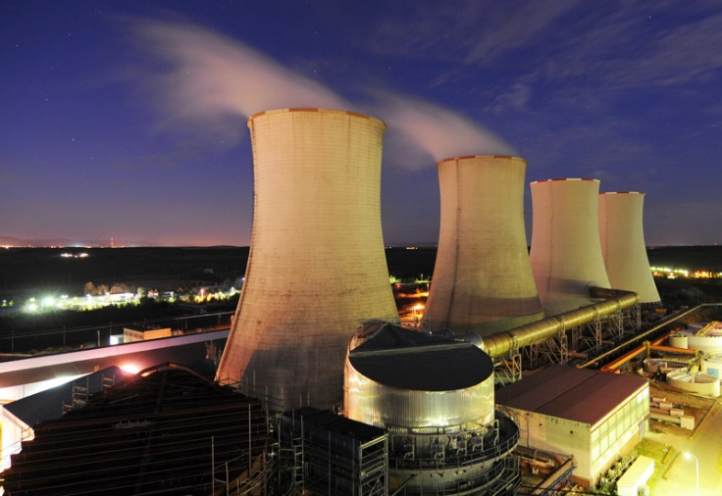
Background: Operating reserve
ZJU
Residual demand
Overflow
Fig.1. EcoGrid EU-assumed wind power capacity in 2025^{[1]}
[1] Ding Y, Nyeng P, Ostergaard J, et al. Ecogrid EU-a large scale smart grids demonstration of real time market-based integration of numerous small DER and DR
Fig.2. Smart house
Fig.3. Conventional generating units
Notes:
For example, the figure 4 is the assumed wind power capacity in 2025 in Denmark. Sometimes, the wind power is able to meet the demand, but sometimes not. In the future, this will happen more frequently.
So this put forward more significant requirements of operating reserve, for maintaining system balance between generation and demand.
Operating reserve is an important concept for ensuring the planning of generators' schedule can withstand the uncertainty.
Operating reserve is the generating capacity, which is available to the system operator within a short interval of time. Most power systems are designed that, the operating reserve is always at least the capacity of the largest generator plus a fraction of the peak load.
In general, the operating reserve comes from the conventional generating units. However, with the development of information and communication technologies, it has been possible that small end-consumers provide operating reserve.

Slide 4

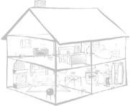
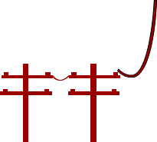

Background: Interaction between generation and consumption
Traditional thermal plants
interaction
Hydroelectric
Wind plants
PV
Generation
Consumption
Fig.4. Interaction between generation and consumption
  Air conditioners are one of the most popular and significant flexible demands.
  Several indexes for operating reserve provided by flexible demands are quantified, including reserve capacity, response time, duration time and ramp rate.
Notes:
This slide shows the Interaction between generation and consumption. Flexible demands, such as air conditioners, heat pumps and plug-in electric vehicles, they are fast growing and account for a larger share in the power consumption side.
Many studies have shown that flexible demands have positive effects on system balance between generation and demand.
However, the research on operating reserve performance of flexible demands is not sufficient. In this paper, a quantitative analysis method of air conditioner aggregation for providing operating reserve is proposed.
Since air conditioners are one of the most popular and significant flexible demands.
Similar to the operating reserve provided by conventional generating units, several indexes for operating reserve provided by flexible demands are quantified, including reserve capacity, response time, duration time and ramp rate.

Slide 5
CONTENTS
ZJU
1
  Introduction
2
  Quantitative Analysis of Air Conditioner Operating Reserve
3
  Quantitative Analysis of Air Conditioner Aggregation Operating Reserve
4
  Case Studies and Discussions
Notes:
The next section is Quantitative Analysis of Air Conditioner Operating Reserve.

Slide 6
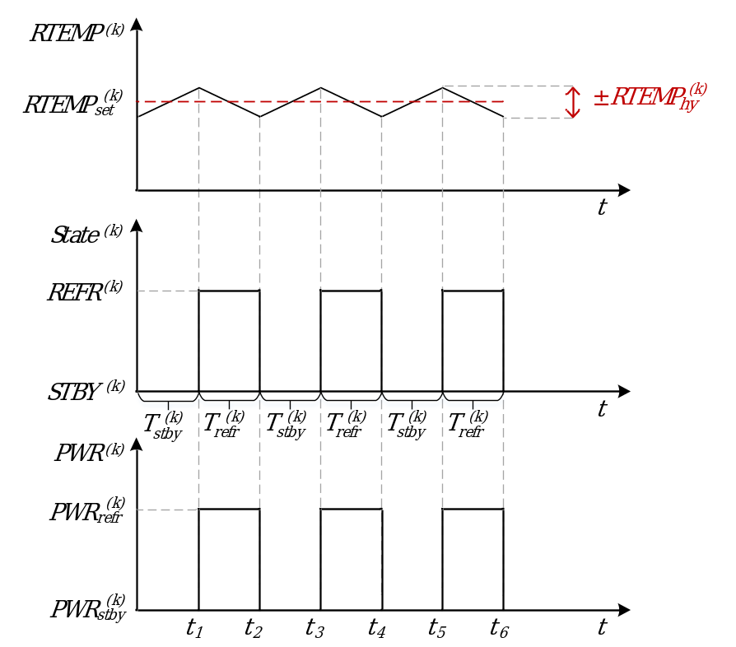
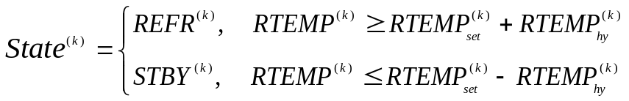
Normal operation characteristics of AC
Fig.5. Normal operation characteristics of air conditioner(AC)
The kth room temperature(RTEMP) interval can be expressed as
(1)
The kth AC’s operating state can be expressed as
(2)
Notes:
First, let’s analyze the normal operation characteristics of one air conditioner.
This is the room temperature, state of air conditioner and the power of air conditioner. The room temperature is set by the consumers who are living in the room. However, the temperature cannot strictly equal to the set temperature all the time. There is a temperature hysteresis of control , which means the highest difference between the real room temperature and the set temperature is RTEMPhy. The kth room temperature interval can be expressed as equation one.
In this paper, it is assumed that all the air conditioners operate in the refrigeration state. So, the kth air conditioner’s operating state can be expressed as equation 2. That is to say, when the room temperature is equal to or higher than the upper limit value , the air conditioner is turned on. Conversely, when the room temperature is equal to or lower than the lower limit value , the air conditioner is turned to standby state.
Actually, the power in this figure is not accurate. The refrigeration power is not a constant and the standby power is not zero in practice. The power is related to a lot of factors, such as the room area, the house internal construction, the ambient temperature and the power limit of air conditioner. Therefore, the refrigeration power and the length of refrigeration time are different at different times of the day.

Slide 7
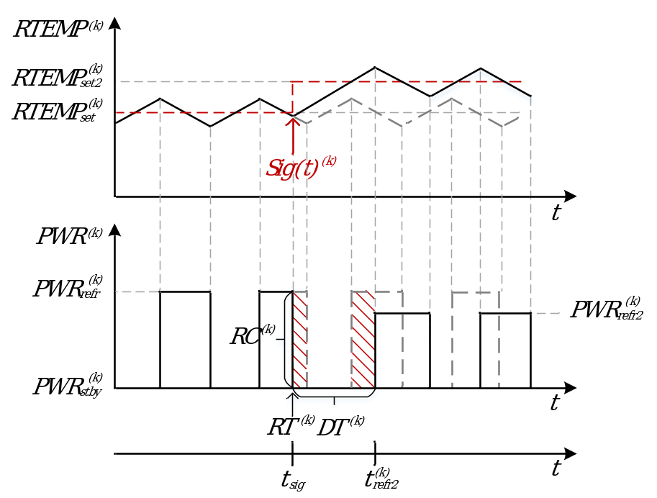
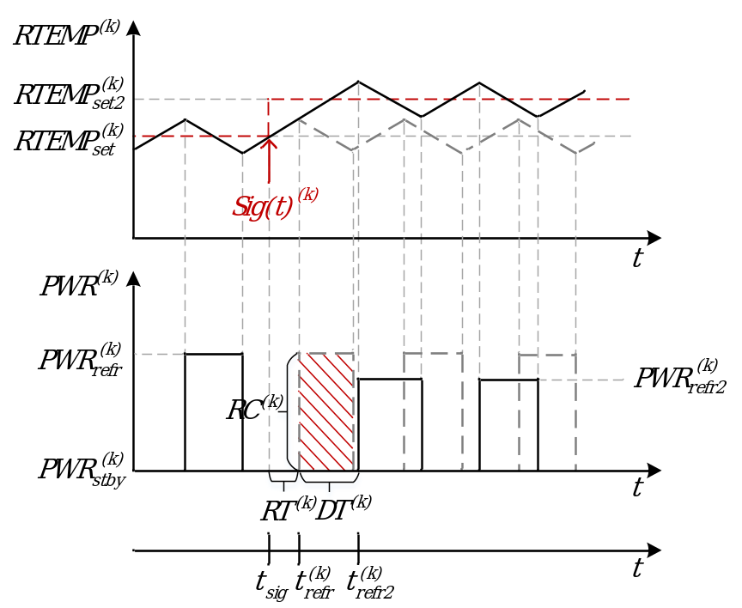



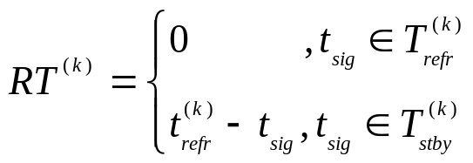
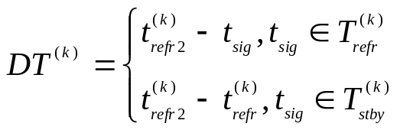
Operating reserve performance of AC
Fig.6. Operating reserve performance of AC
(a) Sig is received in ; (b) Sig is received in
The operating reserve can be quantified as
(3)
(4)
(5)
Notes:
This slide shows the operating reserve performance of one air conditioner. Air conditioners can provide operating reserve by cutting down the consumption of power.
There are two different figures, because at different control signal time, air conditioner has different operating reserve performance. It can be divided into two typical cases: control signal is received in the refrigeration state period or in the standby state period.
In this paper, the control strategy is resetting the temperature. Compared with the on/off control strategy, resetting the temperature is a softer approach to influence the consumers. By increasing the set temperature from RTEMPset to RTEMPset2, the air conditioner can decrease the power consumption and extend the standby time.
The operating reserve can be quantified as equation 3, 4 and 5. The most important principle to calculate these indexes is comparison analysis between normal operation and after-signal operation.
We can see that, these two cases have the same reserve capacity. But response time and duration time are different. The response time in the first case is zero, but in the second case is t refrigeration minus t signal. The duration time in the first case is t refrigeration2 minus t signal, but in the second case is t refrigeration2 minus t refrigeration.

Slide 8
CONTENTS
ZJU
1
  Introduction
2
  Quantitative Analysis of Air Conditioner Operating Reserve
3
  Quantitative Analysis of Air Conditioner Aggregation Operating Reserve
4
  Case Studies and Discussions
Notes:
The next section is Quantitative Analysis of Air Conditioner Aggregation Operating Reserve.

Slide 9
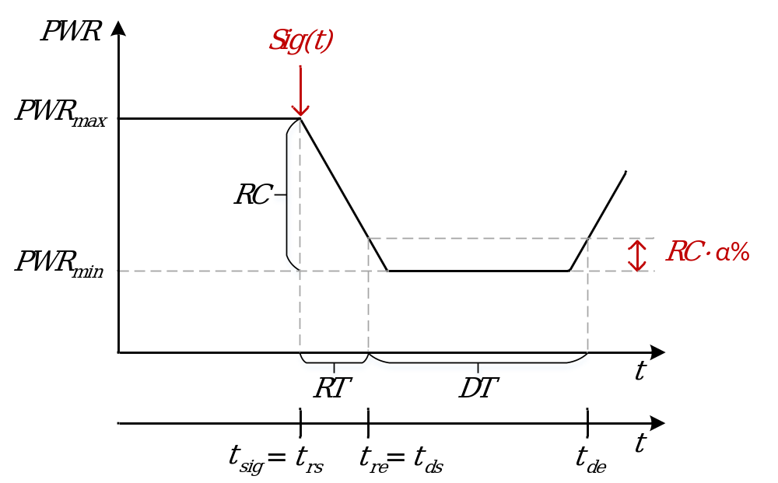




Quantitative Analysis of AC Aggregation Operating Reserve
Fig.7. Operating reserve performance of AC aggregation
Reserve capacity of AC aggregation can be calculated as
(6)
Duration time can be calculated as
(7)
(8)
(9)
Notes:
Air conditioner aggregation contains N number of air conditioners. They have different rated powers, different Energy Efficiency Ratios, different set temperatures.
And correspondingly, there are N number of rooms. Each room’s area and internal construction are different.
Moreover, every consumer has his or her own way of life. That is, the number of available air conditioners is different at different times of the day. Because only the air conditioners which have been turned on and the corresponding room temperature is lower than the preset highest tolerable temperature are available.
In analogy to the generators that provide operating reserve, four indexes are quantified: reserve capacity, response time, duration time and ramp rate.
As shown in equation six, reserve capacity can be calculated as maximum power minus minimum power. Here, the maximum power is the real-time power when receiving the signal.
For the duration time, first, we should solve the equation seven. Power t equals to maximum power minus reserve capacity multiply bracket one minus alpha. Here, the alpha is an important parameter. Because the minimum power is not a strict horizontal line in fact. So here, we define the interval – “reserve capacity multiply alpha” is the duration time.
The equation seven has two solutions: tds and tde. The duration time is tde minus tds.

Slide 10


Quantitative Analysis of AC Aggregation Operating Reserve
Fig.8. Operating reserve performance of AC aggregation
Response time can be calculated as
(10)
Ramp rate can be calculated as
(11)
Notes:
The response time can be calculated as tre minus trs. It’s equal to tds minus tsignal.
Finally, the ramp rate can be calculated as RC multiply bracket one minus alpha, then divide response time.

Slide 11
CONTENTS
ZJU
1
  Introduction
2
  Quantitative Analysis of Air Conditioner Operating Reserve
3
  Quantitative Analysis of Air Conditioner Aggregation Operating Reserve
4
  Case Studies and Discussions
Notes:
Then it’s the four section, case studies and discussions.

Slide 12


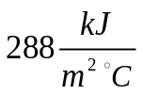
Case Studies and Discussions
Initialization of parameters-1
  The initial temperatures:
  Set temperatures of each AC distribute randomly between 23℃ and 26℃.
  The temperature hysteresis of control is 1℃.
  Each AC’s will increase 1℃ to after receiving the signal.
  Each room’s parameters:
  The area of each room is generated as N values in the normal distribution (the mean value is 100m², and the standard deviation is 40m²).
  The height of each room is 2.5m.
  The heat capacity is .
  Each air conditioner’s parameters:
  Assumed that each AC’s rated power equals to sixtyfold area. That is, the rated power is 1800W if the corresponding room area is 30m².
  The Energy Efficiency Ratios (EER) distribute randomly between 3.0 and 3.6.
Notes:
These are the initialization of parameters.
Square meters. Watt.

Slide 13
Case Studies and Discussions
Initialization of parameters-2
  Table A-1. The ambient temperature on August 1 in Hangzhou, China^{[3]}
Time(CST) | Temperature | Time(CST) | Temperature | Time(CST) | Temperature | Time(CST) | Temperature
12:00 AM | 86.0 °F | 6:00 AM | 82.4 °F | 12:00 PM | 96.8 °F | 6:30 PM | 95.0 °F
12:30 AM | 86.0 °F | 6:30 AM | 84.2 °F | 12:30 PM | 98.6 °F | 7:00 PM | 93.2 °F
1:00 AM | 82.4 °F | 7:00 AM | 86.0 °F | 1:00 PM | 98.6 °F | 7:30 PM | 93.2 °F
1:30 AM | 84.2 °F | 7:30 AM | 86.0 °F | 1:30 PM | 98.6 °F | 8:00 PM | 91.4 °F
2:00 AM | 84.2 °F | 8:00 AM | 89.6 °F | 2:30 PM | 98.6 °F | 8:30 PM | 91.4 °F
2:30 AM | 82.4 °F | 8:30 AM | 89.6 °F | 3:00 PM | 96.8 °F | 9:00 PM | 91.4 °F
3:00 AM | 82.4 °F | 9:00 AM | 91.4 °F | 3:30 PM | 96.8 °F | 9:30 PM | 91.4 °F
3:30 AM | 82.4 °F | 9:30 AM | 93.2 °F | 4:00 PM | 93.2 °F | 10:00 PM | 91.4 °F
4:00 AM | 82.4 °F | 10:00 AM | 93.2 °F | 4:30 PM | 95.0 °F | 10:30 PM | 89.6 °F
4:30 AM | 80.6 °F | 10:30 AM | 95.0 °F | 5:00 PM | 95.0 °F | 11:00 PM | 87.8 °F
5:00 AM | 80.6 °F | 11:00 AM | 95.0 °F | 5:30 PM | 96.8 °F | 11:30 PM | 86.0 °F
5:30 AM | 80.6 °F | 11:30 AM | 96.8 °F | 6:00 PM | 95.0 °F
  α%=10%
  N=100, 500, 1000, 5000
[3] https://www.wunderground.com/
Notes:
This is the ambient temperature in the simulation. We chose an ordinary day in summer in Hangzhou.
The alpha is set to ten percent.
N is set to 100, 500, 1000 and 5000.

Slide 14
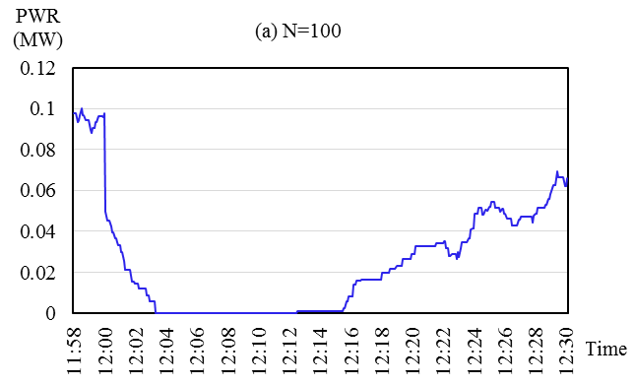
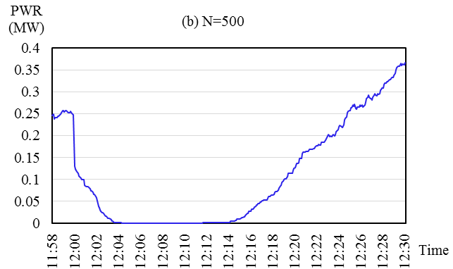
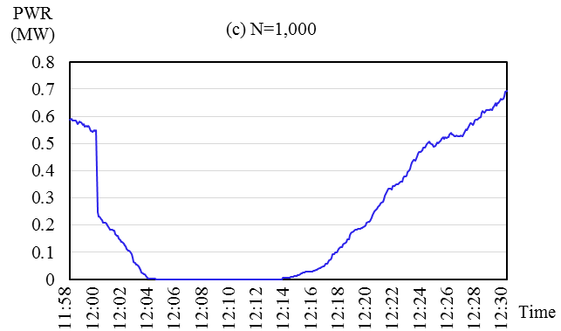
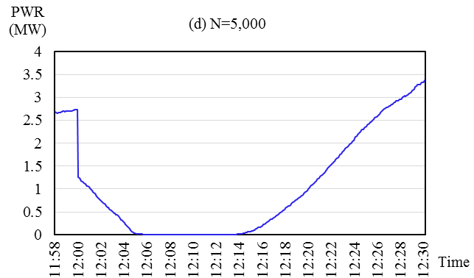
Case Studies and Discussions
The simulation results-1
Fig.9. The simulation curves
(a) N=100; (b) N=500; (c) N=1,000; (d) N=5,000
Notes:
This is the simulation results. The control signal time is 12:00 PM. We can see that the power decrease temporarily.

Slide 15
Case Studies and Discussions
The simulation results-2
  Table 1. The simulation result
Indexes | N=100 | N=500 | N=1,000 | N=5,000
RT (Min) | 2.75 | 2.67 | 3.00 | 4.08
DT (Min) | 13.42 | 13.25 | 13.92 | 12.42
RC (MW) | 0.0977 | 0.2480 | 0.5493 | 2.7396
RR (MW/Min) | 0.0319 | 0.0836 | 0.1648 | 0.6043
  Discussions and Conclusions:
  RT is short enough to provide operating reserve. (RT≤10min)
  DT is nearly invariable.
  RC and RR increase proportionally to the variable N.
  The flexible demands have huge potential for providing operating reserve.
  This paper proposed a method for quantitatively analyzing potential of AC aggregation for providing operating reserve.
Notes:
The data in the table 1 is more clear.
We can see that the response time is short enough to provide operating reserve. Since the air conditioner aggregation is able to reach the maximal reserve capacity within ten minutes. As the number of air conditioners gets larger, the response time has an increasing trend with slight changes.
The duration time is nearly invariable.
The reserve capacity and the ramp rate increase proportionally to the variable N.
However, there are some flaws in the simulation:
1)The effect of communication delay is not considered in this case. So the response time may be longer in practice.
2) It is also unpractical that all the air conditioners will increase 1 degree after receiving the control signal, because different consumers have different requirements in comfort.
3) Therefore, the reserve capacity depends on consumers acceptance seriously.
Finally, the conclusions are that: 1) 2).

Slide 16
Thank you for
your attention!
Notes:
That’s my presentation, thank you for your attention!

