Slide 1

Modeling and analysis of inverter air conditioners for primary frequency control considering signal
delays and detection errors
Hongxun Huiª, Yi Dingª, Yonghua Songª, Shihai Yang^{b}
a. College of Electrical Engineering, Zhejiang University, Hangzhou, China
b. State Grid Jiangsu Electric Power Research Institute, Nanjing, China
August 2018
Notes:
Thanks chairman, Good morning everyone. I’m Hongxun Hui, a PhD student in Zhejiang University. My advisor is Professor Yi Ding. Thank him very much for supporting me to attend this conference.
Today, my topic is “Modeling and analysis of inverter air conditioners for primary frequency control considering signal delays and detection errors”.

Slide 2
Contents
1.
  Background
2.
  Modeling of inverter air conditioners
3.
  Control strategy of inverter air conditioners
4.
  Case studies
5.
  Discussions and conclusions
Notes:
This is my contents. There are five sections. Firstly, I will introduce the background, and then develop the model of the inverter air conditioner, and then introduce the control strategies and case studies.

Slide 3
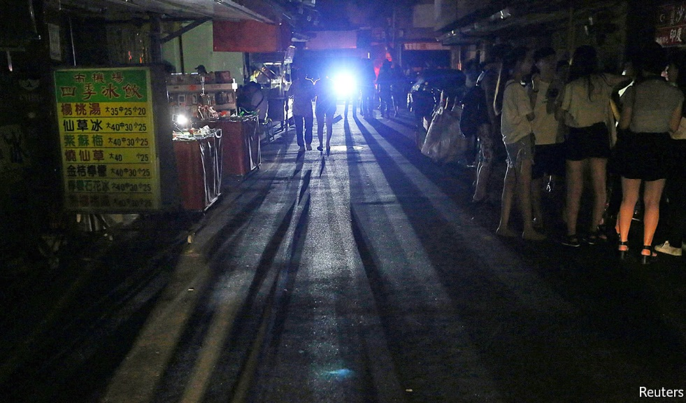
1. Background (I)
https://www.economist.com/asia/2017/08/17/a-massive-blackout-prompts-questions-about-taiwans-energy-policy
Fig. 1 The blackout in Taiwan on Aug. 15, 2017
  - The large-scale blackouts are increasing.
  The blackout in Taiwan on Aug. 15, 2017 affected about 6.68 million customers^{[1]}.
  The blackout in Brazil on Mar. 21, 2018 resulted in 22.5% failure of power output^{[2]}.
  - The fundamental reason is the shortage of the operating reserve.
[1] Wu H, et al. Administrative investigation report on the 815 power failure. Executive Yuan, Taiwan, Republic of China, Tech. Rep. 1060907, Sep. 2017. <http://www.ey.gov.tw>
[2] U.S. News. Tens of Millions in Northern Brazil Hit by Massive Power Outage. <https://www.usnews.com/news/world/articles/2018-03-21/tens-of-millions-in-northern-brazil-hit-by-massive-power-outage>
Notes:
The background is that, large-scale blackouts are increasing around the world. For example, the blackout in Taiwan on Aug. 15, 2017 affected about 6.68 million customers. This accident has become the worst blackout in the past 20 years of Taiwan.
Based on the survey report, the direct reason of the accident is the interruption of the gas supply to the power plant. However, the fundamental reason is the shortage of the operating reserve. The operating reserve is the power generation capacity to deal with the power fluctuations and maintain the system balance between supply and demand. Before the blackout, the operating reserve in Taiwan is only around 3%.

Slide 4

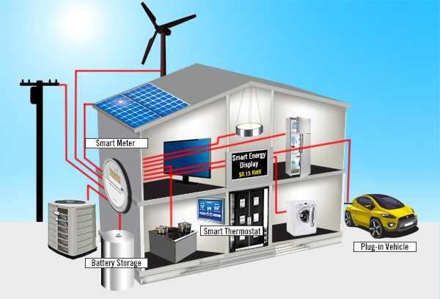
1. Background (Ⅱ)
  Conventionally, the operating reserve is provided by traditional generation units, such as the thermal power plants or hydro turbines^{[3]}.
https://image.baidu.com
Fig. 2 Traditional generation units
  The development of the information and communication technology makes it easier for household appliances to provide operating reserve, which we can call smart home^{[4]}.
https://image.baidu.com
Fig. 3 Smart home system
[3] Rebours YG, Kirschen DS, Trotignon M, Rossignol S. A survey of frequency and voltage control ancillary services—Part I: Technical features. IEEE Trans. Power Syst., vol. 22, no. 1, pp. 350-357, Feb. 2007.
[4] Siano P. Demand response and smart grids—A survey. Renew. Sustain. Energy Rev., vol. 30, pp. 461-478, Feb. 2014.
Notes:
Conventionally, the operating reserve is provided by traditional generation units, such as the thermal power plants or hydro [ˈhaɪdroʊ] turbines. However, these traditional generation units may be phased out gradually in the future. And the operating reserve capacity may be insufficient to deal with the large-scale contingency accidents.
With the development of the information and communication technology, the smart home system has made great progress and has been used in more houses. Therefore, the household appliances can be controlled faster and it’s easier to provide the operating reserve for the power system.

Slide 5
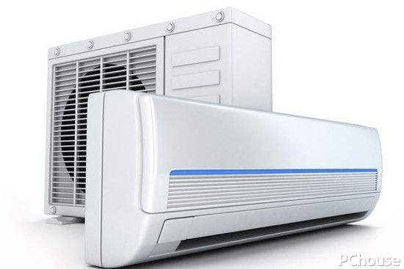
1. Background (Ⅲ)
  Air conditioners (ACs) account for a large share in the power consumption^{[5]}.
  ACs can be regulated in a short time without much influence on the customer comfort^{[6]}.
https://image.baidu.com
Fig. 4 Air conditioners
  Regular fixed speed air conditioners.
  Inverter air conditioners (IAC).
  Can be adjusted more flexibly.
  Have little influence on the IAC life time.
[5] Hui H, Ding Y, Liu W, Lin Y, Song Y. Operating reserve evaluation of aggregated air conditioners. Appl. Energy, vol. 196, pp. 218-228, Jun. 2017.
[6] What is Inverter Technology AC, Bijli Bachao, Tech. Rep., 2017. <https://www.bijlibachao.com>
Notes:
Among the household appliances, air conditioners account for a large share in the power consumption. It has been proved in many papers that the air conditioners can be regulated in a short time without much influence on the customer comfort. So the air conditioners have huge potential to provide operating reserve.
The air conditioners can be divided to two categories, the regular fixed speed air conditioners and inverter air conditioners. The main difference of the two kinds of air conditioners is the compressor. The traditional air conditioner’s compressor can only operate in two modes, ON or OFF. However, the inverter air conditioner’s compressor can be adjusted continuously. Therefore, the inverter air conditioner can be controlled and regulated more flexibly and have little influence on their life time. To sum up, the inverter air conditioners are more suitable to provide operating reserve for the power system.
This paper will develop the model of inverter air conditioners, and then compare two kinds of control strategies to provide operating reserve for the power system.

Slide 6
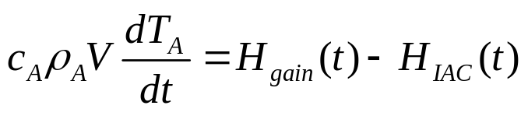


2. Modeling of the inverter air conditioner (IAC)
The thermal model of a room^{[8]}:
(1)
Heat gains of the room:
(2)
The refrigerating capacity:
(3)
The operating power of an IAC:
(4)
Compressor’s operating frequency
[7] Shao S, Shi W, Li X, Chen H. Performance representation of variable-speed compressor for inverter air conditioners based on experimental data. Int. Journ. Refrig., vol. 27, no. 8, pp. 805-815, Dec. 2004.
[8] Hui H, Ding Y, Zheng M. Equivalent Modeling of Inverter Air Conditioners for Providing Frequency Regulation Service. IEEE Trans. Ind. Electron. doi: 10.1109/TIE.2018.2831192, in press, 2018.
Notes:
This slide shows the model of the inverter air conditioner. Because the power consumption of an inverter air conditioner is related to the indoor temperature and the ambient temperature. Therefore, it is necessary to build the thermal model of a room, as shown in equation 1. The indoor temperature is related to the heat gains and the refrigerating capacity, as shown in equation 2 and 3. These three equations are the same with the regular fixed speed air conditioners.
The difference is the equation 4. The operating power of the inverter air conditioner is related to the operating frequency of the compressor. As for an inverter air conditioner, the compressor accounts for the maximum share of the power consumption. Therefore, the control strategy is aimed at the compressor.
-heat capacity of the air, density of the air, room volume, the indoor temperature.
-heat transfer coefficient, the surface area of the room, the air exchange times, random disturbances from people.

Slide 7



3. The control method of IACs (I)
The basic control method
The basic control strategy of an IAC (PI controller):
Temperature deviation of the indoor temperature and the set temperature:
The improved control strategy of an IAC (PI controller + P controller):
(5)
Power system’s frequency deviation
Notes:
So next, I want to introduce the control method of the inverter air conditioner. If the inverter air conditioner doesn’t participate in the regulation, the compressor’s operating frequency is determined by the temperature deviations of the indoor temperature and the set temperature. It’s a PI controller.
However, if the inverter air conditioner can provide operating reserve for the power system, the power consumption of the IAC should be regulated with the system frequency, as shown in equation 5. If the power system’s frequency decreases, the operating frequency of the compressor will also be reduced to decrease the power consumption.
-temperature deviation of the indoor temperature and the set temperature
-the constant coefficients of the proportional-integral-controller
-the power system frequency deviation

Slide 8
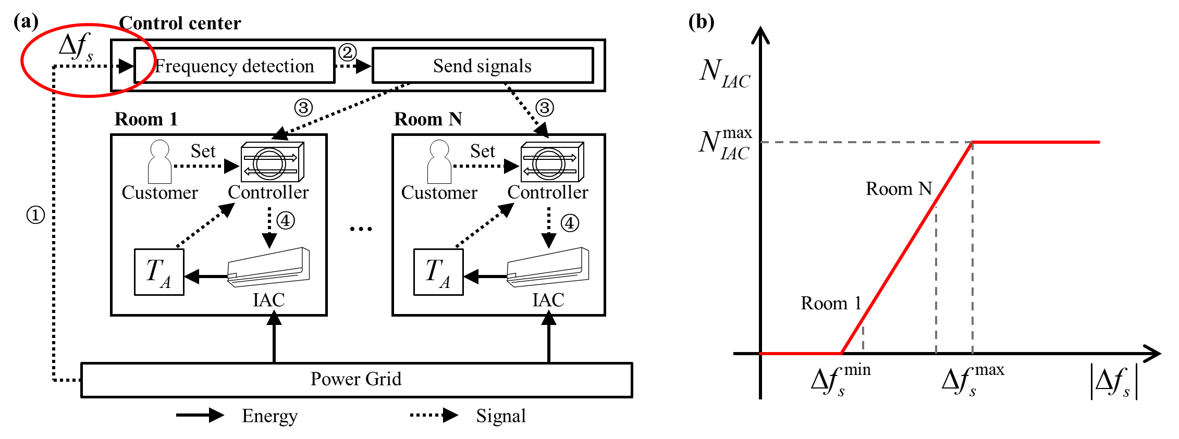
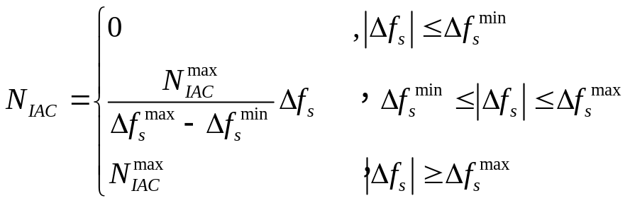
3. The control method of IACs (Ⅱ)
The centralized detection control (CDC) of aggregated IACs
The control strategy of an IAC:
More IACs will be dispatched:
Notes:
As we all know, the regulation power of one inverter air conditioner is insignificant for the power system. A large number of them should be aggregated and controlled to provide operating reserve.
Here I want to introduce two methods to detect the system frequency deviations, the centralized detection control (CDC) method and distributed detection control (DDC) method.
This slide shows the centralized detection control method. The system frequency is detected by the control center. If the system frequency deviates from the rated value, the control center will send signals to IACs to take actions. With the increase of the system frequency deviation, more IACs will participate in the response, as shown in the right figure.
-temperature deviation of the indoor temperature and the set temperature
-the constant coefficients of the proportional integral controller
-the power system frequency deviation

Slide 9
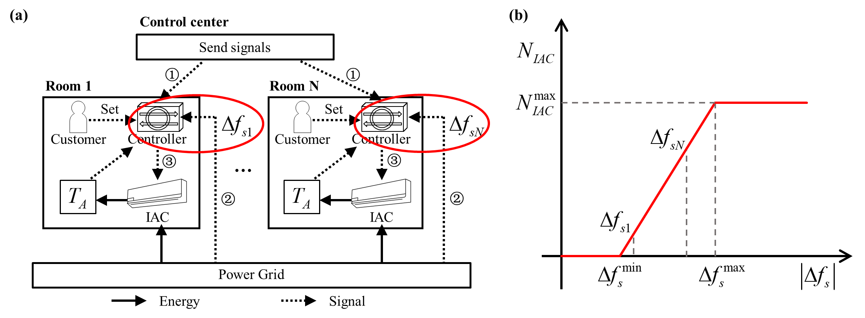
3. The control method of IACs (Ⅲ)
The distributed detection control (DDC) of aggregated IACs
The control strategy of an IAC:
The IACs are set different frequency thresholds to realize the same effect.
Notes:
The second is the distributed detection control (DDC) method. Different from the centralized detection control method, the system frequency is detected by each controller of the IAC. The control center will set different frequency thresholds to each inverter air conditioner in advance. Each inverter air conditioner’s frequency thresholds are randomly distributed from the minimum value to the maximum value. So more IACs will participate in the response with the increase of the system frequency deviation.

Slide 10
3. The control method of IAC (Ⅳ)
The comparison of the two detection control methods
 | Centralized detection method | Distributed detection method
Number of detection devices | fewer | more
Accuracy | better | lower
Communication time | longer | shorter
Notes:
These two detection control methods have different characteristics.
Generally, the number of the detection devices [dɪˈvaɪs] in the centralized detection method is far fewer than that in the DDC method. Moreover, the detection device is designed to monitor the system frequency more accurately in the first method, because the accuracy of the frequency detection will influence all the IACs. However, the control center has to send signals to the IACs in real time, which will lead to the communication delay.
In the second method, the control centre will set frequency thresholds of each IAC in advance. The system frequency deviation is detected locally. Therefore, there are less communication delays. However, in order to reduce the cost of the large number of controllers, the frequency detection may be not so accurate as that in the centralized detection method. So there may be some detection errors.
The case studies will analyse the effects of the communication delays and the detection errors in the two methods.

Slide 11



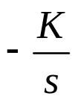

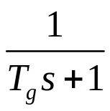
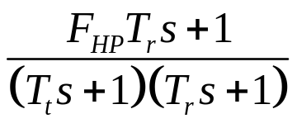

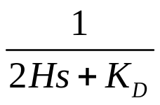



4. Case Studies (I)
The test system
  The initial parameters:
  The initial loads of the power system are 560MW.
  The number of the aggregated IACs is 30,000.
  The ambient temperature and the set temperature of the IAC are 33℃ and 26℃, respectively.
  The minimum and maximum thresholds of the system frequency deviation are 0.01Hz and 0.03Hz, respectively.
  It’s assumed that the load deviation is 80MW.
  The system:
The aggregated inverter air conditioners
Speed governor
Reheat steam turbine
Generator and loads
Notes:
Hertz [hɜ:rts]

Slide 12


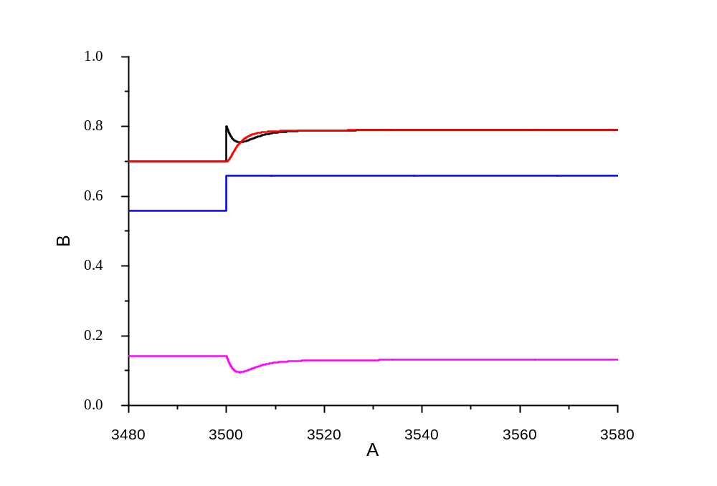

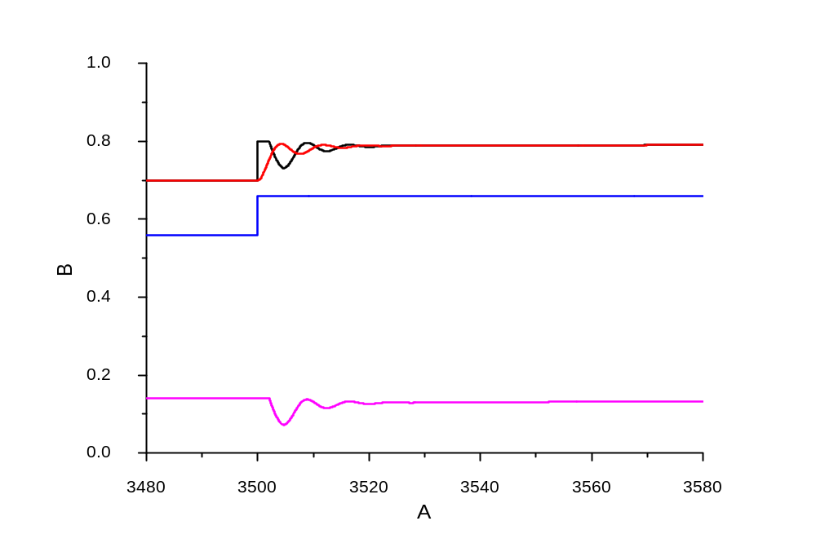

















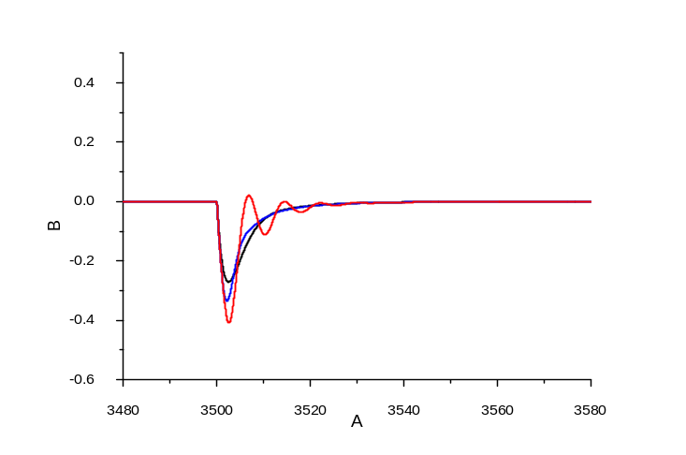









4. Case Studies (Ⅱ)
The simulation results - The centralized detection control
CASE | (HZ) | (MW)
Case 1 | -0.270 | -36.56
Case 2 | -0.335 | -44.80
Case 3 | -0.409 | -55.04
Notes:
As for the centralized detection control method, there are three cases. In Case 1, there is no communication delay, while in Case 2 and 3, the delay time are 1 second and 2 seconds, respectively.
The three figures in the first row are the three cases. The red line is the total power generation, the black line is the total power and consumption. The pink line is the power consumption by the inverter air conditioners, and the blue line is the power consumption by other loads. When the power consumption increases delta P_D, the IACs will decrease the power consumption to reduce the gap between the power generation and power consumption. Due to the communication delay time, there is a time lag in Case 2 and 3.
The influence on the power system can be seen more clearly from the system frequency curves and the table. The maximum system frequency deviation is minimum in Case 1. However, the system frequency deviation is larger and even bring oscillations [ˌɑ:sɪ'leɪʃəns] in Case 3.

Slide 13



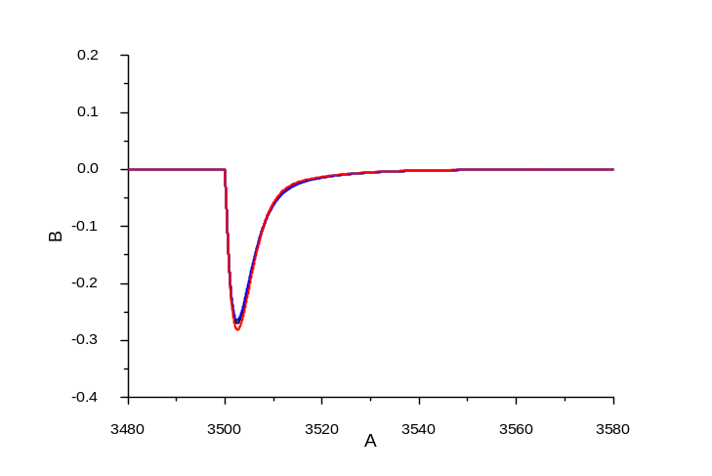




4. Case Studies (Ⅲ)
The simulation results - The distributed detection control
CASE | (HZ) | (MW)
Case 1 | -0.270 | -36.56
Case 2 | -0.265 | -37.60
Case 3 | -0.281 | -34.32
Notes:
As for the distributed detection control method, there are also three cases. In Case 1, there is no frequency detection errors, while in Case 2 and 3, the errors are random between 5% and negative 10%, respectively.
It can be seen that the maximum frequency deviation are similar in the three cases.
In the actual system, the frequency detection errors are randomly distributed among zero. Therefore, as for the aggregated IACs, the impacts of the detection errors can be ignored.

Slide 14
5. Discussions and Conclusions
  The model of the inverter air conditioner (IAC) is developed in this paper.
  Two detection control methods are proposed, the centralized detection control (CDC) method and the distributed detection control (DDC) method.
  The IACs have been proved to be able to provide operating reserve for the power system.
  The communication delays in the CDC method will enlarge the system frequency deviations and even bring frequency oscillations, while the detection errors in the DDC method have less influences on the system frequency deviation.
  Therefore, as for the large-scale aggregated IACs, the DDC method may be more appropriate than the CDC method.
Notes:
[ˌɑ:sɪ'leɪʃəns]
Finally I want to use one slide to show our future work.

Slide 15
Thanks for
your attention!
Notes:
That’s all. Thanks for your attention.

