Slide 1
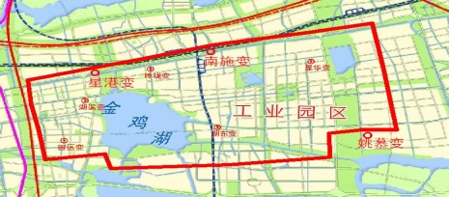
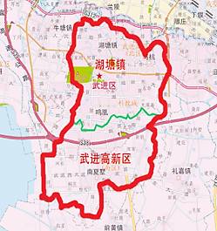
Demonstration in Suzhou City
Administrative region: 78 km²
Resident population: 780,000
Large industry customers：1420
Commercial customers：32437
Residential customers: 352,600
Load aggregators: 5
Demonstration in Changzhou City
Administrative region: 182 km²
Resident population: 1,600,000
Large industry customers：590
Commercial customers：21755
Residential customers: 530,000
Load aggregators: 3

Slide 2
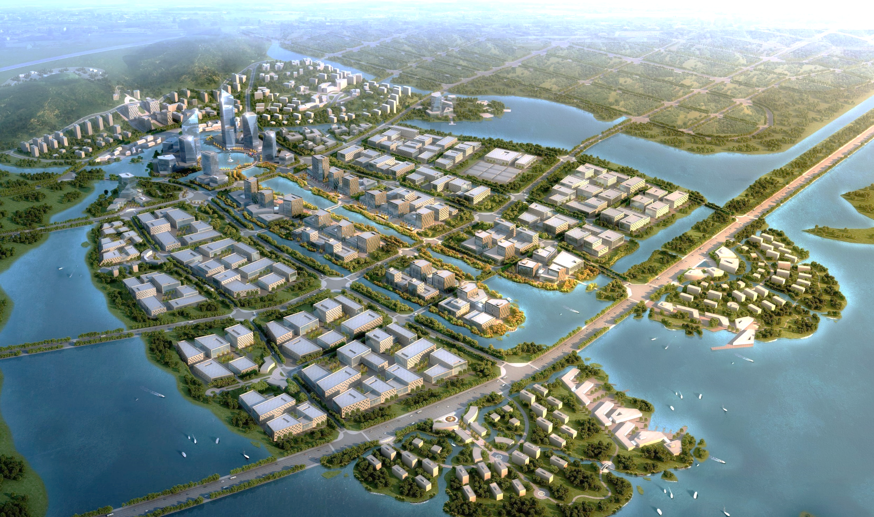









Upstream
Smart energy optimal scheduling platform
Internet of Things
Big data and artificial intelligence
Electric vehicles
EV Charging station
Manufacture of energy devices
……
……
Midstream
Manufacture of energy-saving equipment
Construction of zero-carbon house
Hydrogen fuel cell
Downstream
Smart energy distinctive town
Typical application scenarios
……

Slide 3
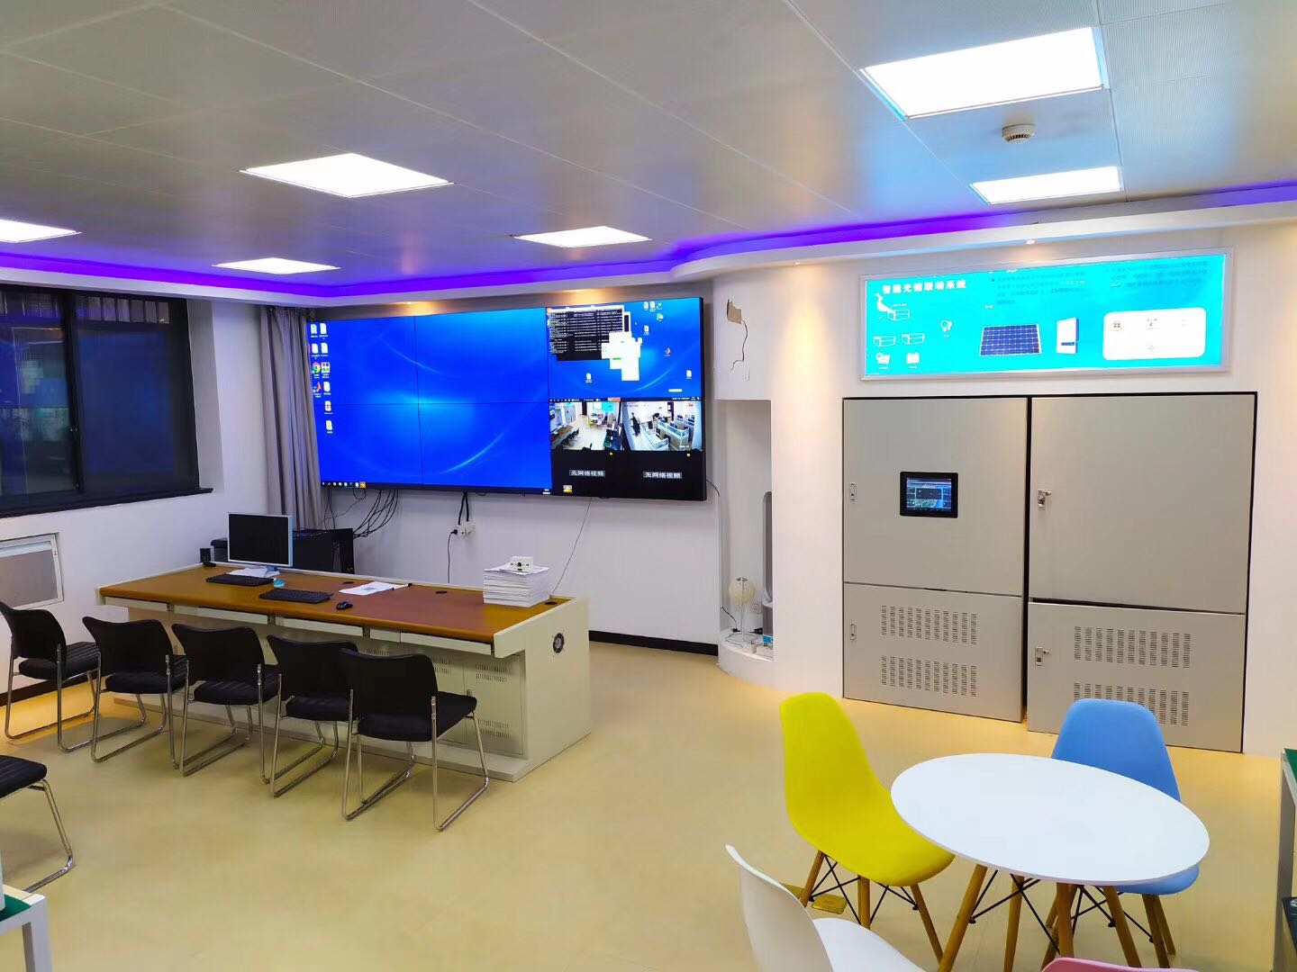



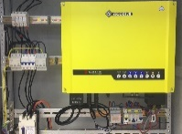
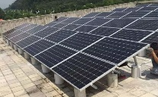

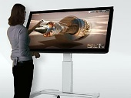
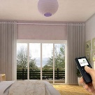
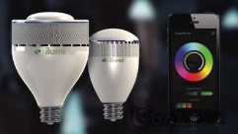
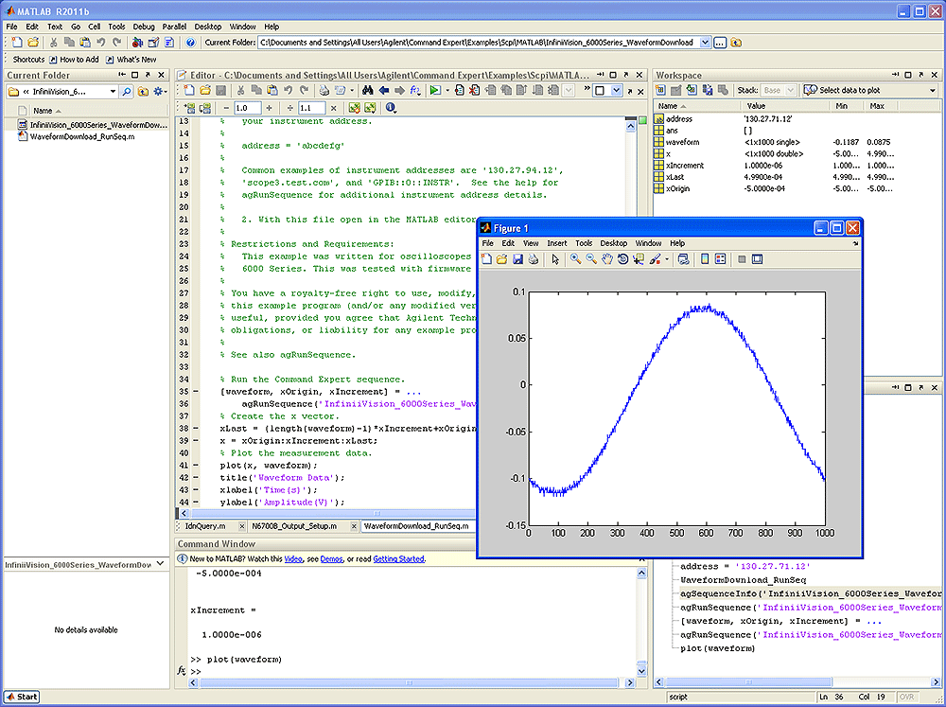
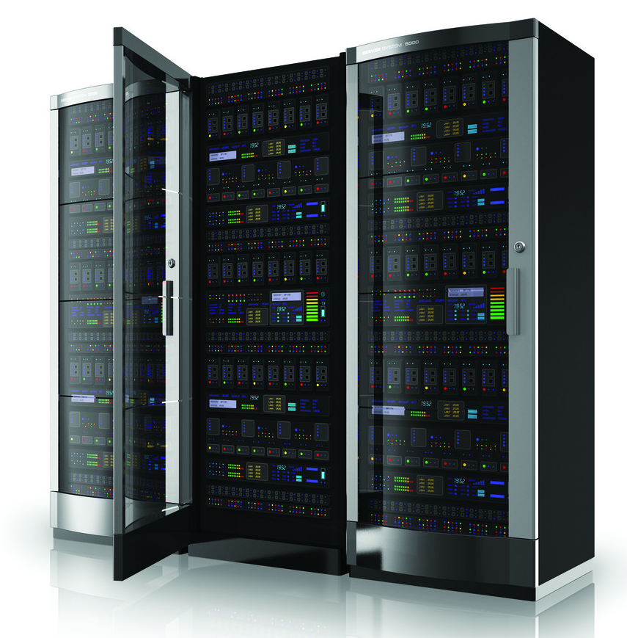
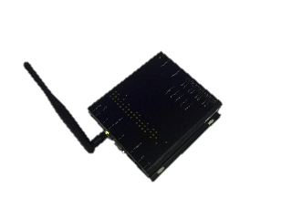
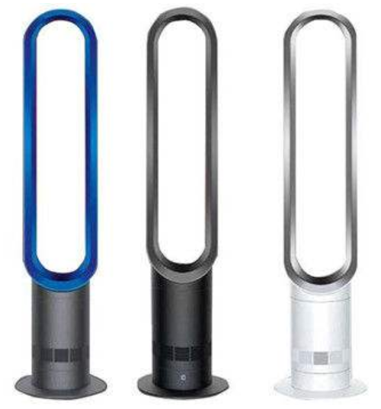
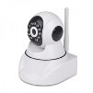
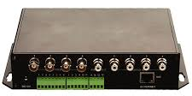
Power generation
Outside electric line
Inside electric line
PV and battery system
Lithium batteries
Inverter
PV
Electricity price simulation
Power generation simulation system
Electricity price broadcast
Video
Smart curtain
Smart lights
Large-scale power consumption simulation
Inside electric line
Air cleaner
Smart security system
Interface
Simulation server
Smart home system

Slide 4
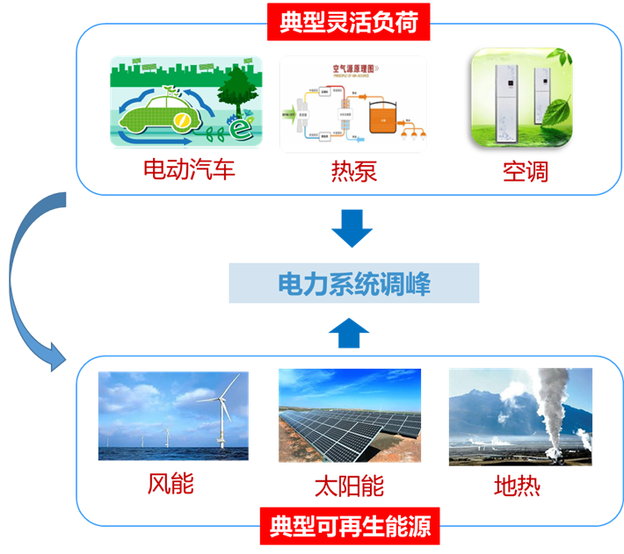
Typical flexible loads
EVs Heat pumps Air conditioners
Power system peak-shaving
Wind PV Geothermal
Typical renewable energies

Slide 5
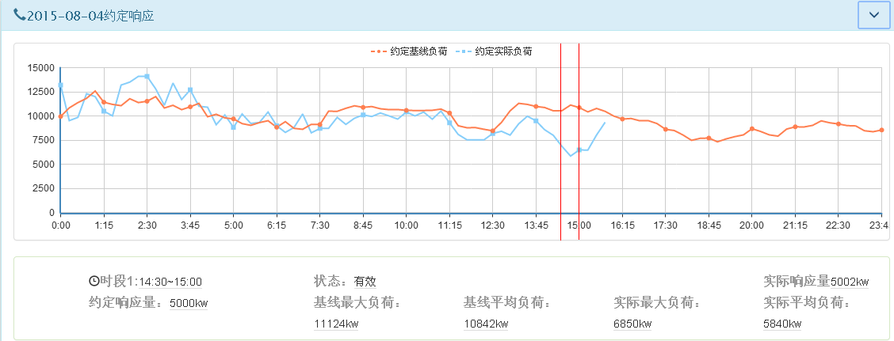
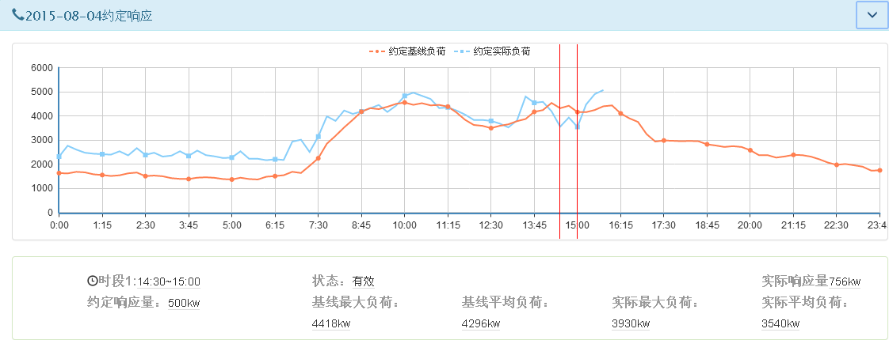
Customer A
Customer B

Slide 6
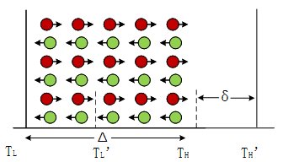
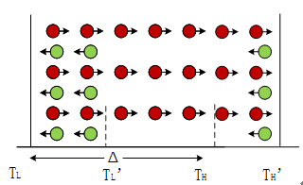
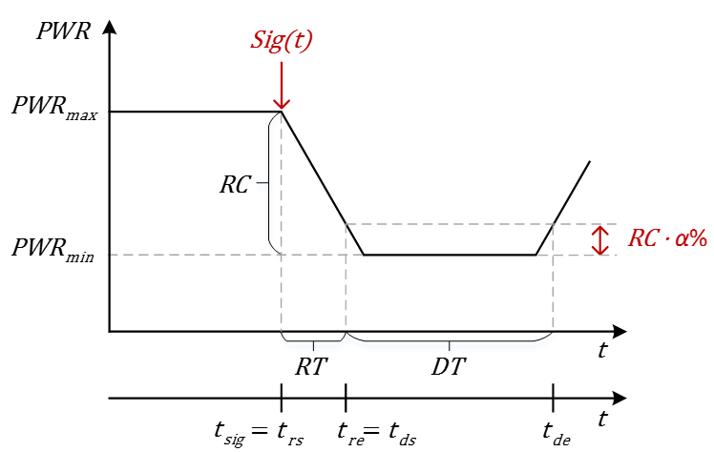
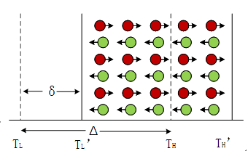
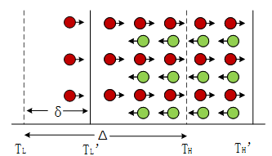
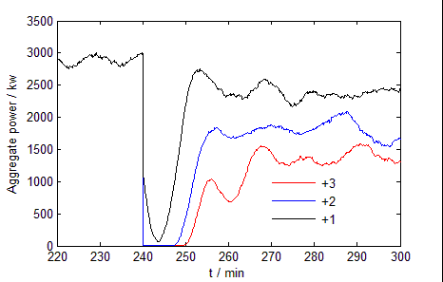
Asynchronous scheduling of aggregated air conditioners
Reserve Capacity (RC)
Ramp Rate (RR)
① Increase upper limit
② Wait for entering standby state
Response Time (RT)
Duration Time (DT)
④ Finish
③ Increase lower limit

Slide 7
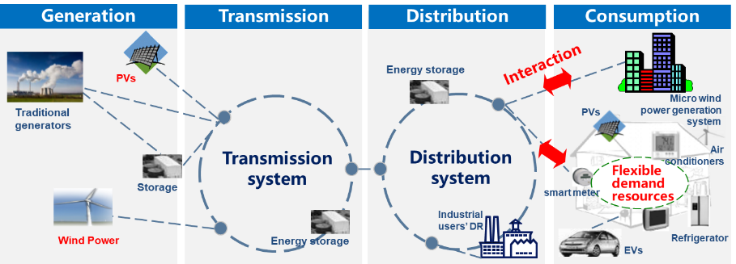

Slide 8


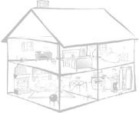



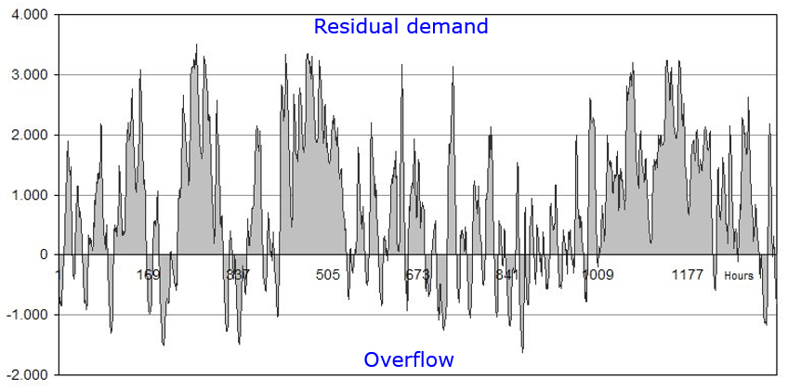
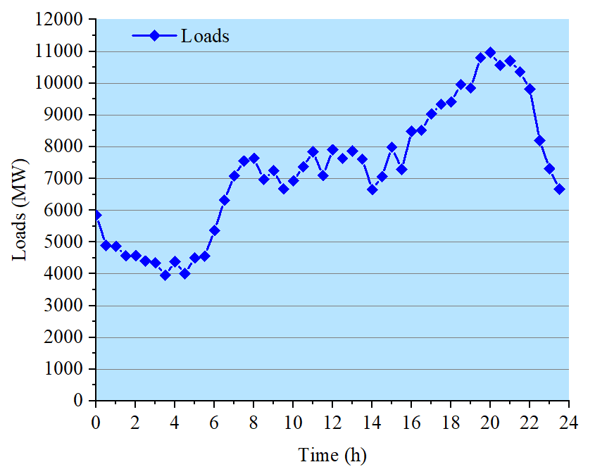
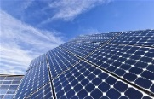
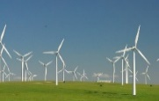
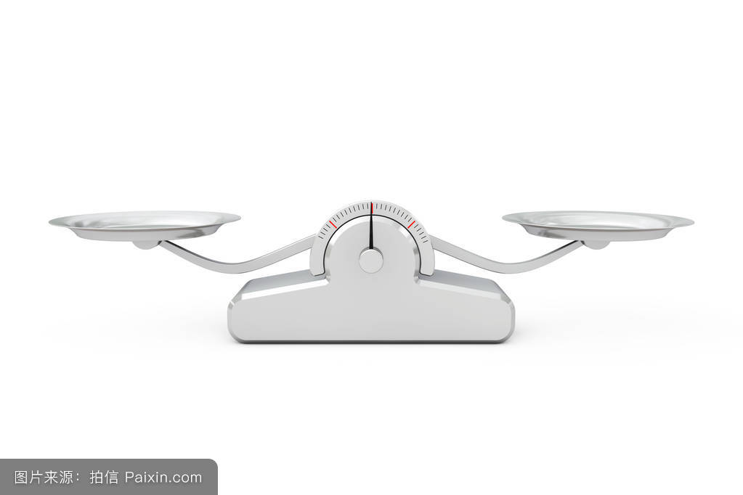
Generation
Transmission
Distribution
Consumption
Energy storage
Interaction
PVs
Traditional generators
PVs
Micro wind power generation system
Transmission system
Distribution system
Flexible demand resources
Air conditioners
Storage
smart meter
Industrial users’ DR
Wind Power
Energy storage
EVs
Refrigerator
Supply
50Hz
Demand

Slide 10
Power-supply side
Power-demand side
Cooperative control
Thermal
Interaction
Turbine
Wind
PV

