Slide 1
Law Hackathon Proposed Solution
Mariam Jaber, Gary Bai, Andrew Ha, Alexander Jones, Sheng An Zhang

Slide 2
Agenda
Introduction
Analysis
Approach
Conclusion

Slide 3
Situation
Refugee Advice & Casework Service & Casework Service (RACS) currently aid refugees who have had their claims for a TVP or SHEV rejected through the Fast Track Process.
RACS offers a legal pathway for these refugees to appeal this decision in which they would not have otherwise.
They currently use an e-mail system in conjunction with their local database to allow the clients to send in their forms and papers that are required to review and lodge their application.
Situation
Analysis
Approach
Conclusion

Slide 4
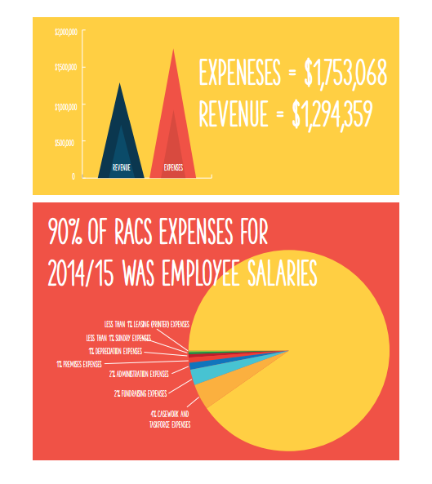
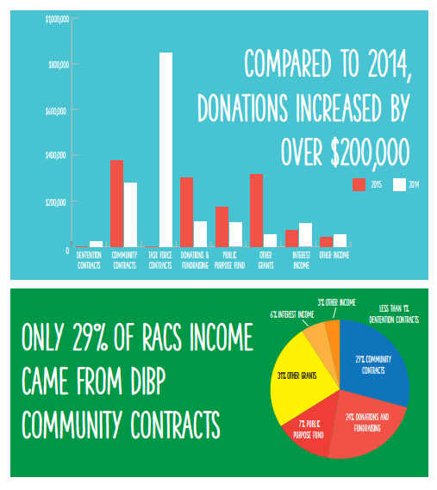
Situation (cont.)
Situation
Analysis
Approach
Conclusion

Slide 5
Problem
We identified the main issue that has the largest impact on not only RACS but also the stakeholders within this Non-for-Profit organisation.
The current E-mail system is extremely inefficient and often causes the administration staff and legal staff to follow up on the clients due to unclear or missing information/papers that are essential and mandatory for the claim.
The three major stakeholder parties that we have identified are :
RACS (As its own entity excluding all legal staff)
The legal staff (Both volunteer and contracted to carry out appeal)
The sponsors (A party comprising of all parties that fund RACS)
Situation
Analysis
Approach
Conclusion

Slide 6
Key Assumptions
RACS have confirmed that most if not all clients that have applied for this process have had access to smartphones.
Situation
Analysis
Approach
Conclusion

Slide 7
How the problem affects each party
RACS: They are overburdened with extra workloads to follow up on incomplete or missing information. This leads to extra costs and inefficient usage of resources to provide translation services or extra interviews.
The legal staff: They are often given time-consuming, repetitive tasks that could be automated to increase efficiency to that the staff could apply their expertise to other clients that need their valuable time
The sponsors: The money that is granted/donated/paid to RACS is often allocative inefficient due to the inefficient use of other resources (i.e. Time, Workforce)
Clients: They are given fewer resources to utilise to help them lodge an appeal
Situation
Analysis
Approach
Conclusion

Slide 8
Our proposed solution with working Prototype
Situation
Analysis
Approach
Conclusion

Slide 9
Impact of our solution on stakeholders
RACS: They are able to streamline their services and automate much of the information collection that will be generated and stored in their local database. This would drastically improve the efficiency of the entity and the use of its resources.
The legal staff: Instead of performing arduous back-and-forth information hunts and repetitive actions, they are better able to spend their time preparing and reviewing cases for clients
The sponsors: Their money is better used and the costs are cut drastically meaning RACS can reuse them for other endeavours.
Clients: They gain access to a 24/7 online portal that provides tailored support to each client throughout their application filling process.
Situation
Analysis
Approach
Conclusion

Slide 10
Considered risks and issues
Clients may have limited or no access to platform
Resistance to change
Special cases in which cannot be solved within the scope of the technology (i.e. Human error, Loss of Documentation)
A single local database in RACS creates a risk of data loss or server failure.
Situation
Analysis
Approach
Conclusion

Slide 11
UNTITLED
Situation
Analysis
Approach
Conclusion

Slide 12
UNTITLED
Situation
Analysis
Approach
Conclusion

Slide 13
UNTITLED
Situation
Analysis
Approach
Conclusion

Slide 14
UNTITLED
Situation
Analysis
Approach
Conclusion

Slide 15
UNTITLED

Slide 16
UNTITLED

Slide 17
UNTITLED

Slide 18
UNTITLED

Slide 19
UNTITLED

Slide 20
UNTITLED

Slide 21
UNTITLED

Slide 22
UNTITLED

Slide 23
UNTITLED

