Slide 1
Law Hackathon Proposed Solution
Mariam Jaber, Gary Bai, Andrew Ha, Alexander Jones, Sheng An Zhang

Slide 2
Agenda
Introduction
Analysis
Approach
Conclusion

Slide 3
Situation
Refugee Advice & Casework Service & Casework Service (RACS) currently aid refugees who have had their claims for a TVP or SHEV through the Fast Track Process.
RACS offers a legal pathway for these refugees to appeal this decision in which they would not have otherwise.
They currently use an e-mail system in conjunction with their local database to allow the clients to send in their forms and papers that are required to review and lodge their application
Situation
Analysis
Approach
Conclusion

Slide 4
Problem
We identified the main issue that has the largest impact on not only RACS but also the stakeholders within this Non-for-Profit organisation.
The current E-mail system is extremely inefficient and often causes the administration staff and legal staff to follow up on the clients due to unclear or missing information/papers that are essential and mandatory for the claim.
The three major stakeholder parties that we have identified are :
RACS (As its own entity excluding all legal staff)
The legal staff (Both volunteer and contracted to carry out appeal)
The sponsors (A party comprising of all parties that fund RACS)
Situation
Analysis
Approach
Conclusion

Slide 5
How the problem affects each party
RACS: They are overburdened with extra workloads to follow up on incomplete or missing information. This leads to extra costs and inefficient usage of resources to provide translation services or extra interviews.
The legal staff: They are often given time-consuming, repetitive tasks that could be automated to increase efficiency to that the staff could apply their expertise to other clients that need their valuable time
The sponsors: The money that is granted/donated/paid to RACS is often allocatively inefficient due to the inefficient use of other resources (i.e. Time, Workforce)
Clients: They are given fewer resources to utilise to help them lodge an appeal
Situation
Analysis
Approach
Conclusion

Slide 6
Our proposed solution with working Prototype
Situation
Analysis
Approach
Conclusion

Slide 7
Impact of our solution on stakeholders
RACS: They are able to streamline their services and automate much of the information collection that will be generated and stored in their local database. This would drastically improve the efficiency of the entity and the use of its resources.
The legal staff: Instead of performing arduous back-and-forth information hunts and repetitive actions, they are better able to spend their time preparing and reviewing cases for clients
The sponsors: Their money is better used and the costs are cut drastically meaning RACS can reuse them for other endeavours.
Clients: They gain access to a 24/7 online portal that provides tailored support to each client throughout their application filling process.
Situation
Analysis
Approach
Conclusion

Slide 8
Considered risks and issues
Situation
Analysis
Approach
Conclusion

Slide 9
Criteria for Mergers & Acquisition
 | Vega Group Ltd. | D&B Hold Company | McGraw-Hill Federal Credit Union | Moody’s Investors
Business Growth
Strategic Advantage
Synergy
1
2
3
Situation
Analysis
Approach
Conclusion

Slide 10
Why does Veda group Ltd. fit in our criteria
1
2
3
Business Growth
Strategic Advantage
Synergies
Annual net profit increased by 780 in the last 4 years
Access to over 85% of Australian credit data
Collects crucial data which Equifax needs → Complimentary acquisition
300% growth over the last 4 years
Has high market share of 41.5%
Possesses varied technologies to analyze data which Equifax can integrate into their company
Diversified into consumer, commercial, B2C and international
Veda collects data Equifax analyzes data
Situation
Analysis
Approach
Conclusion

Slide 11
Recommended Approach – Acquisition of Veda
Enterprise Value
$1,500,000,000
Offer Price
$2,500,000,000
Reason for Acquisition Approach
Good way to achieve market power and share
Fastest, largest initial international expansion
Low risk compared to greenfield
Situation
Analysis
Approach
Conclusion

Slide 12
Conclusion
Company needs
Australian Market
Veda Group Ltd.
Financially sound
Acquire Veda Group Ltd.
Situation
Analysis
Approach
Conclusion

Slide 13
Appendix
Opening slide
Agenda
Situation
Criteria for market expansion (i)
Criteria for market expansion (ii)
Criteria for market expansion (iii)
Criteria for M&A activity (i)
Criteria for M&A activity (ii)
Criteria for M&A activity (iii)
Why does Veda Group Ltd. fit in our criteria
Recommended Approach – Acquisition of Veda
Conclusion
Appendix -----------------
Criteria for market entry reasoning
Company Net Profits and growth
Criteria for M&A – D&B Hold Co.
Criteria for M&A - McGraw
Criteria for M&A – Moody’s Investors
Alternative M&A: Fitch Australia Pty. Ltd.
Alternative M&A: Experian Australian Holdings Pty. Ltd.
Calculation of Acquisition Price - Veda

Slide 14
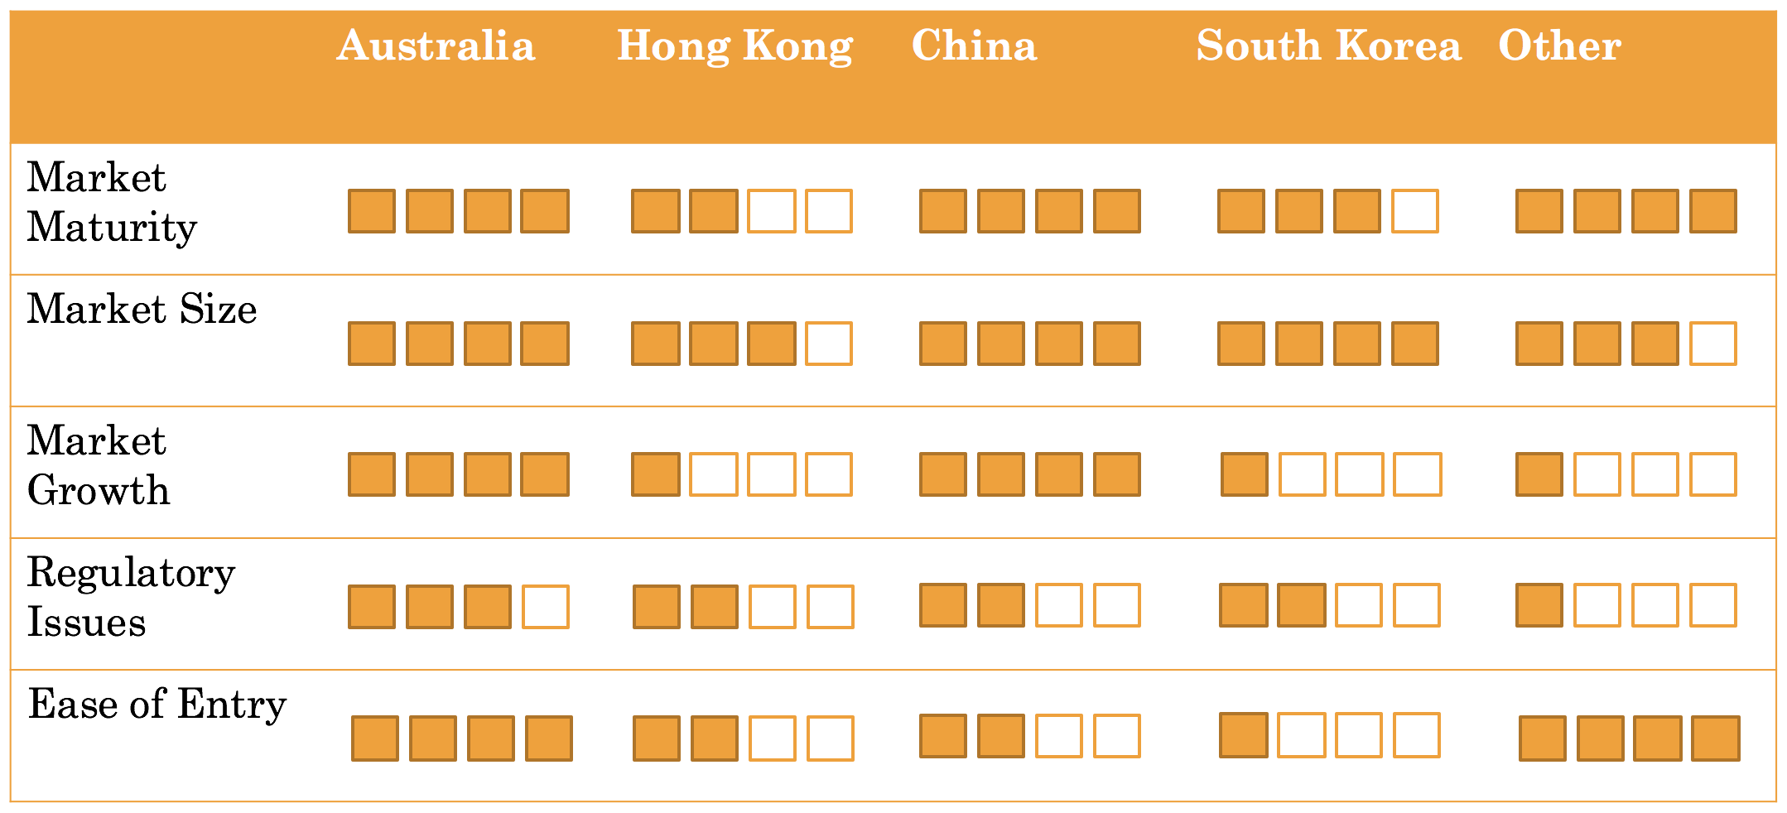
Criteria for market expansion reasoning
China
911 million working population
77 million companies
Credit rating goes down, then borrowing also decreases
Hong Kong
7.24 million working population
1.163 million registered business
~90% of population
South Korea
26.293 million Employed
1. 780 million registered companies
~90% of population
Others
57.06 million
944,897 Businesses
80%

Slide 15
Company Net Profits and Growth
Net Profit
 | Veda | D&B | McGraw | Moody
2012 | 390 | 297 | 492 | 1660
2013 | 820 | 262 | 1268 | 1660
2014 | 1060 | 298 | -13 | 1680
2015 | 1170 | 173 | 1466 | 1664
Percentage Growth
 | Veda | D&B | McGraw | Moody
2012-2013 | 110 | -12 | 158 | 33
2013-2014 | 29 | 14 | -101 | 6
2014-2015 | 10 | -42 | 114 | -19

Slide 16



Criteria for M&A – D&B Hold Company
1
Business Growth
See graph
2
Strategic advantage:
Commercial reporting and insight for business in international market
Risk management solutions, sales and marketing solutions
Largest influence on commercial reporting and insight for business
3
Synergy
Small presence in consumer credit reporting – consumer markets are the largest

Slide 17
Criteria for M&A – McGraw
1
Business Growth
See graph
2
Strategic advantage:
Iconic brand in finance and business: including S&P Ratings Services, S&P Global Market Intelligence, S&P Dow Jones Indices, Platts and J.D. Power
Intelligence to manage risks and identify growth opportunities
Focuses on SCR – good perception
3
Synergy
Independent benchmarks & ratings, analytics, data and research in the global capital, commodity and corporate markets
Promote sustainable growth in the global capital, commodity and corporate markets by providing customers with essential intelligence and superior service

Slide 18
Criteria for M&A – Moody’s Investors
1
Business Growth
See graph
2
Strategic advantage:
Access to worldwide data and advisory services
Leading edge technology
Research for credit and economic analysis and financial risk management
3
Synergy
Credit rating, research, tools and analysis
Competition to business (does not complement like Veda)

Slide 19
Alternative M&A: Fitch Australia Pty. Ltd.
Estimated market share: 4.1%
Fitch is one of the big three global ratings agencies. Its Australian business is smaller than those of its global counterparts Standard and Poor's and Moody's. Dual-headquartered in New York and London, the company has a presence in a growing number of countries worldwide. Its letter rating system covers AAA to D credit.
Fitch is part of the French company Fimalac, since its purchase in 1997 and merger with IBCA, Europe's largest rating agency. It also acquired the credit agency Duff & Phelps and Bankwatch in 2000, which provides credit ratings to banks, 1,200 corporate issuers, 90 governments and 45,000 municipal transactions.
Globally, Fitch rates about 1,600 financial institutions and 1,000 corporate clients. It maintains surveillance on 3,300 structured finance and 17,000 municipal bond ratings in the US tax-exempt market. Fitch Ratings also covers more than 800 insurance companies and about 70 sovereigns.

Slide 20
Alternative M&A: Experian Australia Holdings Pty. Ltd.
Estimated market share: 2.0%
Experian Australia Holdings Pty Ltd is a subsidiary of Experian plc, a Dublin-based global provider of credit reporting services. The company was incorporated in 2007 and mainly provides analytics and intelligence on online consumer behavior. The company also provides marketing strategies that capitalize on its research.
In August 2011, the Australian Competition and Consumer Commission allowed ANZ, Citigroup, the Commonwealth Bank, GE Capital Finance, NAB and Westpac collectively to acquire a minority stake in Experian. The joint venture plans to expand Experian's activities to include consumer and credit reporting services. While their market share is currently low, the partnership with the big investors may allow Experian to quickly build both a large database of reports based on data from its investors and a large client base.

Slide 21
Calculation of Acquisition Price- Veda
Market capitalization
Enterprise Value
Acquisition Price
$1,742,940,000
$1,519,040,000
$2,500,000,000
Market Capitalization = Shares Outstanding x Share Price
Enterprise value = Net Debt + Market Capitalization + Hybrids
Acquisition Price = Enterprise value + estimated future profits (estimate)

