Slide 1
Poem Writer
Shenghan Gao
Kai Yan
Xin Liu

Slide 2
Introduction
use neural network to generate a Chinese poem
Chinese poems are organized in certain formats
example：Chinese quatrain (jueju)
Four lines, exactly 20 or 28 characters
Rhyme： the last characters of the second and the fourth line
Tonal pattern: Every Chinese character has a tone (Ping or Ze)

Slide 3
Data preprocessing
Data：about 140,000 quatrains from Complete Tang Poems and Complete Song Poems
Preprocessing:
a poem each line. (a ‘^’ at the beginning, ‘$’ at the end)
allocate a unique index to each Chinese character
generating two maps: char_to_index, index_to_char
Example:
[0] ， [1] 。 [2] 不 [3] 人 [4] 一 [5] 风 [6] 山 [7] 无 [8] 有 [9] 来
[2] not [3] man [4] a [5] wind [6] hill [7] no [8] have [9] come

Slide 4
Implementation
- Use TensorFlow to implement neural network.
- Use TensorFlow’s well packaged LSTM model without bothering building our own.
- Very efficient and saved us a lot of time.

Slide 5
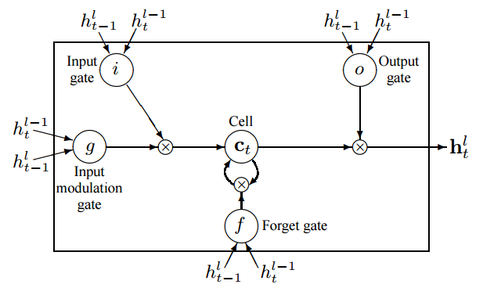
LSTM Cell

Slide 6
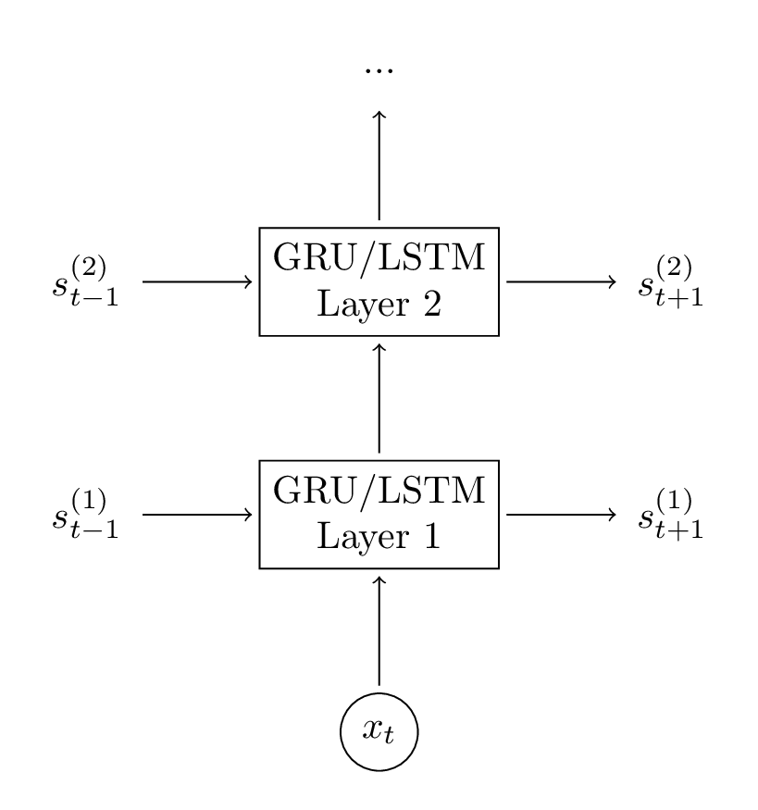
Model Building

Slide 7
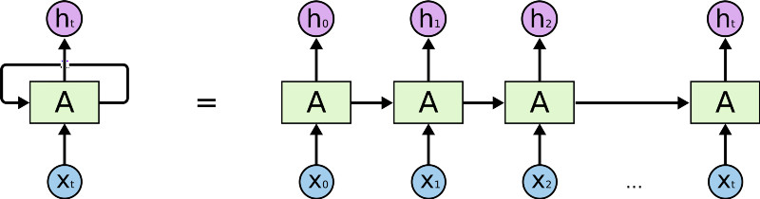
Model Building
Batch size words

Slide 8
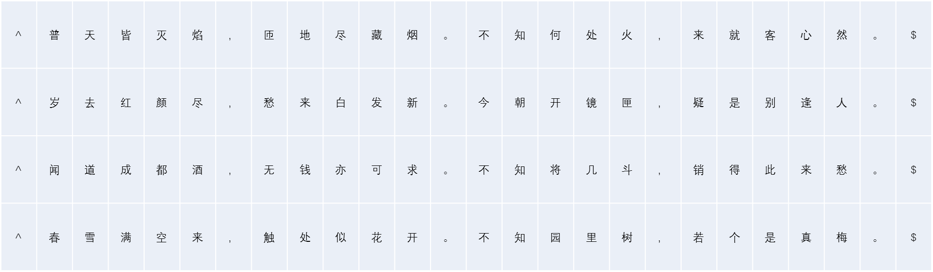
Feed Data
X
Y
X
Y
batch_size rows
seq_length = 10

Slide 9
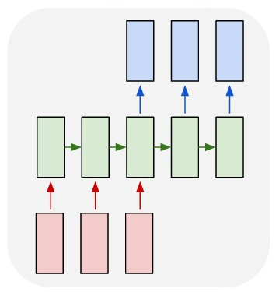
Sampling
冷
桂
头
input = 花
zero_state
^
花
冷
桂

Slide 10
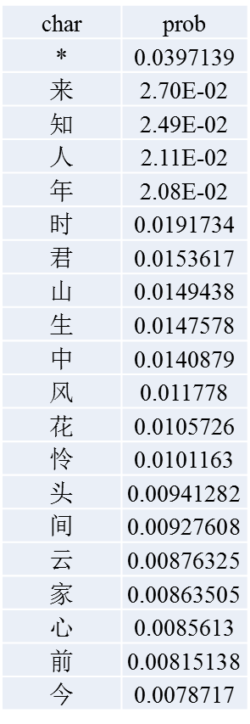
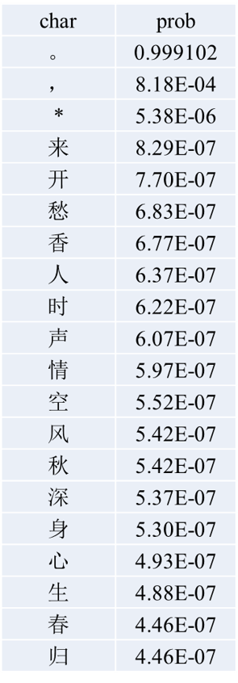
Sampling
prev = 飞, but according to the format of the line, next character should be a period
prev = 方

Slide 11
Poems
Produced poem examples:
秋卧长军陇醉园，理君楼界未春鸣。燕琴含莎来请重，一泽楼寒二此间。
月岁银听几拟苍，黄期尚从去子悬。故闻初海诸无惆，塞作风花闭一秋。
花纶波手我有来，秋高送自岁青仁。年贫玄爱时代笔，紫水穿归送日风。

Slide 12
Demo

Slide 13
Challenges
- Understanding the working mechanism of LSTM is difficult.
- RNN takes a long time to train well.
- TensorFlow is relatively new, so the APIs’ information is not complete.

Slide 14
Possible Improvements
- Let model create poem based on the meaning of the given word.
- If given enough computation power, we can improve the training quality.

