Slide 2
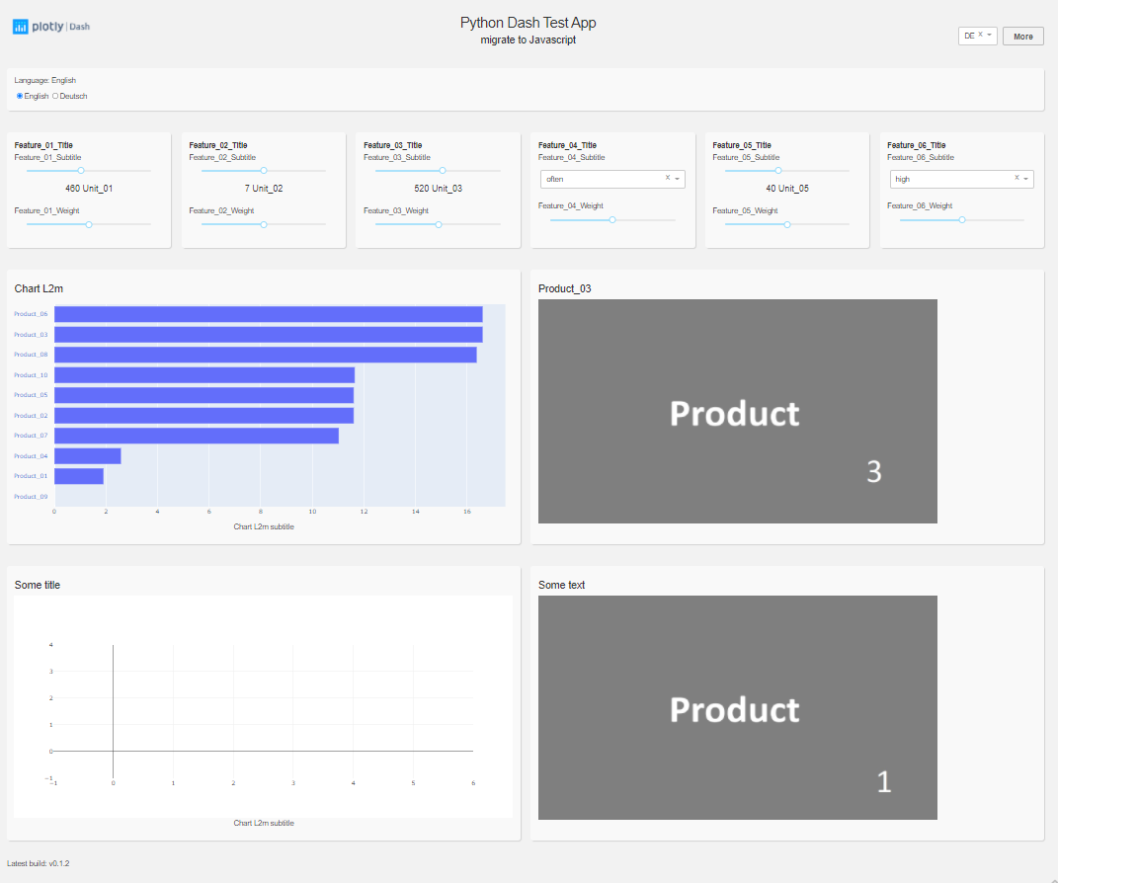

Slide 3
https://www.evernote.com/l/As2VDegt4BhBw6mQlA84ubRf0XF55zrUhOI

Slide 4
Customer behaviour data of a multi-category e-commerce store
https://www.kaggle.com/mkechinov/ecommerce-behavior-data-from-multi-category-store

Slide 5
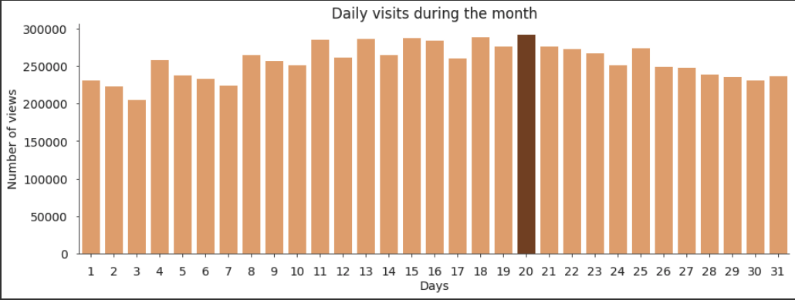
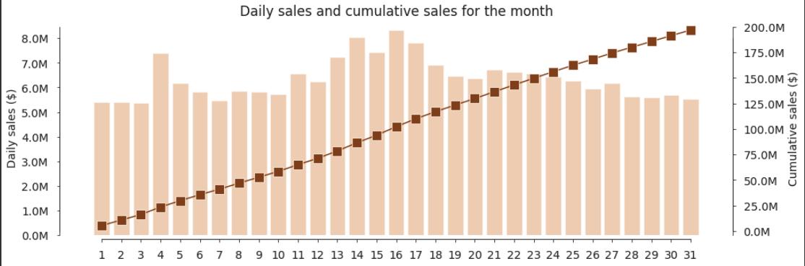
Daily summary tables
Daily sales
Daily visit
Daily sales
Line chart

Slide 6
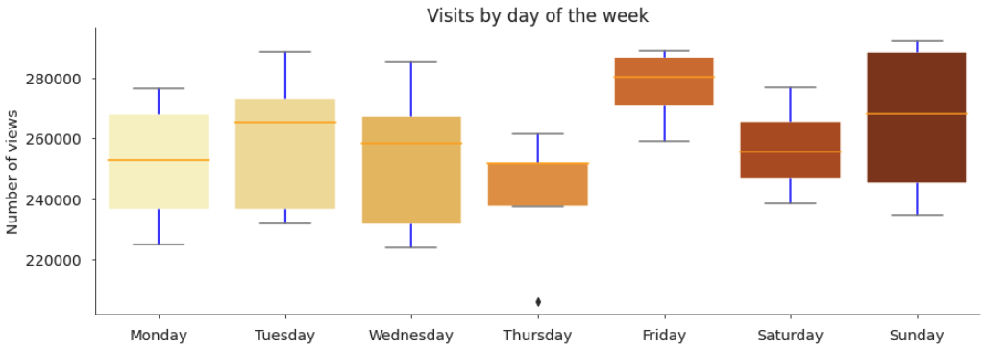
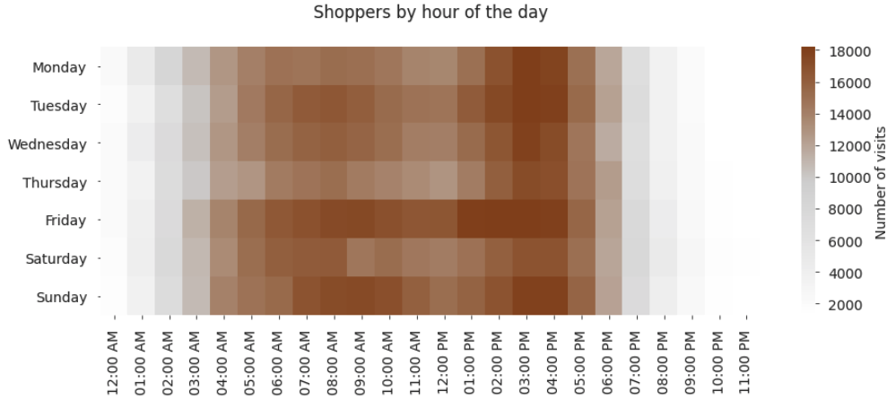
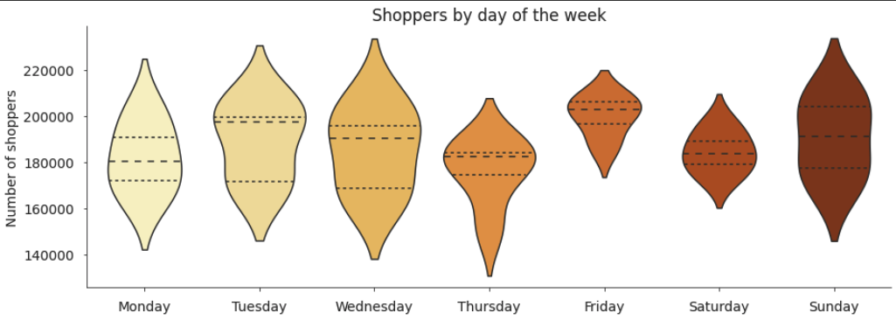

Slide 7
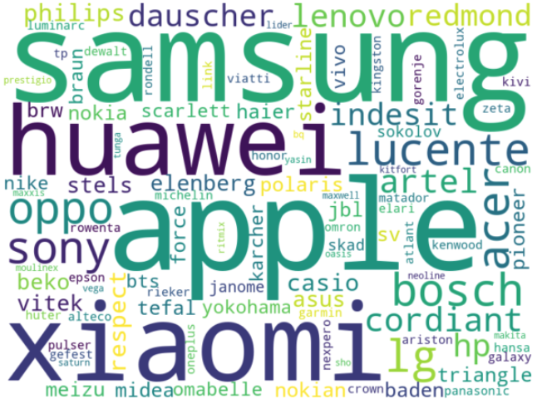
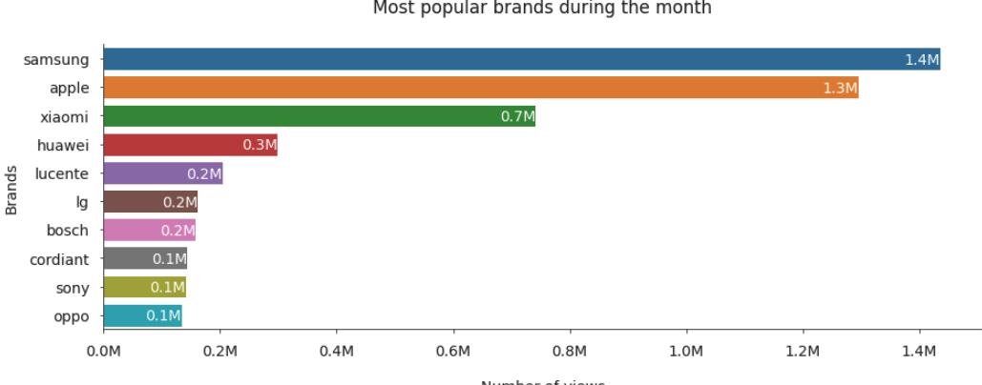
Bar chart

Slide 8
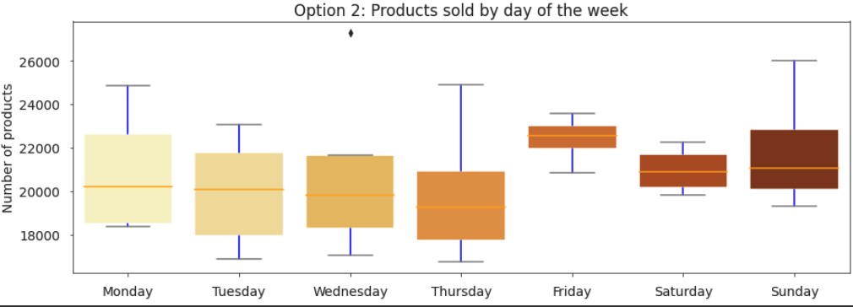

Slide 9
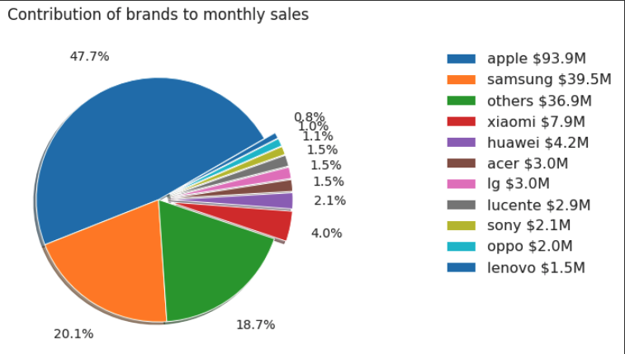

Slide 10
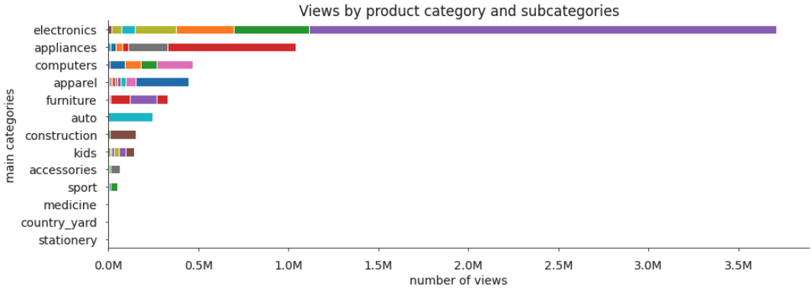

Slide 11
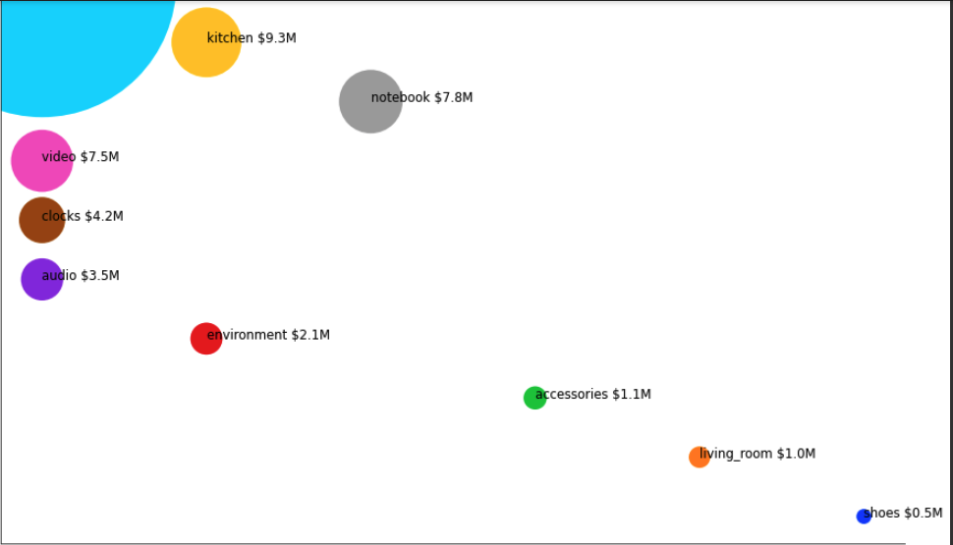

Slide 12
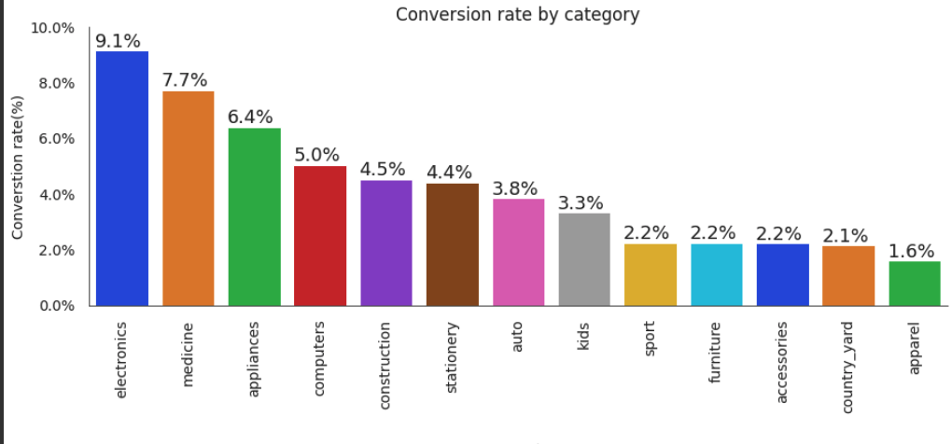

Slide 13
