Slide 1

New York City
short-term rental insights

Slide 2
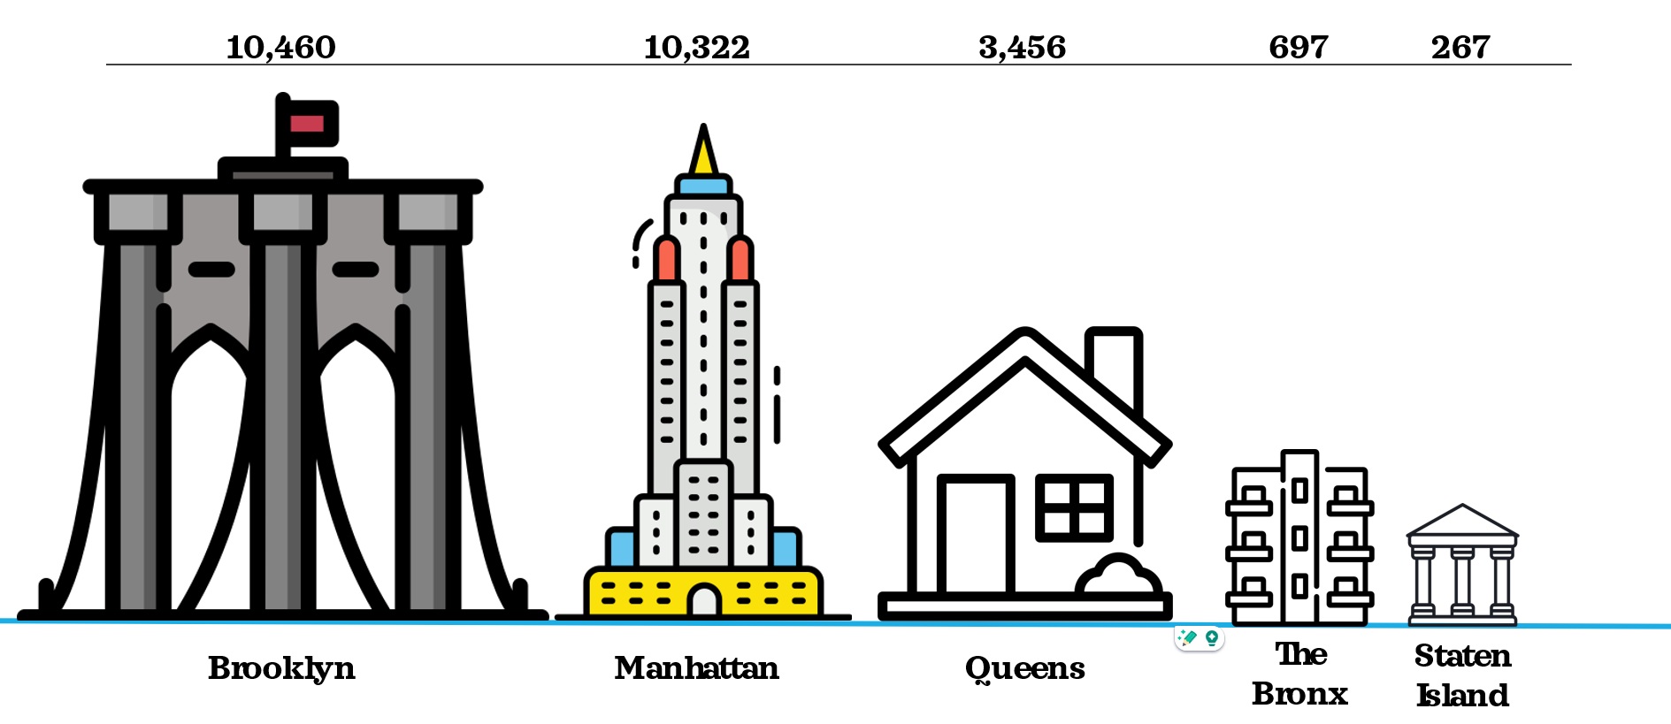
What is the most popular borough in New York?
Based on the number of listings both booked and available in 2019. This clearly depicts Brooklyn as the most popular borough to rent an Airbnb in New York. There is a substantial fall in the number on offer within the more residential boroughs, with Staten Island only having 267 and The Bronx at 697.

Slide 3
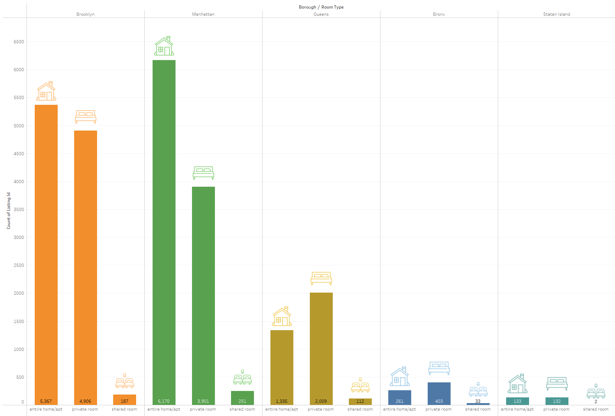
Most commonly rented property type
Across the boroughs’ the most popular room types vary; for both Brooklyn and Manhattan it is entire homes followed closely by private rooms. Whereas in Queens and The Bronx, private rooms are the most popular. Across all boroughs’ shared rooms are the least popular, with often massively less on offer / available. Entire homes or private rooms are however a lot more evenly matched in terms of numbers.

Slide 4
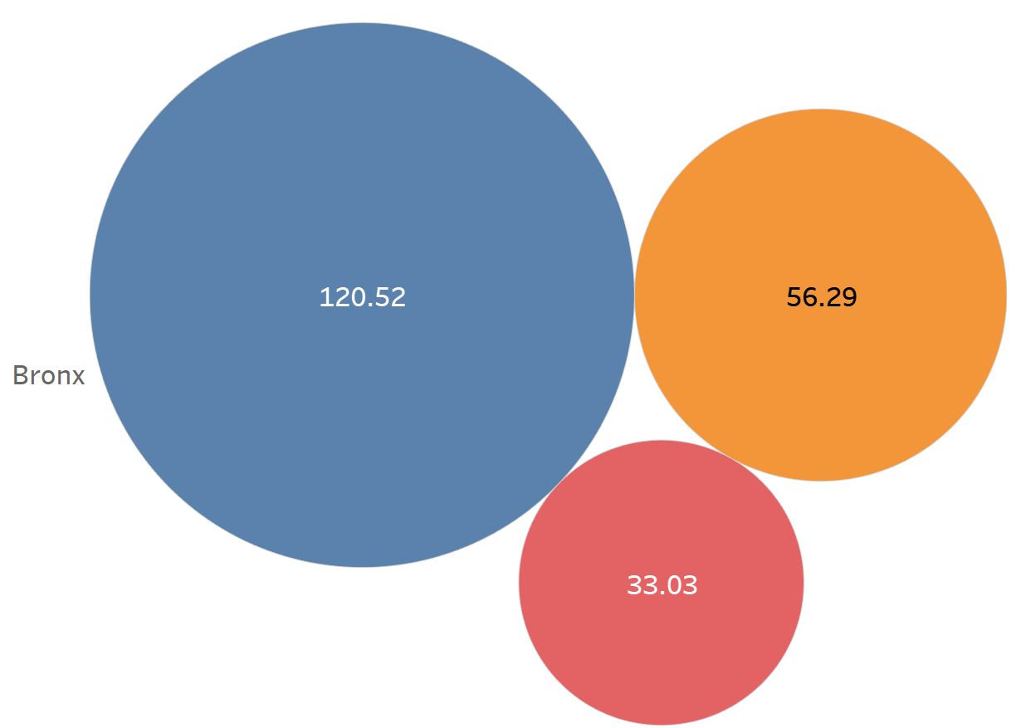
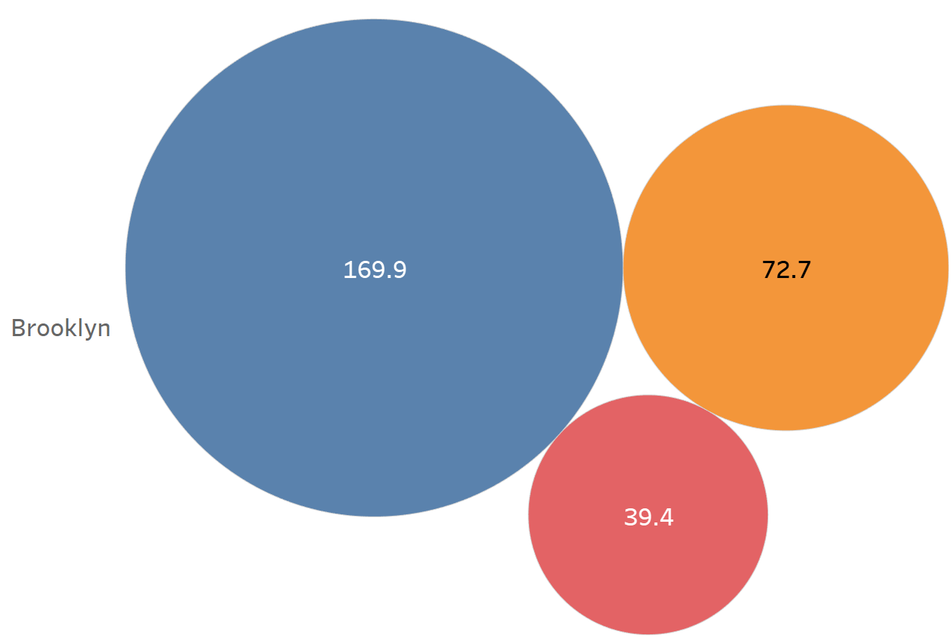
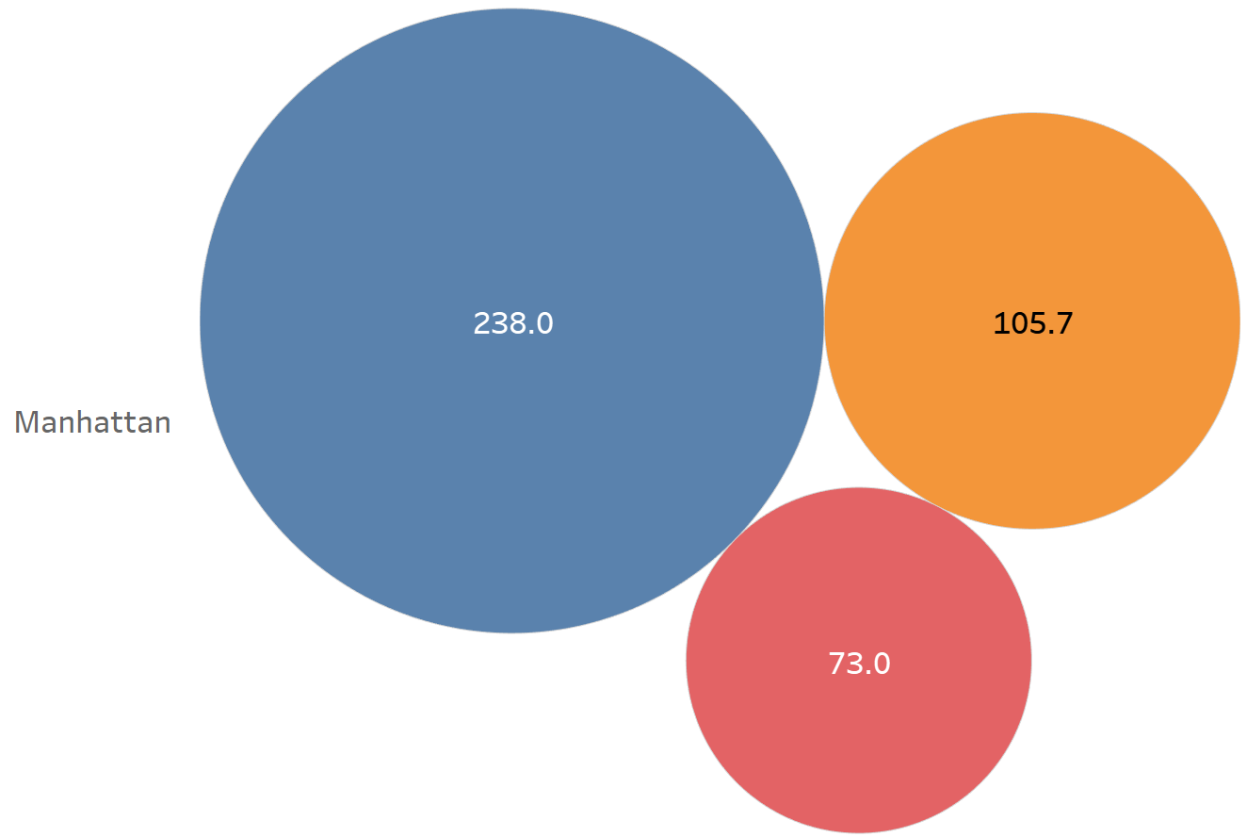
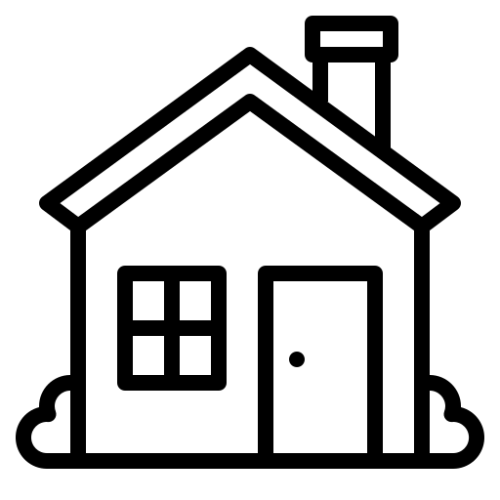

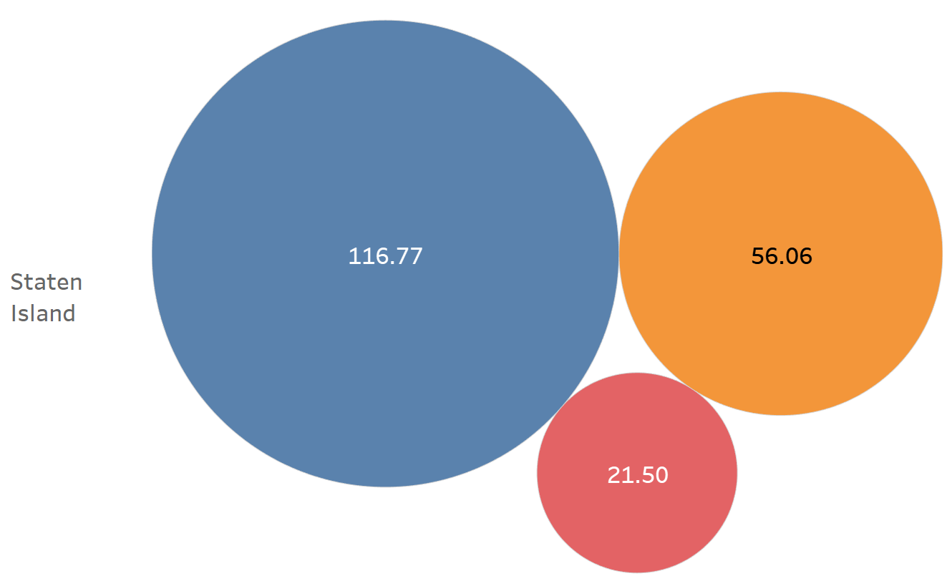
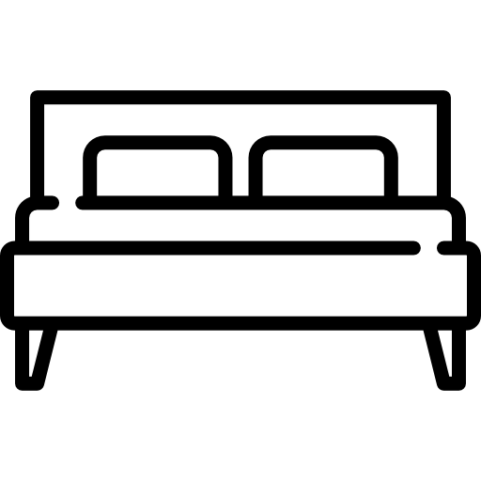
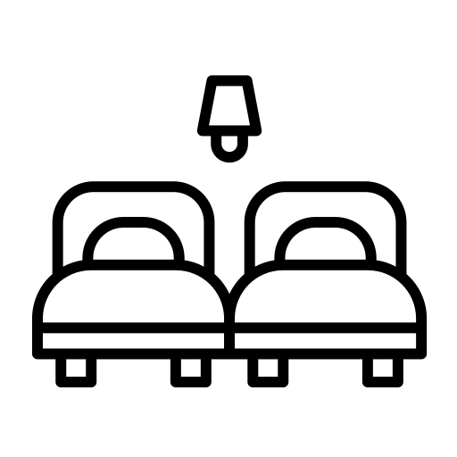
Average Price per room type for each borough
Entire homes / apartments
Private Rooms
Shared Rooms
Manhattan leads the way with the most expensive average across all room types, apartments are $68 more on average than Brooklyn. Private rooms in Bronx, Staten Island and Queens are remarkably similar prices with a spread of only $7.64. Staten Island is clearly the cheapest for all room types, with The Bronx only slightly more.

Slide 5
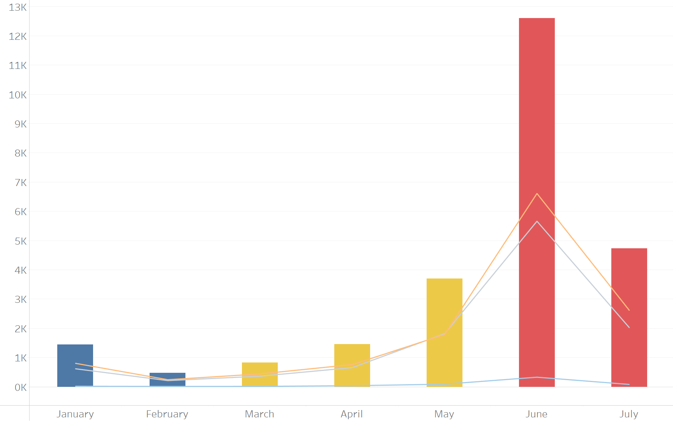
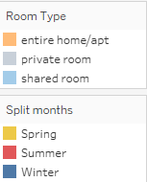
Demand for short term rentals over seven months of 2019
The bar graph above shows the total number of reviews left by tenants for each month across all of New York, the line graph placed atop shows the split of reviews between the different room types on offer at Airbnb. The graph clearly shows a seasonal swing in the number of people renting, with June being the most popular by a significant margin and February being the least.

Slide 6
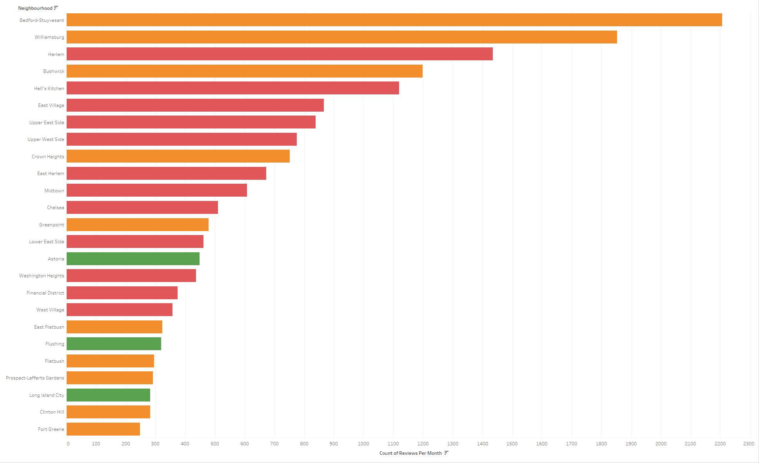

Top 25 most in-demand neighbourhoods
Expanding on the previous slide this bar chart shows the top 25 neighbourhoods across all boroughs of New York. Unsurprisingly The Bronx and Staten Island boroughs did not make it into the chart, with the first within The Bronx at only 46 reviews, 78th place on the chart. The two most popular neighbourhoods both are parts of Brooklyn, interestingly though Manhattan neighbourhoods dominate the next 15 places. This is how the boroughs have such similar numbers in popularity.

Slide 7
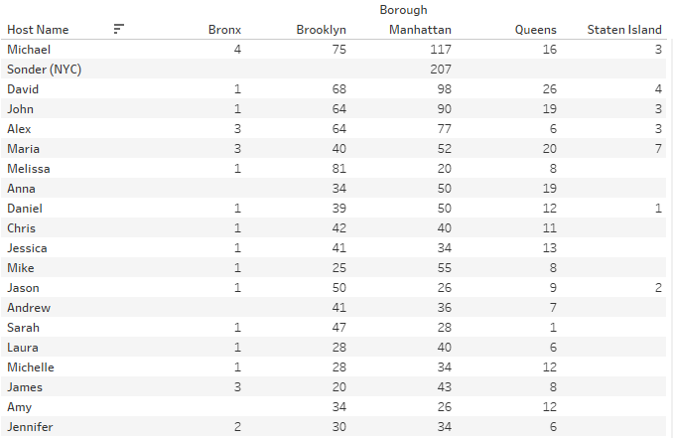
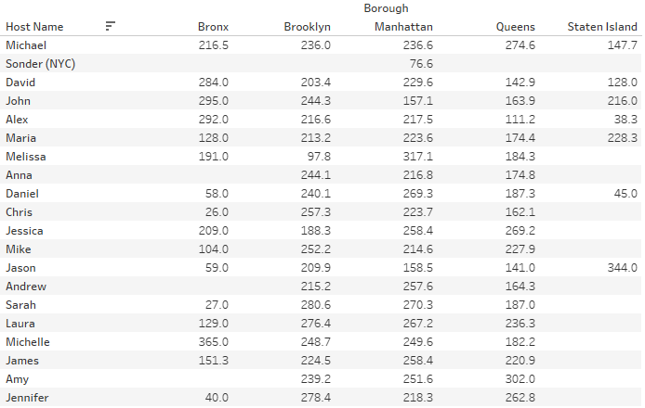
Hosts with the largest number of properties
Above is a table on the left of the top 20 hosts with the largest total number of properties to let within New York. On the right is a table showing the same hosts and the average number of days those rentals are booked. This quite clearly indicates that the highest demand for short-term rentals is within Manhattan and Brooklyn. If you are able to rent there, there is also a high probability that it will have less downtime where there are no tenants.

