Slide 1
Predictive modeling
Project 3 Group 1

Slide 2
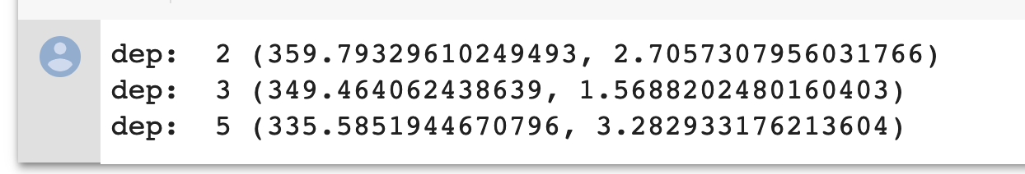
Baseline
Code
Training Unit: point
Features: 8 points
Response: 4 points
Method:
Gradient Boosting Method
Train 12 classifiers
Train each color channel (RGB ) independently
MSE and std under different tree depth
LR
HR
1
2
3
1
2
4
x
5
3
4
6
7
8
PSNR: 22.8

Slide 3
SRCNN
Code
Reference paper (Image Super-Resolution Using Deep Convolutional Networks)
Training Unit: patch
Features & Response: same dimension
Train all color channel (RGB ) together
Workflow:
Interpolation (Bicubic)
Take patches
Train the model
Prediction
Training Performance (PSNR)
w1
w2
w3

Slide 4
Comparison
Baseline
Unit: point
RGB train in each channel
For each point
8 -> 4 projection
SRCNN
Unit: patch -> more information
RGB train together
For each patch, both input and output of CNN are the same dimension

Slide 5
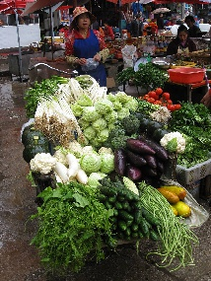
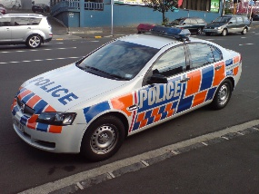


Comparison
Low Resolution
High Resolution

Slide 6
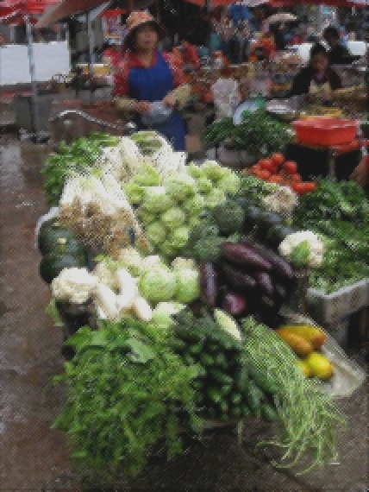


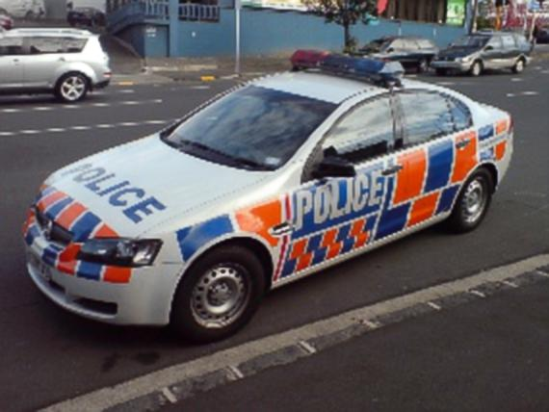
Comparison
Baseline
SRCNN

Slide 7
Conclusion
Advantages of SRCNN model
Visual Effects: Clear and Colorful
Metrics: High Testing PSNR > 26
Speed: 10 mins for feature extraction; 5 mins for training with GPU

