Slide 1
Swatch structure
-- Presented by Shengjie and Bo

Slide 3
CAT
Occasion Problem
Need additional device to be transmitter and receiver
It is impossible for watch users to take another device.
Technique Problem
Since FMCW does not have the absolute distance measuring. So CAT needs a reference point. It is suitable for a smart TV, because it is located statically in the room and a static reference Point is available.

Slide 4
liu
Occasion Problem
Smartwatch cannot distinguish the phase change caused by Doppler change from the phase change caused by Watch changing.
Because the “static vector” proposed by Alex Liu is also dynamic in his method.
Technique Problem
Impossible for a accurate phase measuring in real environment. The popular FFT method is not effective in phase measuring.

Slide 5
SWatch
Combine the velocity and distance information together.
No additional device.
Stable Modulated Signal.
Less real-time latency
Used in dynamic-dynamic situation

Slide 6
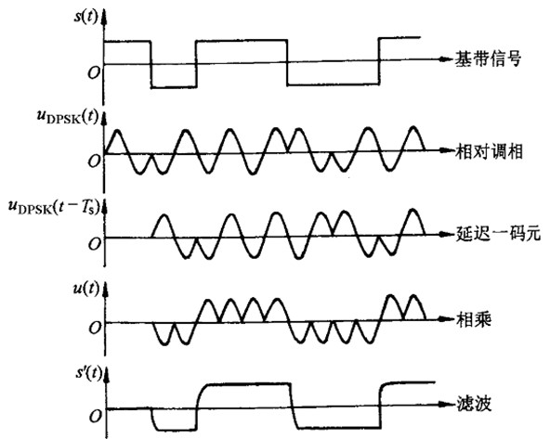
What is psk?
Phase-Inversion is the feature of PSK modulated.
The phase change of PI can be detected without environment influence.
Differential Coherent Demodulate does not need reference signals.
Even two waves mixed together, PSK is still effective.

Slide 7
Why psk?
Frequency – Modulated
The frequency would be affect by Doppler effect.
The frequency-modulated signal cannot employ the power of Doppler effect.
All frequency modulated signal lead to the unaccurate-distance-only measuring.
Amplitude – Modulated
The amplitude of audio signal is extremely unstable. A nearby object can change the signal intensity to a great extent.
Phase – Modulated
No accurate method to easily measure the phase.
Only the phase-inverse, the biggest sort of phase changes can be detected.
The phase change does not influence the frequency distribution. Information-Modulated method can be used with Doppler Effect together !

Slide 8
PSK
PSK is designed for real-time distance measuring within time delay less than 0.01s and distance error within 0.93cm.
PSK is a phase-modulated signal within steady signal transmission and less influenced by environment.
PSK is a high-accuracy method to identify LOS&NLOS path.

Slide 10
Thanks!

