Slide 1


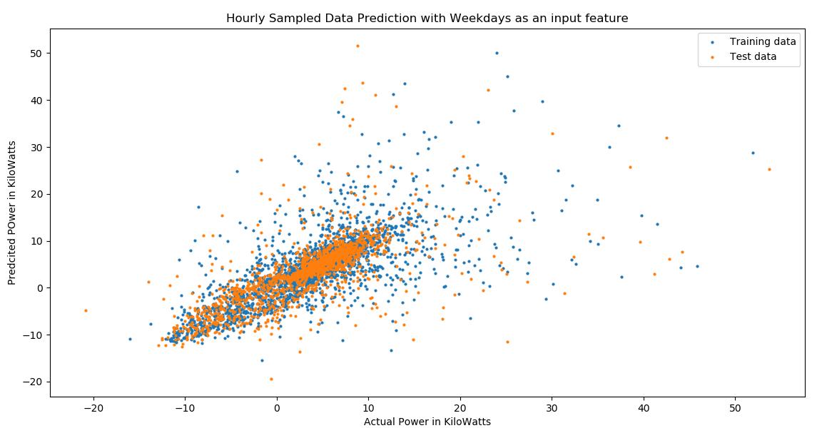
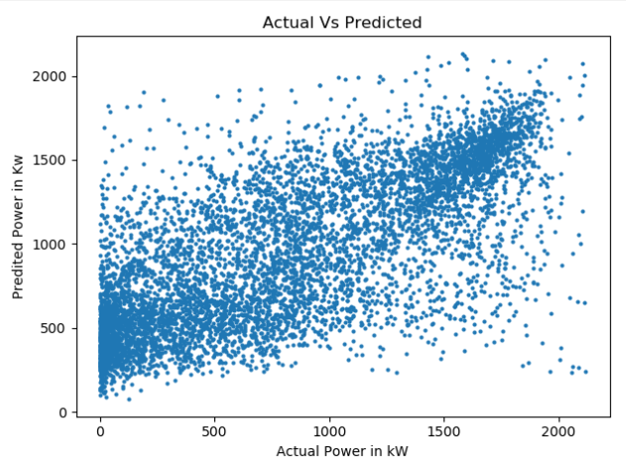
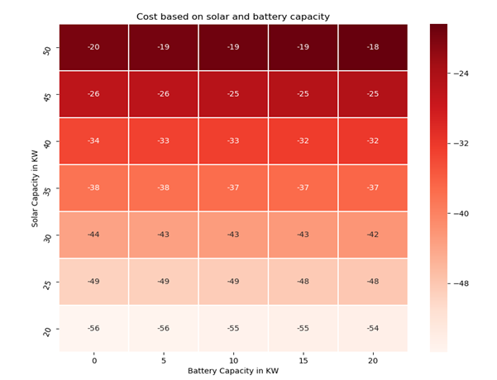
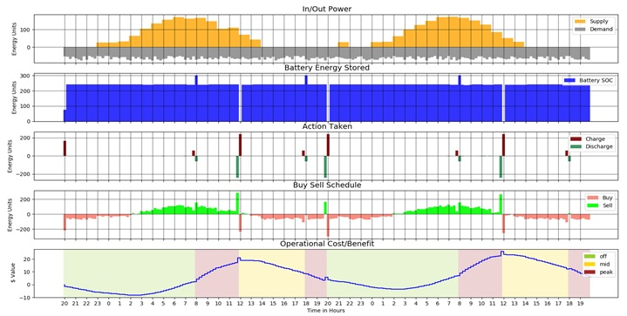
Microgrid Optimization Using Reinforcement Learning
Ashit Neema , Pratyusha Sai Kamarouthu
CS 6890 -003 Reinforcement Learning Spring 2019
Gym python package has been used to get next possible state during training. Reward is the cost for net energy after taking action and supply demand. Considering battery characteristics, battery damage cost has been added to the reward. The learning algorithm will be able to calculate the ideal times to purchase electricity from the main power-grid based on the reward. It will also be able to decide when to sell the stored energy back to the main power grid, and when to use the energy stored in the battery to accommodate the load on the Micro-grid.
Abstract
The rapid deployment and optimal operation of micro-grids is an essential step in increasing the adoption of solar power, improving grid resilience and expanding electrical power availability in developing countries. Micro-grids integrate local energy generation and storage, local loads and can run in isolation or with a grid connection. Given time-of-day grid energy pricing, predictions of solar energy production and knowledge of upcoming loads, it is possible to determine the optimal operating policy through reinforcement learning. We present a system that combines historical weather and usage data with neural-network prediction and reinforcement learning methods to determine this policy. Results show the learned policy significantly reduces operating costs.
Results
Problem Description
Figure c - The load prediction has been plotted for a year’s data. The diagonal line indicated that the prediction is working as expected.
The core problem is to minimize cost of battery operation and maximizing the profit on energy. Given time series weather data, time series load data and price of the day energy price, we have to calculate the battery charge and discharge schedule such that operational cost will be minimized.
Methods
Solar Power Prediction: Considering the weather data reasonable solar energy prediction can be done by using artificial neural network. Weather parameters considered are solar radiation, temperature, cloud coverage, azimuthal angle, zenith angle, visibility, dew point. ANN used has two hidden layers activating each with relu function and adam as optimizer. Algorithm for predicting the solar energy is a machine learning linear regression model. The results are shown in Figure a.
Optimization: The method currently used to optimize the micro-grid is a value iteration algorithm (VIA). The VIA will calculate the optimal reward for each state the Micro-grid can enter and then choose an action that will advance the state to the next, most beneficial state. The VIA do this by using the energy generated by the solar panels, the current load on the Micro-grid, and the current state of the battery, for all possible states. The results are shown in Figure b.
Load Prediction: Considering the given load data, a recurrent neural network is used to predict the future load data. The inputs include the previous hours load data, and a boolean value indicating whether it’s a weekend or not. RNN used has two hidden layers with relu as activation function. The data used for prediction has been provided by Select lab USU. The results are shown in Figure c.
Operational Cost: It shows how the algorithm is working for different configurations of PV(photo voltaic or solar) panel and battery. For instance with a battery capacity of 20kWatts and PV panel of 20kWatts for a period of 48 hours we have to spend 54 dollars to supply the demand. When we consider 20kWatts Battery with 50kWatts solar panel the operation cost has been reduced to 18 dollars as shown in Figure d.
Figure a – Actual values versus predicted values are plotted for an year with a resolution of one hour.
Figure d - The above figure shows the operating cost for 48 hours for different combination of PV power and battery capacity. The digits on each box shows the cost to supply the given load.
Conclusion
A more reasonable solar power prediction can be made since the neural network is not predicting good if the power is less that 200 Kilowatts.
The operational cost is reduced by applying value iteration algorithm, as can be deduced from Figure b.
The Load Prediction is working reasonably for short term prediction but as the range is increased the accuracy decreases, on which further improvements can be made.
Figure b - First segment of the above figure shows solar power and load data for 48 hours. Based on which the charge and discharge schedule has been made. Second and third segment shows the battery charge available in battery and schedule to charge and discharge battery. Fourth segment shows the buy and sell schedule in order to meet the demand and action. The fifth segment shows the cumulative operating cost for 48 hours. Operating cost also includes battery operating cost with the net energy cost.
References
Reinforcement Learning An introduction- second edition Richard S.Sutton and Andrew G.Barto.
https://www.ncdc.noaa.gov/
Dataset from Select Lab in Utah State University.

