Slide 1
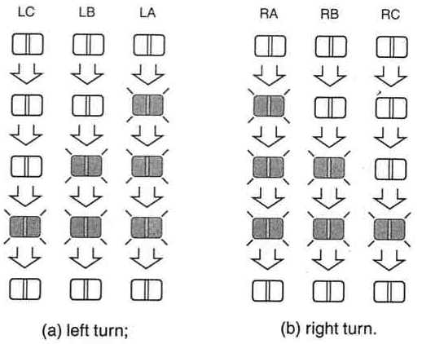
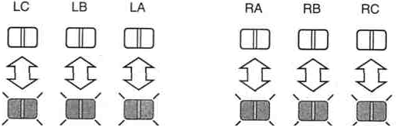
Lab 3
Figure 1:
car tail lights
L3 L2 L1 R1 R2 R3
L3 L2 L1
R1 R2 R3
L3 L2 L1 R1 R2 R3
(c) Emergency
Note: Figures above are from John F. Wakerly, “Digital Design: Principles & Practices,” 3rd ed., Prentice Hall, 2000.

Slide 2
Note: below is NOT a complete state diagram
First, there are 3 input signals: E, L, R. Each state must have the transitions that cover all 2³ = 8 combinations of inputs
E L R
0 0 0 E’L’R’
0 0 1 E’L’R
0 1 0 E’LR’
0 1 1 E’LR
1 0 0 EL’R’
1 0 1 EL’R
1 1 0 ELR’
1 1 1 ELR
Observe that this transition from ‘off’ to ‘allon’ covers 5 input combinations
allon
E’LR, EL’R’, EL’R, ELR’, ELR
E’L’R’
It is your pre-lab 3 assignment to
complete this state diagram
E’L’R
off
Ron1
E’LR’
To make an easier to read state diagram, below is the outputs of each state
State L3 L2 L1 R1 R2 R3
Off 0 0 0 0 0 0
allon 1 1 1 1 1 1
Ron1 0 0 0 1 0 0
Lon1 0 0 1 0 0 0
Lon1
Note: From the above state diagram, state ‘off’ is complete with all transitions

