Slide 1
TASK 1: Implementing a datapath to execute Arithmetic (R-type) operations

Slide 2
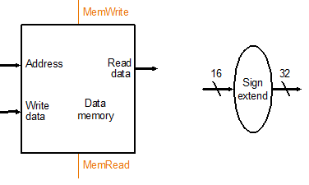
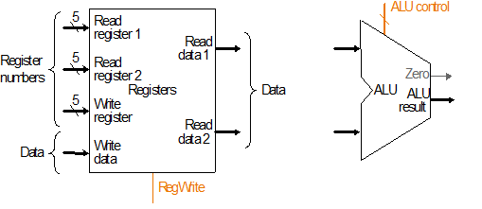
Building blocks
d. Data memory unit
e. Sign-extension unit
4
32
s
0
out
1
32
32
f. Register File
g. ALU
h. 2-to-1 Mux

Slide 3
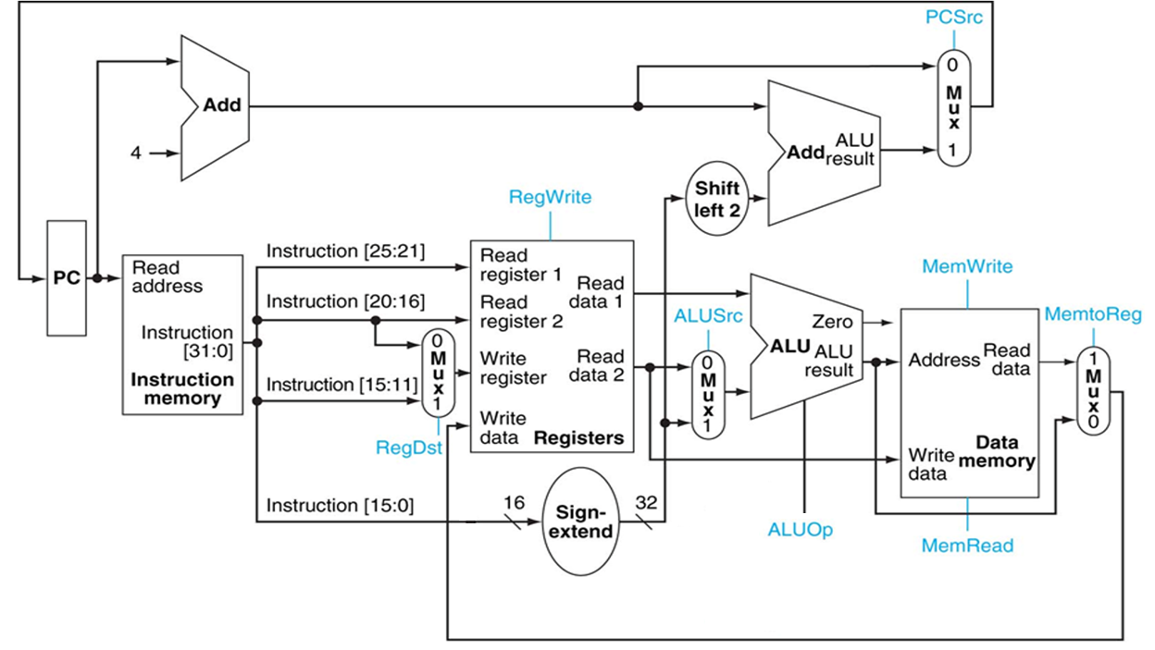
Below is the Datapath that we will use. We will start with understanding how we can configure the Control signals based on any given instruction
Instruction[31:0]
31:26
25:21
20:16
15:11
10:6
5:0
op
rs
rt
rd
shamt
funct
Note: The control signals need to be properly set in order to correctly execute any given instruction. We will change state of the datapath through a controller (not shown on this slide)

Slide 4
Single-cycle processor
Instruction format
31:26
25:21
20:16
15:11
10:6
5:0
op
rs
rt
rd
shamt
funct
RegDst
RegWrite
Opcode ALUSrc
MemRead
func MemWrite
MemtoReg
PCSrc
ALUOp
Controller
6
6
4

Slide 5
Instruction Representation (Addition example)
31:26
25:21
20:16
15:11
10:6
5:0
A = X + Y
X and Y are sources, A is the destination
In hardware, values of X and Y will be stored in a pair of registers
just like a variable in “C programming”
We need to have a way of telling the datapath that
it needs to do “addition” and
sources X and Y are in stored a specific register pair and the result will be stored in a specific register.
Instruction is formed as a 32 bit package
rs will indicate which register X is stored,
rt will indicate which register Y is stored,
rd will indicate where the result of the summation of rs and rt register contents will be stored.
rs, rt, rd: indicate the register id, there are 32 registers in the register file, therefore 5 bits needed
Sometimes we will need to shift the contents of a register, since each register is 32bits wide we can do at most 32 bit shift. The “shamt” field is designated for indicating this shift amount.
“op” and “func” fields (each 6bits) together will be used to determine the nature of operation
op
rs
rt
rd
shamt
funct

Slide 6
Example Operation: Addition
 | 6 bits | 5 bits | 5 bits | 5 bits | 5 bits | 6 bits | Total of 32 bits
 | op | rs | rt | rd | shmt | func | Expression
add | 000000 | used | used | used | 00000 | 100000 | Reg[rd] = Reg[rs]+Reg[rt]
Assume that you have a register file named “Reg” with 32 entries each 32 bits long and you are given the following 32-bits as the instruction:
Based on our specification, if the “op” == 000000 and “func” == 100000 then this will be designated as an addition operation.
It is reading two registers from the register file “Reg”
rs = 16 (10000), rt=9 (01001)
Read from register file as: Reg[16] and Reg[9]
The controller will change the state of the datapath and configure it to execute the addition operation over the values read form the register file
The result of the addition will be stored in register 7 (rd).
Reg[7] = Reg[16] + Reg[9]
addition operation does not use the “shmt” field. Later we will see instructions that utilize this field in the instruction.
000000 | 10000 | 01001 | 00111 | 00000 | 100000

Slide 7
Configuring the ALU to execute a specific arithmetic operation
ALU Table
Op | ALUOp | Description
ADDITION | 0000 | ALUResult = A + B
SUBRACTION | 0001 | ALUResult = A - B
MULTIPLICATION | 0010 | ALUResult = A * B
AND | 0011 | ALUResult = A and B
OR | 0100 | ALUResult = A or B
SET LESS THAN | 0101 | ALUResult =(A < B)? 1:0
SET EQUAL | 0110 | ALUResult =(A==B) ? 1:0
SET NOT EQUAL | 0111 | ALUResult =(A!=B) ? 1:0
LEFT SHIFT | 1000 | ALUResult = A << B
RIGHT SHIFT | 1001 | ALUResult = A >> B
ROTATE RIGHT | 1010 | ALUResult = A ROTR B
COUNT ONES | 1011 | ALUResult = A CLO
COUNT ZEROS | 1100 | ALUResult = A CLZ
NOTES:-
MULTIPLICATION : 32-bit signed multiplication results with 64-bit output.
ALUResult will be set to lower 32 bits of the product value.
SET LESS THAN : ALUResult is '32'h000000001' if A < B.
LEFT SHIFT: The contents of the 32-bit "A" input are shifted left,
inserting zeros into the emptied bits by the amount
specified in B.
ROTR: logical right-rotate of a word by a fixed number of bits.
The contents of the 32-bit "A" input are rotated right.
The bit-rotate amount is specified by "B".
CLO: Count the number of leading ones in a word.
Bits 31..0 of the input "A" are scanned from most significant to
least significant bit.
CLZ: Count the number of leading zeros in a word.
Bits 31..0 of the input "A" are scanned from most significant to
least significant bit.

Slide 8
16
9
7
7
Datapath configured for the addition operation
Type | RegDst | RegWrite | ALUSrc | ALUOp | MemRead | MemWrite | MemtoReg | PCSrc
add | 1 | 1 | 0 | 0000 (ALU Table See slide 6) | 0 | 0 | 0 | 0
000000 | 10000 | 01001 | 00111 | 00000 | 100000
op | rs | rt | rd | shmt | func
Reg[7] = Reg[16] + Reg[9]

Slide 9
Instruction List for Task-1 (R-Type of Operations)
 | 6 bits | 5 bits | 5 bits | 5 bits | 5 bits | 6 bits | Total of 32 bits
Inst. | Opcode | rs | rt | rd | shmt | func | Expression
add | 000000 | used | used | used | x | 100000 | Reg[rd] = Reg[rs]+Reg[rt]
sub | 000000 | used | used | used | 00000 | 100010 | Reg[rd] = Reg[rs]-Reg[rt]
and | 000000 | used | used | used | x | 100100 | Reg[rd] = Reg[rs] AND Reg[rt] (bitwise and)
or | 000000 | used | used | used | x | 100101 | Reg[rd] = Reg[rs] OR Reg[rt] (bitwise or)
slt | 000000 | used | used | used | 00000 | 101010 | if (Reg[rs] < Reg[rt]) Reg[rd] = 1 else Reg[rd]=0
sll | 000000 | x | used | used | used | 000000 | Reg[rd] = Reg[rt] < < shmt (left shift)
srl | 000000 | x | used | used | used | 000010 | Reg[rd] = Reg[rt] >> shmt (logical right shift)
clo | 011100 | used | not used | used | x | 100001 | Reg[rd] = count_leading_ones in Reg[rs]
clz | 011100 | used | not used | used | x | 100000 | Reg[rd] = count_leading_zeros in Reg[rs]
mul | 011100 | used | used | used | x | 000010 | Reg[rd] = Reg[rs] X Reg[rt]
rotrv | 000000 | used | used | used | x | 000110 | Reg[rd] = Reg[rt] right_rotated by Reg[rs]
mul: General purpose register (GPR) rs is multiplied by the 32-bit value in GPR rt, treating both operands as signed values, to produce a 64-bit result. The least significant 32 bits of the product are written to GPR rd
sll: The contents of the 32-bit word of GPR rt are shifted left, inserting zeros into the emptied bits; the word result is placed in GPR rd. The bit-shift amount is specified by shmt
srl: The contents of the 32-bit word of GPR rt are shifted right, inserting zeros into the emptied bits; the word result is placed in GPR rd. The bit-shift amount is specified by shmt.
X: don’t care

Slide 10
Exercise-1
Refer to Slides 6 and 8 for the instruction specs., Complete the table below
Type | Opcode | func | ALUSrc | RegDst | RegWrite | ALUOp | MemRead | MemWrite | MemtoReg | PCSrc
add | 000000 | 100000 | 0 | 1 | 1 | 0000 | 0 | 0 | 0 | 0
sub | 000000 | 100010
and | 000000 | 100100
or | 000000 | 100101
slt | 000000 | 101010
sll | 000000 | 000000
srl | 000000 | 000010
clo | 011100 | 100001
clz | 011100 | 100000
mul | 011100 | 000010

Slide 11
Arithmetic with Immediate Values
31:26
25:21
20:16
15:0
op
rs
rt
address
 | Instruction Fields |  |  |  | Expression
 | 6 bits | 5 bits | 5 bits | 16 bits
Inst. | opcode | rs | rt | offset
addi | 001000 | used | used | 16 bits immediate value | Reg[rt] = Reg[rs] + immediate
ori | 001101 | used | used | 16 bits immediate value | Reg[rt] = Reg[rs] OR immediate
Sometimes values are available at the compilation time, such as the constant values you declare or expressions with constant values in a C program: A=A+2. You don’t need to store the constant value in a register. The instruction itself can provide this value to the Datapath. We refer to this class of instructions as “Immediate” type, where value of A will be retrieved from the register file using the “rs” field and the value “2” will be stored in the least significant 16 bits of the instruction. In this case, all we need to do is read the “A” value from the register file and configure ALU to do addition with its second input set to 2.
You will be supporting “addi” and “ori” operations on your Datapath. Controller will determine that this is a “addi” or “ori” instruction based on its unique opcode (op) value of 8 or 13 respectively.
We will read the contents of “rs” register (Reg[rs])
Hardcoded immediate value is a 16-bit number. Our Datapath is a 32-bit architecture. ALU receives two 32-bit inputs. Therefore we need to extend the 16-bit immediate value to 32 bits. While doing this we need to take into account the sign of the value. Offset amount can be positive or negative. Therefore we will first sign extend this immediate value and then feed into the ALU.
We will write the result of the operation (output of ALU) to our destination register rt. Note that in R-type of instructions, destination register is always indicated by the “rd” field. For the immediate field we no longer have the “rd” field and we will use the “rt” field in the instruction instead
Now let’s identify the values of Datapath control signals for executing addi and ori instructions.
You will see the role for some of the muxes shown in the datapath with this exercise. (next slide)

Slide 12
Exercise-1 (Continue)
Type | opcode | RegDst | RegWrite | ALUSrc | ALUOp | MemRead | MemWrite | MemtoReg | PCSrc
addi | 001000
ori | 001101
 | Instruction Fields |  |  |  | Expression
 | 6 bits | 5 bits | 5 bits | 16 bits
Inst. | opcode | rs | rt | offset
addi | 001000 | used | used | 16 bits immediate value | Reg[rt] = Reg[rs] + immediate
ori | 001101 | used | used | 16 bits immediate value | Reg[rt] = Reg[rs] OR immediate

Slide 13
Task 1: Implementation and Functional Verification for R and I type operations
Controller: Using the tables generated in Exercise 1, implement (write Verilog code) a controller for the given Datapath.
The controller (slide 4) has 2 inputs: 6-bit opcode and 6-bit func. Its outputs are control
signals listed in the table of Exercise 1 (Slide 9).
Datapath: Using slide 3, write the Verilog code to implement Datapath (structural way – connecting several modules that you already implemented together as shown on Slide 3). It has two inputs: Clock, Reset and 1 output: the output from the rightmost 2x1 32-bit mux on slide 3.
All control signals should be declared as wire.
Note: This Datapath is not complete/ready to be used. See next slide (slide
14) for an explanation.
Integrate the controller with the Datapath. Call/Instantiate Controller in the Datapath code.
Run both behavioral and post-synthesis simulations. Before you can run the simulation,
- Read slide 14 and make sure that your Instruction memory has what is required as stated in slide 14
- write a testbench

Slide 14
Datapath completion
Inst. | [31:26] | [25:21] | [20:16] | [15:11] | [10:6] | [5:0]
 | 6 bits | 5 bits | 5 bits | 5 bits | 5 bits | 6 bits | Total of 32 bits
 | Opcode | rs | rt | rd | shmt | func | Expression
sll | 000000 | x | used | used | used | 000000 | Reg[rd] = Reg[rt] < < shmt (left shift)
srl | 000000 | x | used | used | used | 000010 | Reg[rd] = Reg[rt] >> shmt (logical right shift)
The given Datapath (Slide 3) is not ready to support the shift left and shift right instructions shown above
The shmt bits (Instruction[10:6]) should be fed to the B input of ALU. Also the [rt] register content should be fed into the A input of ALU.
Since the shmt has only 5 bits, zero extension instead of sign extension should be used so that the 6-bit value turns into a 32-bit value before feeding into the ALU.
Hint:
#1) 2x1 muxes should be used to make sure that the input A of ALU and the input B of ALU get the correct input signals when the shifting operation needs to be executed.
input A of ALU should come from Reg[rt] (which is Readdata2 (not Readdata1 - as shown in Datapath (Slide 3))
input B of ALU should come from shmt (Insrt bits [10:6] shown in the table above) (not the output from the mux with ALUSrc as select signal - as shown in Datapath (Slide 3))
#2) More control signals should be added to the Controller (extra control signals are from the select signal of the muxes that you have to add in Hint #1)

Slide 15
Initializing the Instruction Memory for testing
In the folder “task1_r-type” in “DatapathComponents” zipped file, the contents of “rtype_inst_memory.txt” is what already in the initialization block (initial begin … end) in the instruction memory component.
The “r_type_with_answers.s” file shows the original source code with the expected results
Values in registers 8, 16, 17, 18, and 19 (RegFile[8], [16], [17], [18] and [19]) will be monitored during your post-routing simulation.
These registers correspond to t0, s0, s1, s2, and s3 in the commented parts of the “rtype_inst_memory.txt”
After initializing the instruction memory, synthesize your design and run post-routing simulation.
Bring registers 8, 16, 17, 18, and 19 (RegFile[8], [16], [17], [18] and [19]) from your RegisterFile to your simulation waveform
Monitor the values in these registers.

Slide 16
Task 1 (R-type and I-type): Expected Output and Grading Scheme
Task 1 (325 pts):
(10 pts) Complete slides 10 and 12
(315 pts) Post synthesis simulation for each instruction in Instruction memory (see the table on the right)
Penalty Conditions
30% penalty if work only in the behavioral simulation
maximum of 25% of the total score will be given if your processor does not function at all.
Cycle | Inst. | Value | Points
1 | addi | Reg[16]=14 | 20
2 | addi | Reg[17]=15 | 5
3 | addi | Reg[18]=29 | 5
4 | addi | Reg[19]=-15 | 5
5 | add | Reg[8]=44 | 25
6 | and | Reg[8]=12 | 25
7 | mul | Reg[8]=210 | 25
8 | or | Reg[8]=31 | 25
9 | ori | Reg[8]=30 | 25
10 | sub | Reg[8]=-15 | 25
11 | clo | Reg[8]=28 | 25
12 | clz | Reg[8]=27 | 25
13 | slt | Reg[8]=1 | 20
14 | slt | Reg[8]=0 | 5
15 | sll | Reg[8]=60 | 25
16 | srl | Reg[8]=3 | 25
 |  | Total | 315

