Slide 1

Smart Café CRM
Tailored Database Design for Tamil Nadu Cafés
Pivot to better customer relationships !

Slide 2

Contents
Introduction
Role of SQL
Table
Stored Procedures
Conclusion

Slide 3
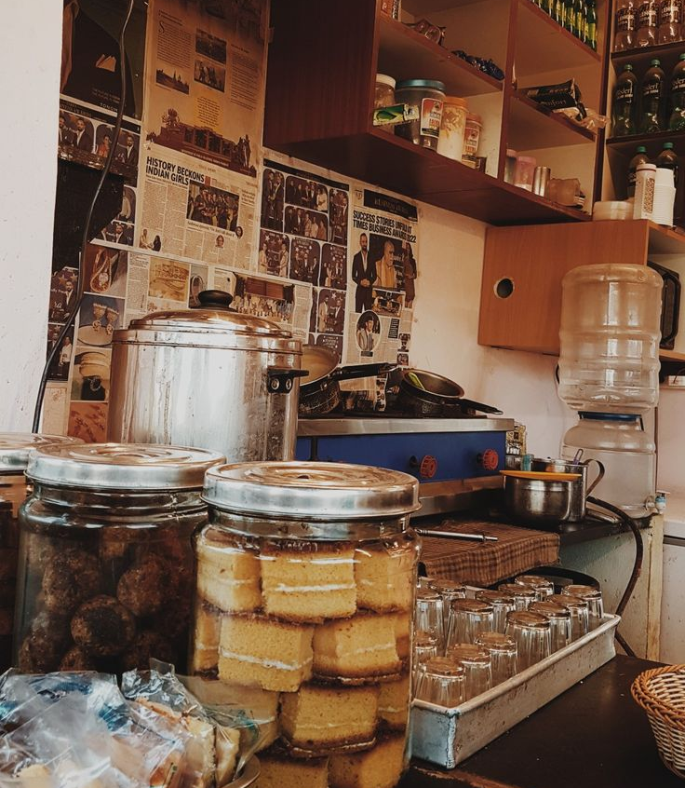
Introduction
Tamil Nadu’s cafés and bakeries rely on manual operations with minimal customer tracking.
Most use a POS system, but lack structured data management for orders, customers, and loyalty.
Inspired by Starbucks' data-driven model, this CRM bridges the gap for local cafés.

Slide 4
The Role of SQL
Relational consistency: Ensures structured and secure storage.
Efficient queries: Fast retrieval of customer preferences & order trends.
Scalability: Supports multi-branch expansion across Tamil Nadu.

Slide 5
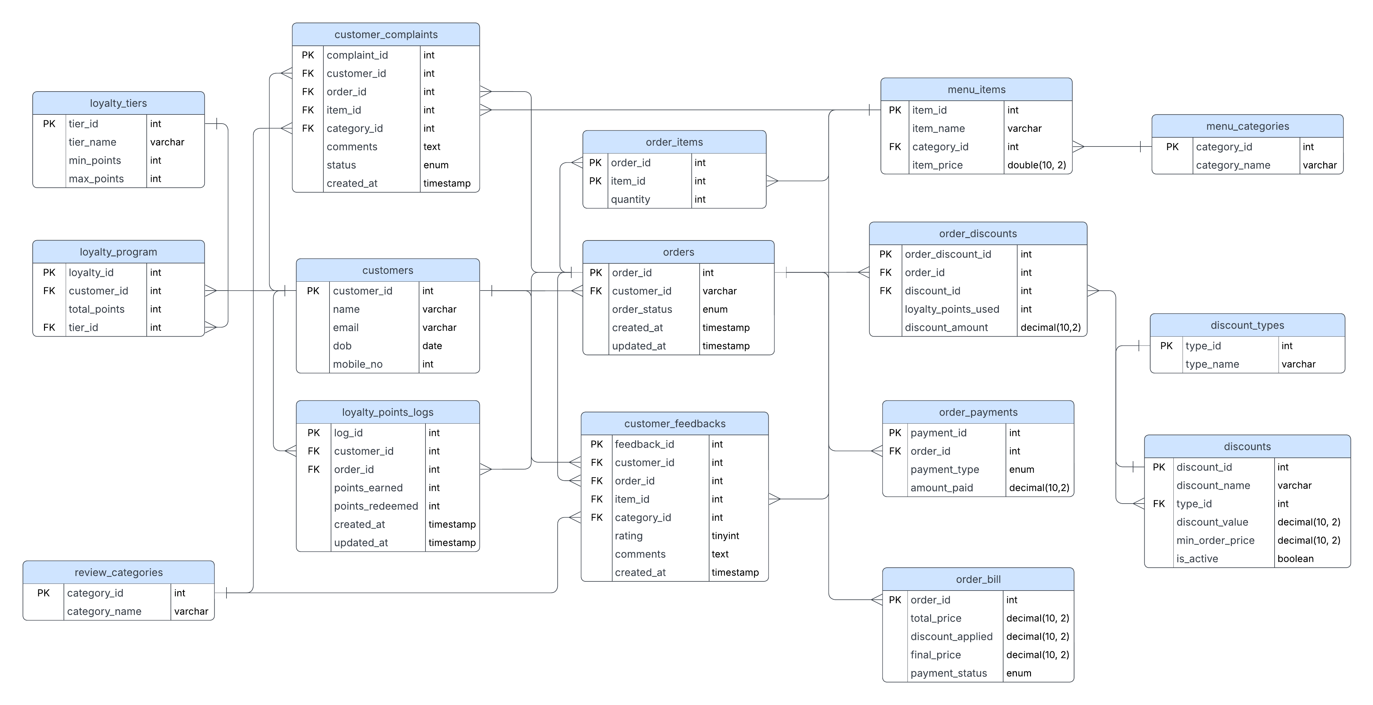
Tables

Slide 6
Stored Procedures
GetCustomerOrderCounts()
GetTopSpendingCustomers(n)
GetMonthlyRevenue()
GetCustomerAverageSpending()
GetPeakOrderHours()
GetRedeemedPointsPercentage()
GetMostOrderedMenuItems()
GetComplaintCategoryCounts()
GetMenuItemAverageRatings()
GetFrequentCustomers(n)

Slide 7
Conclusion
A café-specific CRM tailored for Tamil Nadu’s local market.
SQL-powered efficiency ensures accurate and rapid data handling.
Future-proof design ready for expansion into AI-driven insights.

