Slide 1

Pneumonia Detection
using
Convolutional Neural Network
Presented by,:
Shenjin S A Solomon
Reg.no:613521104043
Government College of
Engineering,Dharmapuri.

Slide 2

AGENDA:
PROBLEM STATEMENT
PROJECT OVERVIEW
PROPOSED SYSTEM/SOLUTION
SYSTEM DEVELOPMENT APPROACH
ALGORITHM AND DEPLOYMENT
RESULTS
CONCLUSION

Slide 3
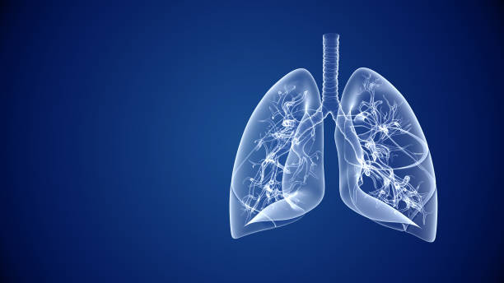
PROBLEM STATEMENT :
Develop a robust and efficient system for the automated detection of pneumonia from chest X-ray images.
The system should accurately classify X-ray images as either showing signs of pneumonia or being normal. Additionally, the system should be able to distinguish between bacterial and viral pneumonia if possible.
The system should prioritize high accuracy, reliability, and speed to aid in prompt patient treatment and management.

Slide 4

PROPOSED SYSTEM /SOLUTION:
One proposed solution for pneumonia detection could involve developing an AI-powered system that analyzes chest X-rays using CNN algorithm.
This system could accurately identify patterns associated with pneumonia, providing quick and reliable diagnoses to healthcare professionals, thereby aiding in timely treatment and improving patient outcomes.
Additionally, integrating this technology into existing healthcare infrastructure could enhance efficiency and reduce diagnostic errors.

Slide 5
SYSTEM DEVELOPMENT APPROACH:
Software requirements:
Programming Languag: Python (preferred for its rich ecosystem of libraries like TensorFlow, PyTorch, and OpenCV).
Development Environment: Jupyter Notebook or IDEs like PyCharm, Visual Studio Code.
Machine Learning Libraries:TensorFlow, PyTorch, Scikit-learn.
Image Processing Libraries:OpenCV, PIL (Python Imaging Library).
Data Handling: Pandas for data manipulation.
Visualization: Matplotlib, Seaborn for data visualization.
User Interface (Optional):Flask or Django for web application development.
Version Control: Git for tracking changes and collaboration.
Documentation: Markdown for documenting code and project progress.

Slide 6
GPU (Graphics Processing Unit): Optional but highly recommended for faster model training. NVIDIA GPUs, such as GeForce or Tesla series, are commonly used for deep learning tasks.
CPU (Central Processing Unit): A multi-core CPU with sufficient processing power for data preprocessing, model training, and inference.
Memory (RAM): At least 8GB of RAM is recommended for handling large datasets and training deep learning models.
Storage: Sufficient disk space for storing datasets, model checkpoints, and application files. SSD (Solid State Drive) is preferred for faster data access.
Internet Connection: Required for downloading libraries, datasets, and updates, as well as for deploying web-based applications.
Hardware requirements:

Slide 7

ALGORITHM AND DEPLOYMENT:
Convolutional neural network (CNNs)algorithm is used.
CNN takes image as input and assigns relative weight to different object present in the image and be able to differentiate one from the other.
CNNs are regulated versions of multilayer perceptrons ,it usually means fully connected network that is each neuron in one layner is connected to all neurons in the ext layer.

Slide 8
METHODOLOGY:
1. Research and Data Collection: Collect a dataset of chest X-ray images with labeled pneumonia cases.
2. Data Preprocessing : Clean and preprocess the chest X-ray images, including resizing, normalization, and augmentation to ensure quality and diversity in the dataset.
3. Model Selection : Choose a suitable machine learning or deep learning model for image classification tasks likeconvolutional neural networks (CNNs).
4. Model Training : Train the selected model using the preprocessed dataset.
5. *Validation and Evaluation:* Validate the trained model using a separate validation dataset and evaluate its performance metrics such as accuracy, precision, recall, etc....

Slide 9
6. Deployment:
Develop a user-friendly interface to deploy the trained model, allowing healthcare professionals to upload chest X-ray images and receive real-time predictions on pneumonia presence.
7. Testing and Feedback:
Conduct thorough testing of the system to ensure reliability and usability, and gather feedback from potential users to iterate and improve the system as needed.
8. Documentation and Presentation :
Document the entire development process, including methodologies, results, and challenges faced, and present the findings in a clear and concise manner for project dissemination.

Slide 10

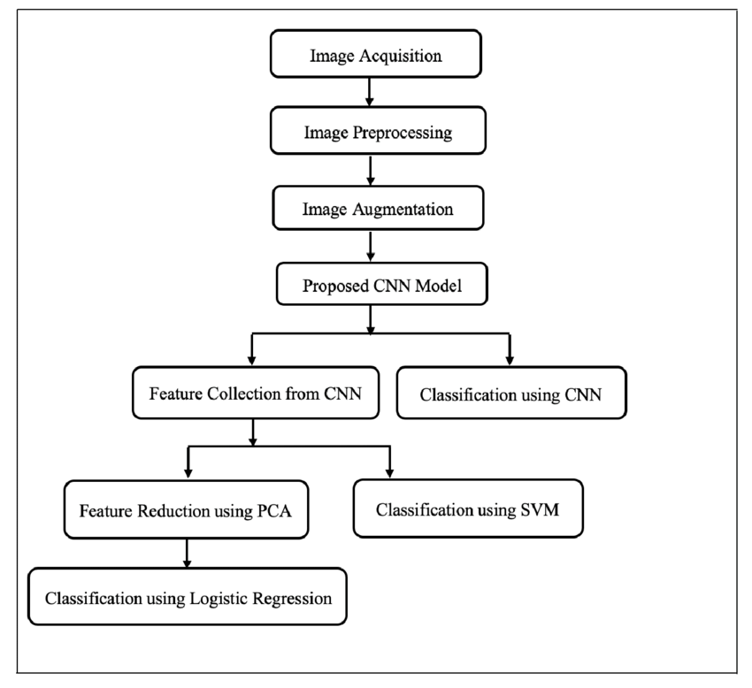
Methodology flowchart:
A step by step illustration of how covolutional neural network works inorder to classify X-rays to find for pneumonia detection.

Slide 11


DATASET USED IN THE MODEL:
The dataset used in this project is a kaggle dataset of chest X-rays images which contains more than 5000 images.
This dataset is further divided into test,train and validation images.
These images in the dataset are further classified into two categories they are normal and pneumonia infected images and model is trained.

Slide 12
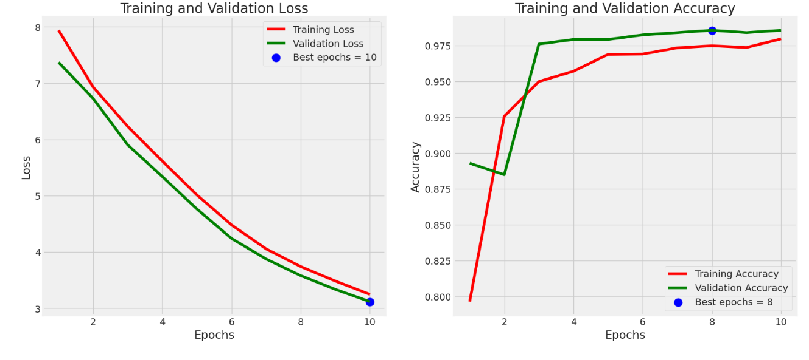
RESULT:
The model demonstrated high accuracy, sensitivity, and specificity in detecting pneumonia, showcasing its potential as a valuable tool for assisting healthcare professionals in diagnosing this respiratory condition.

Slide 13
CONCLUSION:
In conclusion, the pneumonia detection mini project demonstrates the feasibility and effectiveness of leveraging machine learning techniques, particularly deep learning models, for automated detection of pneumonia from chest X-ray images. Through systematic data collection, preprocessing, model development, and validation, the project showcases the potential to aid healthcare professionals in diagnosing pneumonia accurately and efficiently. While further refinement and validation are necessary for real-world deployment, the project lays a solid foundation for future advancements in medical image analysis and diagnostic support systems.

Slide 14


