Slide 1

Slide 1
“ Microcontroller Based Plant Hydrator Using Weather Prediction and Soil Analysis”

Slide 2
Maria Mehjabin Shenjuti
2018-1-60-244

Slide 3
Introduction
Shortage of water is a big problem nowadays as the level of ground water is declining. In this situation wastage of water is a big issue to prevent. As sometimes farmers forget to water the plants which causes damage to plants. So, the water should be used properly. The aim of this project is to overcome the problem. This project is based on Arduino using temperature and soil moisture analysis.

Slide 4
Problem Statement
Culturing tree is a very lengthy process.
It takes a lot of manpower to solve all the problems of the tree and make it bigger.
It is also costly process.
Physical monitoring is a monotonous matter for the farmers but no automation system for irrigation.
Giving water of the plants depends on many other surrounding purpose like temperature , humidity etc.

Slide 5
Problem Solution
To remove burden from the farmers, we’ve come across with some points.
A System is based on Arduino microcontroller which monitors the amount of soil moisture content in soil.
A temperature sensor to sense the environment’s temperature.
In case of dry soil, automation system can be used for the irrigation system, pumping water for watering the plants and as soon as the motor is turned on , a blue led light will come on.
When the temperature rises, a sound system is needed for emergency.

Slide 6
Requirements
Arduino UNO R3
Coil(1210-271K)
Capacitor(100uF)
DC Voltage Source (battery) 12v
NPN Transistor
Soil Moisture Sensor
Temperature Sensor
20x4 Alphanumeric LCD
DC Motor(12v)
Sounder
Potentiometer(10k ohm)
Relay
Resistor
Push Button
LED (Blue)

Slide 7
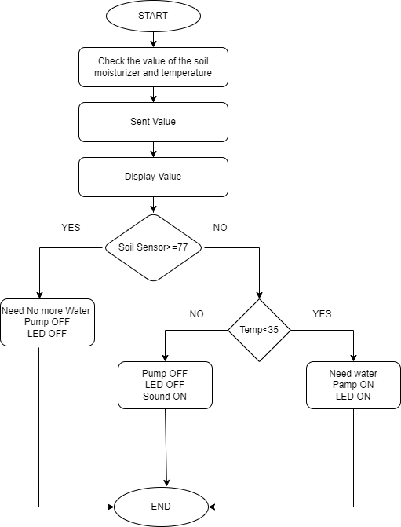
Methodology

Slide 8
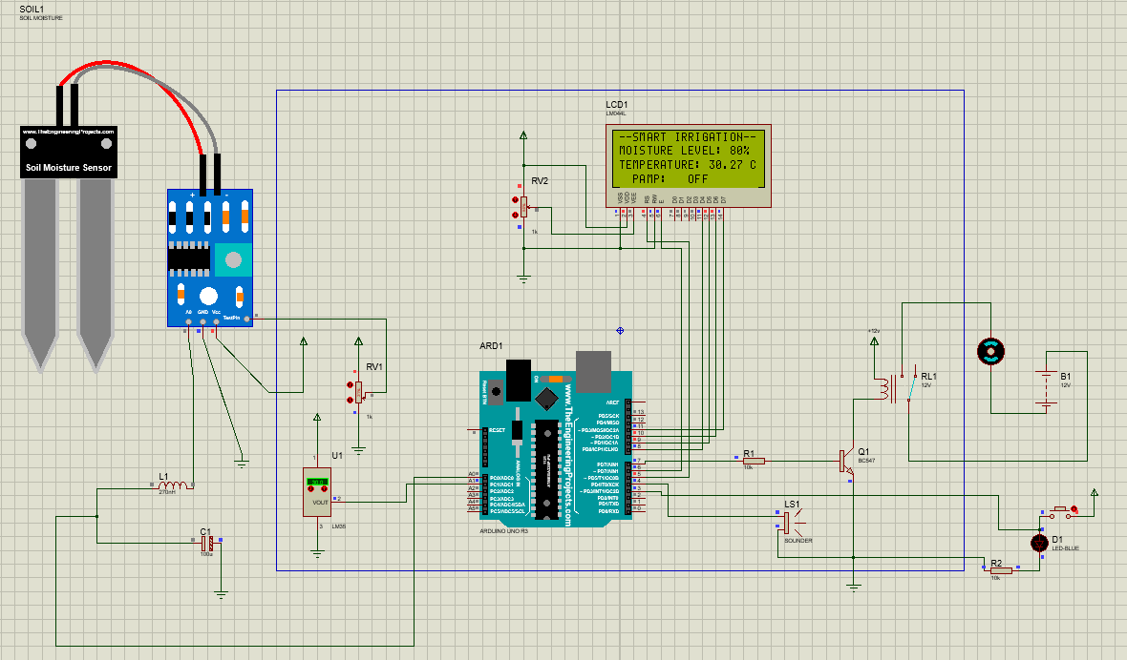
Condition-1
When the soil moisture is more than 77%, the motor will be off, and the LED lights will be off also.
If soil moisture level is 80%,then the diagram is-

Slide 9
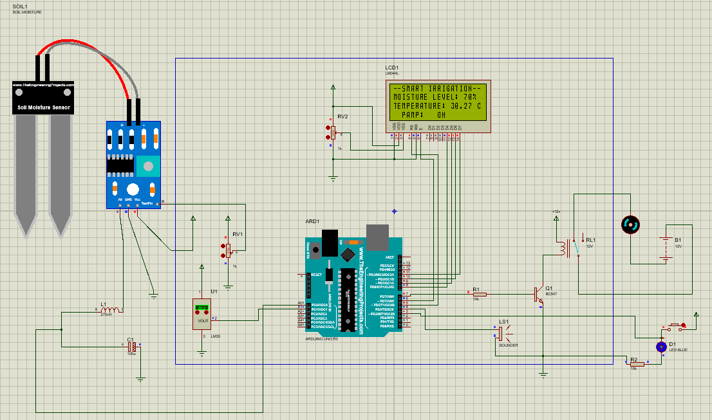
Condition-2
When the soil moisture is less than 77% and the temperature is less than 35C, both the motor and the LED lights will be on.
If soil moisture level is 70% and temperature is 30.27C,then the diagram is-

Slide 10

Condition-3
When the soil moisture is less than 77% and the temperature is greater than 35C, both the motor and the LED light will be off, but the sounder is on.
If soil moisture level is 70% and the temperature is 40.04C,then the diagram is-

Slide 11
Advantages
Automation
Time effective
Cost-effective
Efficient
The wastage of water will be decreased also. A sound system is available here for emergencies.

Slide 12
Future Work
IOT
Incorporation of Artificial Intelligence
Time scheduling
Weather predictor

Slide 13
Conclusion
This project allows the agriculturist to screen and keep up the moisture remotely regardless of time. It is an effective approach to less human effort and wastage of water in farming. The framework has an immense interest and future extension as well.

Slide 14
Slide 1
Thank you….

