Slide 1
Deep Learning-Based
Chest X-Ray Diagnosis
Using Medical Images and Radiology Reports
Sheneeza Chaudhary
ID: 22015775 | NP01MS7S250063
CC7009NI Neural Networks and Deep Learning
Notes:
This is a multi modal project and the aim is to explore how integrating visual and textual data can improve diagnostic reliability compared to single-modality approaches.

Slide 2
Project Overview
The Challenge
Solution
Single-modality systems lack clinical context
Image-only models miss textual insights
Text-only models lack visual pathology
Manual interpretation is time-consuming and error-prone
Multimodal deep learning framework
Integrates chest X-ray images with radiology reports
Binary classification: Normal vs Abnormal
Clinical decision-support tool
Notes:
Instead of relying only on images or only on text, the system jointly learns from both chest X-ray images and their corresponding radiology reports to classify cases as normal or abnormal.
This setup is closer to real clinical practice, where radiologists use both visual evidence and written findings to make decisions.

Slide 3
Dataset & Methodology
Indiana University Chest X-Ray Dataset
Supervised Multimodal Learning
Paired frontal X-ray images & radiology reports
Binary labels: Normal & Abnormal
70/15/15 train/validation/test split
Transfer learning from pretrained models
Feature-level fusion of image & text
Class-weighted loss for imbalance
Data Preprocessing
Images
Text
Overfitting
Resize to 224×224
ImageNet normalization
Remove label-related terms
BioBERT tokenization
Early stopping
Learning rate scheduling
Notes:
Features extracted from images and text are combined using feature-level fusion. Since the dataset is imbalanced, a class-weighted loss function is applied to reduce bias toward the majority class. normalized using ImageNet statistics.
For text preprocessing, label-related terms are removed from reports to prevent data leakage, and the text is tokenized using BioBERT’s tokenizer.
To prevent overfitting, techniques such as early stopping and learning rate scheduling are applied.

Slide 4
Multimodal Architecture
Chest X-Ray
Image
ResNet-18
Image Feature
Extractor
(512-dim)
Feature Fusion
+ MLP Classifier
Radiology
Report
BioBERT
Text Feature
Extractor
(768-dim)
Normal /
Abnormal
Total Parameters: ~122M
Notes:
The architecture consists of two parallel branches. The image branch uses ResNet-18, which extracts a 512-dimensional feature vector from the chest X-ray image. The text branch uses BioBERT, producing a 768-dimensional embedding from the radiology report. These features are concatenated and passed through a multilayer perceptron classifier to predict normal or abnormal cases.
Transfer learning is used with ImageNet-pretrained weights for ResNet and PubMed-trained weights for BioBERT. The AdamW optimizer is used for efficient training and better generalization.

Slide 5
Training Strategy & Hyperparameters
Optimization
Regularization
Configuration
Optimizer: AdamW
Initial LR: 1×10⁻⁴
Fine-tune LR: 1×10⁻⁵
Batch Size: 16
Max Epochs: 20
Dropout: 0.3
Early Stopping
LR Scheduling
Class Weighting
Framework: PyTorch
Hardware: Google Colab GPU
Loss: Weighted CE
Text Length: 256 tokens
Image Size: 224×224

Slide 6
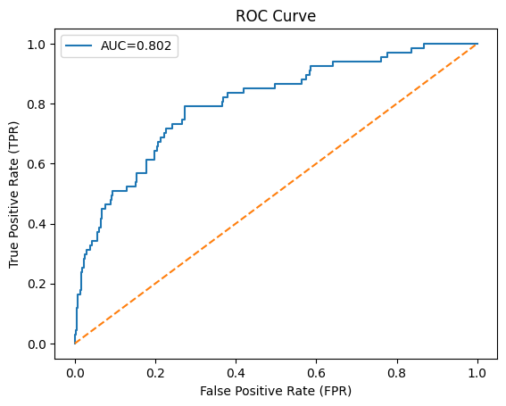
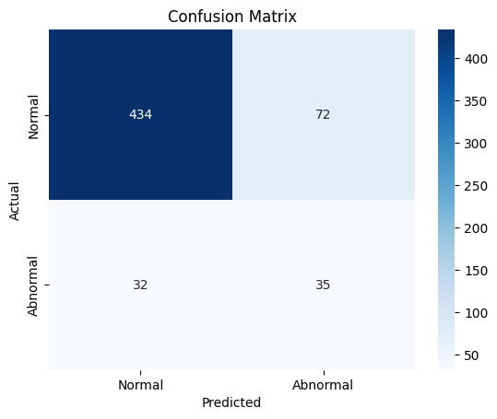
Performance Results
82%
0.802
~122M
Overall Accuracy
ROC-AUC Score
Model Parameters
Class-wise Performance
Class | Precision | Recall | F1-Score
Normal | 0.93 | 0.86 | 0.89
Abnormal | 0.33 | 0.52 | 0.40
Notes:
These results show that the multimodal approach is effective despite the relatively small dataset size.

Slide 7
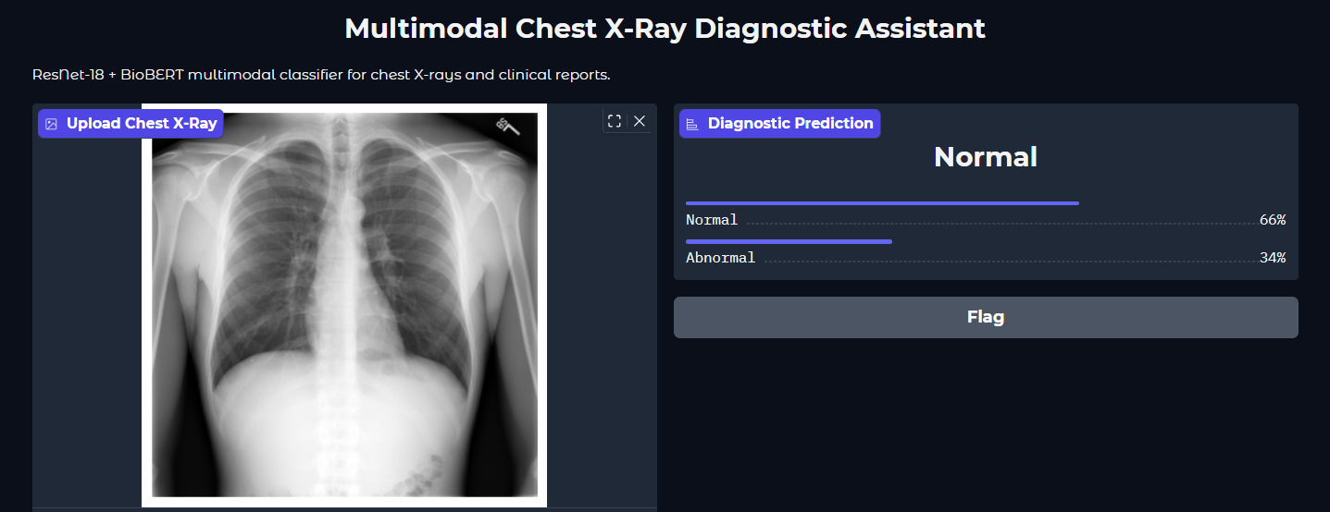
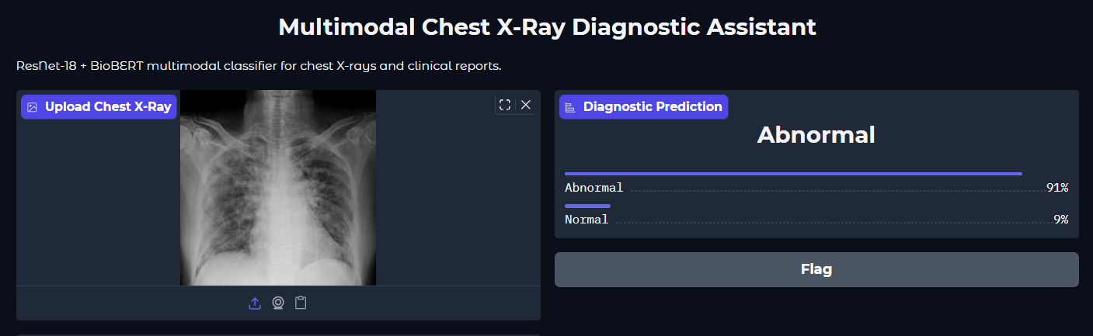
Performance Results
Notes:
The model performs particularly well on normal cases, achieving high precision of around 93%. However, performance on abnormal cases is lower, especially in terms of recall, which is around 52%. This reflects the impact of class imbalance and limited abnormal samples in the dataset.

Slide 8
Comparison & Contributions
Performance vs. Existing Work
Approach | Modality | ROC-AUC Range
Traditional CAD | Image Only | 0.65 - 0.75
CNN-based (CheXNet) | Image Only | 0.75 - 0.85
Multimodal System | Image + Text | 0.802
Novel Contributions
1
Multimodal Fusion
2
Clinical Context
3
Practical Design
First to combine ResNet-18 + BioBERT for chest X-ray diagnosis
Leverages actual radiologist reports for enhanced diagnosis
Balanced approach addressing real clinical workflows

Slide 9
Limitations & Future Enhancements
Current Limitations
Dataset Size: IU-Xray dataset is relatively small compared to modern medical imaging datasets
Class Imbalance: Lower sensitivity to abnormal cases due to dataset imbalance
Generalization: Model trained on single institution data may not generalize to diverse populations
Proposed Enhancements
Train on larger datasets (MIMIC-CXR, CheXpert)
Multi-institutional validation
Vision transformers for images
Notes:
Main limitations: small dataset size and class imbalance and limited generalizability due to single-institution data.
Future work includes training on larger datasets, exploring advanced architectures like vision transformers
Improve interpretability through attention visualization

Slide 10
THANK YOU!
Sheneeza Chaudhary | 22015775

