Slide 1
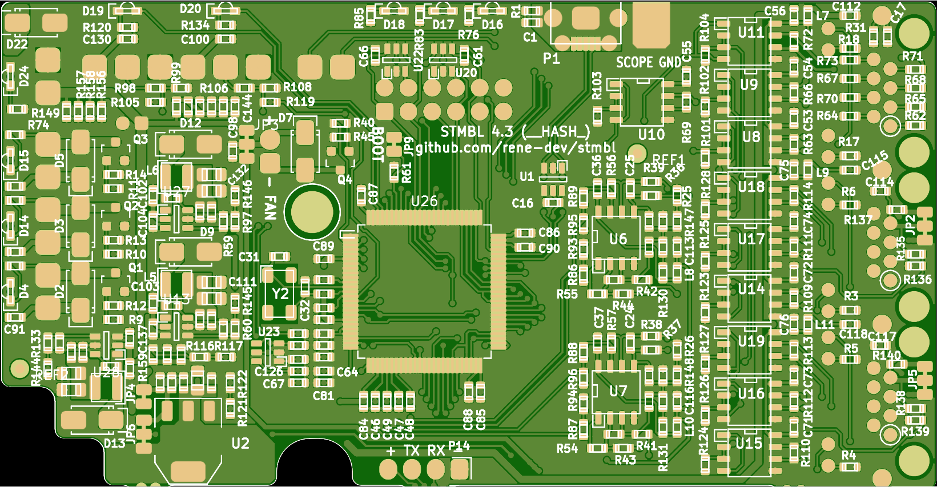
LED G
LED G
LED G
Y
R
SMAJ24A
G
G
L6 10u
G
ACT4088
L5 4.7u
G
8Mhz
ACT4088
ACT4088
L12 4.7u
U2 zldo1117

Slide 2
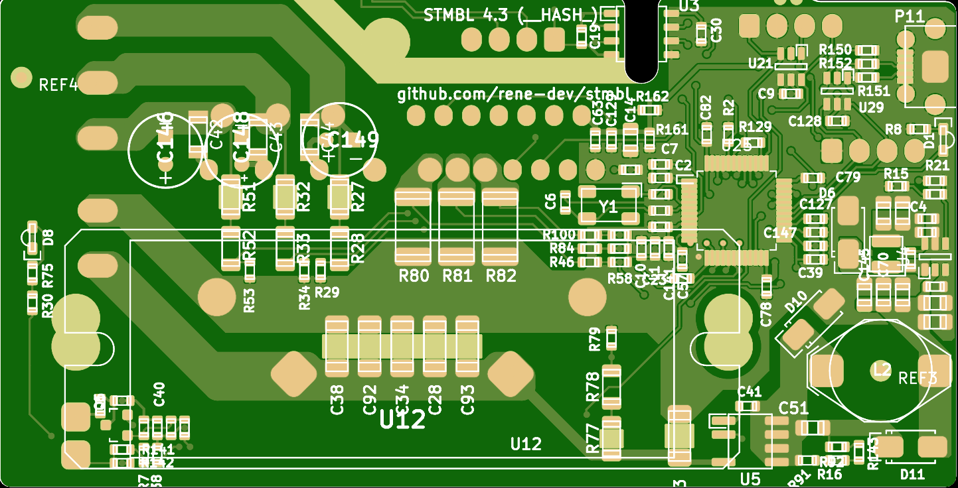
SI8621
3x22uF
LED R
8Mhz
3x3mΩ
LED G
L4 10u
ACT4088
18pF back
5x150nF
L2 1mH
150nF
LNK
304D

