Slide 1
3D Graphics Rendering with OpenGL
Jerred Shepherd
Notes:
Brief introduction about me

Slide 2
Overview
Graphics rendering background
Core concepts
Introduction to OpenGL
Brief demo
Conclusion

Slide 3
Graphics Rendering Background

Slide 4
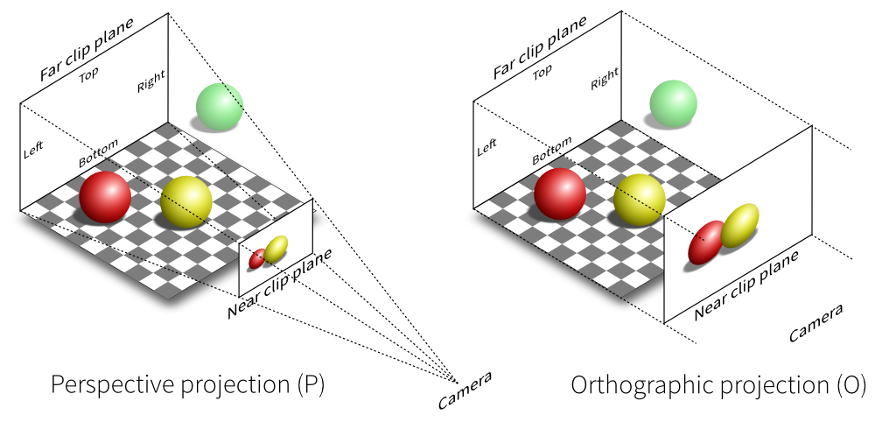
What is Graphics Rendering?
[15]
Notes:
Process of creating an image from a 2D or 3D scene
We see it in action every day on our phones, laptops, and every Friday on this projector

Slide 5
Where is Graphics Rendering Used?
Bootloaders
Operating systems
Computer animation
Game engine
Notes:
Very low-level places like text tendering for a bootloader
High-level places like videos game and desktop applications
Mention capstone game

Slide 6
Why Learn Graphics Rendering?
Gain a better understanding of computers
Write better applications
Implement your own graphics rendering if needed
Notes:
We use it every day, but most of us probably don't know much about it
Most of us won't write graphical programs running at such a low level
It is useful to understand how things work

Slide 7
Graphics Rendering Computation
Graphics rendering requires a lot of computation
This computation can be done in parallel
CPUs aren't well suited to this task
Notes:
TODO change title

Slide 8
Graphics Rendering Computation
Graphics Processing Units (GPUs) were created to supplement CPUs
Excel at floating-point calculations
Highly parallel
General Purpose GPU (GPGPU)
AI
Computer vision
Neural networks
Scientific computing
Simulations
Research

Slide 9
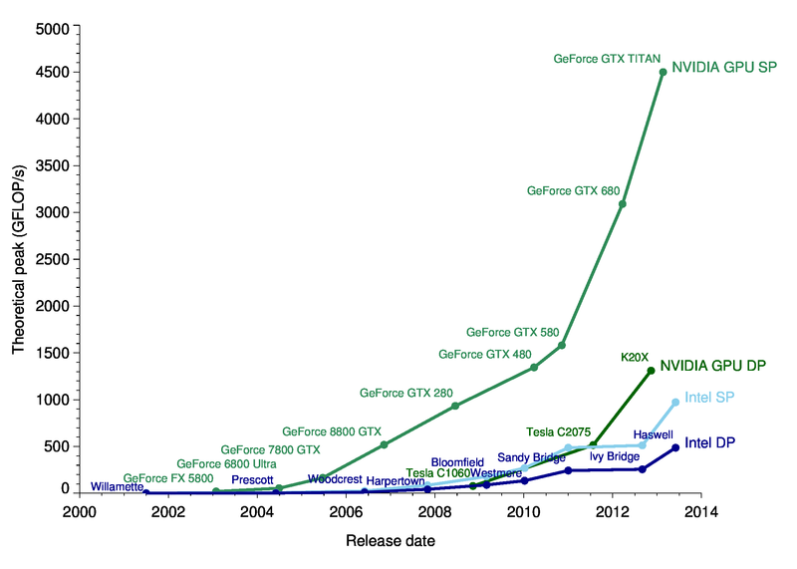
Graphics Rendering Background
[3]
Notes:
TODO make bigger

Slide 10
GPU Programming
CPU programming vs GPU programming
Interacting with GPUs requires the use of a graphics API
GPUs shader programs
Minimizing communication between CPU and GPU is ideal
Notes:
Programming a CPU involves writing code, compiling it, and then executing a binary
Using a GPU is different
Instead of directly writing code, you use a API to communicate with the GPU
You can also write programs that execute on the GPU, but you still need to use APIs to load and execute the program

Slide 11
Modern Graphics APIs
OpenGL (1992)
DirectX (1995)
Metal (2014)
Vulkan (2016)
Notes:
Which one you can use depends on your operating system and graphics card
OpenGL is a popular cross-platform API, and is supported on all modern consumer graphics cards
Vulkan is the successor to OpenGL, but is too new to be widely used

Slide 12
Core Concepts of Graphics Rendering
Notes:
Before we dig into OpenGL, it's important to understand some core concepts of computer graphics
These concepts will transfer over to any graphics API

Slide 13
Primitives
Points
Lines
Triangles

Slide 14
Primitives
Commonly defined as a vector of size four
Components are x, y, z, and w
w is the homogeneous coordinate
Notes:
Primitives are defined as vectors with a length of four
They contain x, y, z, and w elements
These are the three most important primitives in graphics rendering

Slide 15
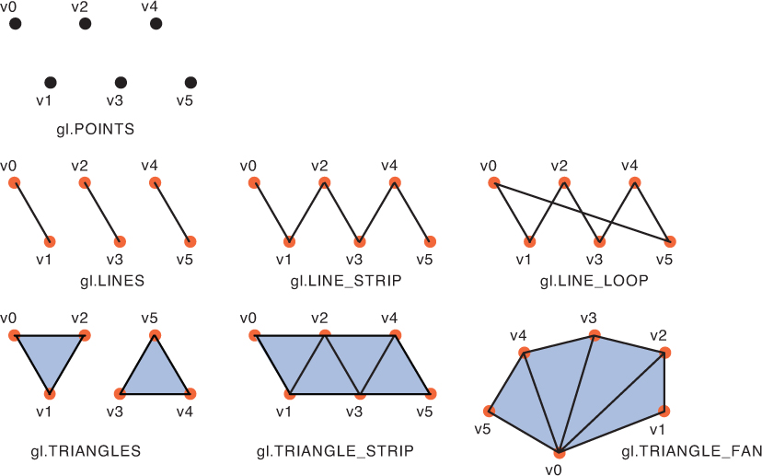
Primitives
[12]
Notes:
Base primitives
Primitive assembly

Slide 16
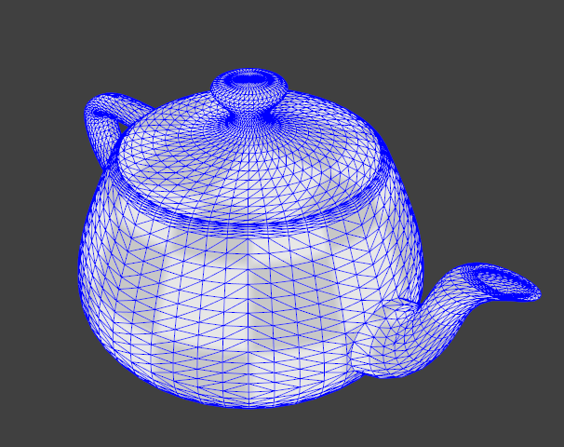
Primitives
[14]

Slide 17
Matrices
OpenGL uses matrices to transform matrices
Projection Matrix
Maps primitive coordinates to screen coordinates
Model Matrix
Used for translating, rotating, and scaling

Slide 18
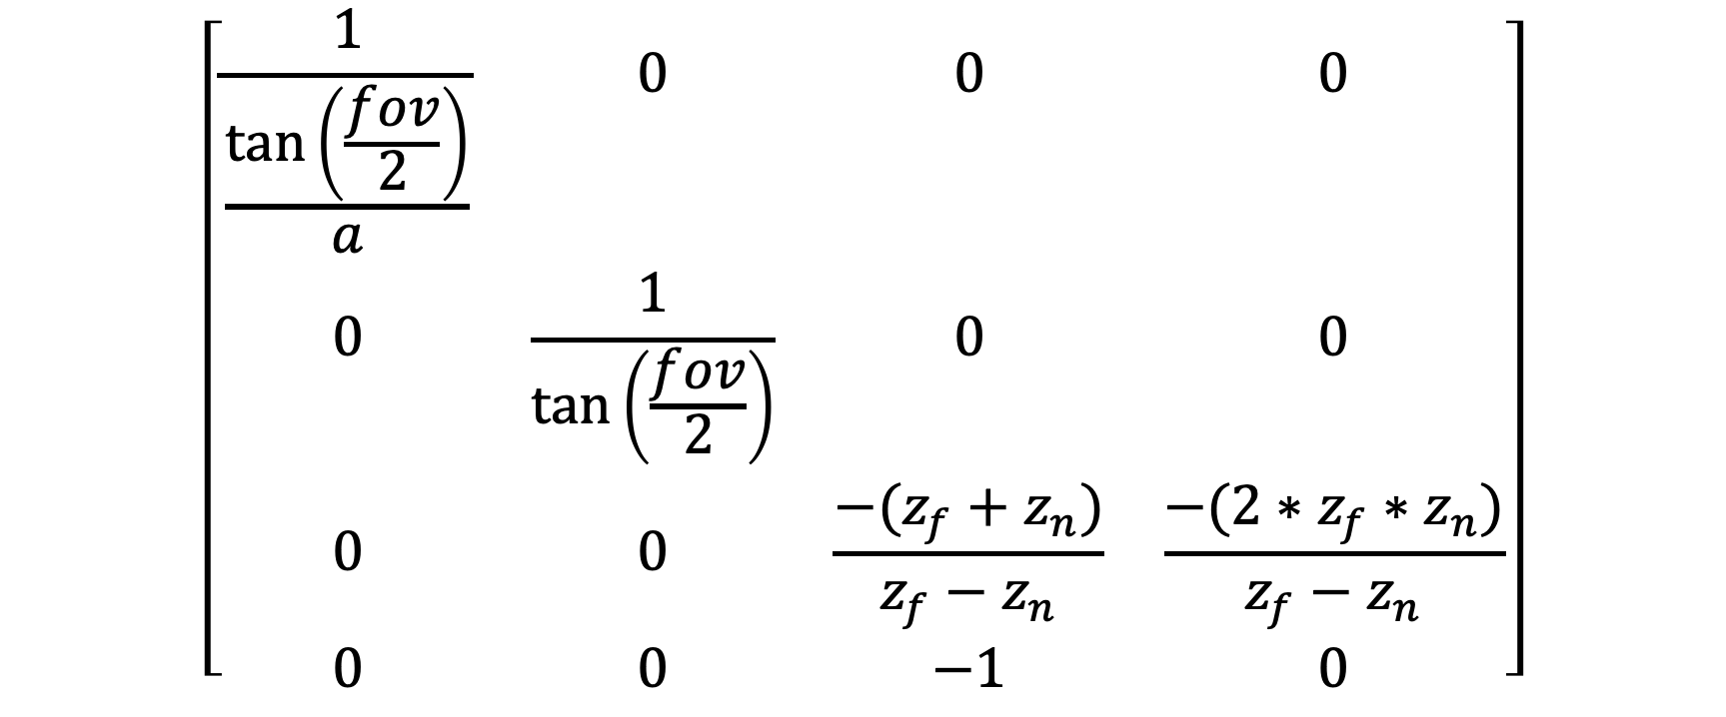
Projection Matrix
$$\left[\begin{matrix}\frac{1}{\frac{\text{tan}\left(\frac{fov}{2}\right)}{a}} & 0 & 0 & 0 \\ 0 & \frac{1}{\text{tan}\left(\frac{fov}{2}\right)} & 0 & 0 \\ 0 & 0 & \frac{−(z_{f}+z_{n})}{z_{f}−z_{n}} & \frac{−(2∗z_{f}∗z_{n})}{z_{f}−z_{n}} \\ 0 & 0 & −1 & 0\end{matrix}\right]$$
[1]

Slide 19

Model Matrix: Translation
$$\left[\begin{matrix}1 & 0 & 0 & x \\ 0 & 1 & 0 & y \\ 0 & 0 & 1 & z \\ 0 & 0 & 0 & 1\end{matrix}\right]$$
[7]

Slide 20
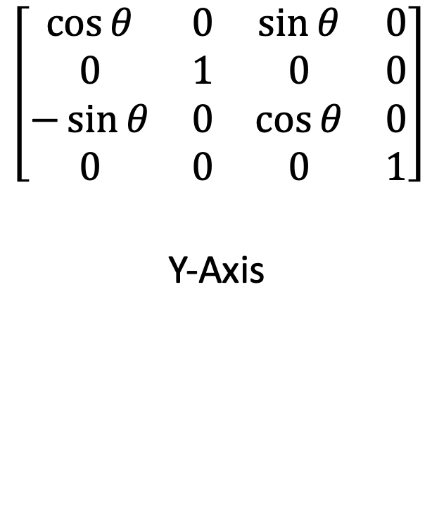
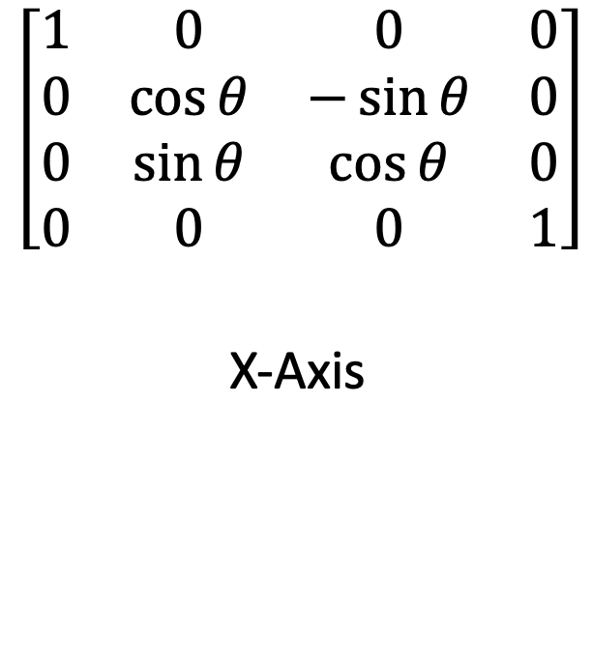
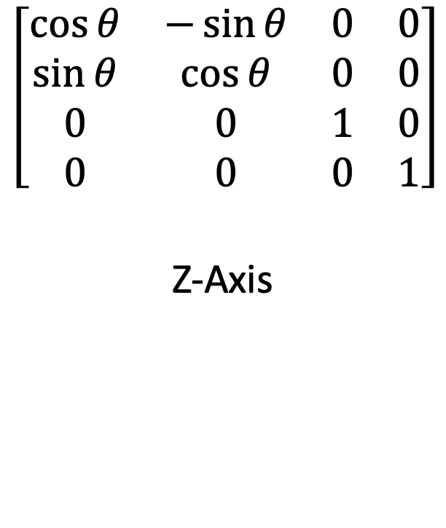
Model Matrix: Rotation
$$\left[\begin{matrix}1 & 0 & 0 & 0 \\ 0 & \cos{θ} & −\sin{θ} & 0 \\ 0 & \sin{θ} & \cos{θ} & 0 \\ 0 & 0 & 0 & 1\end{matrix}\right]$$
X-Axis
$$\left[\begin{matrix}\cos{θ} & 0 & \sin{θ} & 0 \\ 0 & 1 & 0 & 0 \\ −\sin{θ} & 0 & \cos{θ} & 0 \\ 0 & 0 & 0 & 1\end{matrix}\right]$$
Y-Axis
$$\left[\begin{matrix}\cos{θ} & −\sin{θ} & 0 & 0 \\ \sin{θ} & \cos{θ} & 0 & 0 \\ 0 & 0 & 1 & 0 \\ 0 & 0 & 0 & 1\end{matrix}\right]$$
Z-Axis
[10]

Slide 21

Model Matrix: Scale
$$\left[\begin{matrix}x & 0 & 0 & 0 \\ 0 & y & 0 & 0 \\ 0 & 0 & z & 0 \\ 0 & 0 & 0 & 1\end{matrix}\right]$$
[7]

Slide 22
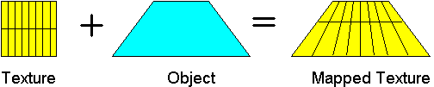
Textures
[13]

Slide 23
Introduction to OpenGL

Slide 24
Introduction to OpenGL
A specification created by the Khronos Group
Implemented by hardware vendors (i.e. Nvidia, AMD)
We use the OpenGL API to interact with hardware that supports it
Notes:
TODO API

Slide 25
OpenGL Compatibility
Most programming languages
All major operating systems
All major windowing systems

Slide 26
Java and OpenGL
Lightweight Java Game Library (lwjgl)
OpenGL
GLFW (Game Library Framework)
stb (Texture and font loading)
Easily create cross-platform applications
Examples will use Java 11 with OpenGL 3.2
Full application source available at https://github.com/ShepherdJerred-homework/seminar-application

Slide 27
Boilerplate
A lot of boilerplate code is required
Once a simple renderer is created, adding on is trivial

Slide 28
Creating a Window
Before OpenGL can be used, a window must be created
GLFW provides a cross-platform API to create windows
GLFW also provides and OpenGL context
Notes:
We will begin with creating a blank window on our desktop
This isn't particularly impressive, but it is required
GLFW, or Graphics Library Framework, is a cross-platform library for creating windows and handling window events such as input
GLFW will create our window for us, and something called an OpenGL context
All of our drawing will occur within this OpenGL context
OpenGL context: stores OpenGL state. All OpenGL commands will effect the current context.

Slide 29
Creating a Window
// Initialize GLFW // Checks what features the machine has, finds input methods, performs platform-specific initialization glfwInit(); // Create a new window with a given width, height, and title. long window = glfwCreateWindow(300, 300, "Hello World!", NULL, NULL); // Set the newly created window at the current OpenGL context glfwMakeContextCurrent(window); // Show the window glfwShowWindow(window); // Loads the native OpenGL library and creates OpenGL bindings GL.createCapabilities();
Notes:
glfwCreateWindow: First NULL parameter is the fullscreen monitor to use, second NULL parameter is the window to share resources with (VBOs, textures, etc.)

Slide 30
VAOs and VBOs
VAO: Vertex Array Object
Stores all of the information to render an object
VBO: Vertex Buffer Object
Bound to VAO
Stores arbitrary data
Notes:
OpenGL stores vertices in vertex buffer objects
These buffers are then bound to vertex array objects
A VAO is then bound and drawn by OpenGL

Slide 31
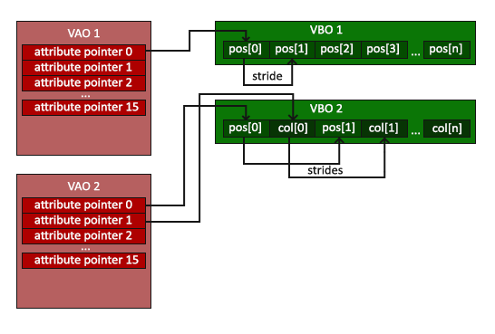
VAOs and VBOs
[2]

Slide 32
Creating a VBO
glVboName = glGenBuffers(); glBindBuffer(GL_ARRAY_BUFFER, glVboName);
Notes:
OpenGL patterns – names and binding
OpenGL state machine

Slide 33
Buffering Data to a VBO
float[] vertices = new float[]{ 0.0f, 0.5f, 0.0f, -0.5f, -0.5f, 0.0f, 0.5f, -0.5f, 0.0f }; try (var stack = MemoryStack.stackPush()) { // Allocate a native buffer to store the vertices var vertexBuffer = stack.mallocFloat(vertices.length); // Put the previously declared vertices into the float buffer vertexBuffer.put(vertices); vertexBuffer.flip(); // Send the vertices to the graphics hardware glBufferData(GL_ARRAY_BUFFER, vertexBuffer, GL_STATIC_DRAW); }

Slide 34
Creating a VAO
glVaoName = glGenVertexArrays(); glBindVertexArray(glVaoName);

Slide 35
Binding a VBO to a VAO
// Bind the previously created VBO glBindBuffer(GL_ARRAY_BUFFER, glVboName); // Have the first VAO index point to the bound VBO // Arguments: VAO index, size of VBO, data type glVertexAttribPointer(0, 3, GL_FLOAT, false, 0, 0); // Enable the zeroth VAO index glEnableVertexAttribArray(0);

Slide 36
Drawing a VAO
glDrawArrays(GL_TRIANGLES, 0, 3);

Slide 37
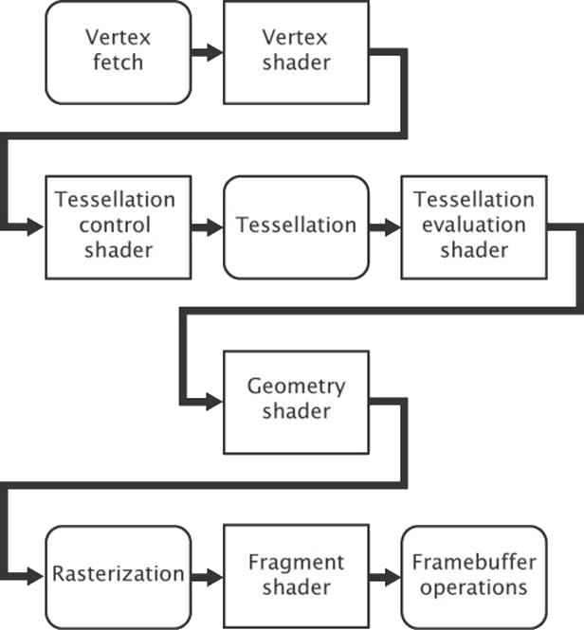
The Rendering Pipeline
[11]

Slide 38
Shaders
Programs that run on the GPU
Executed during the rendering pipeline
Allows the user to define how OpenGL handles data
Written in OpenGL Shading Language (GLSL)
Two shaders are required
Vertex shader
Fragment shader

Slide 39
Vertex Shader
#version 330 core // A vector of 3 floats at index 0 of the VAO layout (location = 0) in vec3 position; // A vector of 4 floats at index 1 of the VAO layout (location = 1) in vec4 inColor; // Output a vector of 4 floats out vec4 color; void main() { // Transform the position of the vertex by the projection matrix gl_Position = vec4(position, 1.0); // Pass the color to the fragment shader color = inColor; }

Slide 40
Fragment Shader
#version 330 core // A vector of 4 floats in in vec4 color; // A vector of 4 floats out out vec4 outColor; void main() { // Set the outgoing color to the incoming color outColor = color; }

Slide 41
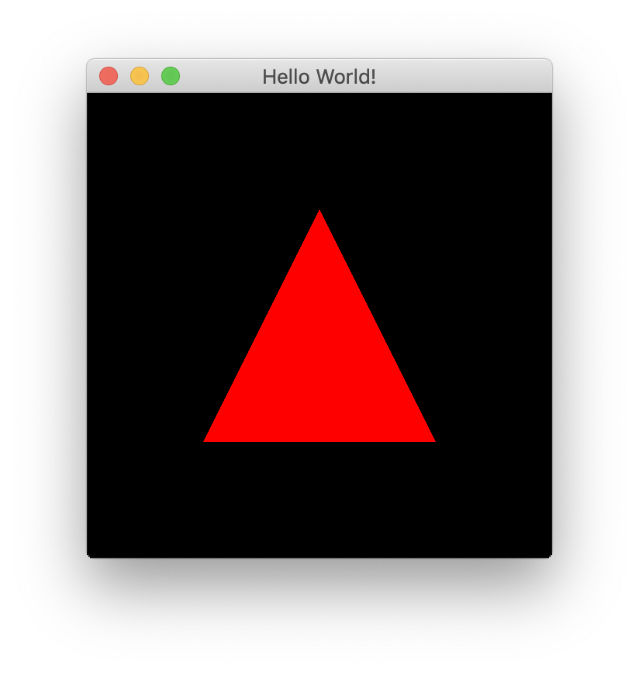
Our First Triangle

Slide 42
Uniforms
Used in shaders
Stores a value does not change during a single render call
Able to store matrices

Slide 43
Setting a Uniform
// Create a 4x4 identity matrix of floats var matrix = new Matrix4f(); // Get the location of the uniform in the shader program glUniformName = glGetUniformLocation(glShaderProgramName, name); try (MemoryStack stack = MemoryStack.stackPush()) { FloatBuffer fb = stack.mallocFloat(16); matrix.get(fb); // Send the data to OpenGL glUniformMatrix4fv(glUniformName, false, fb); }

Slide 44
Using a Uniform
#version 330 core layout (location = 0) in vec3 position; layout (location = 1) in vec4 inColor; out vec4 color; uniform mat4 projectionMatrix; uniform mat4 modelMatrix; void main() { gl_Position = projectionMatrix * modelMatrix * vec4(position, 1.0); color = inColor; }

Slide 45
Creating a Texture
// Create and bind a texture glTextureName = glGenTextures(); glBindTexture(GL_TEXTURE_2D, glTextureName); // Load a texture into the bound texture buffer glTexImage2D(GL_TEXTURE_2D, 0, GL_RGBA, width, height, 0, GL_RGBA, GL_UNSIGNED_BYTE, imageData);

Slide 46
Fragment Shader with Texture
#version 330 core vec2 textureCoord; out vec4 outColor; // Uses the bound texture uniform sampler2D textureSampler; void main() { outColor = texture(textureSampler, textureCoord); }

Slide 47
Demo

Slide 48
Demo

Slide 49
Conclusion
Graphics rendering has many applications
Rendering consists of defining objects with primitives and projecting them on the screen
There is a lot of boilerplate
Once the boilerplate is written, more complex renderers are much easier

Slide 50
Questions?

Slide 51
References
[1] A. H. Bejarano, “Lwjglgamedev.” [Online]. Available: ahbejarano.gitbook.io/lwjglgamedev/
[2] J. de Vries, “Learn opengl.” [Online]. Available: learnopengl.com/
[3] M. Galloy, “Cpu vs gpu performance.” [Online]. Available: michaelgalloy.com/2013/06/11/ cpu-vs-gpu-performance.html
[4] J. Larkin, “Gpu fundamentals.” [Online]. Available: www.icl.utk.edu/~luszczek/teaching/courses/ fall2016/cosc462/pdf/GPU_Fundamentals.pdf
[5] lwjgl, “Lightweight java game library.” [Online]. Available: www.lwjgl.org
[6] lwjgl wiki, “Lwjgl wiki.” [Online]. Available: github.com/LWJGL/lwjgl3-wiki/
[7] A. Masserann, “Opengl tutorial.” [Online]. Available: www.opengl-tutorial.org/
[8] J. L. McKesson, “Learning modern 3d graphics programming.” [Online]. Available: paroj.github.io/ gltut/
[9] Khronos, “Opengl wiki.” [Online]. Available: www.khronos.org/opengl/wiki/Main_Page
[10] A. Overvoorde, “Opengl tutorial.” [Online]. Available: open.gl/
[11] e. a. Graham Sellers, OpenGL Superbible: Comprehensive Tutorial and Reference. Addison-Wesley, 2016.
[12] R. L. Kouichi Matsuda, WebGL Programming Guide: Interactive 3D Graphics Programming with We-
bGL. Addison-Wesley Professional, 2013.
[13] D. Rogerson, “Opengl vii: Scratching the surface of texture mapping.” [Online]. Available: http://web. agelid.com/protect/utile/documentation/OpenGL/OpenGL%207%20-%20Texture%20Mapping.htm
[14] hyperknot, “How to draw one line on top of another in opengl without z-fighting.” [Online]. Available: https://stackoverflow.com/questions/13708661/ how-to-draw-one-line-on-top-of-another-in-opengl-without-z-fighting/13746597
[15] glumpy, “Rendering a cube.” [Online]. Available: https://glumpy.readthedocs.io/en/latest/tutorial/ cube-ugly.html

Slide 52
Appendix

Slide 53
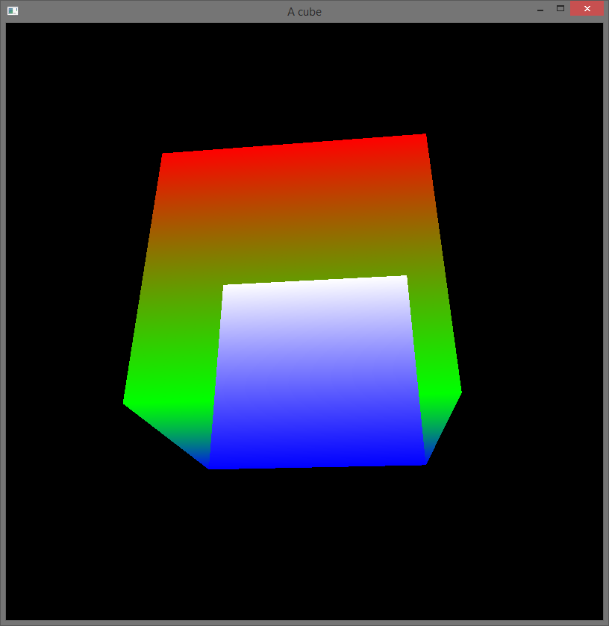
Depth Testing
https://stackoverflow.com/questions/30310024/opengl-depth-test-doesnt-work

Slide 54
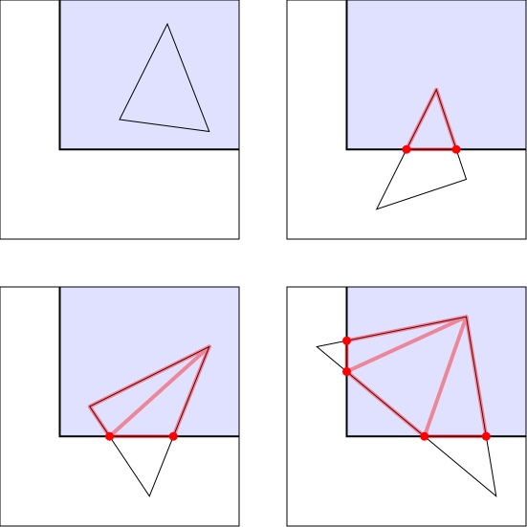
Clipping
https://paroj.github.io/gltut/Positioning/Tut05%20Boundaries%20and%20Clipping.html

Slide 55
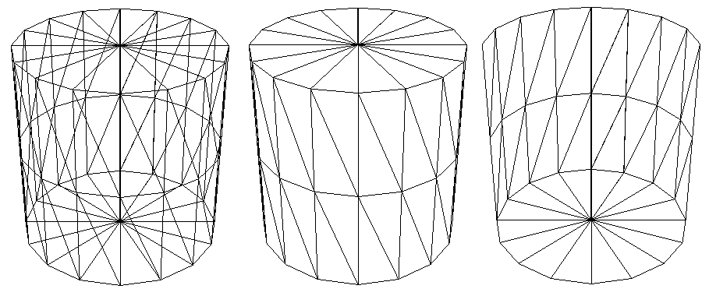
Culling
http://glasnost.itcarlow.ie/~powerk/technology/opengl/hsr_culling.html

Slide 56
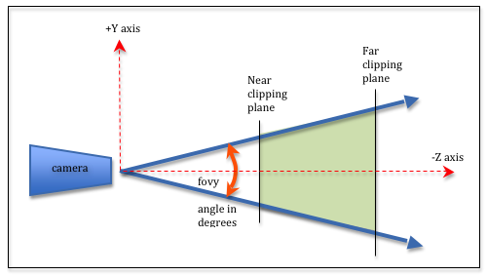
Projection Matrix Concepts
http://learnwebgl.brown37.net/08_projections/projections_perspective.html

Slide 57
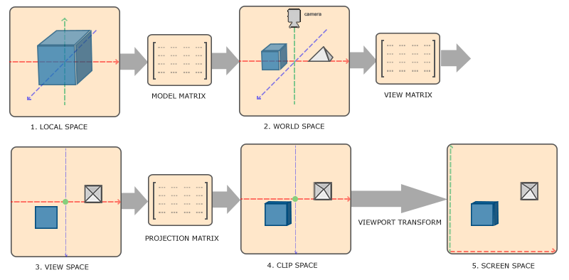
Coordinate Systems
https://learnopengl.com/Getting-started/Coordinate-Systems

Slide 58
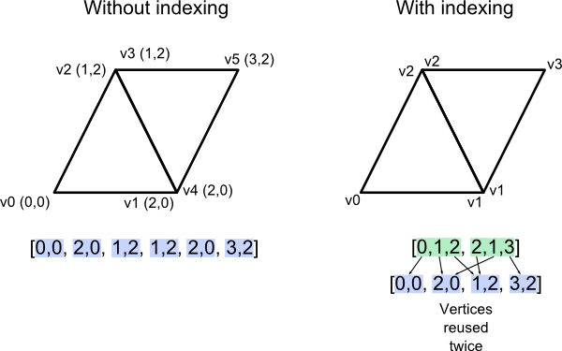
Indexing
http://www.opengl-tutorial.org/intermediate-tutorials/tutorial-9-vbo-indexing/

Slide 59
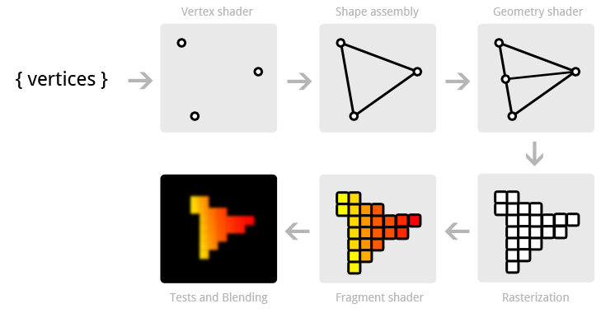
Pipeline Visualized
https://open.gl/drawing

Slide 60
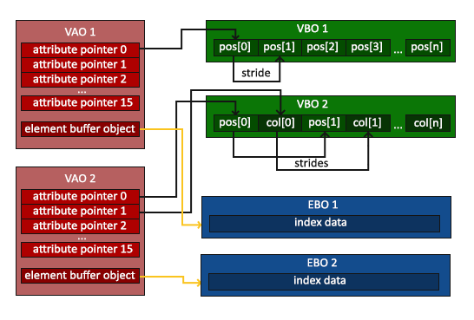
Element Buffer
https://learnopengl.com/Getting-started/Hello-Triangle

Slide 61

Texture Filtering
https://learnopengl.com/Getting-started/Textures

Slide 62
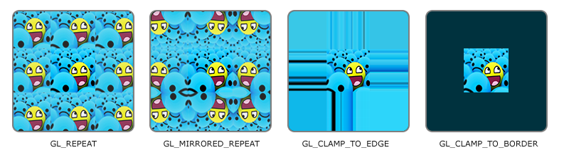
Texture Wrapping
https://learnopengl.com/Getting-started/Textures

Slide 63
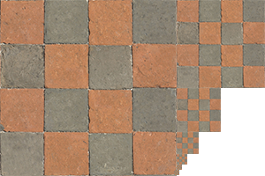
Mipmapping
https://learnopengl.com/Getting-started/Textures

