Slide 1
3D Graphics Rendering with OpenGL
Jerred Shepherd
Notes:
Brief introduction about me

Slide 2
Overview
Background of graphics rendering
Core concepts of graphics rendering
Introduction to OpenGL
Brief demo
Conclusion

Slide 3
Graphics Rendering Background

Slide 4
What is Graphics Rendering?
Creating an image from a 2D or 3D scene
A scene might be a video game, user interface, etc.

Slide 5
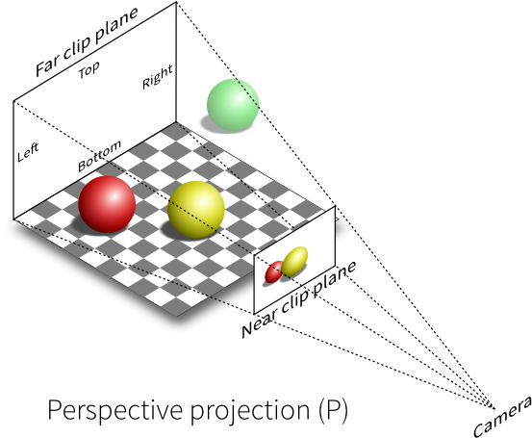
What is Graphics Rendering?
[15]
Notes:
Process of creating an image from a 2D or 3D scene
We see it in action every day on our phones, laptops, and every Friday on this projector

Slide 6
Where is Graphics Rendering Used?
Bootloaders
Operating systems
Computer animation
Game engine
Notes:
Very low-level places like text tendering for a bootloader
High-level places like videos game and desktop applications

Slide 7
Why Learn Graphics Rendering?
Gain a better understanding of computers
Assembly
OSI Model
Implement your own graphics rendering
Notes:
We use it every day, but most of us probably don't know much about it
Most of us won't write graphical programs running at such a low level
It is useful to understand how things work

Slide 8
Challenges of Graphics Rendering
Graphics rendering requires a lot of floating-point calculation
Luckily, these calculations can be parallelized

Slide 9
Challenges of Graphics Rendering
CPUs are great for general processing, but they aren’t well suited towards graphics processing
Not enough cores
Context switches are slow
Notes:
TODO change title

Slide 10
Challenges of Graphics Rendering
Graphics Processing Units (GPUs) were created to supplement CPUs
Excellent at floating-point calculations
Highly parallel – thousands of cores
Individual cores are slower and more limited
General Purpose GPU (GPGPU)
AI
Computer vision
Neural networks
Scientific computing
Simulations
Research

Slide 11
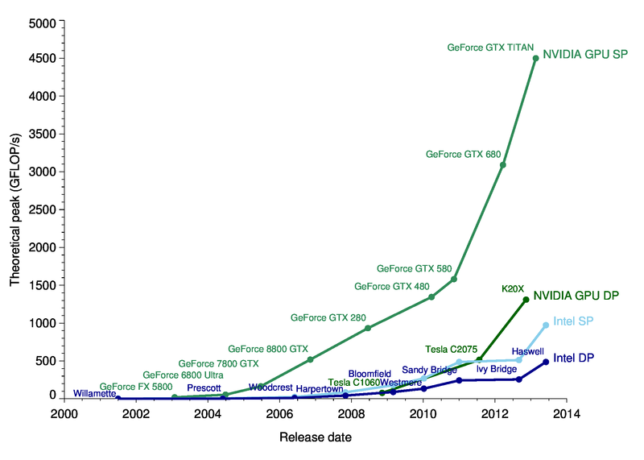
CPU vs GPU Performance
Blue: CPUs
Green: GPUs
[3]
Notes:
Single precision
Double precision

Slide 12
GPU Programming
CPU programming vs GPU programming
Interacting with a GPU requires the use of a graphics API
GPUs shader programs
Minimizing communication between CPU and GPU is ideal
Notes:
Programming a CPU involves writing code, compiling it, and then executing a binary
Using a GPU is different
Instead of directly writing code, you use a API to communicate with the GPU
You can also write programs that execute on the GPU, but you still need to use APIs to load and execute the program

Slide 13
Popular Graphics APIs
OpenGL (1992)
Cross-platform
DirectX (1995)
Windows
Metal (2014)
macOS
iOS
Vulkan (2016)
Cross-platform
Notes:
Which one you can use depends on your operating system and graphics card
OpenGL is a popular cross-platform API, and is supported on all modern consumer graphics cards
Vulkan is the successor to OpenGL, but is too new to be widely used

Slide 14
Core Concepts of Graphics Rendering
Notes:
Before we dig into OpenGL, it's important to understand some core concepts of computer graphics
These concepts will transfer over to any graphics API

Slide 15
Primitives
Points
Lines
Triangles

Slide 16
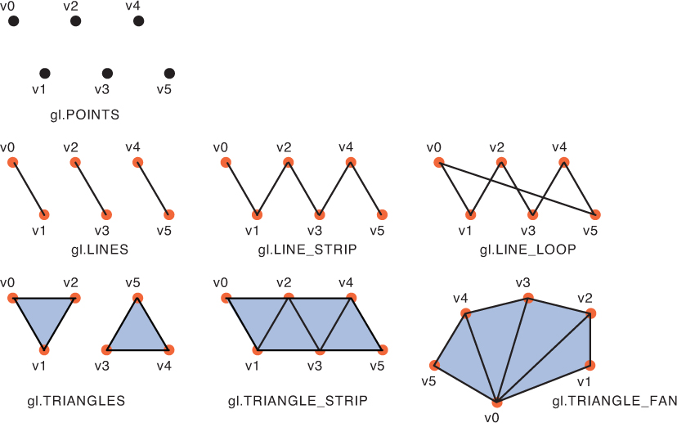
Primitives
[12]
Notes:
Base primitives
Primitive assembly

Slide 17
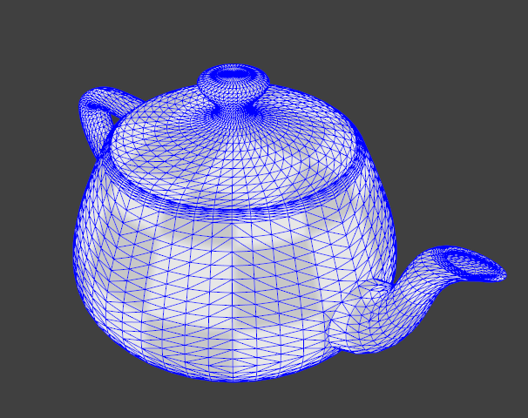
Primitives
[14]

Slide 18
Primitives
Commonly defined as a vector of size four
Components are x, y, z, and w
w is the homogeneous coordinate
Notes:
Primitives are defined as vectors with a length of four
They contain x, y, z, and w elements
These are the three most important primitives in graphics rendering

Slide 19
Matrices
Matrices modify the position of primitives
Projection Matrix
Maps coordinates of primitives to screen coordinates
Model Matrix
Used for translating, rotating, and scaling

Slide 20
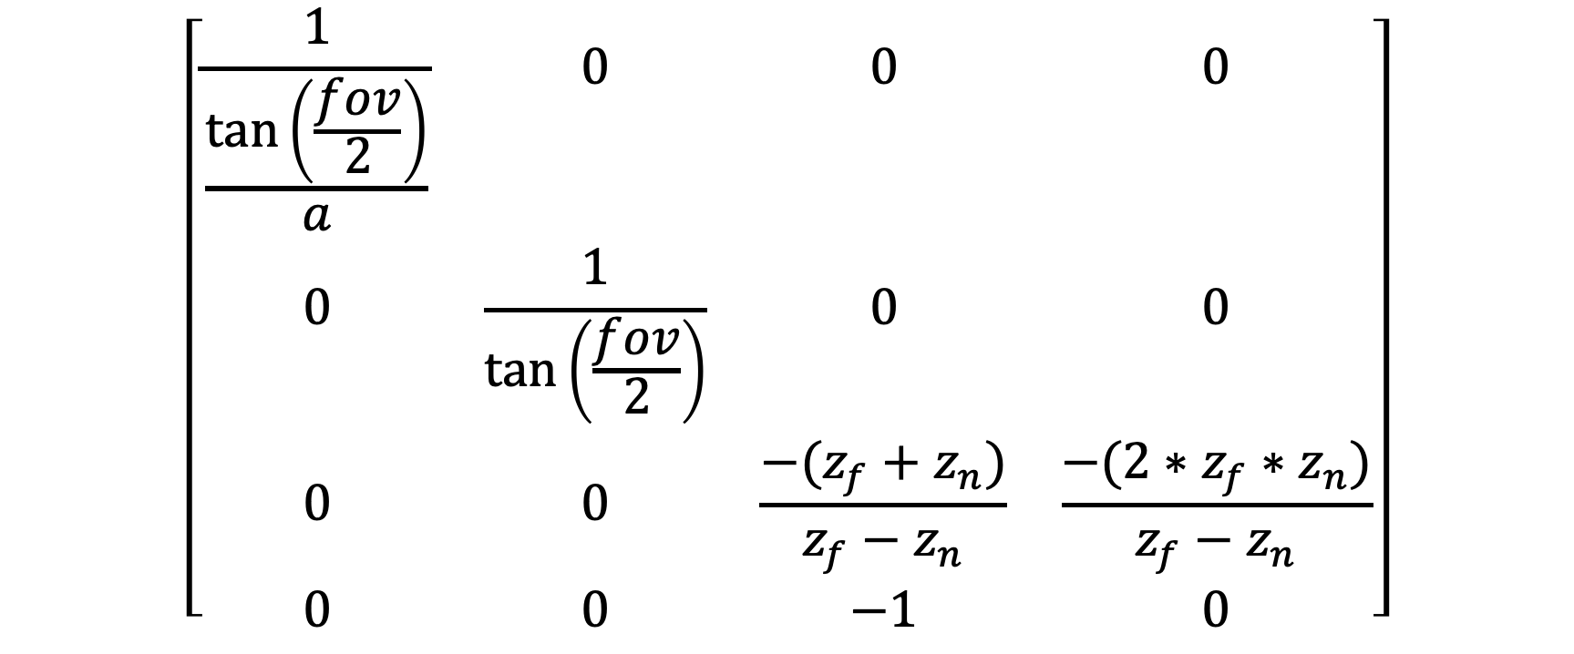
Projection Matrix
$$\left[\begin{matrix}\frac{1}{\frac{\text{tan}\left(\frac{fov}{2}\right)}{a}} & 0 & 0 & 0 \\ 0 & \frac{1}{\text{tan}\left(\frac{fov}{2}\right)} & 0 & 0 \\ 0 & 0 & \frac{−(z_{f}+z_{n})}{z_{f}−z_{n}} & \frac{−(2∗z_{f}∗z_{n})}{z_{f}−z_{n}} \\ 0 & 0 & −1 & 0\end{matrix}\right]$$
[1]

Slide 21

Model Matrix: Translation
$$\left[\begin{matrix}1 & 0 & 0 & x \\ 0 & 1 & 0 & y \\ 0 & 0 & 1 & z \\ 0 & 0 & 0 & 1\end{matrix}\right]$$
[7]

Slide 22
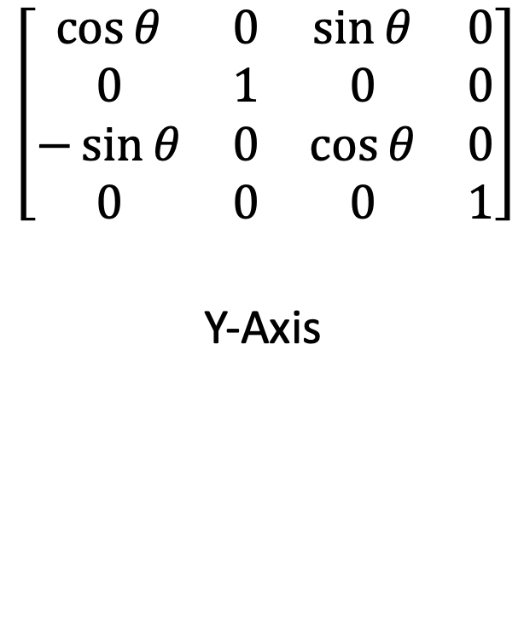
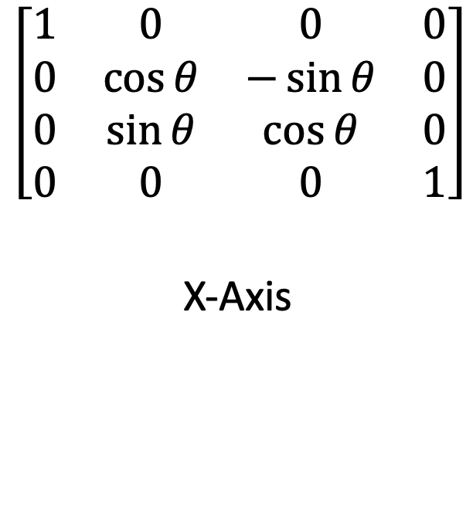
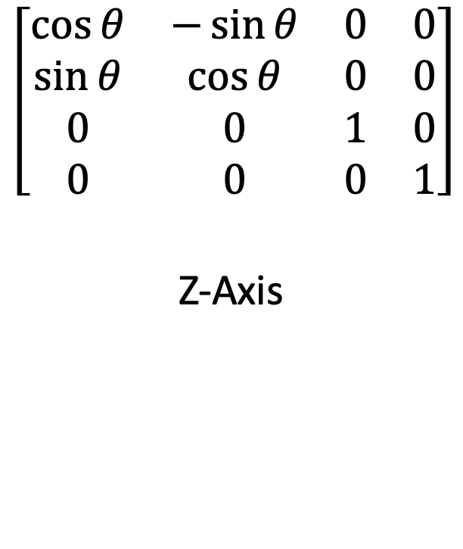
Model Matrix: Rotation
$$\left[\begin{matrix}1 & 0 & 0 & 0 \\ 0 & \cos{θ} & −\sin{θ} & 0 \\ 0 & \sin{θ} & \cos{θ} & 0 \\ 0 & 0 & 0 & 1\end{matrix}\right]$$
X-Axis
$$\left[\begin{matrix}\cos{θ} & 0 & \sin{θ} & 0 \\ 0 & 1 & 0 & 0 \\ −\sin{θ} & 0 & \cos{θ} & 0 \\ 0 & 0 & 0 & 1\end{matrix}\right]$$
Y-Axis
$$\left[\begin{matrix}\cos{θ} & −\sin{θ} & 0 & 0 \\ \sin{θ} & \cos{θ} & 0 & 0 \\ 0 & 0 & 1 & 0 \\ 0 & 0 & 0 & 1\end{matrix}\right]$$
Z-Axis
[10]

Slide 23

Model Matrix: Scale
$$\left[\begin{matrix}x & 0 & 0 & 0 \\ 0 & y & 0 & 0 \\ 0 & 0 & z & 0 \\ 0 & 0 & 0 & 1\end{matrix}\right]$$
[7]

Slide 24
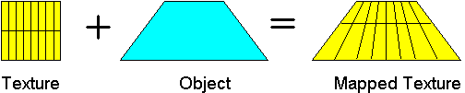
Textures
[13]

Slide 25
Introduction to OpenGL

Slide 26
What is OpenGL?
A specification created by the Khronos Group
Implemented by hardware vendors (i.e. Nvidia, AMD)
We use the OpenGL API to interact with hardware that supports it
Notes:
TODO API

Slide 27
OpenGL Compatibility
Most programming languages
All major operating systems
All major windowing systems

Slide 28
Java and OpenGL
Lightweight Java Game Library (lwjgl)
OpenGL
GLFW (Game Library Framework)
stb (Texture and font loading)
Easily create cross-platform applications
Examples will use Java 11 with OpenGL 3.2
Full application source available at https://github.com/ShepherdJerred-homework/seminar-application

Slide 29
Boilerplate
A lot of boilerplate code is required
Once a simple renderer is created adding on is much easier
We’ll start by drawing a single triangle with a solid color
After we’ll draw a textured cube that rotates

Slide 30
Creating a Window
Before OpenGL can be used, a window must be created
GLFW provides a cross-platform API to create windows
GLFW also provides and OpenGL context
Notes:
We will begin with creating a blank window on our desktop
This isn't particularly impressive, but it is required
GLFW, or Graphics Library Framework, is a cross-platform library for creating windows and handling window events such as input
GLFW will create our window for us, and something called an OpenGL context
All of our drawing will occur within this OpenGL context
OpenGL context: stores OpenGL state. All OpenGL commands will effect the current context.

Slide 31
Creating a Window
// Initialize GLFW // Checks what features the machine has, finds input methods, performs platform-specific initialization glfwInit(); // Create a new window with a given width, height, and title. long window = glfwCreateWindow(300, 300, "Hello World!", NULL, NULL); // Set the newly created window at the current OpenGL context glfwMakeContextCurrent(window); // Show the window glfwShowWindow(window); // Loads the native OpenGL library and creates OpenGL bindings GL.createCapabilities();
Notes:
glfwCreateWindow: First NULL parameter is the fullscreen monitor to use, second NULL parameter is the window to share resources with (VBOs, textures, etc.)

Slide 32
VAOs and VBOs
VAO: Vertex Array Object
Stores all of the information to render an object
VBO: Vertex Buffer Object
Bound to VAO
Stores arbitrary data
Notes:
OpenGL stores vertices in vertex buffer objects
These buffers are then bound to vertex array objects
A VAO is then bound and drawn by OpenGL

Slide 33
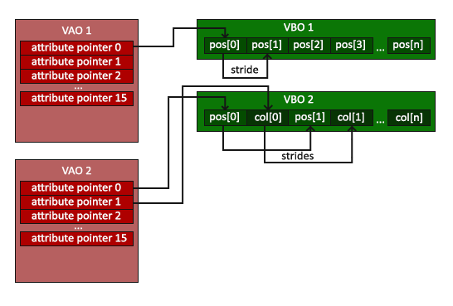
VAOs and VBOs
[2]

Slide 34
Creating a VBO
glVboName = glGenBuffers(); glBindBuffer(GL_ARRAY_BUFFER, glVboName);
Notes:
OpenGL patterns – names and binding
OpenGL state machine

Slide 35
Buffering Data to a VBO
float[] vertices = new float[]{ 0.0f, 0.5f, 0.0f, -0.5f, -0.5f, 0.0f, 0.5f, -0.5f, 0.0f }; try (var stack = MemoryStack.stackPush()) { // Allocate a native buffer to store the vertices var vertexBuffer = stack.mallocFloat(vertices.length); // Put the previously declared vertices into the float buffer vertexBuffer.put(vertices); vertexBuffer.flip(); // Send the vertices to the graphics hardware glBufferData(GL_ARRAY_BUFFER, vertexBuffer, GL_STATIC_DRAW); }

Slide 36
Creating a VAO
glVaoName = glGenVertexArrays(); glBindVertexArray(glVaoName);

Slide 37
Binding a VBO to a VAO
// Bind the previously created VBO glBindBuffer(GL_ARRAY_BUFFER, glVboName); // Have the first VAO index point to the bound VBO // Arguments: VAO index, size of VBO, data type glVertexAttribPointer(0, 3, GL_FLOAT, false, 0, 0); // Enable the zeroth VAO index glEnableVertexAttribArray(0);

Slide 38
Drawing a VAO
glDrawArrays(GL_TRIANGLES, 0, 3);

Slide 39
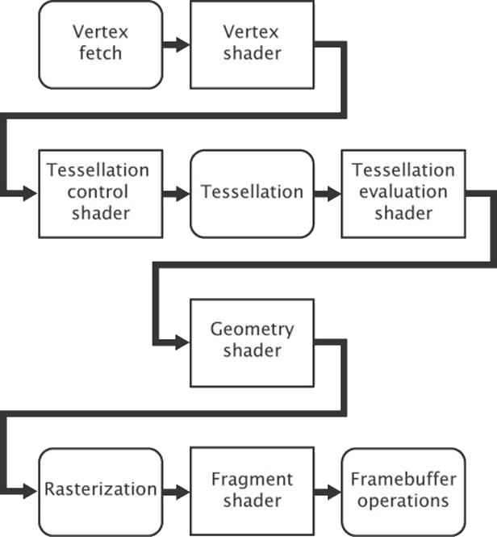
The Rendering Pipeline
[11]

Slide 40
Shaders
Programs that run on the GPU
Executed during the rendering pipeline
Allows the user to define how OpenGL handles data
Written in OpenGL Shading Language (GLSL)
Two shaders are required
Vertex shader
Fragment shader

Slide 41
Vertex Shader
#version 330 core // A vector of 3 floats at index 0 of the VAO layout (location = 0) in vec3 position; // A vector of 4 floats at index 1 of the VAO layout (location = 1) in vec4 inColor; // Output a vector of 4 floats out vec4 color; void main() { // Transform the position of the vertex by the projection matrix gl_Position = vec4(position, 1.0); // Pass the color to the fragment shader color = inColor; }

Slide 42
Fragment Shader
#version 330 core // A vector of 4 floats in in vec4 color; // A vector of 4 floats out out vec4 outColor; void main() { // Set the outgoing color to the incoming color outColor = color; }

Slide 43
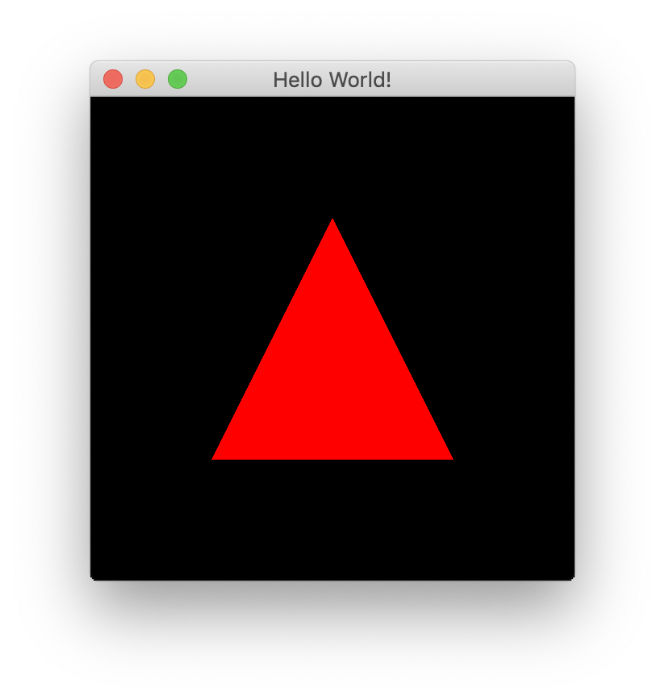
Our First Triangle

Slide 44
Uniforms
Used in shaders
Stores a value does not change during a single render call
Able to store matrices

Slide 45
Setting a Uniform
// Create a 4x4 identity matrix of floats var matrix = new Matrix4f(); // Get the location of the uniform in the shader program glUniformName = glGetUniformLocation(glShaderProgramName, name); try (MemoryStack stack = MemoryStack.stackPush()) { FloatBuffer fb = stack.mallocFloat(16); matrix.get(fb); // Send the data to OpenGL glUniformMatrix4fv(glUniformName, false, fb); }

Slide 46
Using a Uniform
#version 330 core layout (location = 0) in vec3 position; layout (location = 1) in vec4 inColor; out vec4 color; uniform mat4 projectionMatrix; uniform mat4 modelMatrix; void main() { gl_Position = projectionMatrix * modelMatrix * vec4(position, 1.0); color = inColor; }

Slide 47
Creating a Texture
// Create and bind a texture glTextureName = glGenTextures(); glBindTexture(GL_TEXTURE_2D, glTextureName); // Load a texture into the bound texture buffer glTexImage2D(GL_TEXTURE_2D, 0, GL_RGBA, width, height, 0, GL_RGBA, GL_UNSIGNED_BYTE, imageData);

Slide 48
Fragment Shader with Texture
#version 330 core in vec2 textureCoord; out vec4 outColor; // Uses the bound texture uniform sampler2D textureSampler; void main() { outColor = texture(textureSampler, textureCoord); }

Slide 49
Demo

Slide 50
Demo

Slide 51
Conclusion
Graphics rendering has many applications
Rendering consists of defining objects with primitives and projecting them on the screen
There is a lot of boilerplate
Once the boilerplate is written, more complex renderers are much easier

Slide 52
Questions?

Slide 53
References
[1] A. H. Bejarano, “Lwjglgamedev.” [Online]. Available: ahbejarano.gitbook.io/lwjglgamedev/
[2] J. de Vries, “Learn opengl.” [Online]. Available: learnopengl.com/
[3] M. Galloy, “Cpu vs gpu performance.” [Online]. Available: michaelgalloy.com/2013/06/11/ cpu-vs-gpu-performance.html
[4] J. Larkin, “Gpu fundamentals.” [Online]. Available: www.icl.utk.edu/~luszczek/teaching/courses/ fall2016/cosc462/pdf/GPU_Fundamentals.pdf
[5] lwjgl, “Lightweight java game library.” [Online]. Available: www.lwjgl.org
[6] lwjgl wiki, “Lwjgl wiki.” [Online]. Available: github.com/LWJGL/lwjgl3-wiki/
[7] A. Masserann, “Opengl tutorial.” [Online]. Available: www.opengl-tutorial.org/
[8] J. L. McKesson, “Learning modern 3d graphics programming.” [Online]. Available: paroj.github.io/ gltut/
[9] Khronos, “Opengl wiki.” [Online]. Available: www.khronos.org/opengl/wiki/Main_Page
[10] A. Overvoorde, “Opengl tutorial.” [Online]. Available: open.gl/
[11] e. a. Graham Sellers, OpenGL Superbible: Comprehensive Tutorial and Reference. Addison-Wesley, 2016.
[12] R. L. Kouichi Matsuda, WebGL Programming Guide: Interactive 3D Graphics Programming with We-
bGL. Addison-Wesley Professional, 2013.
[13] D. Rogerson, “Opengl vii: Scratching the surface of texture mapping.” [Online]. Available: http://web. agelid.com/protect/utile/documentation/OpenGL/OpenGL%207%20-%20Texture%20Mapping.htm
[14] hyperknot, “How to draw one line on top of another in opengl without z-fighting.” [Online]. Available: https://stackoverflow.com/questions/13708661/ how-to-draw-one-line-on-top-of-another-in-opengl-without-z-fighting/13746597
[15] glumpy, “Rendering a cube.” [Online]. Available: https://glumpy.readthedocs.io/en/latest/tutorial/ cube-ugly.html

Slide 54
Appendix

Slide 55
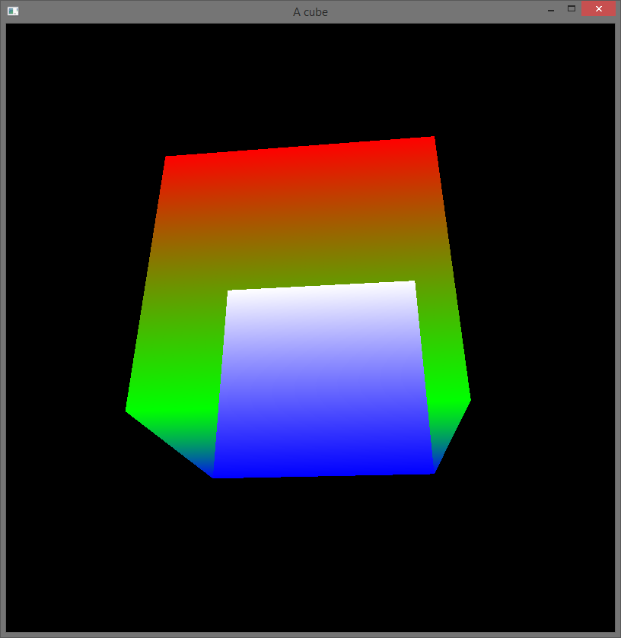
Depth Testing
https://stackoverflow.com/questions/30310024/opengl-depth-test-doesnt-work

Slide 56
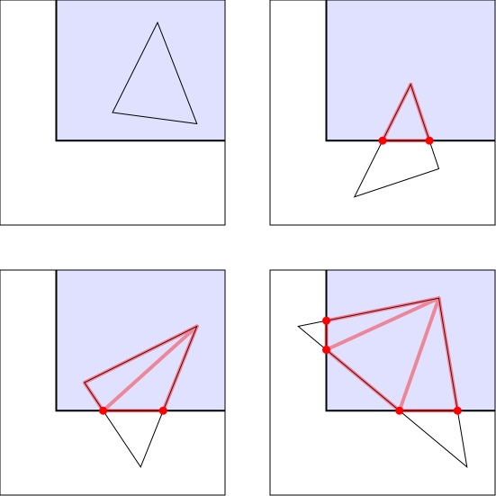
Clipping
https://paroj.github.io/gltut/Positioning/Tut05%20Boundaries%20and%20Clipping.html

Slide 57
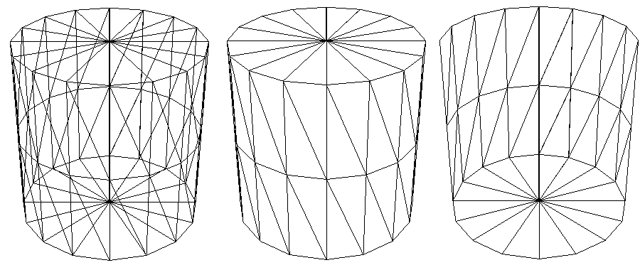
Culling
http://glasnost.itcarlow.ie/~powerk/technology/opengl/hsr_culling.html

Slide 58
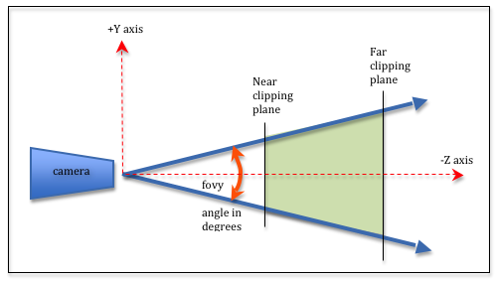
Projection Matrix Concepts
http://learnwebgl.brown37.net/08_projections/projections_perspective.html

Slide 59
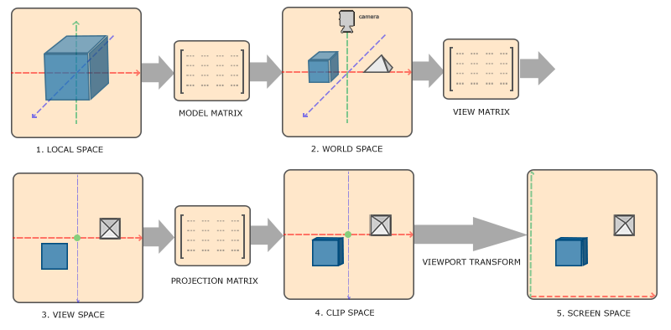
Coordinate Systems
https://learnopengl.com/Getting-started/Coordinate-Systems

Slide 60
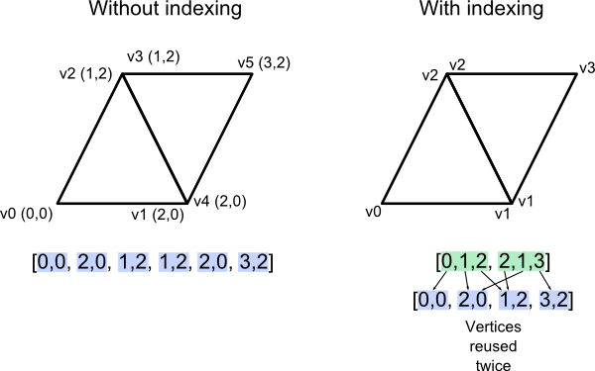
Indexing
http://www.opengl-tutorial.org/intermediate-tutorials/tutorial-9-vbo-indexing/

Slide 61
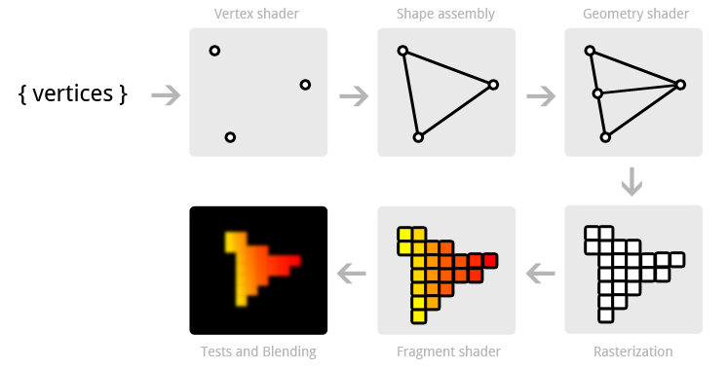
Pipeline Visualized
https://open.gl/drawing

Slide 62
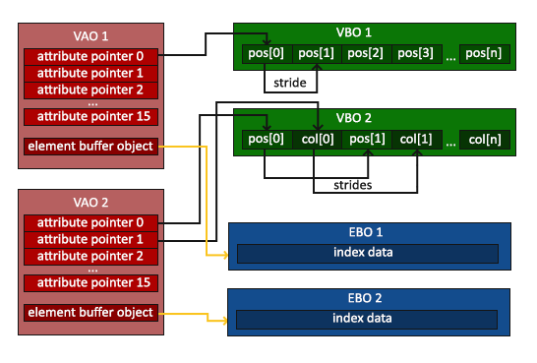
Element Buffer
https://learnopengl.com/Getting-started/Hello-Triangle

Slide 63

Texture Filtering
https://learnopengl.com/Getting-started/Textures

Slide 64
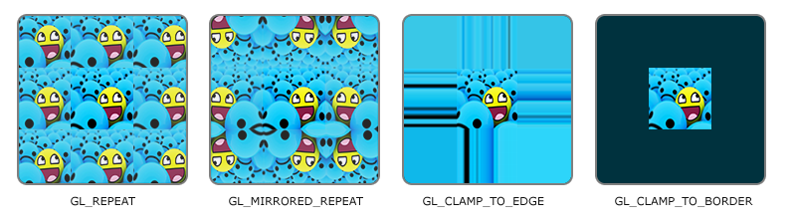
Texture Wrapping
https://learnopengl.com/Getting-started/Textures

Slide 65
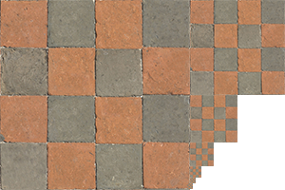
Mipmapping
https://learnopengl.com/Getting-started/Textures

