Slide 1
CHECK-IN 2 BEFORE END-SEM · COMPUTER VISION AND PERCEPTION
Right in meaning,
wrong in place?
ASP asks a language model to guess the rooms and objects a robot has not yet seen, then drives to where the guesses disagree. Its author says the guesses are often in the wrong place but name the right things, and that this is enough. We test that claim.
01
02
03
Last check-in
Since then
End-sem
Does a better guesser make a better explorer? Finish the live test, screen models, re-test our filter.
The live test finished. We rebuilt the paper's reference and scored every run with the author's own code.
A pre-registered test of the author's defense, with ASP scored on the paper's own scale.
Sher Partap Singh · Preesha Katial · Ananya Singla
Base paper: Tang & Chaudhari, Active Semantic Perception, arXiv:2510.05430
Notes:
At the last check-in we asked one question: does a better guesser make a better explorer? We promised to finish the live test, to screen other models, and to re-test our filter.
The live test has finished. We also rebuilt the paper's own yardstick, so our numbers now sit on its scale. One promise changed: we will not run a second model live. Our own cut rule dropped it, so screening stays offline, on the same saved inputs.
Both results lead to the question the author raised when we met him: are ASP's guesses right in meaning, even when they are wrong in place? That is our end-sem question.

Slide 2
01 · THE LIVE TEST, FINISHED · 2 HOMES, SEEDS 42-44, HUMAN LABELS
Live, no gain over random guesses that we could detect
DIFFERENCE IN MAPPING QUALITY (F1 AREA TO 60 M), WITH ITS 95% INTERVAL
WHERE THE LLM PUTS NEW OBJECTS
LLM guesses vs random guesses
+0.013
3.0%
0.5%
LLM guesses
random guesses
LLM + our filter vs LLM
-0.003
New objects within 0.5 m of a real object with the same name, all counted live runs (not tested). 76% of the LLM's are more than 2 m off.
LLM vs frontier, no LLM
-0.012
Random guesses vs frontier
-0.025
Correction: last time we showed 1.7% vs 1.5%; on the 8 matched saved inputs it is 2.1% vs 1.4%.
Exact objects vs random (871)
◀
▶
+0.034
-0.05
0
+0.05
Reading. The LLM lands near a real object 6× as often as random guesses, but 97% miss by over 0.5 m, and we could not detect a better map.
Registered tests, pilot status. Each interval crosses zero. Exact objects: 871 only, 3 runs v 3; all 3 beat all 3 random runs, but p 0.10 is the floor and the interval is unbounded. The LLM arm has 2 runs on 853. A secondary test, F1 at 60 m, favoured the LLM (+0.043, p 0.015; 0.09 after correction).
Right in meaning, wrong in place? · Check-in 2
02 / 5
Notes:
These are live runs in two homes, seeds 42 to 44, scored against the human labels that ship with HM3D. Each line is a difference in mapping quality, with its 95% interval.
The LLM's guesses against random guesses of the same shape: plus 0.013, and the interval crosses zero. Our filter changed it by minus 0.003. Against a plain frontier explorer with no LLM, neither the LLM nor the random guesses did better.
Exact objects ran in one home only. All three runs beat all three random runs, by 0.034, but with three against three the test cannot reach significance, and the interval has no bound. One secondary test does favour the LLM: at the 60-metre endpoint its maps were ahead, though not after correcting for six tests.
Where do the guesses go? 3.0% of the LLM's new objects land within half a metre of a real object with the same name. Random guesses manage 0.5%. So the LLM does about six times better than chance, but 97% of its objects still miss by more than half a metre, and three quarters miss by more than two metres. This corrects our last check-in: on the eight matched saved inputs, the figures were 2.1% against 1.4%.

Slide 3
02 · SAME RULES AS THE PAPER
On the paper's scale, his 853 ASP lead does not appear
NOW AS IN THE PAPER
OBJECT F1 × 100 AT 10, 50 AND 100% OF THE BUDGET
Scoring. the author's own F1 and GED code, on his time axis.
Paper, frontier
Paper, ASP
Ours, frontier
Ours, ASP
Ours, random guesses
Reference. his protocol, scripted: a tour of every reachable point on the start floor, same mapper (85 and 66 stops). It holds 32% and 21% of the human-labelled objects; its repeat tour failed.
Home 853
Home 871
75
50
Frontier. run to its natural end: 5 of 5 runs on 853, 1 of 5 on 871.
WHERE WE DIFFER
25
Budget. the paper gives none; we use our frontier's median end, 632 s (853), and the registered fallback, 809 s (871).
0
LLM. ours DeepSeek, his Gemini 2.5 Pro.
10%
50%
100%
10%
50%
100%
871: 4 frontier runs crashed twice when another user's server took the GPU. A third try waits for a free GPU.
Hollow: the paper's single run against its own reference (Fig. 4 left). Filled: our mean against the rebuilt reference, bars the range; shown where at least half the runs reach that time (our rule). 853 at 100%: 3 of 5 runs. Our ASP runs stop at 60 m and ran in October; frontier ran in November.
Reading. Our frontier ends within about 3 points of his. On 853 his ASP leads frontier by 14 points at 50%; our 2 ASP runs are level (38.7 vs 39.5), and random guesses score 43.9.
Right in meaning, wrong in place? · Check-in 2
03 / 5
Notes:
Next we put our numbers on the paper's scale.
We now score with the author's own F1 and GED code, on his time axis. He built his reference by driving a camera through the house. We rebuilt that with a scripted tour of every reachable point on the start floor, through the same mapper. It holds about a third of the human-labelled objects in one home and a fifth in the other. Its repeat tour failed, so we cannot yet say how much the reference itself moves. The paper gives no time budget, so we use our frontier's median end.
Hollow marks are the paper's single runs; filled marks are ours. At the end of the budget, our frontier explorer lands within about three points of his, though earlier it trails by 3 to 13 points.
In home 853 his ASP leads frontier by 14 to 16 points. Our two ASP runs lead by 4 points early and are level at half the budget, and random guesses score higher than both. In 871 our early numbers are close to his. Two cautions: our ASP uses DeepSeek where he used Gemini, and our ASP and frontier runs ran in different weeks.
Four frontier runs in 871 crashed twice when another user's server took the GPU. A third try waits for a free GPU.

Slide 4
03 · THE AUTHOR'S DEFENSE, TESTED CHEAPEST FIRST
Next: is the meaning right, and would it be enough?
01
02
03
04
Right beyond base rates?
Would it be enough?
Is it the model?
Our validity layer, same pass
Do the rooms and objects named really lie in unexplored space? Compare with controls that see the same map: house statistics, another house, shuffled guesses.
Offline, give ASP exact labels with the placement error real models make, and see how much of the oracle's ranking power survives.
Replay Claude on the same 44 saved inputs as DeepSeek, so a gap points to the model, not the inputs.
For every model: what the filter removes, and whether what it keeps is right more often.
WHY · The prompt says a scene “may contain more than one bedroom”, so naming one proves little.
WHY · ASP rewards disagreement between guesses, so guesses that all agree add nothing to its view score.
WHY · About $320 expected, capped at $460; we ask before spending.
WHY · Live, the filter made no difference we could detect (−0.003).
Each step is $0 except Claude. We hash the rules before any new score. DeepSeek results stay exploratory, because we saw pilot numbers first; the Claude replays are the blind test.
Right in meaning, wrong in place? · Check-in 2
04 / 5
Notes:
When we met the author, he said the guesses can be wrong in place but right in meaning, and that this is enough. We test that, cheapest first.
One: are the guesses right beyond base rates? The author's prompt tells the model a scene "may contain more than one bedroom and more than one bathroom", so naming a bedroom proves little. We score the saved guesses against controls that see the same map: house statistics, guesses made for another house, and the guesses shuffled.
Two: would right meaning be enough? ASP's view score rewards disagreement between guesses, so guesses that all agree add nothing to it. Offline, we give ASP exact labels with the placement error real models make, and see how much of the oracle's ranking power survives.
Three: is it the model? We replay Claude on the same 44 saved inputs as DeepSeek. That costs about $320, and we ask before spending.
Four: our validity layer runs in the same pass, for every model: what it removes, and whether what it keeps is right more often.
We hash the rules before any new score. We saw some DeepSeek pilot numbers while planning, so DeepSeek results stay exploratory; the Claude replays are the blind test.

Slide 5
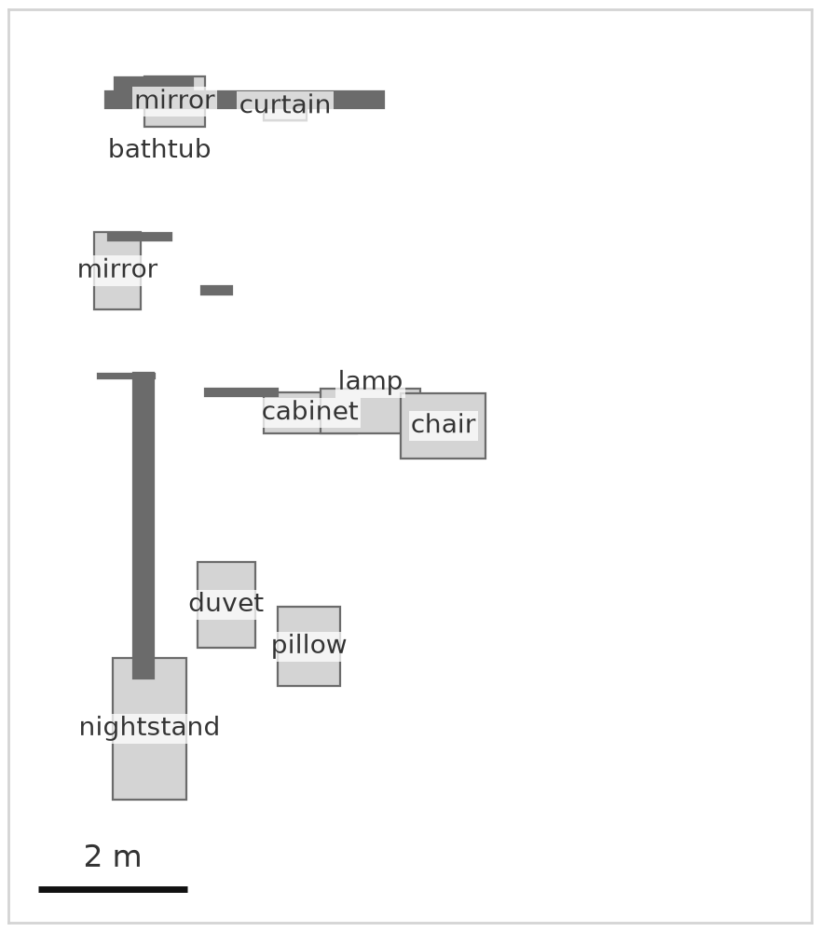
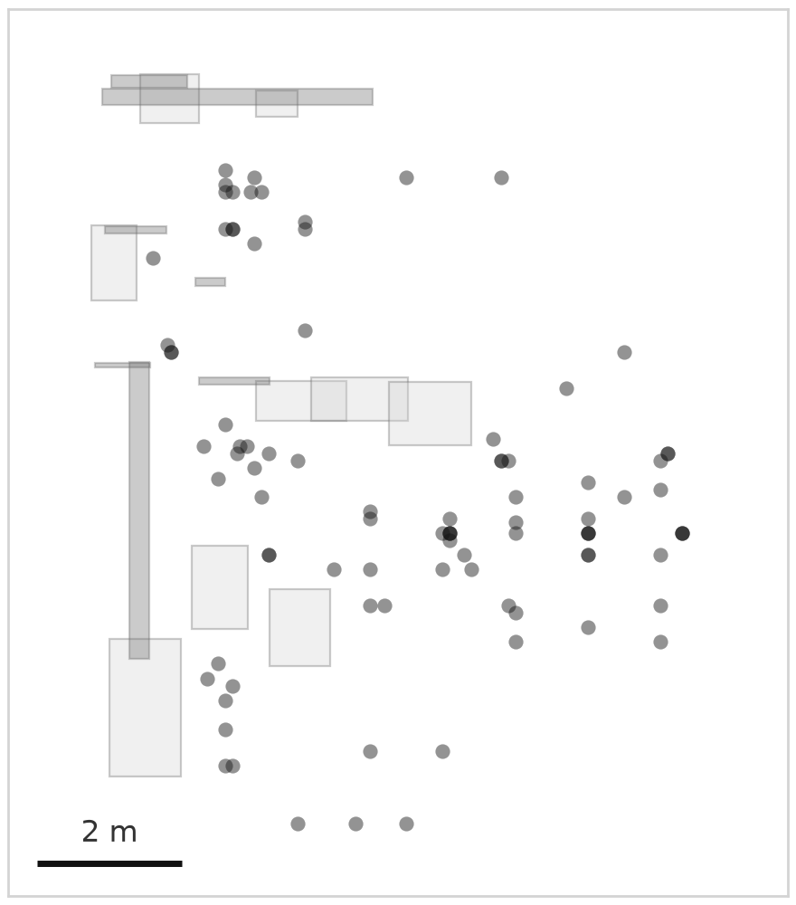
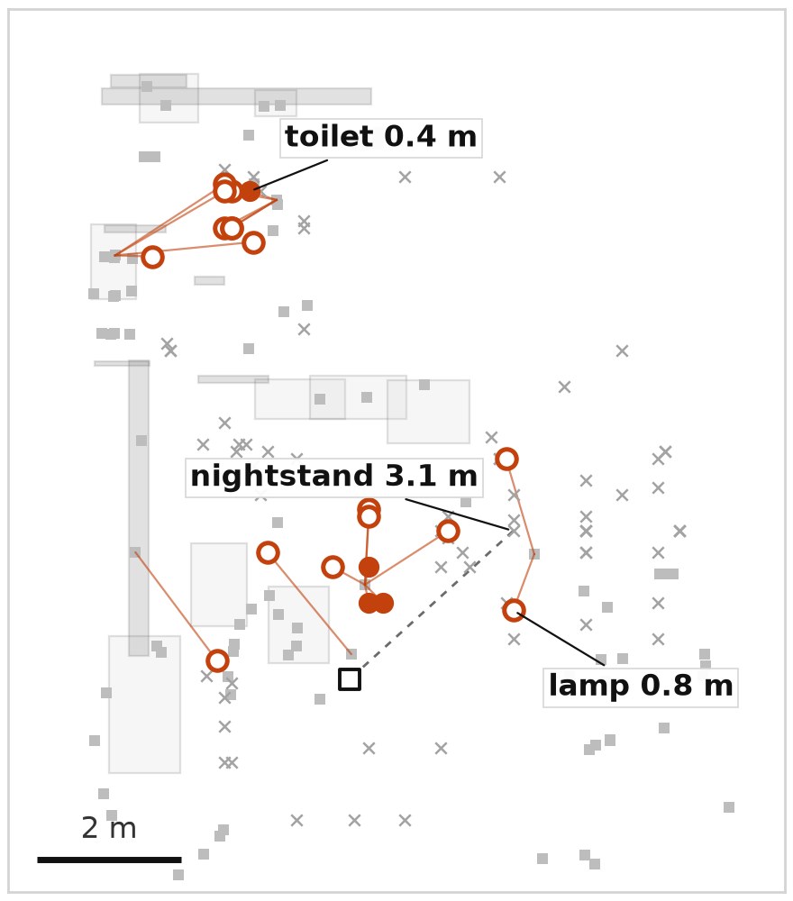
04 · WHAT END-SEM WILL MEASURE
What end-sem will test, in one stage of one run
1 · MAPPED SO FAR
2 · GUESSED, ALL 8 MEMBERS
3 · REAL OBJECTS, MATCHED
HOW TO READ PANEL 3
Same-name real object within 0.5 m
Within 2 m
×
Farther, or no such object
Real object (human label)
A label gives the distance to the nearest real object with that name. Darker marks in panel 2: members agree.
90
new guesses
4
within 0.5 m of a real one
20
within 2 m
DeepSeek, run e1_00853_s42_official_60m, stage 3, 8 members, home 853. Top-down, z 0.5 to 1.5 m, habitat frame. A new guess lies more than 0.5 m from every mapped object. 46 of 90 have a name no real object in the house has.
All 15 sample stages: 30 of 1230 within 0.5 m, 307 within 2 m.
End-sem question. Are the names right beyond base rates, even where the places are wrong? We score this on the same stages, with the validity layer and the Claude replays. Result: a pre-registered test of “right in meaning, wrong in place?”.
Right in meaning, wrong in place? · Check-in 2
05 / 5
Notes:
This is what the end-sem test will look at, on one stage of one live run. DeepSeek, home 853, stage 3, with its 8 guessing members. The slices are top-down views, as the author's pipeline draws them.
First, what the robot had mapped: the walls and 10 objects. This is all the LLM saw.
Second, the new objects the 8 members guessed for the space beyond. There are 90. Darker marks are places where members agree.
Third, the real objects, from the human labels. Each guess is marked by whether a real object with the same name lies near it. Here, 4 guesses are within half a metre of one, and 20 are within two metres. The label says it: a toilet guessed 0.4 metres from a real toilet; a nightstand guessed 3.1 metres from the nearest real one. 46 of the 90 have a name no real object in this house has. Over all 15 sample stages, 30 of 1230 are within half a metre.
End-sem asks whether the names are right beyond base rates, even where the places are wrong. We score the same stages for the validity layer and for the Claude replays. The result will be a pre-registered test of "right in meaning, wrong in place?". Thank you.

