Slide 1
Emotion Detection Using Convolutional Neural Network Model

Slide 2

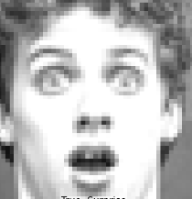
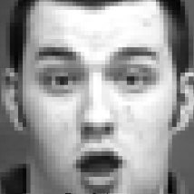
Proposed CNN Model Architecture
Input Images
Feature Extraction Part
Classification Part
Angry
Contempt
SoftMax
Disgust
Pre-Processing
Fear
Happy
Sadness
CNN Layers
Pooling Layers
Surprise
Fully Connected Layers
Fig. 1: Proposed CNN method architecture for emotion classification

Slide 3

System Workflow
Face Detection
Pre-Processing
Face Found
Initialize Webcam
Feature Extraction (CNN)
Yes
No
Start
Emotion Classification
End
Fig. 2: System flowchart of the proposed method for emotion classification.

Slide 4
Model Hyperparameters
Data Augmentation
Sr. No | Hyperparameters | CNN Model
1 | No of Epochs | 100
2 | Batch Size | 16
3 | Image size | 48 x 48
4 | Optimizer | Adam
5 | Activation Function | SoftMax, ReLU
6 | Learning Rate | 0.0001
7 | Dropout | 0.25
Parameters | Values
Horizontal flip | True
Rotation Range | 25
Width Shift | 0.1
Height Shift | 0.1
Shear Range | 0.2
Zoom Range | 0.2

Slide 5
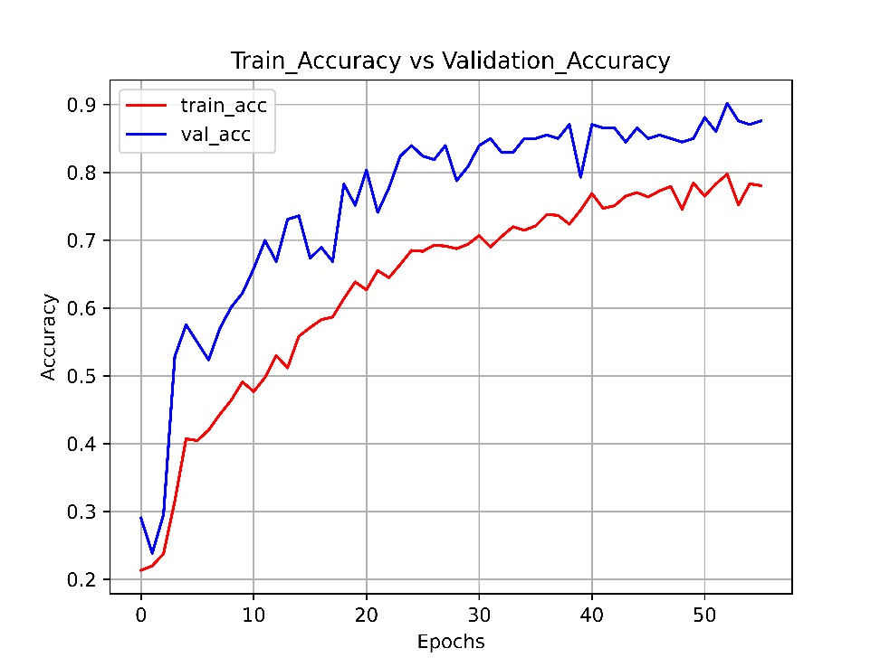
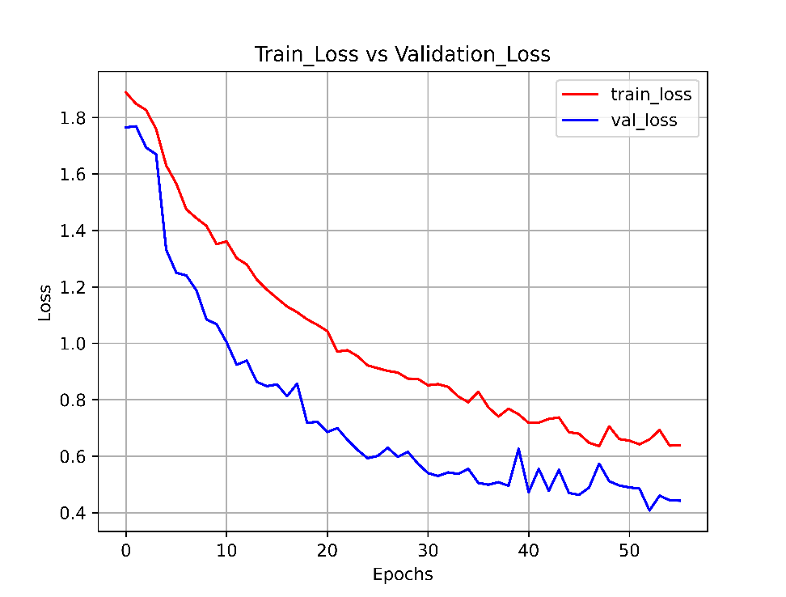
Proposed CNN Model Performance

Slide 6
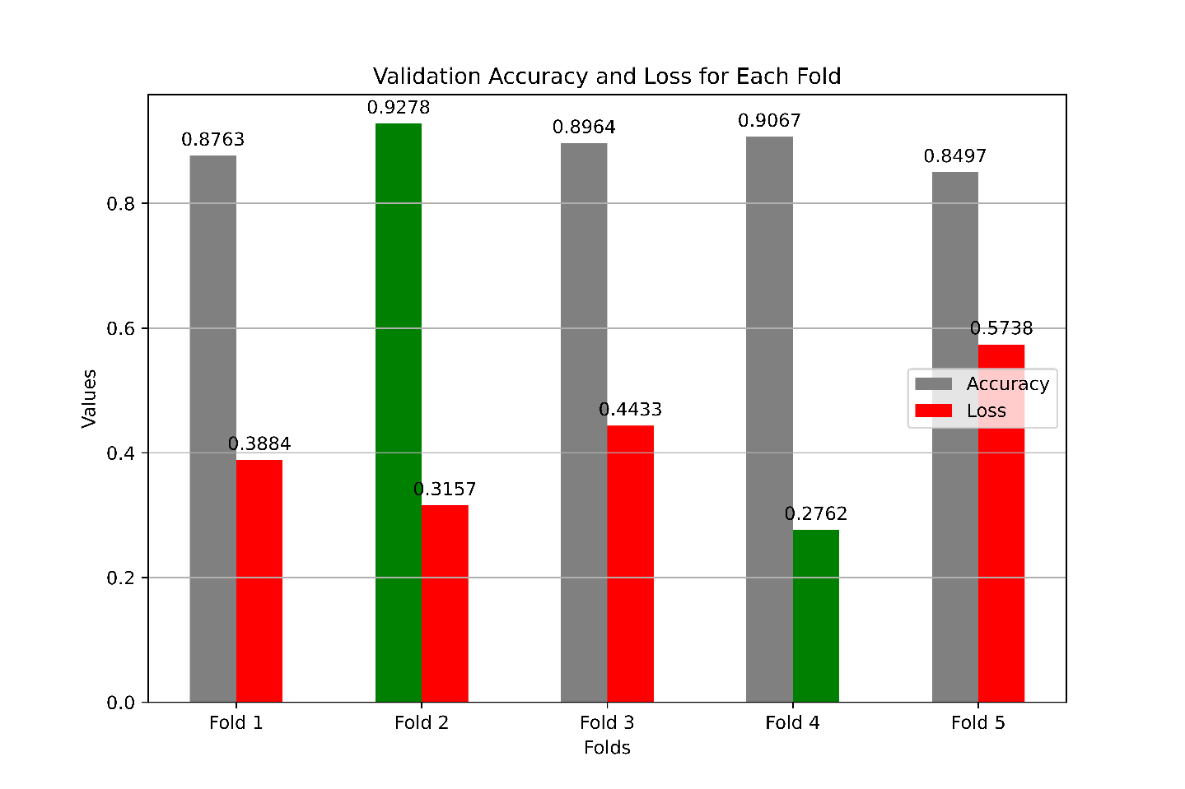
5-fold Validation Performance of proposed CNN Model Performance

Slide 7
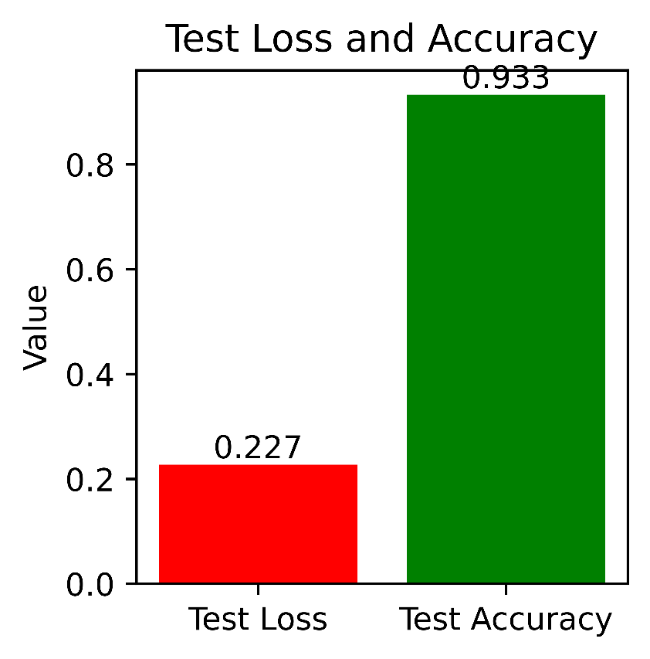
Test Performance of Proposed CNN Model Performance

Slide 8
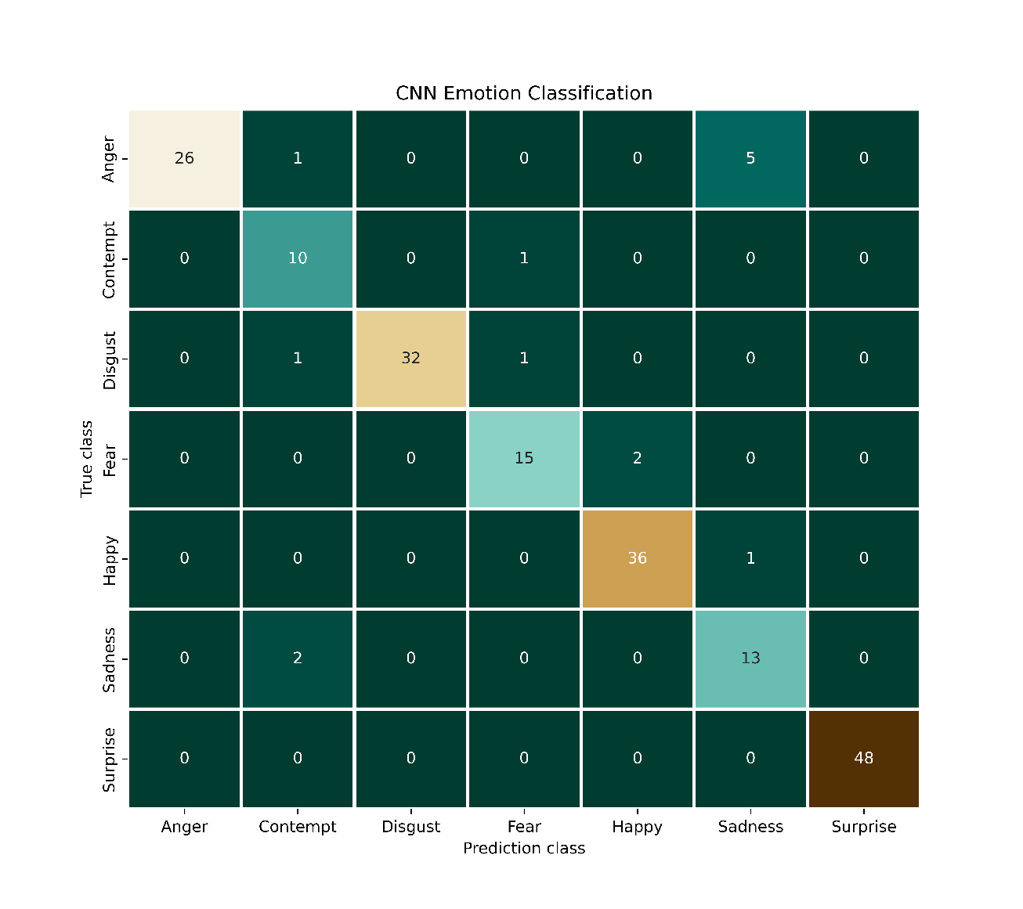
Confusion Metrix of Proposed CNN Model

Slide 9
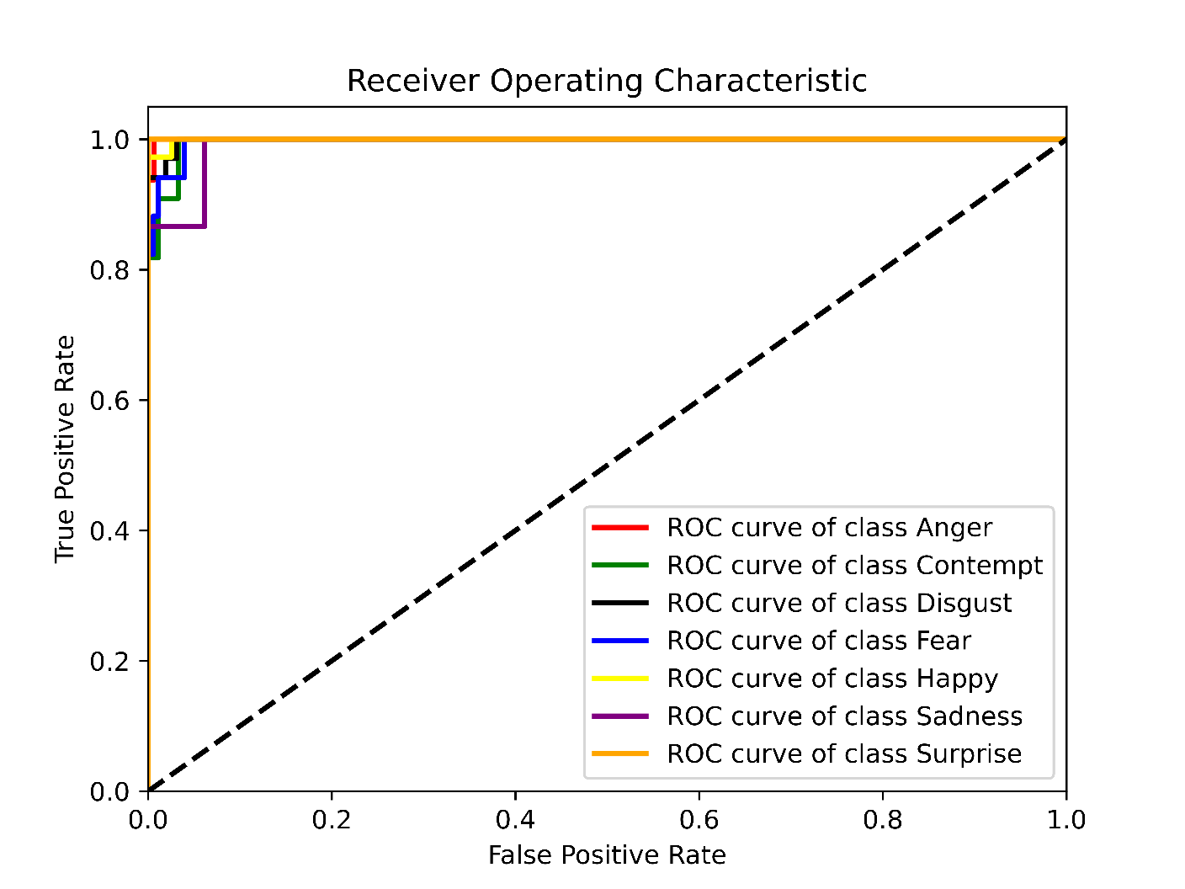
ROC Curve of Proposed CNN Model

Slide 10
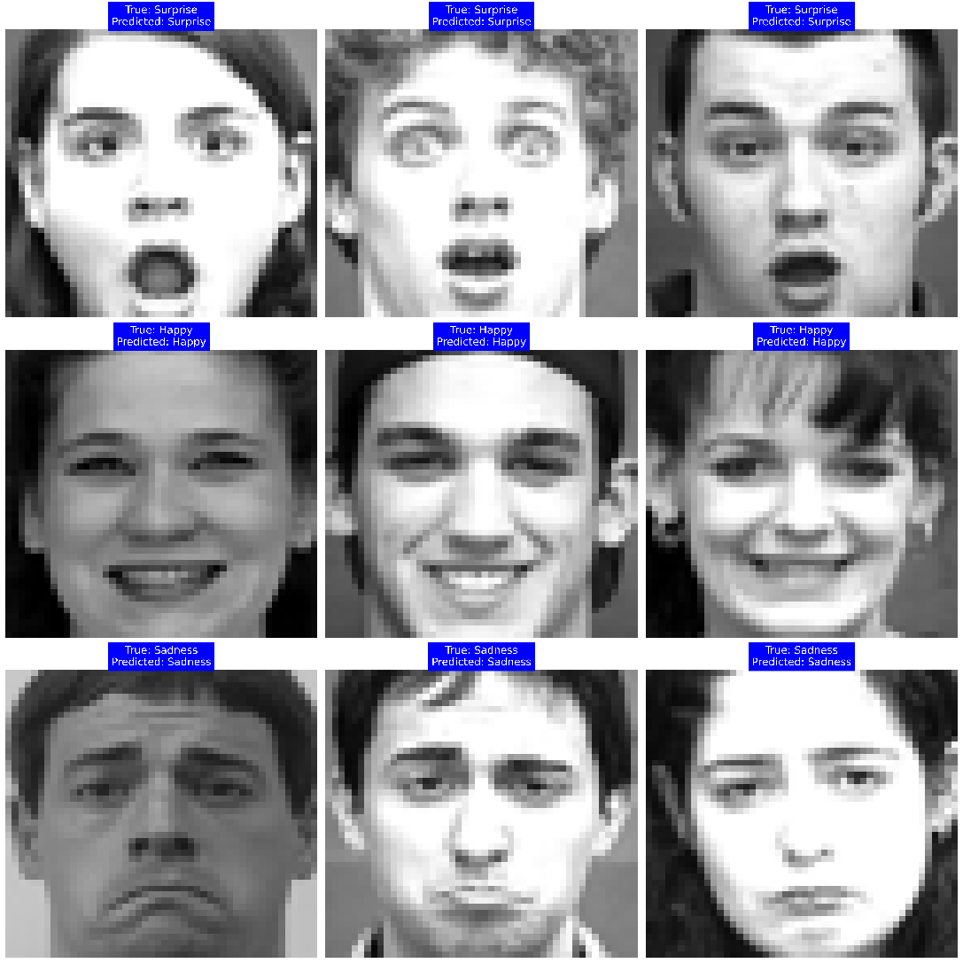
Visualization Results of Proposed CNN Model Performance

Slide 11
Attention CNN using SVM and RF classifier model
Input Images
Feature Extraction Part
Classification Part
Angry
Contempt
SVM/RF Classifier
Disgust
Attention Module
Fear
Pre-Processing
Happy
Sadness
CNN Layers
Pooling Layers
Surprise
Fully Connected Layers

Slide 12
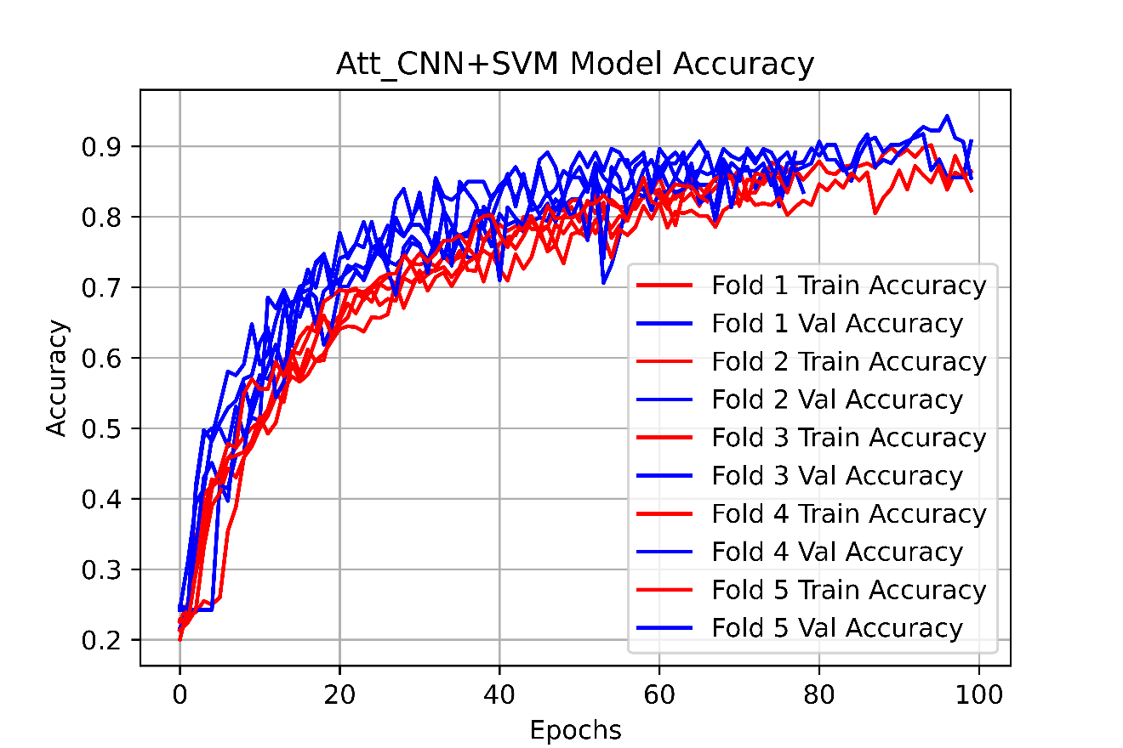
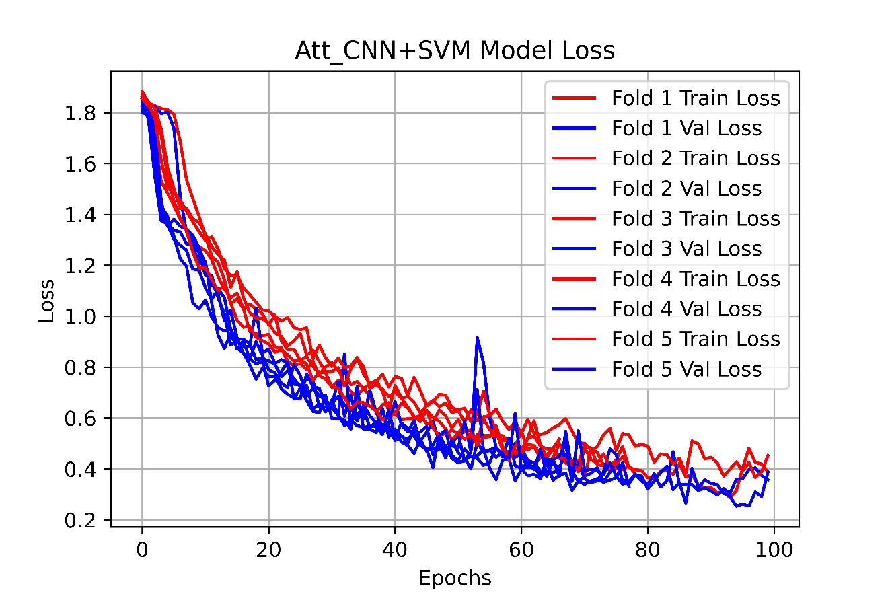
Attention CNN using SVM classifier model

Slide 13
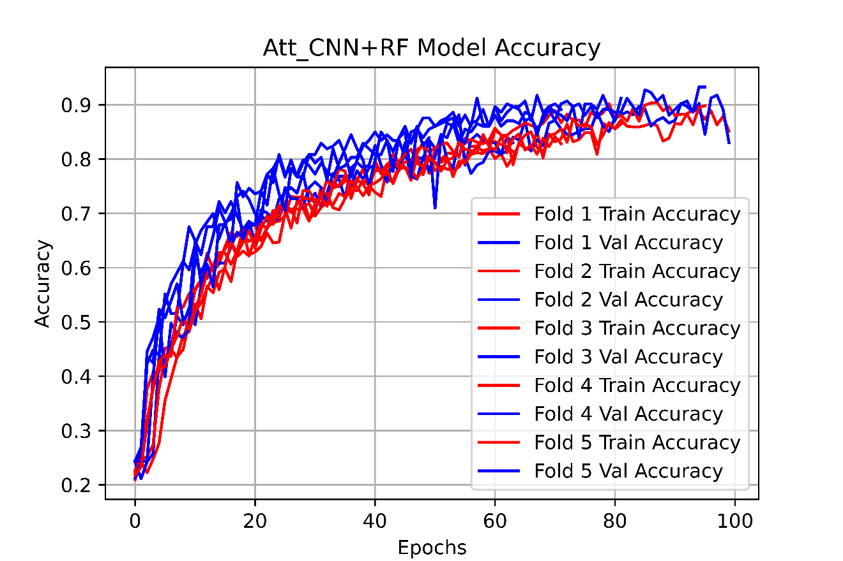
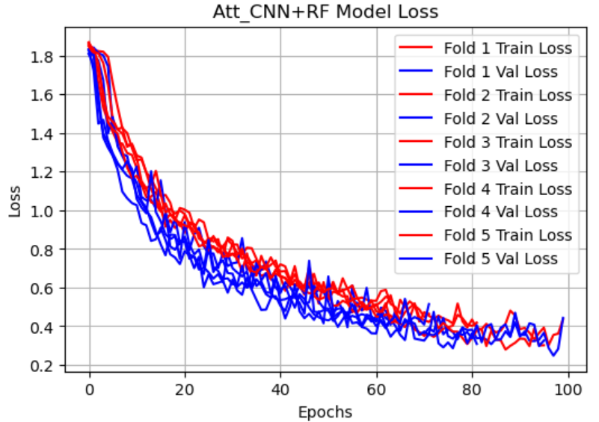
Attention CNN using RF classifier model

Slide 14
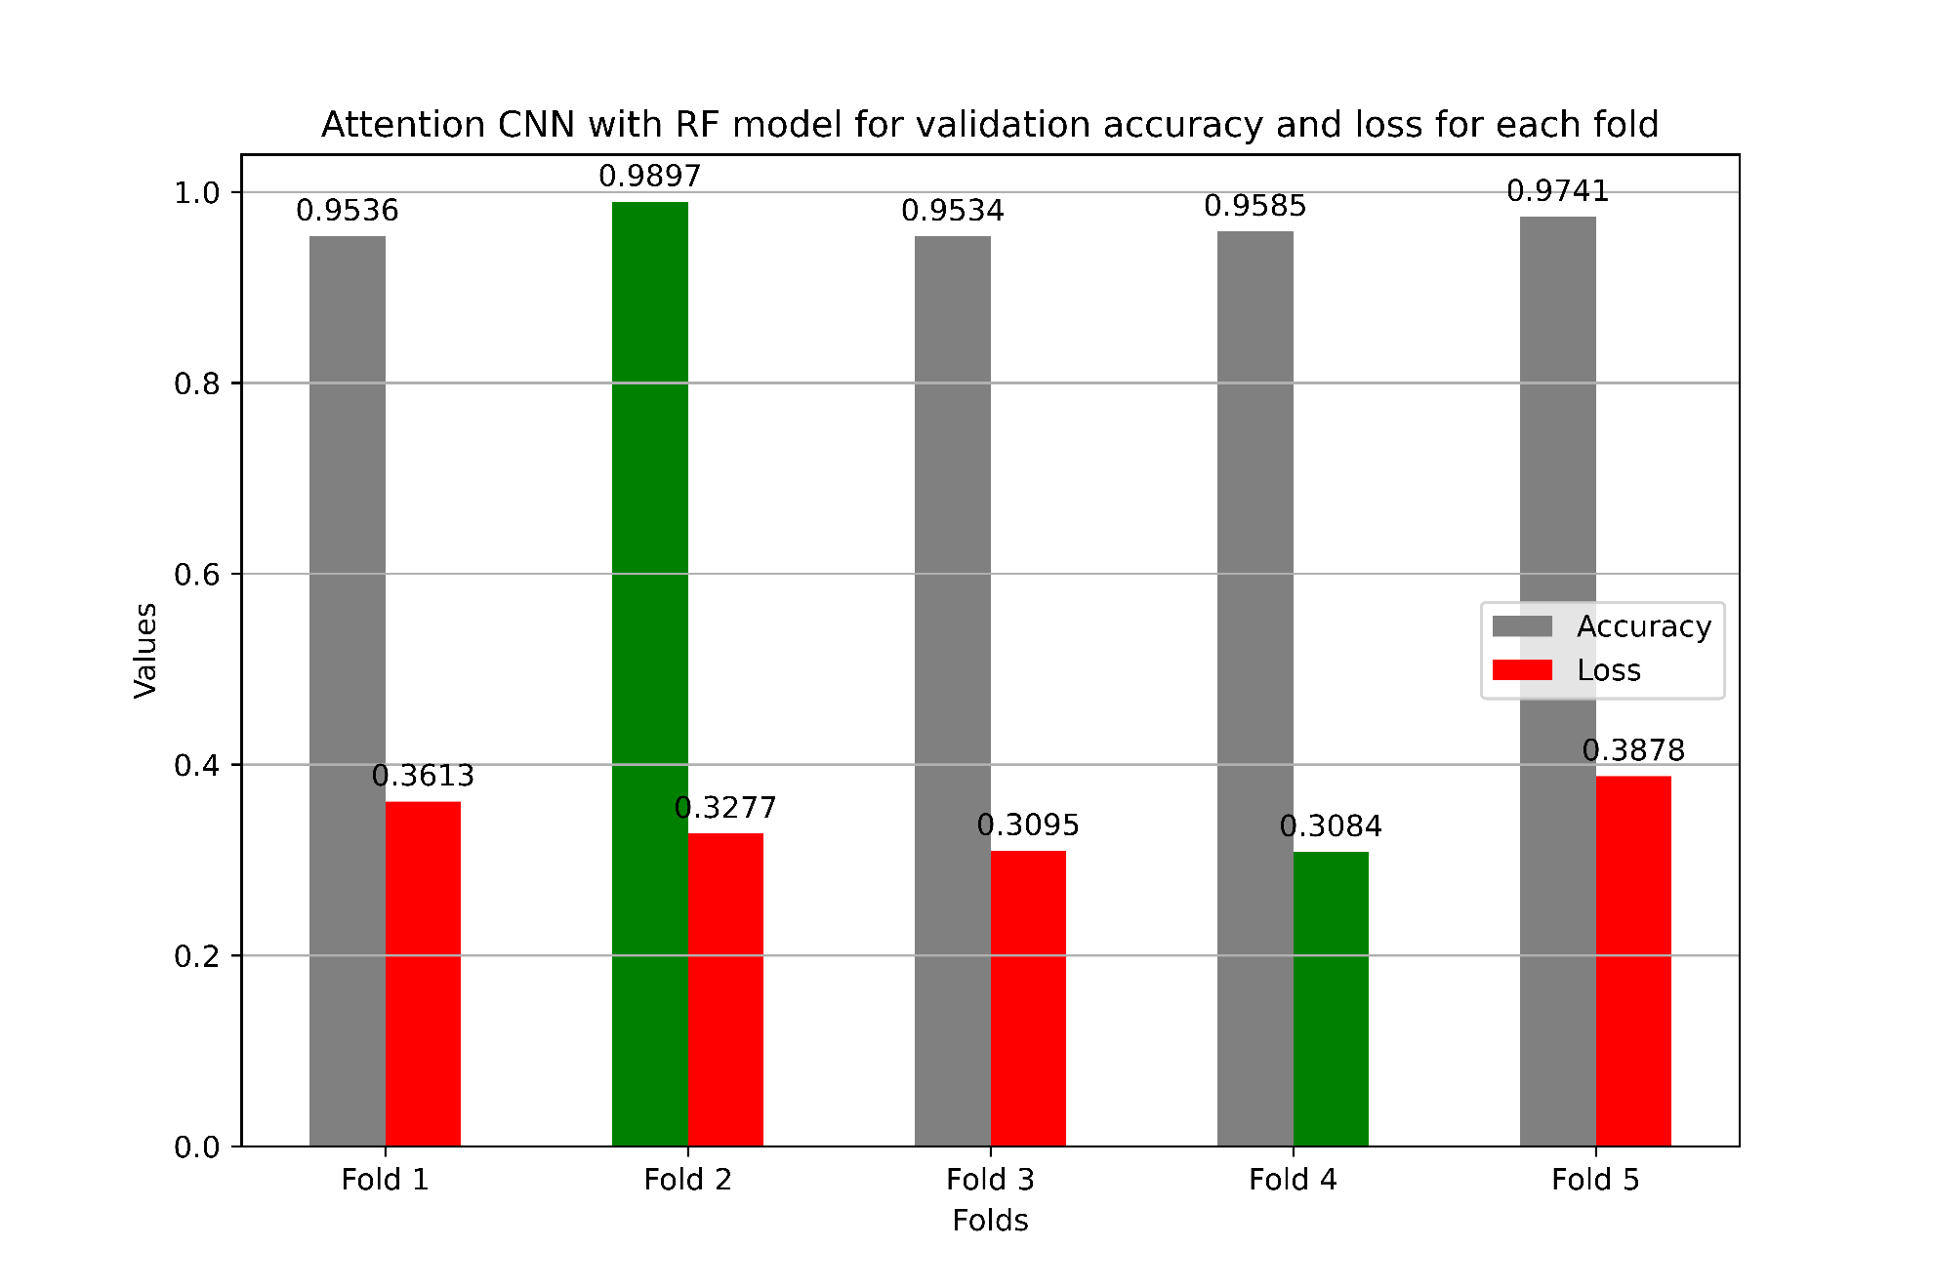
Modified Attention CNN using RF classifier model

Slide 15
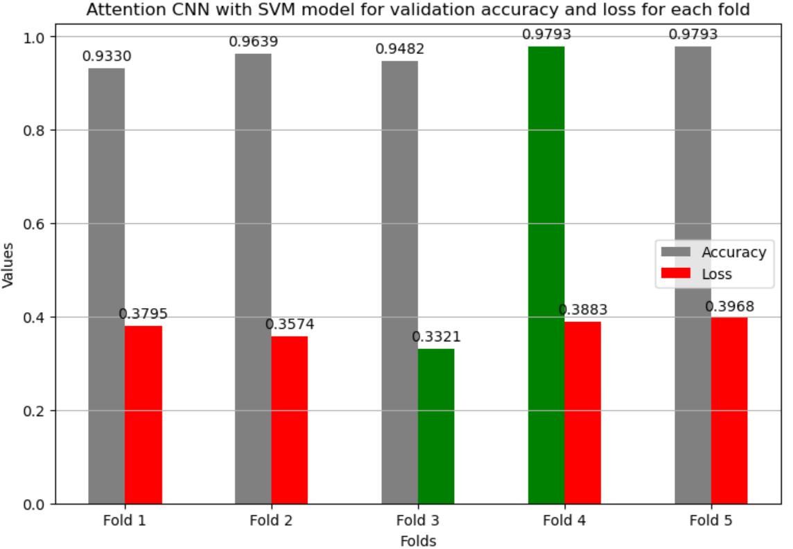
Modified Attention CNN using SVM classifier model

Slide 16
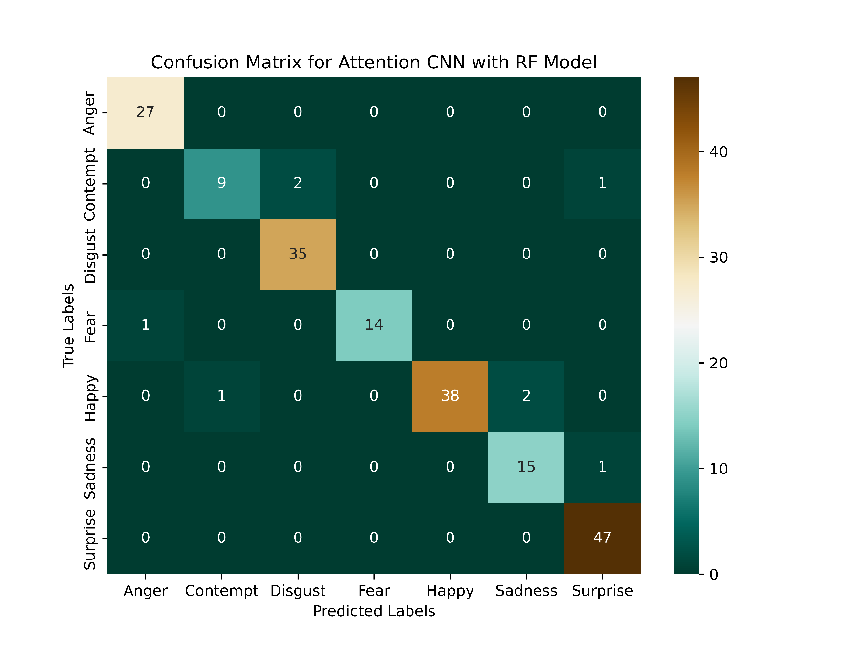
Attention CNN using RF classifier model confusion Matrix performance

Slide 17
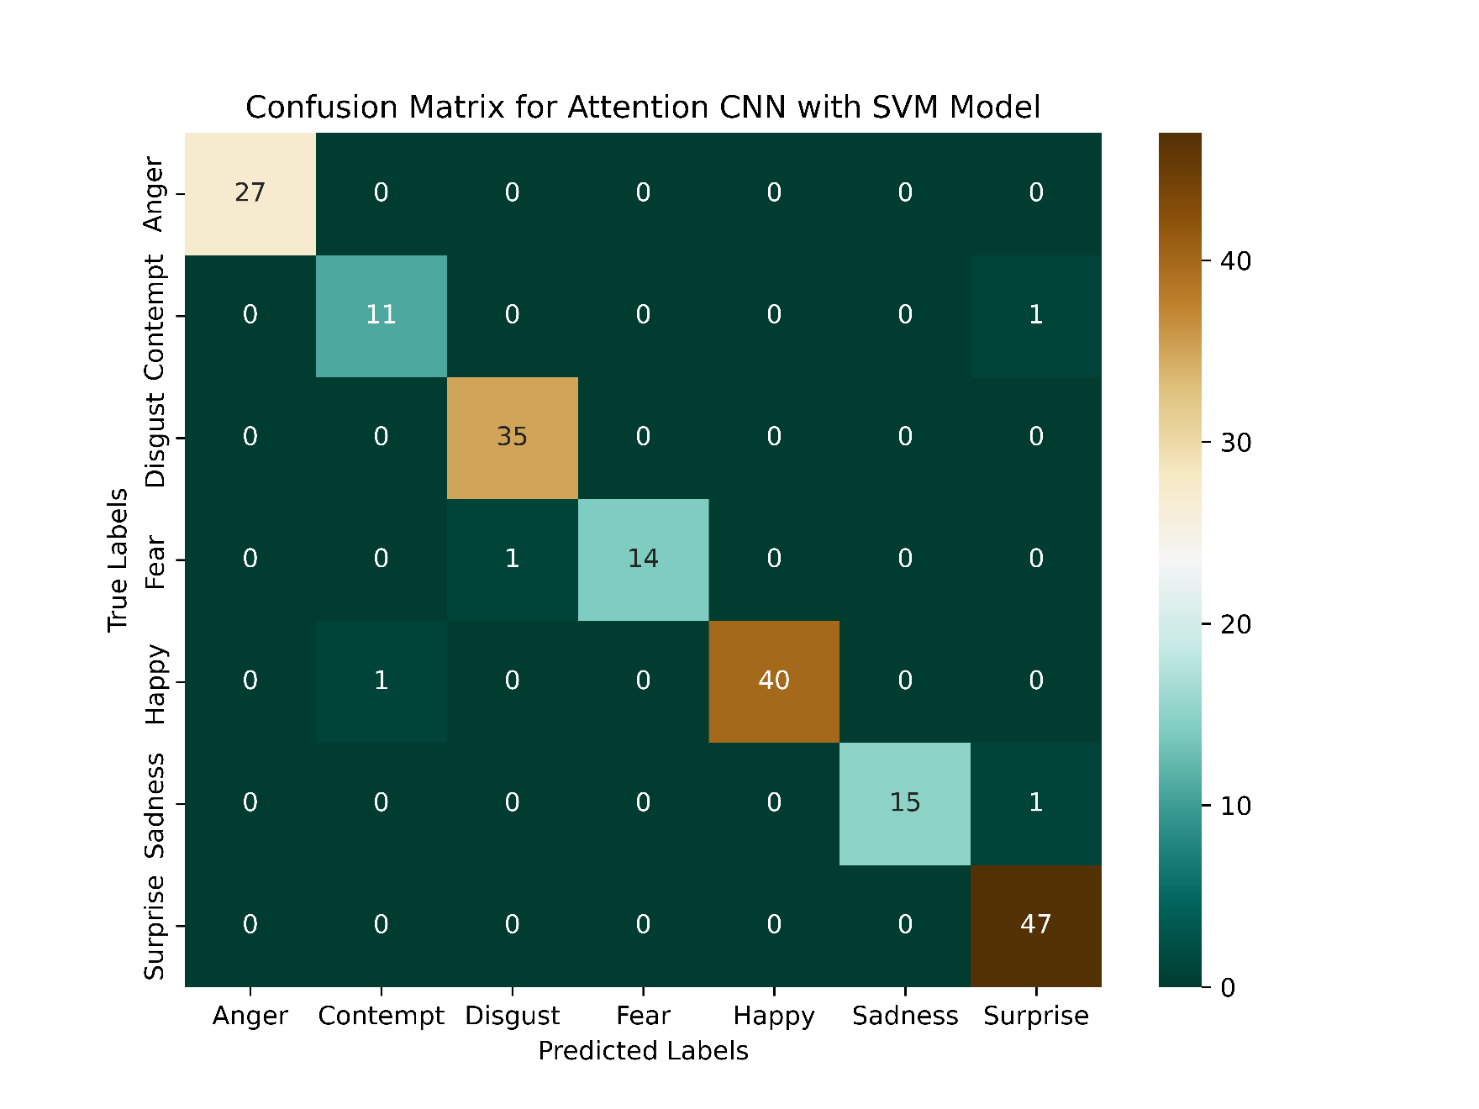
Attention CNN using SVM classifier model confusion Matrix performance

Slide 18
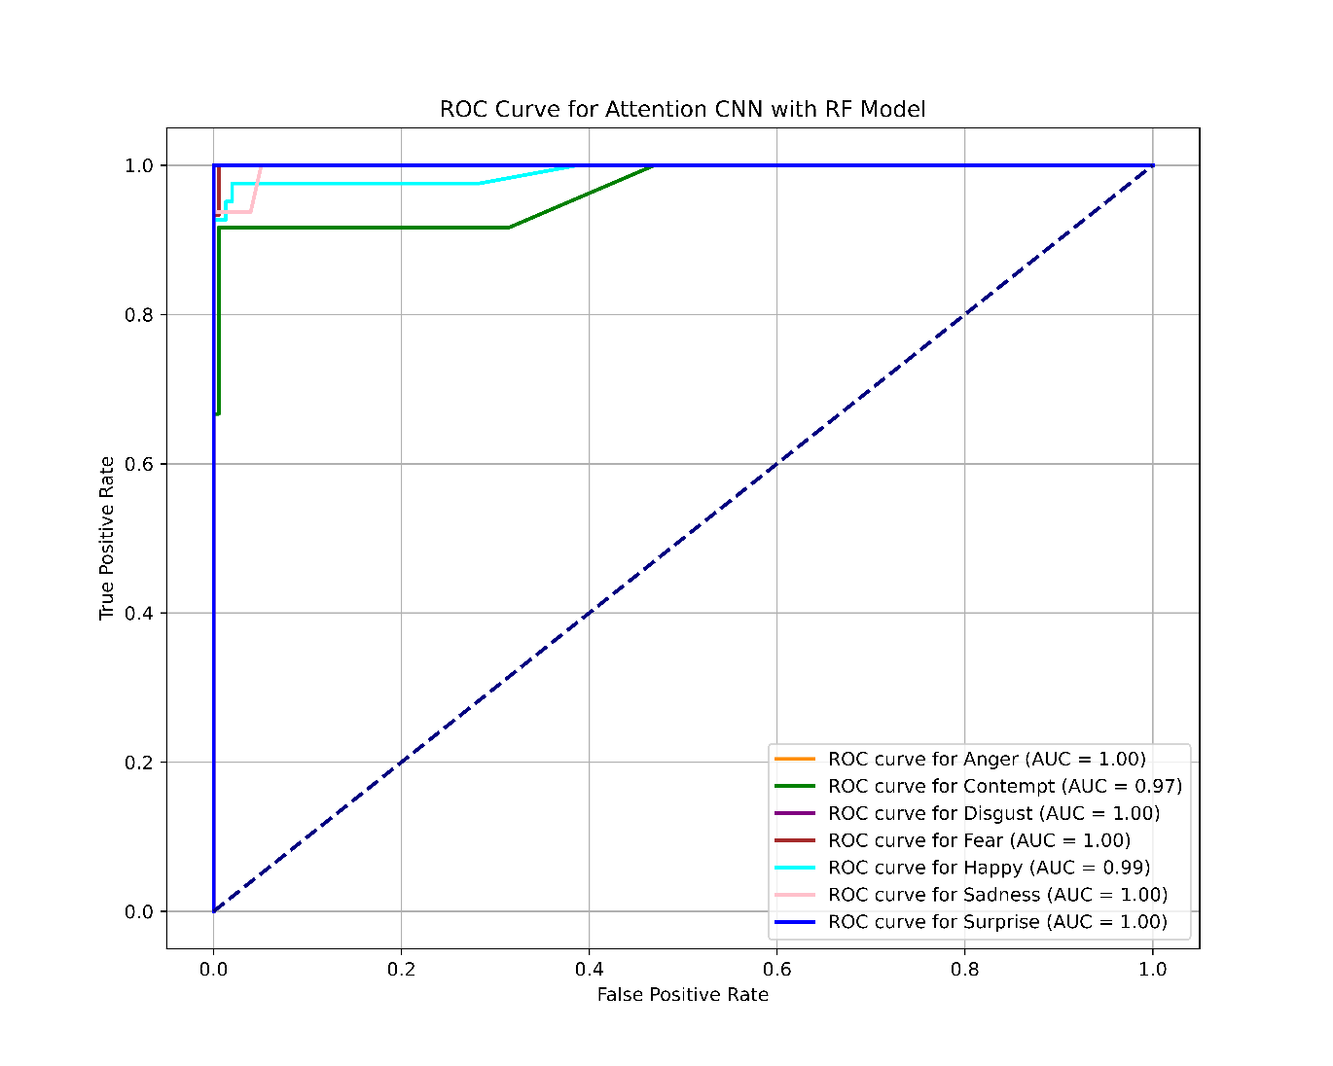
The proposed models ROC curve using Attention CNN and RF model

Slide 19
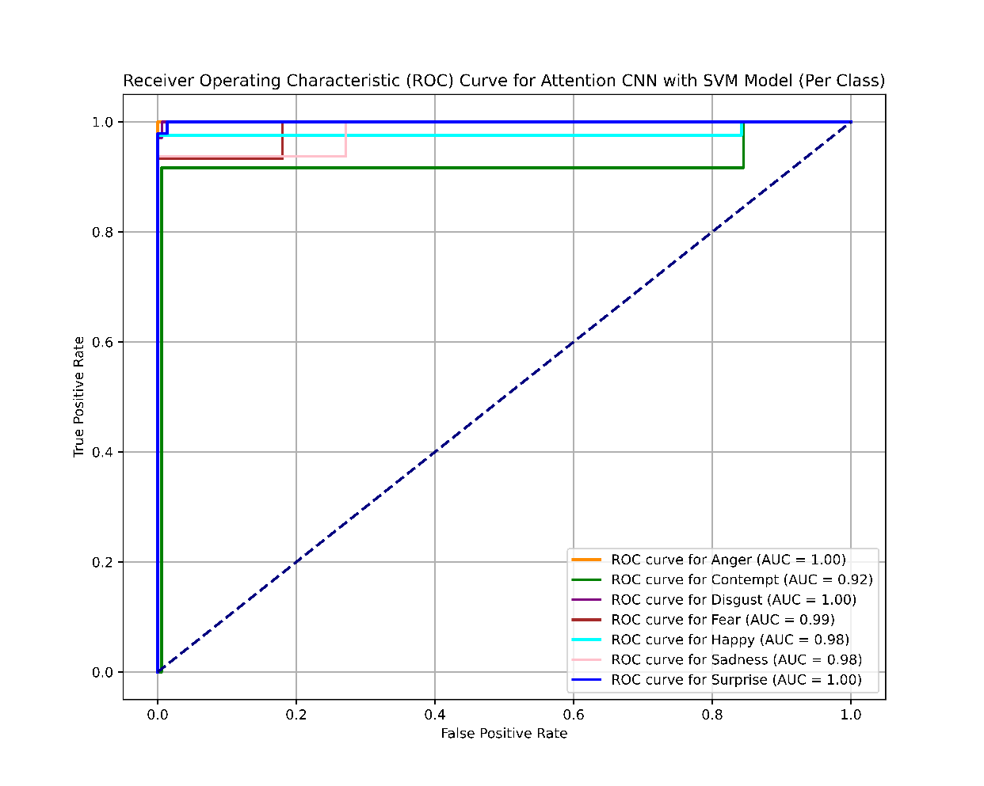
The proposed models ROC curve using Attention CNN and SVM model

Slide 20
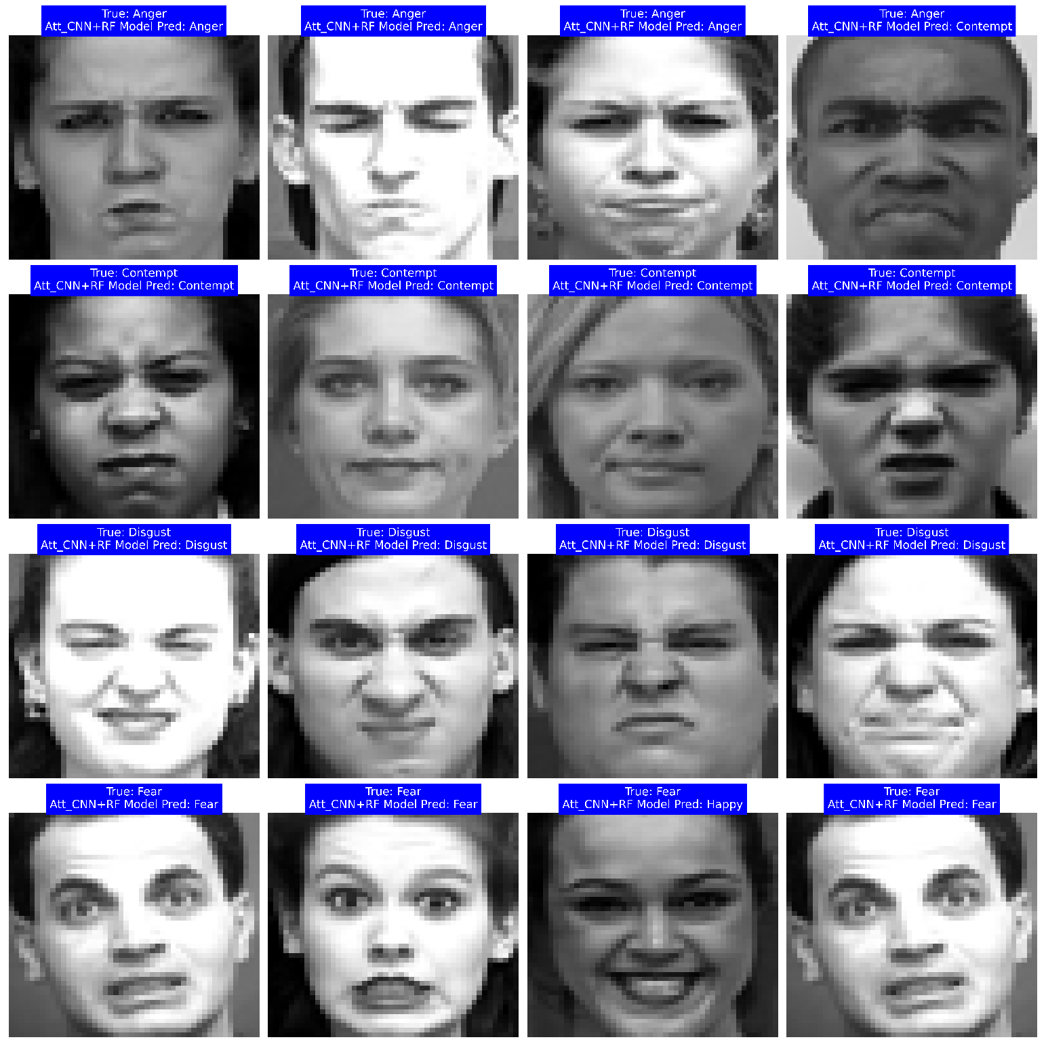
Visualization results of CNN+RF model

Slide 21
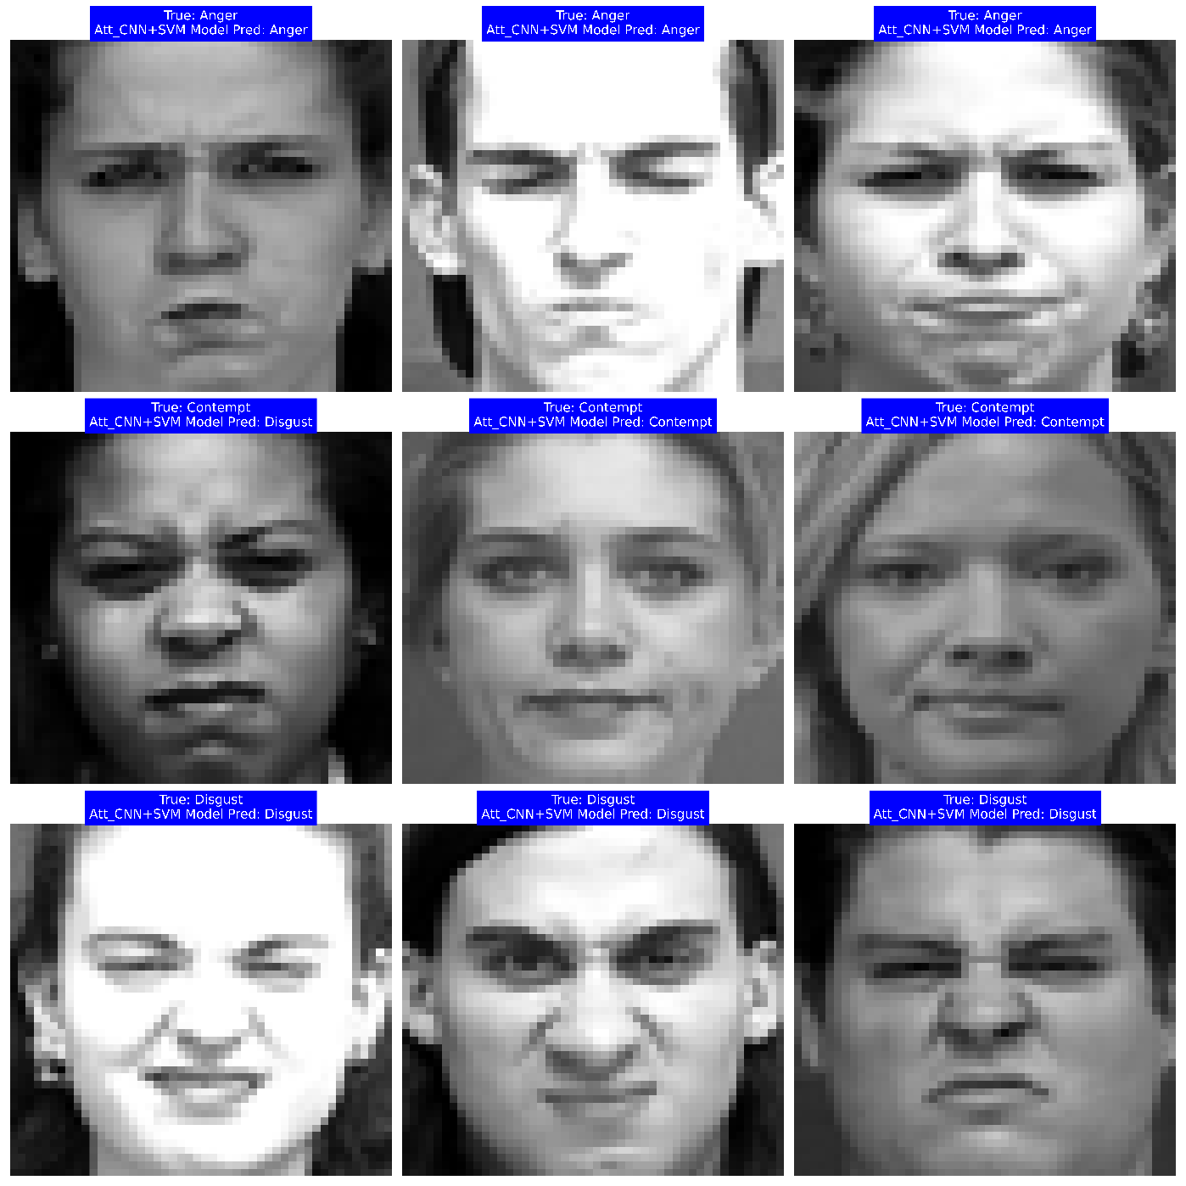
Visualization results of CNN+SVM model

