Slide 1

Social Influence Program Summary
January 1, 2025 – February 1, 2025
#CampaignHashtag

Slide 2
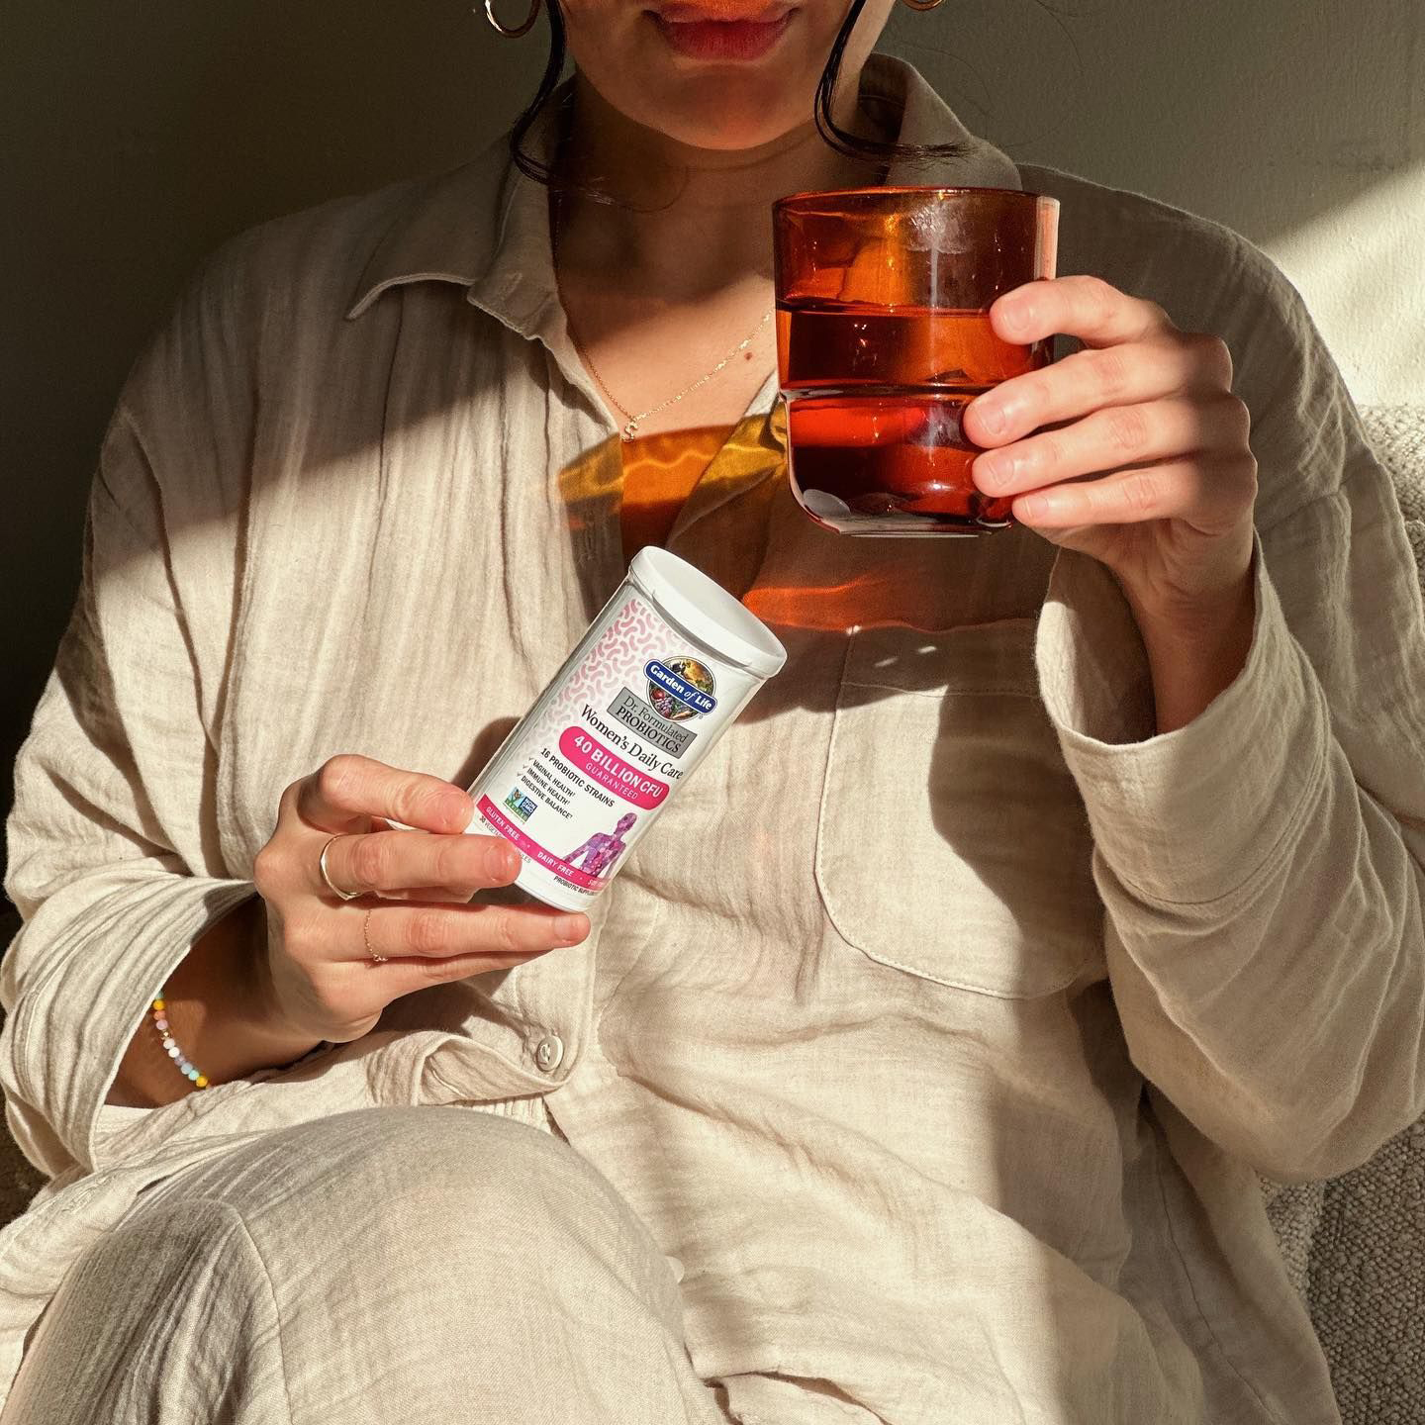

Social Influence Program Summary
January 1, 2025 – February 1, 2025
#CampaignHashtag

Slide 3
Social Influence Program Summary
January 1, 2025 – February 1, 2025
#CampaignHashtag

Slide 4
Program
Overview
PROGRAM GOALS
Create excitement and promote (brand) products available at (retailer).
Encourage shoppers to purchase the (brand and products)…
Proposed Program Details
Soapbox Solution
# Influencers
#% Diversity Rate
# Social Posts & Stories
#% Engagement Rate
# Engagements (#% increase)
# Impressions (#% increase)
Proposed Influencers: #
Proposed Engagements: #
Proposed Impressions: #

Slide 5
Influencer
Feedback
@influencerhandle
## Social Reach - City, State
“Verbatim”
@influencerhandle
## Social Reach - City, State
“Verbatim”
@influencerhandle
## Social Reach - City, State
“Verbatim”
@influencerhandle
## Social Reach - City, State
“Verbatim”
@influencerhandle
## Social Reach - City, State
“Verbatim”
@influencerhandle
## Social Reach - City, State
“Verbatim”

Slide 6

Program
Assets
Program Assets Belong to You
Creative assets and photos from the campaign may be freely used. Program participants understand their work may be repurposed. We strongly encourage clients to tag and give credit to the content creator (although this is not required) to create engagement, momentum, and an overall positive statement.
@influencerhandle
Check them out!

Slide 7

High Performing Posts
Organic
@influencerhandle
# Likes
# Comments
# Views
# Social Reach
Paid
@influencerhandle
# Engagements
# Impressions

Slide 8
High Performing Posts
@influencerhandle
# Likes
# Comments
# Views
# Social Reach
@influencerhandle
# Likes
# Comments
# Views
# Social Reach
@influencerhandle
# Likes
# Comments
# Views
# Social Reach
@influencerhandle
# Likes
# Comments
# Views
# Social Reach

Slide 9
Engagements
Summary
#
Total
Engagements
Total engagements outperformed proposed estimated engagements (#) by #%.
Organic
Paid
Total Post Engagements
Story Engagements
Cart Transfers
100 K
200 K
300 K
Likes
Comments
Shares
Saves
10 K
20 K
30 K
40 K
Likes
Comments
Shares
Saves
3-Sec. Video Views
10 K
20 K
30 K
40 K
##K
Total Engagements
222 K

Slide 10

Impressions
Summary
#
#
#
#
Influencer
Reach
Ad
Impressions
Total
Views
Total
Impressions

Slide 11
Impressions
Summary
#
#
#
#
Influencer
Reach
Ad
Impressions
Total
Views
Total
Impressions

Slide 12
Paid Social
Overview
VIDEO AD PERFORMANCE
$ CPE
$ CPC
% CTR
$ CPM
# ThruPlays
Video Plays
at 100%
#
Video Plays
at 75%
#
Video Plays
at 50%
Video Plays
at 25%
#
#

Slide 13
Click2Cart Recap
Dates of Target Paid Media: 00/00/00 – 00/00/00
10.6K
Cart
Transfers
$27K
Total
Transfers
Transfers By Device

Slide 14

Barriers to
Conversion
Industry averages for cart conversion vary greatly but range from 24% for mobile users to 30% for desktop users.
1
Pricing Expectations
5
Product Reviews
2
Hidden Fees
6
Checkout Process
3
Shipping Expectations
7
Inventory Control
4
Account Creation

Slide 15
Key Insights
On a scale from 1 to 10, 10 being the most likely, how likely would you be able to recommend Ticket to Ride/Ticket to Ride: San Francisco to family and friends?
“Because every time you play there is a new strategy and ways to win and do better. It does bring lots of laughs to the table too.”
“We really enjoyed the game. Loved that it was a new take on one of our favorites and really liked the short play time.”
“It's a great game and it's super fun when you play it with friends or family. I like the way the game is put together and how easy it is to clean up as well. It was a bit confusing at first, but we understood it eventually.”
“It's a fun game once you get the hang of the instructions.”
“It's easy to learn and play and I come from California, so most of my family and friends are familiar with the area.”

Slide 16
Key Insights
What were your favorite parts of the game night
Playing Ticket to Ride: San Francisco?
“Playing around a city I was familiar with.”
“The laughter it brought to the table and that after playing once everyone wanted to play again unlike other games where everyone plays once and then leaves. This is our family's favorite game for game night.”
“Being able to just enjoy our time together stopping and talking about the times we were in SF while playing.”
“The competitive fun and race to get your route!”
“The kids loved competing to see who could get the most. They loved totaling it up in the end to see who won.”

Slide 17
Key Learnings

Slide 18
About our
Company
Elevating brands by delivering targeted retail solutions that drive growth, engagement, and measurable success.
Displays
PDQ Trays
Signage Kits
Fulfillment
Omnichannel Creative
Product Photography
EBC & A+ Content
Animation + Video
Influencer Marketing
Retail Media
Customer Insights
Marketing Services

Slide 19
Let’s connect!
Lauren Scott
Bailey Snow
Director of Client Services
Lscott@soapboxretail.com
Director of Insights & Analytics
bsnow@soapboxretail.com

