Slide 1
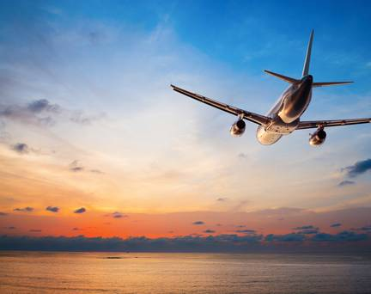
Airplane Safety
Sara Herbstreit
DSC640
Bellevue University

Slide 2
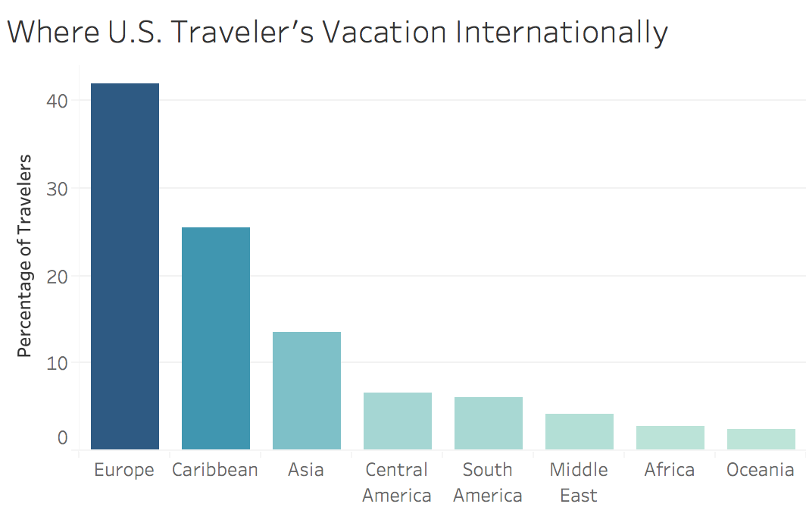
Traveling is a Staple in our Culture
Regions visited by U.S. travelers in 2019. Each bar represents the percentage of international travel to each region. (National Travel and Tourism Office)

Slide 3
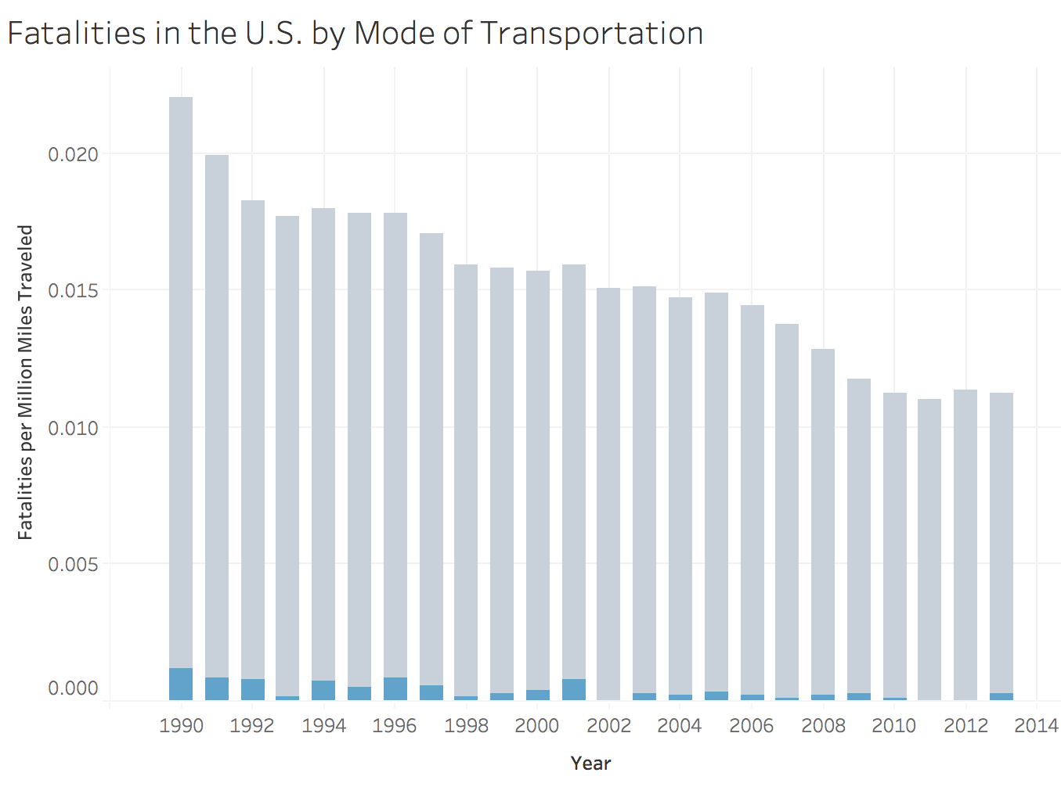

Flying is Much Safer than Driving
When considering the distance traveled, your risk of death by car travel is 40 times greater than that of flying.
Driving has a 258-fold greater risk of sustaining an injury
The low risk of flying coupled with the monumentally decreased time expense should be enough to make one reconsider driving to their next destination.

Slide 4
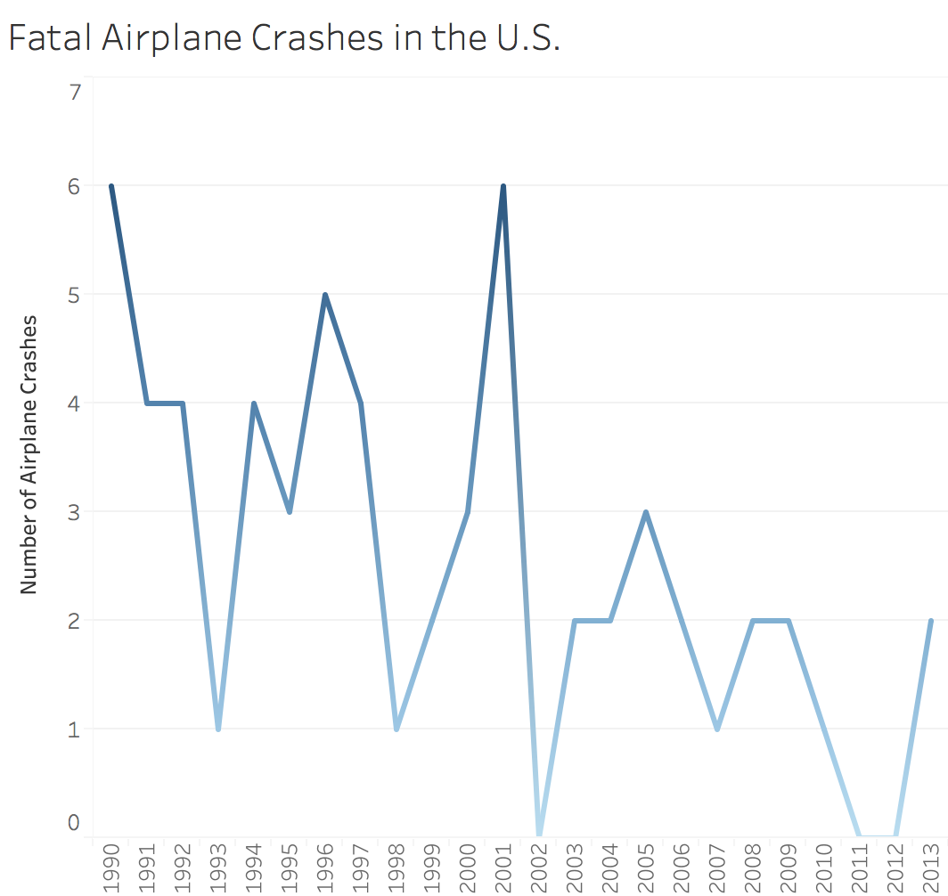
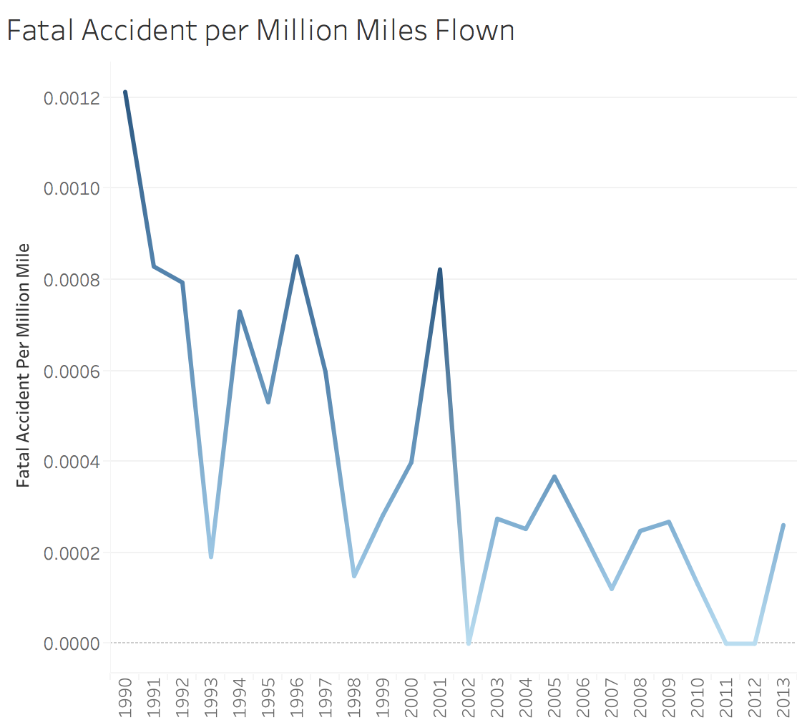
Airplane Crashes are Becoming Less Frequent
The airplane crash fatality trend in the U.S. is at a steady decline
The spike we see in 2001 was from the tragic events that occurred on 911, which caused 4 airplane crashes

Slide 5
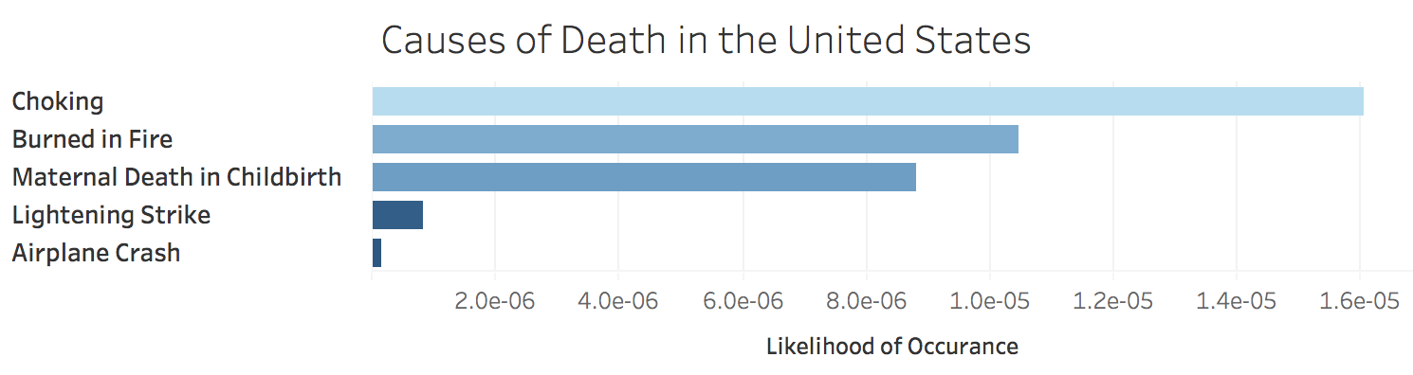
Airplane Crashes are Extremely Rare
You are 5 times more likely to be struck and killed by a lightning strike than be in an airplane crash.

Slide 6
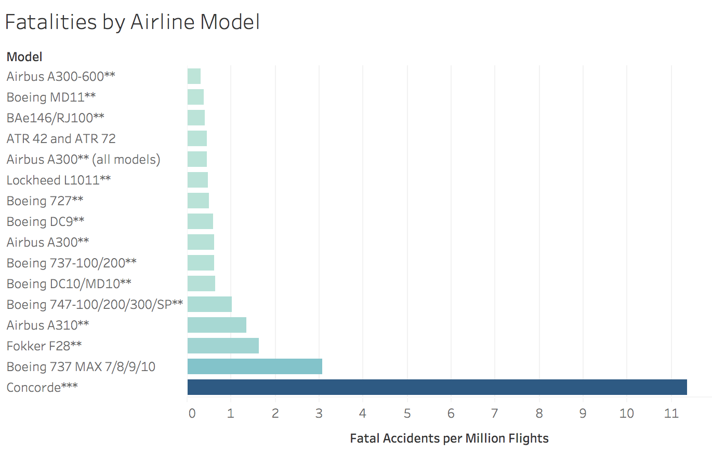
Dangerous models are no longer in Production
Only one of these models is still manufactured, and the Concorde (highest rate) is no longer used in commercial service.
** No longer in production
*** No longer used in commercial service

Slide 7

Thank you for your time.

