Slide 1
Diabetes Mellitus
Prediction of
Using Random Forest
By Team 20

Slide 2
TABLE OF CONTENTS
01
03
02
04
Random Forest Classifier
A brief of the classifier (Random Forest)
Classification Results
The results expected from our model
Dataset Explanation
A brief description of the dataset
Our Model Demo
Eventually, we will show you a demo of our model

Slide 3
INTRODUCTION
In this presentation, we will show you how we built a machine learning model that uses the classifier (Random Forest) to predict whether patients in a dataset have diabetes or not.

Slide 4
01
Random Forest Classifier

Slide 5
Random forest is a machine learning method for classification, regression and many other tasks.
It is constructed from multiple decision trees with different parts of the dataset.
For classification, the output of the random forest is the class selected by most trees, while for regression, the mean or average prediction of all the trees is returned.

Slide 6
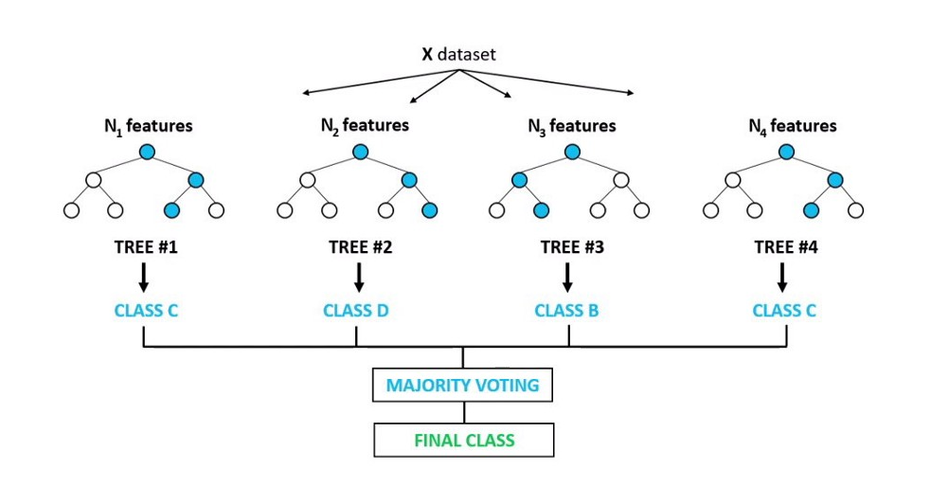

Slide 7
02
Dataset Explanation

Slide 8
The Dataset
Cholesterol | Glucose | hdl_ Chol | Chol_ hdl_ ratio | Age | Gender | Height | Weight | bmi | Systolic_bp | Diastolic_bp | Waist | Hip | Waist_ Hip_ ratio
193 | 77 | 49 | 3,9 | 19 | female | 61 | 119 | 22,5 | 118 | 70 | 32 | 38 | 0,84 | No diabetes
146 | 79 | 41 | 3,6 | 19 | female | 60 | 135 | 26,4 | 108 | 58 | 33 | 40 | 0,83 | No diabetes
217 | 75 | 54 | 4 | 20 | female | 67 | 187 | 29,3 | 110 | 72 | 40 | 45 | 0,89 | No diabetes
226 | 97 | 70 | 3,2 | 20 | female | 64 | 114 | 19,6 | 122 | 64 | 31 | 39 | 0,79 | No diabetes
164 | 91 | 67 | 2,4 | 20 | female | 70 | 141 | 20,2 | 122 | 86 | 32 | 39 | 0,82 | No diabetes
….. | …… | …… | …… | …… | …… | …… | …… | …… | …… | …… | …… | …… | …… | ……

Slide 9
Parameters Leading to Diabetes:

Slide 10
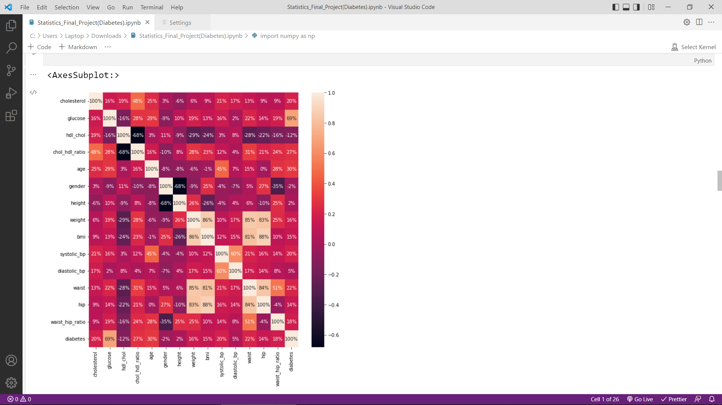

Slide 11
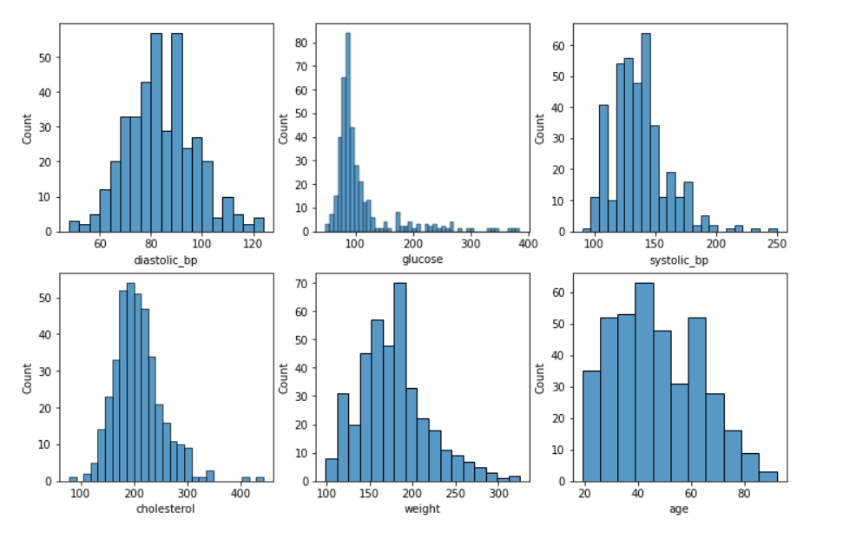

Slide 12
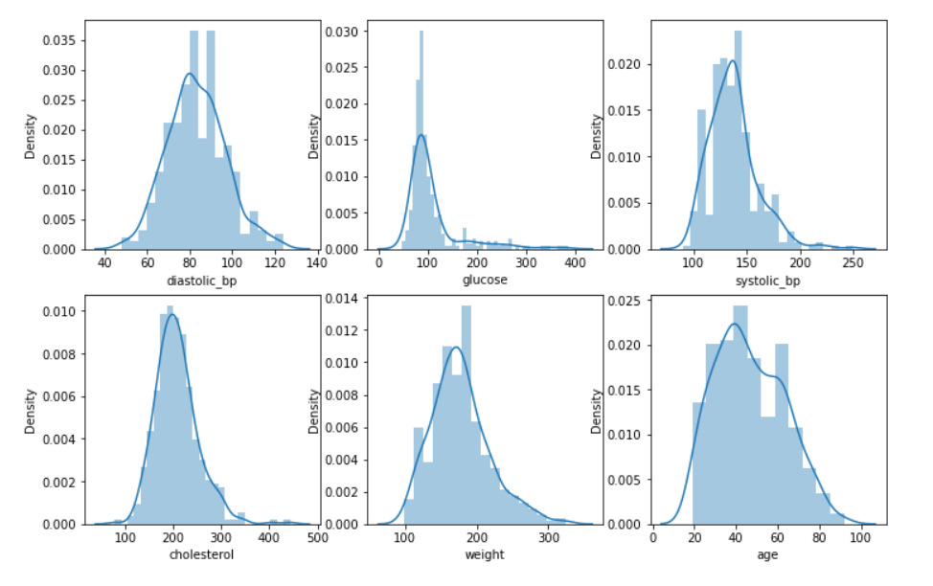

Slide 13
THANK YOU!
Do you have any questions?

