Slide 1
Population Growth Analysis with Tableau

Slide 2
Population growth analysis
What is the population growth rate for several countries?
01
Does population growth affect Health and Education?
02
What its impact on the economy?!
03

Slide 3
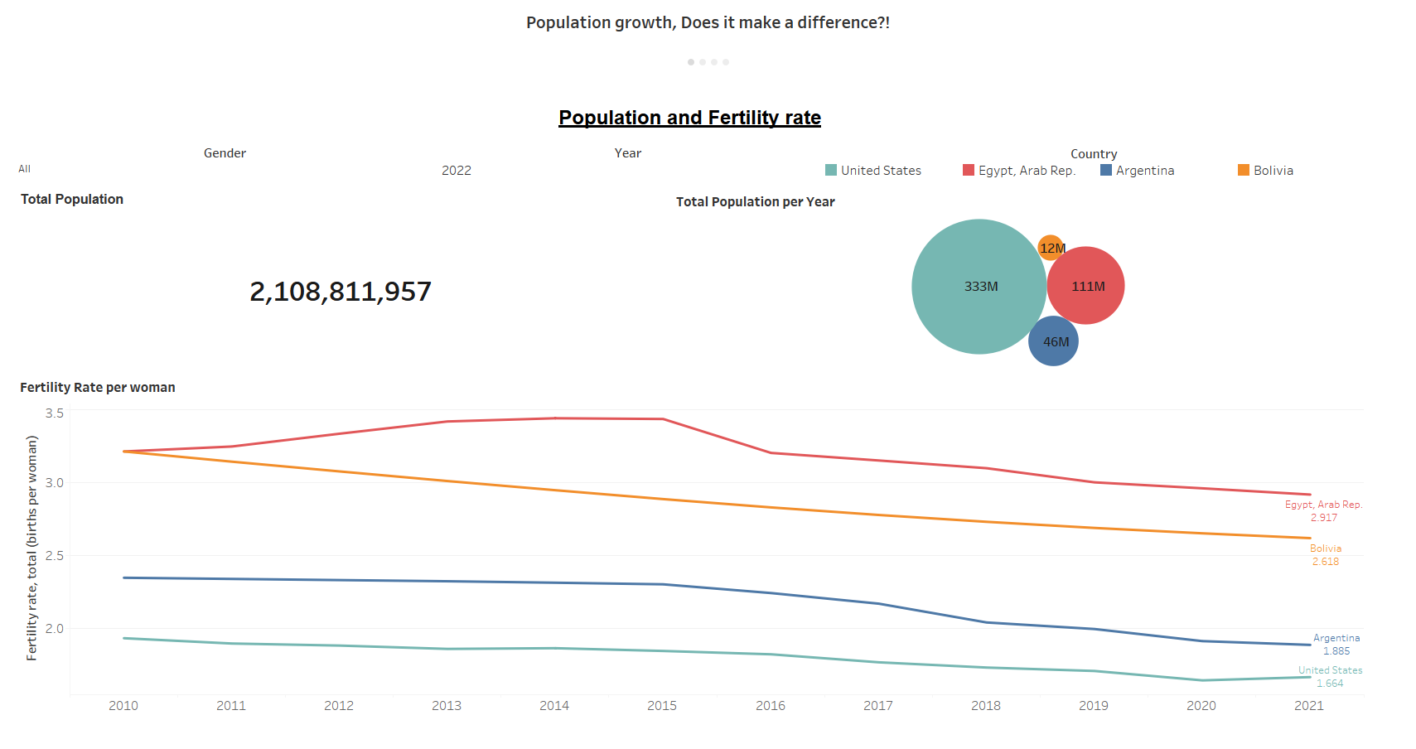
Population count and analysis
As we can see fertility rate decrease for all the 4 countries, we decided to make this analysis on, but with a different rate!

Slide 4
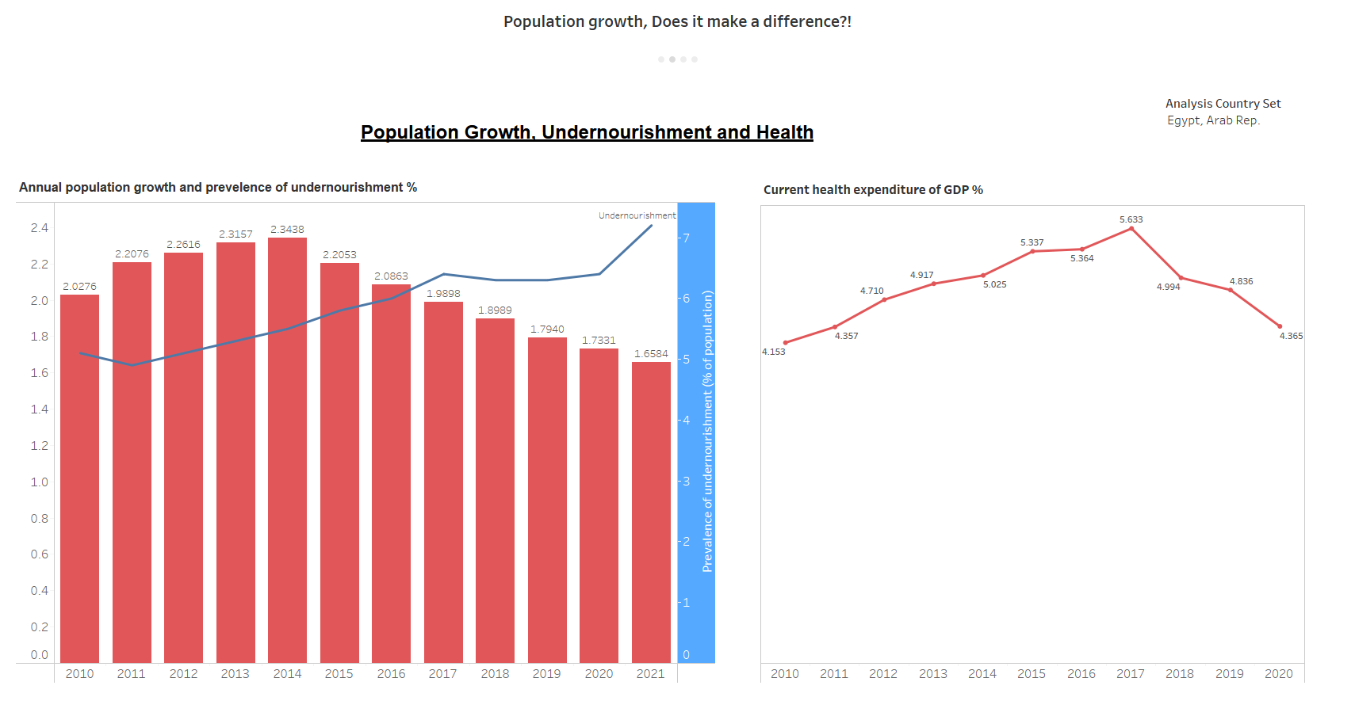
Population growth effect on health and nourishment
Although the population growth decreases year by year, the undernourishment in Egypt increased massively, also the current health expenditure decreased!

Slide 5
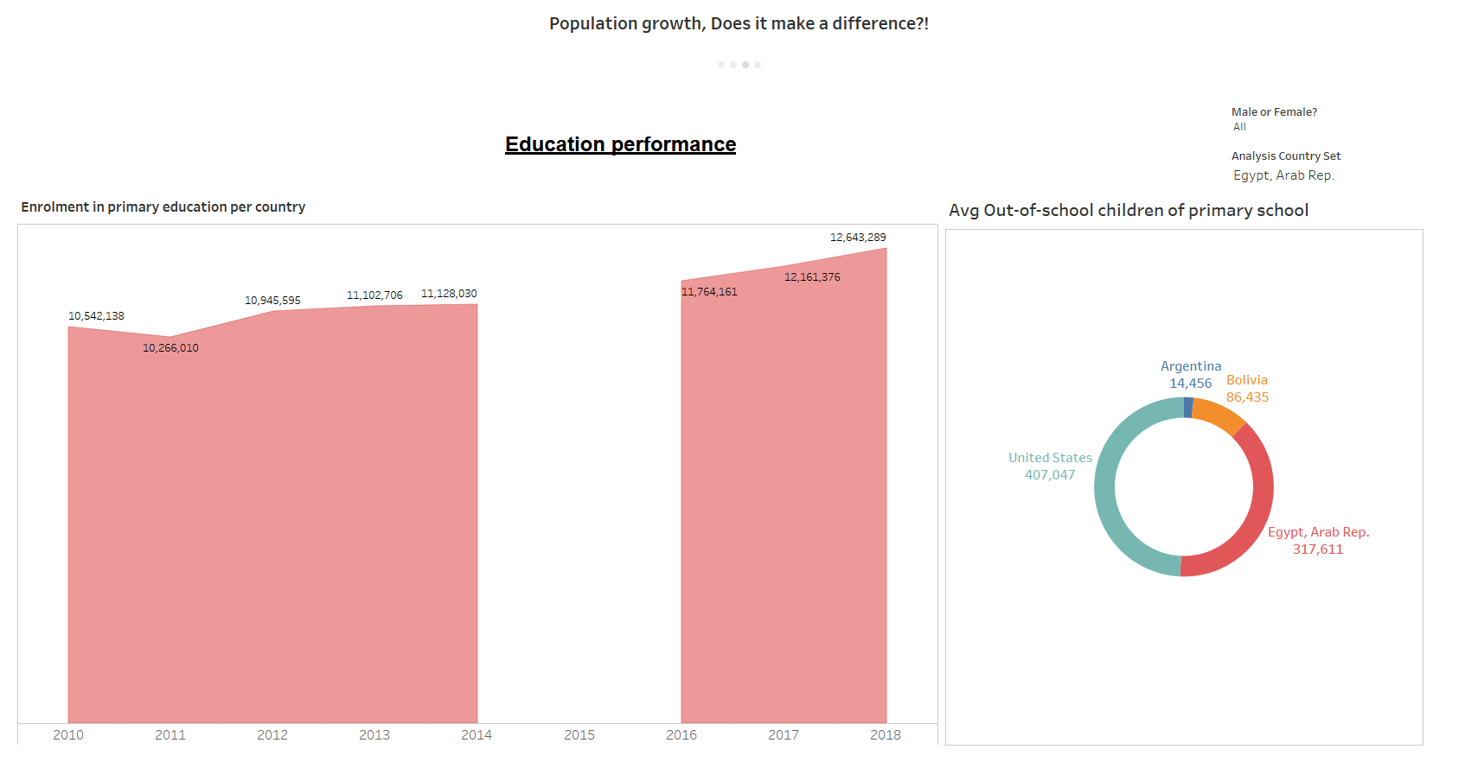
Population effect on education
There is an increase in some countries in primary education enrollment but there’s decrease in another and also the average out-of-school children varies.

Slide 6
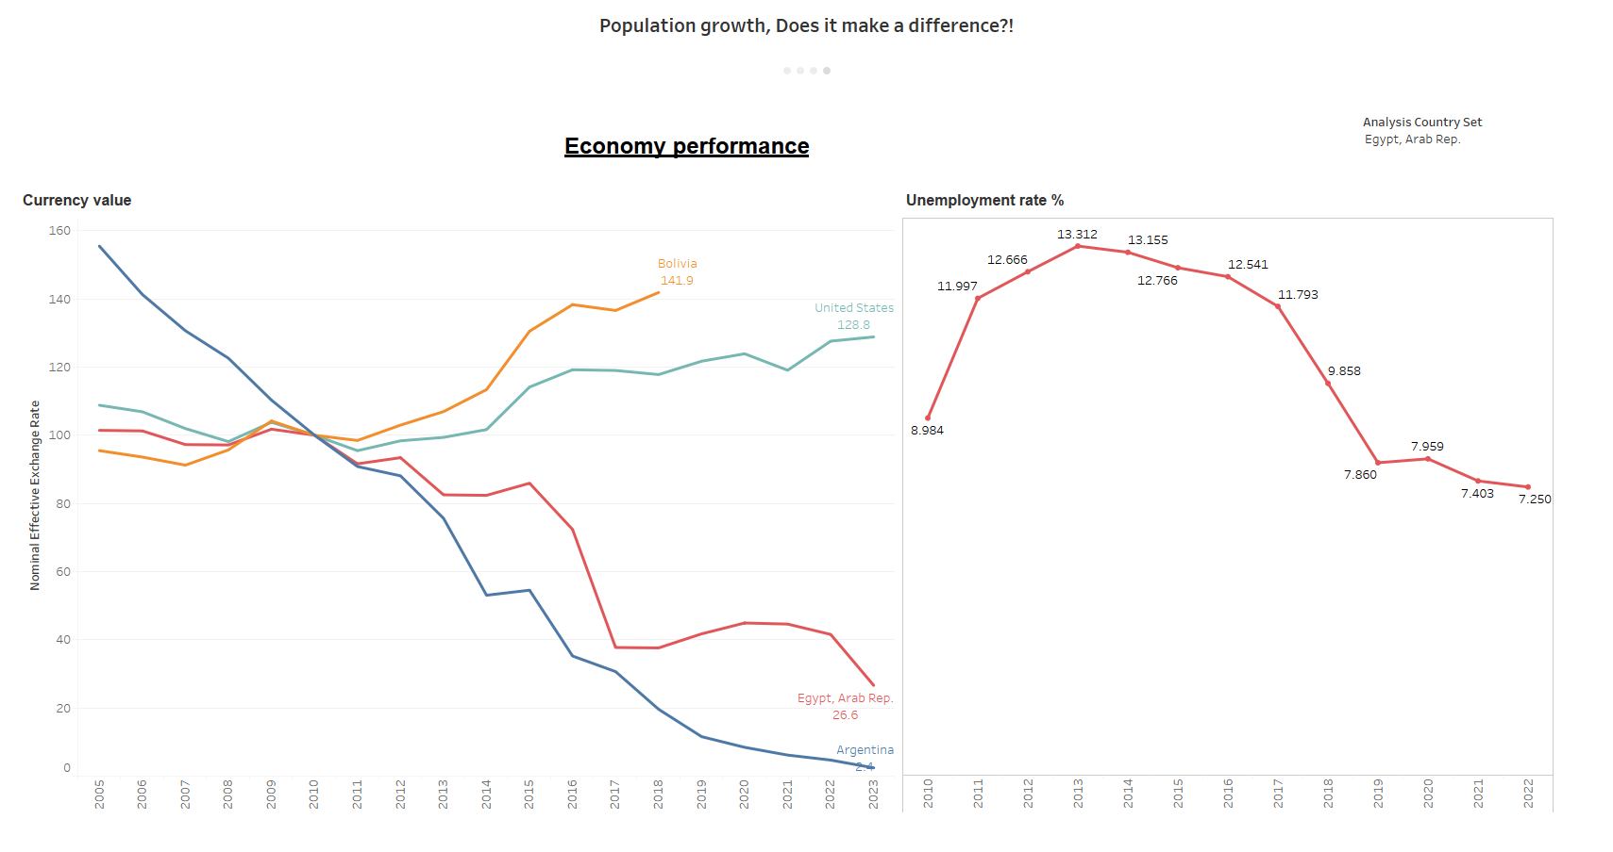
Population growth effect on economy
The currency value deteriorates rapidly for some countries even if the population growth rate is decreasing, but the unemployment rate on other hand is decreasing but at much slower pace.

Slide 7
Outcome
Population growth is very dangerous if it is not controlled but if it is used correctly, you can build a better future, As we saw, although the population growth is decreasing, it didn’t serve much good.
So, we must stop blaming population growth for poor quality of life or bad economical situations, because human capital constitutes the real wealth

Slide 8
THANK YOU
Sherif Ashraf

