Slide 1
Fabrication Tracking
Administrator Guide

Slide 2
Contents
  Example output
  Steps to start a new project
  Troubleshooting
  Questions / Clarifications
DIES

Slide 3
Example
  Fabrication type details
Spool fabrication steps (Property) | Weight Factor | Contribution %
Cutting | 1 | 14%
Welding | 1 | 14%
NDE | 2 | 29%
Painting | 1 | 14%
Coating | 1 | 14%
Testing | 1 | 14%
DIES

Slide 4
Example
  Fabrication type items
Tag Number | Cutting | Welding | NDE | Painting | Coating | Testing | Progress of Tag % | Tag weight factor | Weighted progress
Tag-1 | 1/6/2025 | 1/7/2025 | 1/8/2025 | 1/9/2025 | 1/10/2025 | 1/11/2025 | 100 | 3 | 12%
Tag-2 | 1/7/2025 |  | 1/20/2025 |  |  |  | 57 | 4 | 9%
Tag-3 |  | 1/20/2025 |  | 1/25/2025 |  | 1/28/2025 | 100 | 12 | 48%
Tag-4 | 1/9/2025 |  | 1/11/2025 | 1/12/2025 | 1/13/2025 |  | 86 | 6 | 21%
DIES

Slide 5
Steps to start a new project
  Check DBA settings.
  Check that SPOOL and WELD item types is defined.
  Add any missing property that will be tracked during the fabrication tracking.
  Update the project defaults.
  Define the Where conditions that will be used in dividing items across different fabrication types.
  Create the fabrication types.
  Create the load format for each fabrication type.
  Update the Fabrication Tracking template.
DIES

Slide 6


Step1: Check DBA settings
  FAB_IMPORT_PATH Set this to the database server path where fabrication tracking import files will be stored.
  RBS_FAB Set this to the rollback segment name used during fabrication tracking imports.
    ➡ value: RBS_FAB (keep the default name unless otherwise instructed).
    ➡ Explanation: The Rollback Segment (RBS) is an Oracle Database feature that stores the "before" image of data. This allows transactions to be rolled back in case of errors during the import process, ensuring data integrity.
    Example from a log file:
DIES

Slide 7
Step2: Check that SPOOL item type is defined
  Navigate to Home > Administration > Materials Setup
  Select Item Types.
  Check that the item type “SPOOL” exist with item rule “TFM”.
  Check that the item type “WELD” exist with item rule “TFM”.
  Explanation:
  TFM is tagged fabricated items with milestones (In BOM and in MTO, there is no special logic associated with tagged fabricated items (spool pieces).
DIES

Slide 8
Step3: Add any missing property that will be checked during the fabrication tracking
  Coordinate with the Construction Team
    Share the Fabrication Tracking template with the construction team.
    Confirm if there are any additional properties that need to be tracked during fabrication.
  Check the Properties in the product group ”SDB”
    Navigate to Home > Administration > Tables and Properties.
    Select Properties.
    Check the properties under group “Fab Track”
  If some properties are missing, Create a new property group (project code_FT).
  Add the new properties under the new group.
DIES

Slide 9
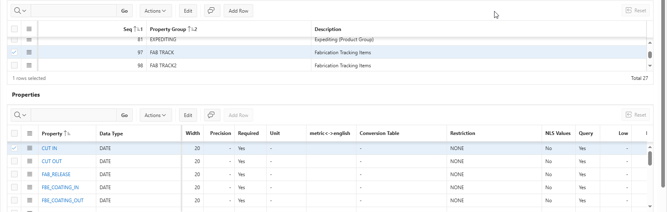
Step3: Add any missing property that will be checked during the fabrication tracking
DIES

Slide 10
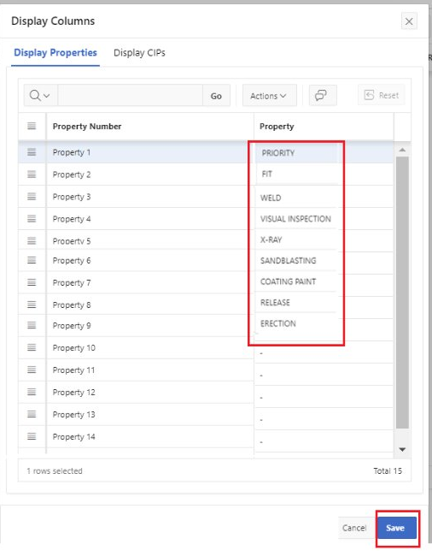
Step3: Add any missing property that will be checked during the fabrication tracking
  Notes:
  Only 15 properties can be included in the Display Column (shown in the Fab/Values) in the Fabrication Tracking (highlight this note if the properties exceed 15).
DIES

Slide 11
Step4: Update the project defaults
  Related project defaults:
  ZB_TFMPART: Defines the default commodity part for the item rule “TFM” (keep it Spools, Spools is a commodity part created on the SDB level)
  ZP_REFDATE: allows to change the behavior of the Reference Date field on the Load Fab Tracking page to be mandatory or not (Select N: Reference Date is optional)
  ZP_FAB_ITY: specifies the item type used in Fab Tracking > Load Fab Tracking page for the import operation.
DIES

Slide 12
Step5: Define the Where conditions that will be used in dividing items across different fabrication types
  Explanation:
  When creating a fabrication type, it is necessary to specify a Where condition that determines which spools from the BOM will be assigned to the corresponding fabrication type. For instance, separate fabrication types may be established for different coating processes such as FBE coating and galvanizing, due to the distinct nature of their processes. The Where condition should encompass all spools associated with the specific process.
  To facilitate this, a position property (e.g., Class or Material) should be added to each spool, which will serve as the basis for constructing the Where condition.
  Recommendation:
  Minimize the number of fabrication types wherever possible, as each type requires a separate sheet in the Fabrication Tracking template, increasing overall complexity.
DIES

Slide 13
Step5: Create the Where conditions that will be used in dividing the fabrication types
  Steps (in this case, two fabrication types will be created “Recommended”) :
  Go to Home > Administration > Query Builder.
  Create new Where condition with module P1091.
  Open the Where condition and add the property (PART = ‘SPOOLS’), (ITEM_TYPE = ‘SPOOL’) for fabrication tracking of spools.
  Generate the view.
  Create another one for welds with the same properties except (ITEM_TYPE = ‘WELD’) for welds.
  Notes
  PART ‘SPOOLS’ is selected as it is the default part used in project default ZB_TFMPART.
  The user shall not be able to change the part (don’t include the part in the FLC).
DIES

Slide 14
Step6: Create the fabrication types
  Go to Home > Site > Maintain Fab Tracking.
  Select Add Fabrication Type.
  Enter the name, Max Revisions to be 1, Calculation Method to be Up to Highest Step With Date.
  Add the Where Condition ( create Fabrication Type for each Where condition).
  in the Fabrication Type Properties:
  Add the properties that will be tracked
  Add the Ref BOM Property if the property will be assigned from the BOM module.
  For properties with Date datatype, add the weight factor (1) – to be discussed with planning.
DIES

Slide 15
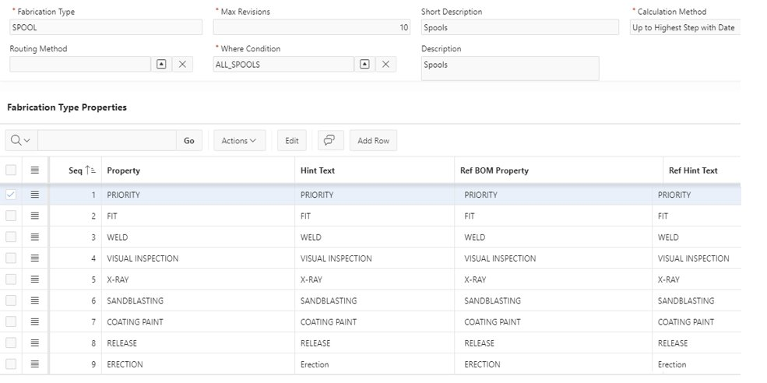
Step6: Create the fabrication types
DIES

Slide 16
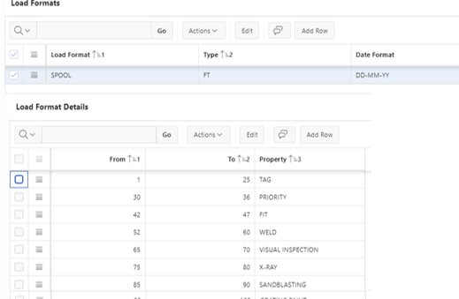
  Step7: Create the load format for each fabrication type.
  Go to Home > Administration > File Setup.
  Select Load Formats.
  In the Load Formats section, add row.
  Enter the name, type: FT, Date Format to be MM-DD-YY and add the fabrication type.
  In the load Format Details, add the property and the location in the txt file.
DIES

Slide 17
  Step7: Create the load format for each fabrication type.
  Notes:
  There is a bug in SMAT web, properties can’t be added in the format (a case is opened with this issue), add the properties in SMAT classic till solving this issue.
  Ensure that the space that added for each property can cover all the values of this property.
  Adding the Hold Code property cause the load Fab Tracking to fail (to be checked).
  For each fabrication type, create its load format.
DIES

Slide 18
  Step8: Update the Fabrication Tracking workbook
  Add any property required to create the Where conditions (Ex: Class).
  Add any property required to be tracked and its value will be assigned from the BOM(EX: total number of BW).
  Update the function and VBA code that required to extract the files.
DIES

Slide 19
  Troubleshooting (Continuously updated with any new issue)
  The issues can be in the below:
  Importing the BOM.
  Loading the BOM into the fabrication type.
  Load Fab Tracking process.
  VBA doesn’t work.
DIES

Slide 20
  Troubleshooting: Importing the BOM
  ERROR: NON-TFM or invalid items found while running in TFM import mode. Skipping BOM node.
    Check that the item type in the Fabrication Tracking template is ‘SPOOL’ and ‘WELD’.
  Positions not created (number of spools created are less than the Fabrication Tracking template)
    Check if there is a duplication in the spool tag in Fabrication Tracking template.
    Check if the tags are already in the project in another commodity part than the default assigned in ZB_TFMPART (see the log to know this error).
    Some properties are not added to the positions as in the template
      Check that the properties added to Home > Bill of Materials > Position Properties
DIES

Slide 21
  Troubleshooting: Importing the BOM
  Checks for any other errors:
    Check the errors in the log file if it is obvious.
    Check that the user select Import Fab Spool during the BOM import.
    Check the uploaded files(location of columns, fixed values for some columns)
    Check the BOM import process (Import File, Data source, Configuration Name and Load Option).
DIES

Slide 22
  Troubleshooting: Loading the BOM into the fabrication type
  Number of imported spools is less than the BOM:
    Check if there is a duplication in the spool tag in Fabrication Tracking template.
    Verify the Where condition configured for the fabrication type is correct by following these steps:
    Navigate to Home > Administration > Query Builder.
    Open the corresponding Where condition.
    Click Count to retrieve the number of records matching the condition.
    Compare this count with the total number of spools intended for the fabrication type.
    If the counts don’t match, proceed to update the Where condition accordingly.
DIES

Slide 23
  Troubleshooting: Load Fab Tracking process.
  Number of the spools in the Fab Items/Values increase after load the file:
    Check that the tags in the Fabrication Tracking template are matching the tags in the BOM (extract the tags from the BOM and check duplication using Excel).
    Check that the tags are not duplicated in the fabrication type (The user may enter a reference date in the Load fab Tracking), delete the spools with reference date.
    The import process failed
      Check the log file and the property that cause the failure will be in it (Ex. Cancel property) .
DIES

Slide 24
  Troubleshooting: VBA doesn’t work
  Check that the macros enabled.
  Open Alt+ F11, navigate to the macro, run it line by line to discover where the code stopped to fix the error.
  If the error can’t be fixed quickly, do the following to solve the problem till further discussion internally:
  To extract the import files:
  Open Spool Tracking sheet.
  Create a copy to new workbook
  Unhide all columns.
  Save and load
  Do the same for the Welding Tracking sheet

Slide 25
  Troubleshooting: VBA doesn’t work
  To extract the Update Status files:
  Open Output Spool sheet.
  Copy column A into a txt file and save.
  Load this file.
  DO the same for the Output Weld sheet.

Slide 26
Questions?

Slide 27
Thank You

