Slide 1
Fabrication Tracking

Slide 2
Index
  Overview
  Fabrication Type
  Tracking Data
  Processes Weight Factor
  Progress Tracking
  Steps and Live example
  Questions / Clarifications
Fabrication Tracking

Slide 3
Overview
  Fabrication tracking is the process of monitoring the progress of fabricated items, like spools, through each stage of production to make sure everything is accurate, high-quality, and on schedule. Every stage—such as cutting, welding, and painting—is logged in the system to show real-time updates on the item’s status and location.
  Tracking:
    Spool progress tracking
    Welding progress tracking
Fabrication Tracking

Slide 4
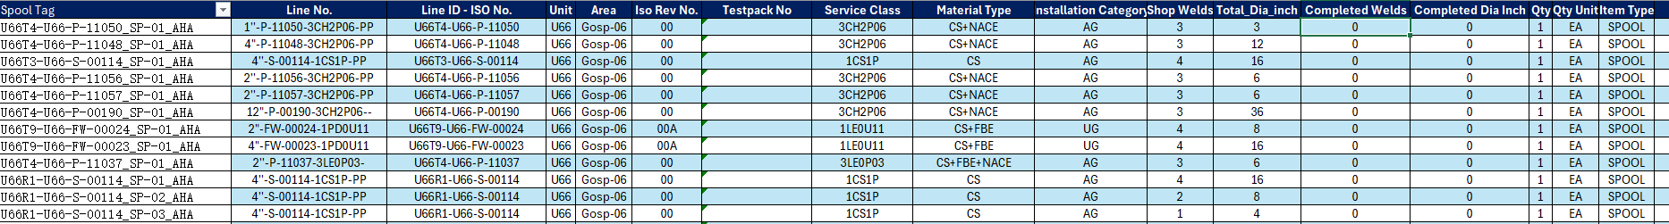
Tracking Data
  Welding Control sheet
Fabrication Tracking
  Spool tracking sheet

Slide 5
Processes Weight Factor
  Fabrication Processes Contribution
Processes | Weight Factor | Contribution %
Cutting | 1 | 14%
Weld in | 1 | 14%
Weld out | 2 | 29%
Testing | 1 | 14%
Coating | 1 | 14%
Painting | 1 | 14%
Fabrication Tracking
Notes:
First: we define the processes that will be tracked during the fabrication type and the weigh factor for each process
Based on that the contribution of each process will be calculated

Slide 6
Overall Progress Tracking
  Fabrication type progress
Tag Number | Cutting | Welding | NDE | Painting | Coating | Testing | Progress of Tag | Tag weight factor | Weighted progress
SP-1 | 1/6/2025 | 1/7/2025 | 1/8/2025 | 1/9/2025 | 1/10/2025 | 1/11/2025 | 100% | 3 | 12%
SP-2 | 1/7/2025 |  | 1/20/2025 |  |  |  | 57% | 4 | 9%
SP-3 |  | 1/20/2025 |  | 1/25/2025 |  | 1/28/2025 | 100% | 12 | 48%
SP-4 | 1/9/2025 |  | 1/11/2025 | 1/12/2025 | 1/13/2025 |  | 86% | 6 | 21%
Fabrication Tracking

Slide 7
Steps
  Import a BOM With the spools and welds included as tagged items.
  Load the spools and welds from the BOM into their fabrication types.
  Incorporate the data received from the fabrication contractor into the Fab Track template file.
  Extract .txt files with the updated data to be compatible with Smart Materials.
  Load these files into SMAT and ensure that the data added to the spools and welds correctly.
  Review and update the tag weight factors and apply any necessary holds.
Fabrication Tracking

Slide 8
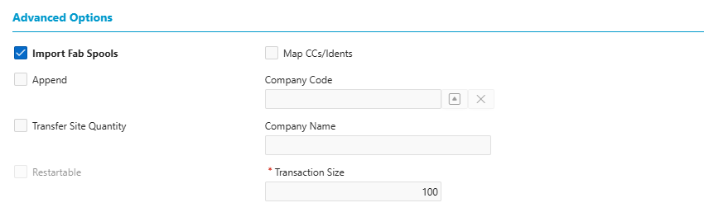
Step1: Import a BOM With the spools and welds included as tagged items
  Fill the Excel sheet (Fab Track template) with the required data.
  Click Extract Import Files to extract 2 workbooks (Imports Spools and Import Welds) in the same folder.
  Import the workbooks into the BOM, following the steps in this link: BOM Overview - Smart Materials Guides.
  Note: In addition to the steps in the guide, ensure that the "Import Fab Spools" checkbox is selected.
Fabrication Tracking

Slide 9
Step1: Import a BOM With the spools included as tagged items.
  Notes
    The spool tag number and weld tag number shall be unique through the project (spool tag: Line-ID_Spool-Number, weld tag: Line-ID_Spool-Number_Joint_Number).
    Keep the discipline (PIPING SPOOLS) and the item type to be SPOOL for Import Spools workbook.
    Keep the discipline (PIPING WELDS) and the item type to be WELD for Import Welds workbook.
    QTY to be 1 and unit to be EA.
    The fabrication tracking is used to track the welds with joint type shop welds.
Fabrication Tracking

Slide 10
  Step2: Load the spools from the BOM into the fabrication type.
  Navigate to Home > Site > Maintain Fab Tracking.
  Select the appropriate Fabrication Type (the name will be provided by the administrators)
  Click on Fab Items/Values.
  Choose Load BOM Items.
  The Spools will be loaded from the BOM into the fabrication type based on the defined Where conditions.
  The Welds will be loaded from the BOM into the fabrication type based on the defined Where conditions.
Fabrication Tracking

Slide 11
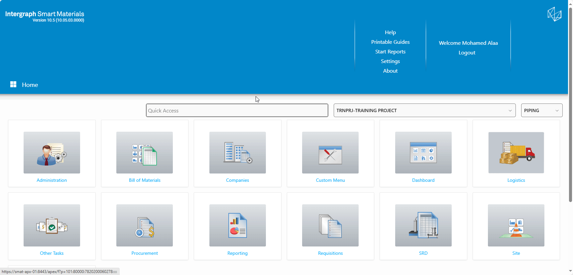
  Step2: Load the spools from the BOM into the fabrication type.
DIES

Slide 12
  Step3: Incorporate the data received from the fabrication contractor into the fab track loading template file.
  Enter the data received from the supplier into the “Welding Control” worksheet for welds (examples: dates of finishing the processes)
  Enter the data for spools in Spool Tracking sheet (examples: dates of finishing the processes).

Slide 13
  Step4: Extract .txt files with the updated data to be compatible with Smart Materials.
  Update Spool
  To update the status, Enter Extract Update Status Files.
  2 txt files are extracted on same path of the workbook (Update Spool Status, Update Weld Status).
DIES

Slide 14
  Step5: Load these files into SMAT, ensure that the data added to the spools and welds correctly.
  correctly
  Navigate to Home > Site > Load FAB Tracking.
  Enter the Load Name, attach the .txt file saved in the previous step, and select the appropriate Load Format (this will be provided by the administrator).
  Save and load.
  After loading, go to Maintain Fab Tracking and open Fab Items/Values to verify that the data has been imported correctly.
DIES

Slide 15
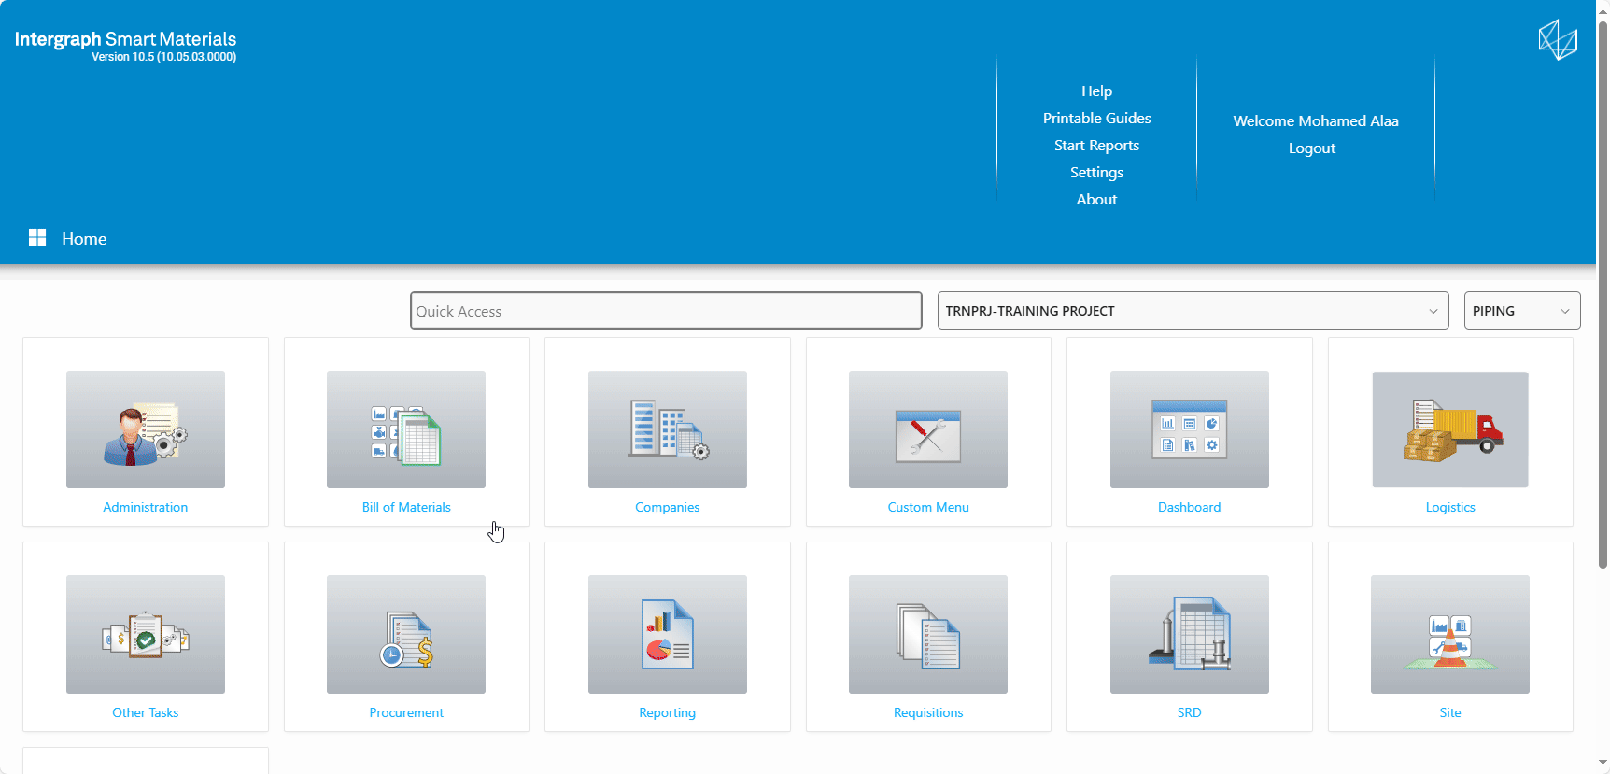
  Step5: Load these files into SMAT, ensure that the data added to the spools and welds correctly.
  correctly
DIES

Slide 16
  Step6: Review and update the tag weight factors and apply any necessary holds to the spools.
  Navigate to Home > Site > Maintain FAB Tracking
  Select the Fabrication type.
  Open Fab Items/Values in the Maintain Fab Tracking.
  In the Hold Code column, enter any applicable hold codes as required.
  In the Tag Weight Factor column, input the corresponding tag weight values.
DIES

Slide 17
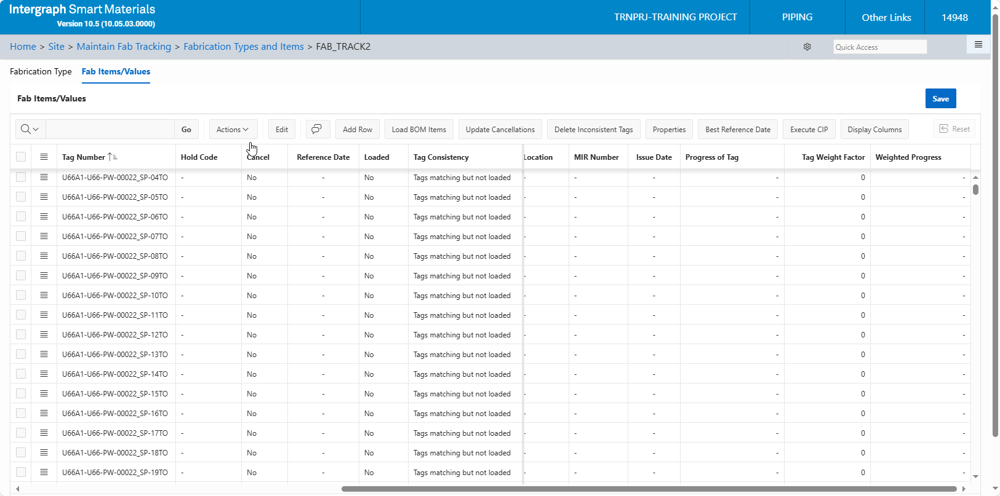
  Step6: Review and update the tag weight factors and apply any necessary holds to the spools.
DIES

Slide 18
  Handling the Modifications.
  Examples for modifications to spools:
    Spools added or deleted.
    Properties of the spool changed (Ex. dia_inch).
    Isometric revision change (To be checked with the construction team).
DIES

Slide 19
  Spools deleted
  Steps to handle adding or removing spools:
    Update the Fabrication Tracking Template to reflect the required spool changes Re-import the BOM using the updated template.
    Under the PIPING SPOOLS node, verify that the number of spools matches the updated import.
    In Maintain FAB Tracking, select the appropriate Fabrication Type and open Fab Items/Values.
    Select Load BOM Items.
    Select the Update Cancellation option. This will automatically mark the "Cancel" column with "Yes" for any spools that were removed from the BOM.
DIES

Slide 20
Questions?

Slide 21
Thank You

