Slide 1
EPC Digital Production Platform
Asset Information Systems
Engineering Systems
Plant Design Systems (3D)
Engineering IM
(Integration)
Document Management
Integrated Digital Delivery
(Digital Twin)
Engineering & Schematics(2D)
Construction & Commissioning
Visualization
Material Management Systems
Client
Reference Data
Schedule
Asset Integrity
Supply Chain
Site Control
ERP

Slide 2
EPC Digital Production Platform
Engineering Systems
Material Management Systems
Plant Design Systems (3D)
Supports Management
SPECs
Reference Data
Site Control
SPECs
Plant IM
DWG
Requisitions
Agreements
Supply Chain
BOM
BOQ
ERP
BOM
Deliverables
Deliverables
Asset Information Systems
Engineering IM
(Integration)
Engineering & Schematics(2D)
Document Management

Slide 3
What is Smart Materials ?
  It is an integrated solution for the life-cycle management of materials, supply chain, and contract/subcontracts.
  Major Functions
    Material Management
    Contract Management
SMAT Implementation

Slide 4
Material Management processes
  Gather engineering requirements
  Agreement strategy
  Post agreement
  Site Control
SMAT Implementation
Notes:
Gather engineering requirements involves three major sub-processes.
Defining a proper work breakdown structure is the first step in identifying the project requirements. A BOM captures all the material requirements for constructing a plant.
Requisitions include specific details of the engineering requirements, like how much, and when.
Planning the fulfillment of the requisitions and tracking their progress continuously is critical to avoid surprises at a later stage, where it can cost heavily.

Slide 5
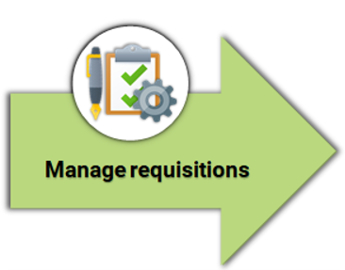
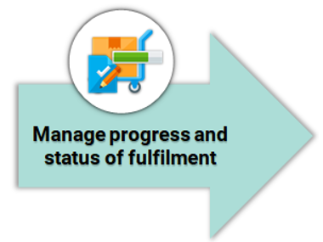
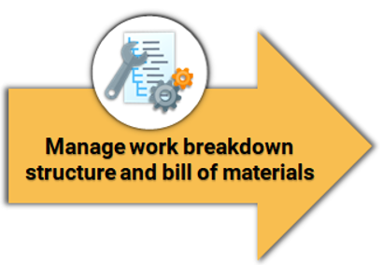
Gather engineering requirements
SMAT Implementation
Notes:
The entire material management process is about meeting the engineering requirements at the correct time. So, generating accurate engineering requirements in an efficient manner is the first step for effective material management.
The goal at this stage is to define and quantify the engineering requirements. These requirements might be new or might result from certain change management in the existing system.
Gather engineering requirements involves three major sub-processes.
Defining a proper work breakdown structure is the first step in identifying the project requirements. A BOM captures all the material requirements for constructing a plant.
Requisitions include specific details of the engineering requirements, like how much, and when.
Planning the fulfillment of the requisitions and tracking their progress continuously is critical to avoid surprises at a later stage, where it can cost heavily.

Slide 6
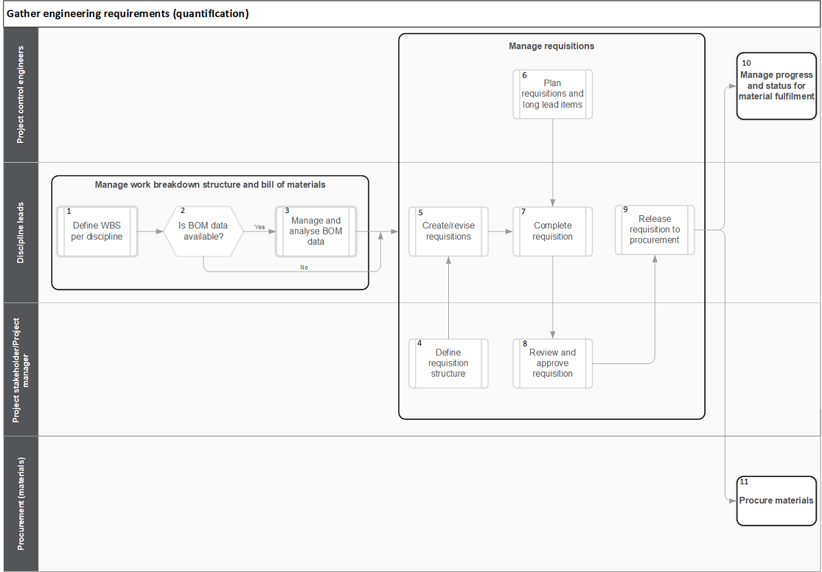
Gather engineering requirements
SMAT Implementation
Notes:
Gather engineering requirements involves three major sub-processes.
Defining a proper work breakdown structure is the first step in identifying the project requirements. A BOM captures all the material requirements for constructing a plant.
Requisitions include specific details of the engineering requirements, like how much, and when.
Planning the fulfillment of the requisitions and tracking their progress continuously is critical to avoid surprises at a later stage, where it can cost heavily.

Slide 7
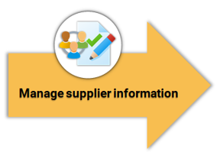
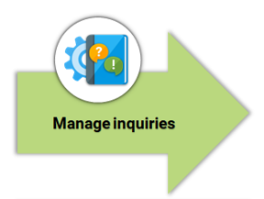
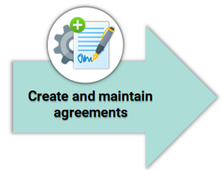
Agreement strategy
SMAT Implementation
Notes:
consists of three major sub-processes.
Maintaining a database of suppliers is an integral part of effective material management. However, maintaining such a database requires frequent update of critical information as well as registering new suppliers and updating existing data.
Creating an inquiry with required information is often the first step towards fulfilling the material requirement. It ensures that only qualified suppliers participate in the bidding process and often saves time during finalizing the agreement.
Proper agreement with the appropriate clauses provides the foundation for effective engagement between both the parties. They also become the basis for subsequent planning and monitoring activities.

Slide 8
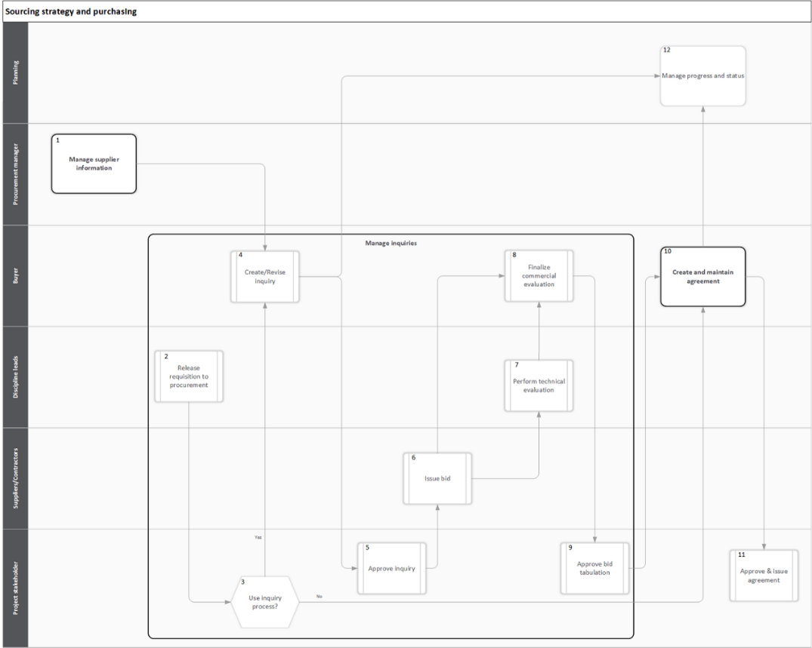
Agreement strategy
SMAT Implementation

Slide 9
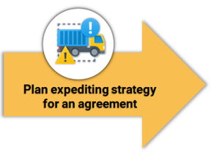
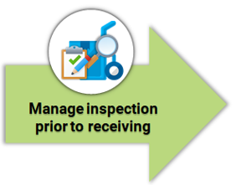
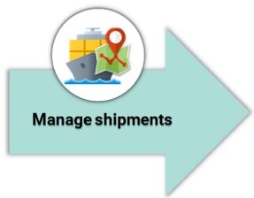
Post agreement activities
SMAT Implementation
Notes:
consists of three major sub-processes.
An expediting strategy helps in early risk identification and risk mitigation. It also helps in managing and mitigating the risks in a timely manner.
Inspection of materials to check if they meet the requirements, is one of the most important task in the monitoring and controlling phase. Early inspection prevents later surprises and ensures proper adherence to the project plan
Managing and tracking shipments are important for optimizing the transport cost and identifying any potential transport delay.

Slide 10
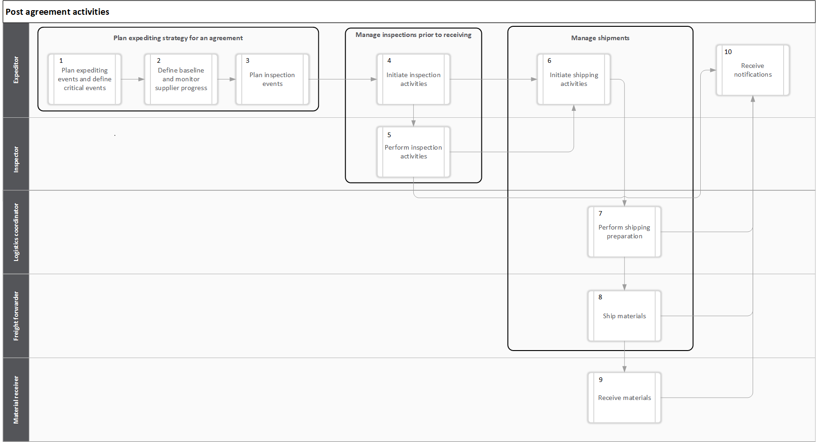
Post agreement activities
SMAT Implementation

Slide 11
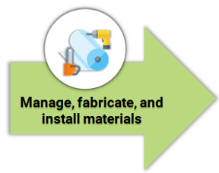
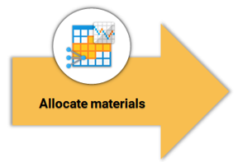
Site Control
SMAT Implementation
Notes:
consists of three major sub-processes.
reserving the material in advance creating proper forecasting plane.
Managing materials at the site involves receiving, issuing, and tracking the materials.

Slide 12
Complete flow through data
Create a Bill of Materials
Create a Requisition
Release Req. to Procurement
Create Inquiry from same Req.
SMAT Implementation
Expediting/ Inspection/Shipping
Create an Agreement
Award the Quote
Approve Inquiry.
Manage Warehouses
Receive Material
Forecast and reservation
Material Issuance and Transfer
Notes:
Create bill of materials using diagrams and drawings.
Divide bill of materials into multiple lists which consolidate and organize materials based on suppliers and time will be required at site.
Inquiry is created with the most suitable suppliers
Suppliers will review the inquiry then respond with quote
Review each offer considering the price, reputation and reliability of each supplier.

Slide 13
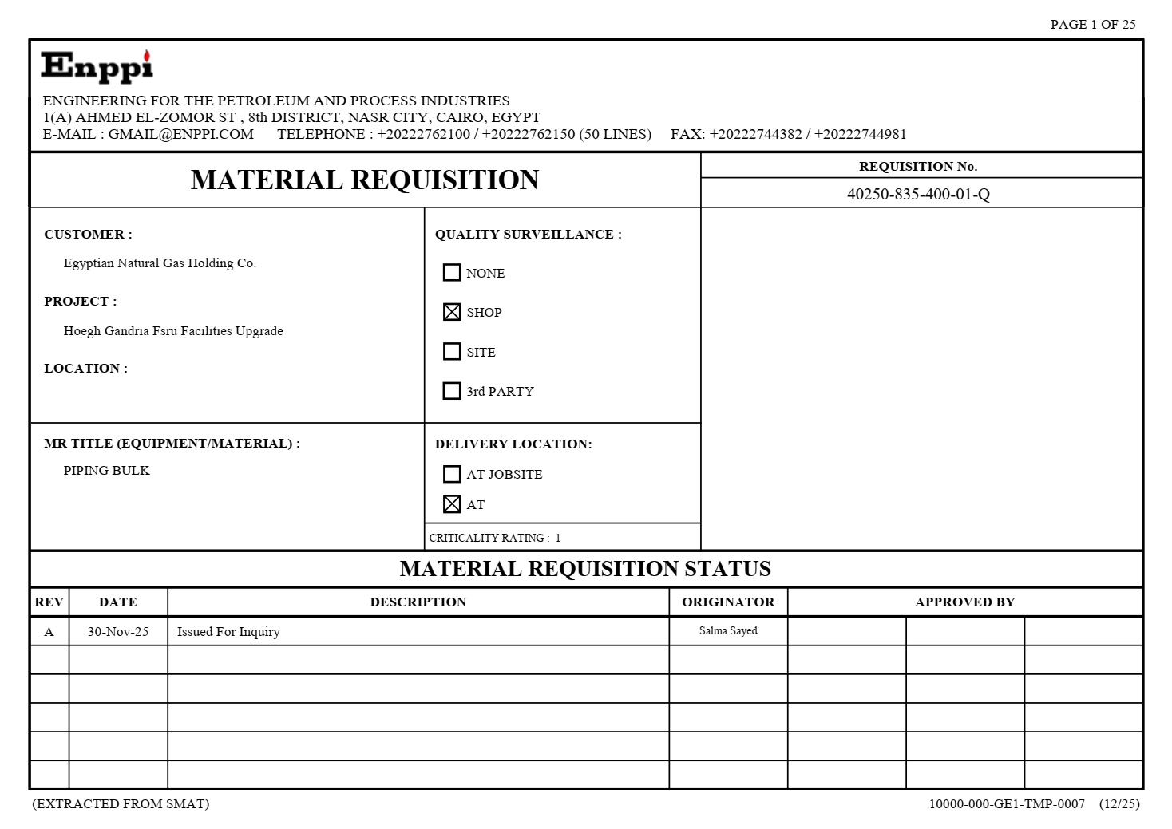
Deliverables (Engineering Requisition)
SMAT Implementation
Notes:
Create bill of materials using diagrams and drawings.
Divide bill of materials into multiple lists which consolidate and organize materials based on suppliers and time will be required at site.
Inquiry is created with the most suitable suppliers
Suppliers will review the inquiry then respond with quote
Review each offer considering the price, reputation and reliability of each supplier.

Slide 14
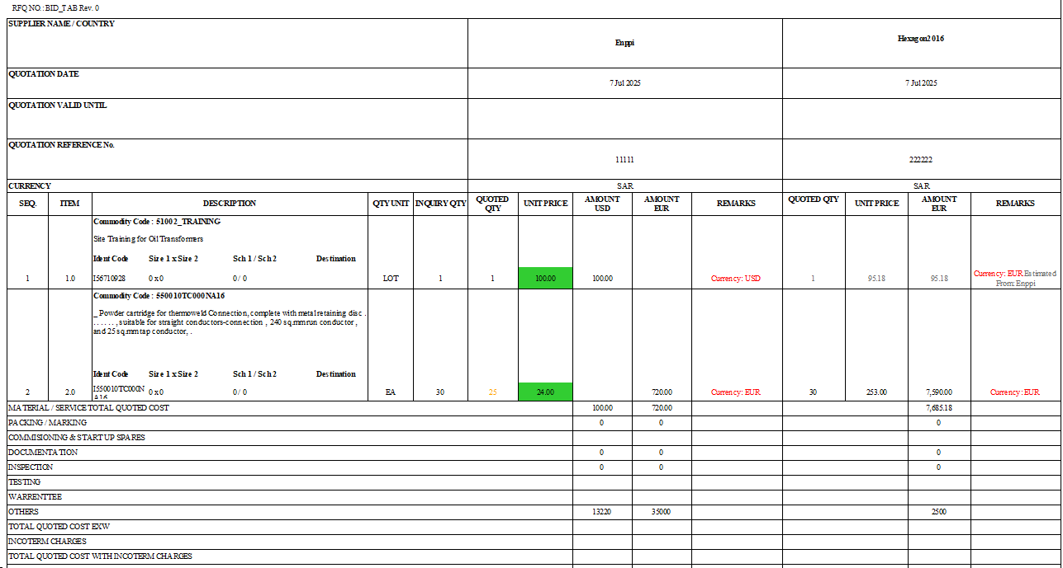
Deliverables (Bid Tab.)
SMAT Implementation
Notes:
Create bill of materials using diagrams and drawings.
Divide bill of materials into multiple lists which consolidate and organize materials based on suppliers and time will be required at site.
Inquiry is created with the most suitable suppliers
Suppliers will review the inquiry then respond with quote
Review each offer considering the price, reputation and reliability of each supplier.

Slide 15
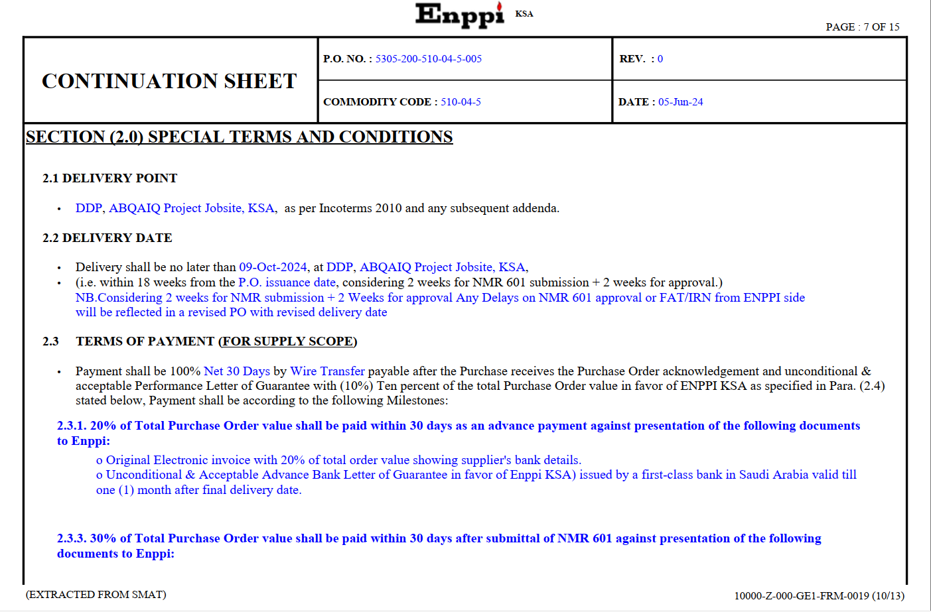
Deliverables (PO)
SMAT Implementation
Notes:
Create bill of materials using diagrams and drawings.
Divide bill of materials into multiple lists which consolidate and organize materials based on suppliers and time will be required at site.
Inquiry is created with the most suitable suppliers
Suppliers will review the inquiry then respond with quote
Review each offer considering the price, reputation and reliability of each supplier.

Slide 16
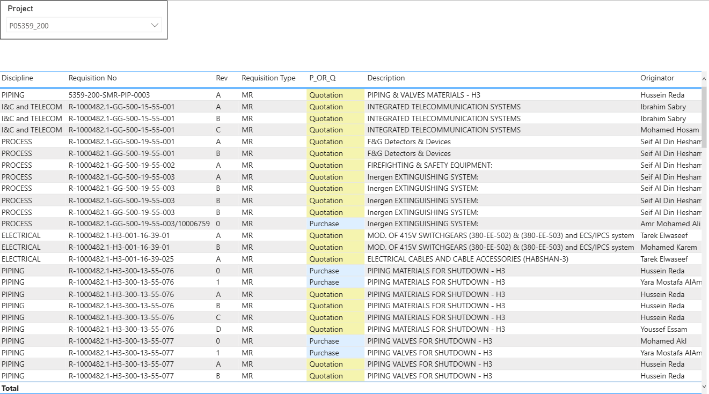
Reports (Engineering Requisitions status)
SMAT Implementation
Notes:
Create bill of materials using diagrams and drawings.
Divide bill of materials into multiple lists which consolidate and organize materials based on suppliers and time will be required at site.
Inquiry is created with the most suitable suppliers
Suppliers will review the inquiry then respond with quote
Review each offer considering the price, reputation and reliability of each supplier.

Slide 17
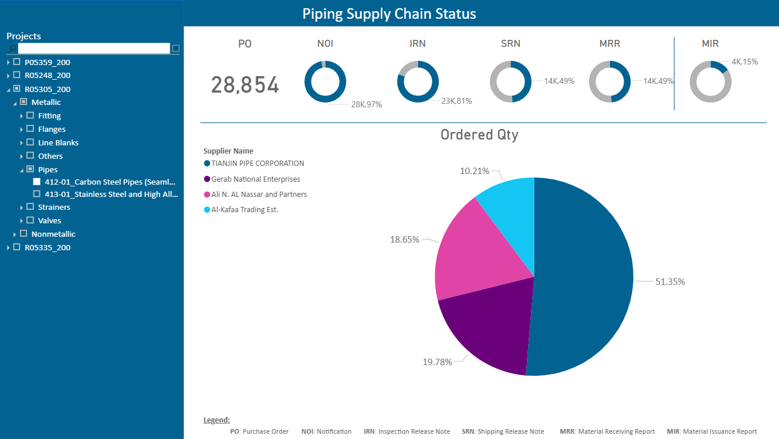
Supply Chain Dashboard
SMAT Implementation
Notes:
Create bill of materials using diagrams and drawings.
Divide bill of materials into multiple lists which consolidate and organize materials based on suppliers and time will be required at site.
Inquiry is created with the most suitable suppliers
Suppliers will review the inquiry then respond with quote
Review each offer considering the price, reputation and reliability of each supplier.

Slide 18
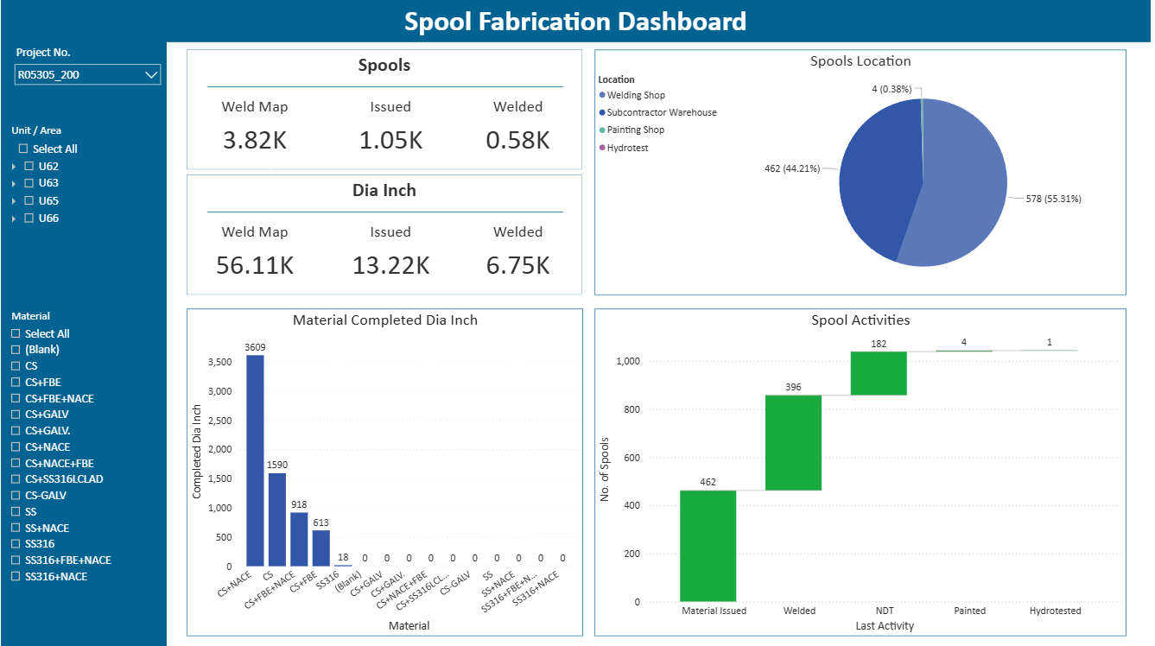
Spools Fabrication Dashboard
SMAT Implementation
Notes:
Create bill of materials using diagrams and drawings.
Divide bill of materials into multiple lists which consolidate and organize materials based on suppliers and time will be required at site.
Inquiry is created with the most suitable suppliers
Suppliers will review the inquiry then respond with quote
Review each offer considering the price, reputation and reliability of each supplier.

Slide 19

SMAT Website
SMAT Implementation

Slide 20
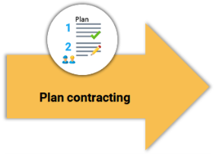
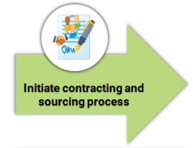
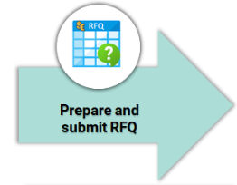

Contract Management (pre-award)
SMAT Implementation
Notes:
The scope of the work to be outsourced needs to be clearly defined before engaging with potential contractors.
Engaging with potential suppliers and contractors.
Creating a RFQ (Request for Quotation) with necessary details.
Evaluating quotes involves both technical and commercial evaluation. The awarding should be done after a thorough consideration of all important technical and commercial aspects of the project

Slide 21
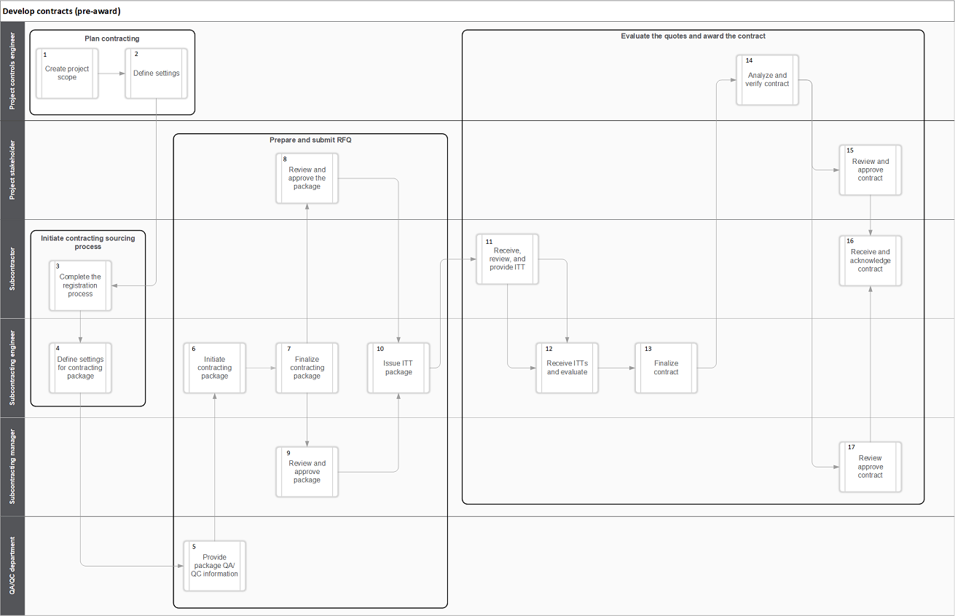
Contract Management
SMAT Implementation
Notes:
Continuous tracking prevents late surprises and is essential for proper risk management. It is even more important in case of outsourced work.
Updating the contract to reflect scope or schedule changes

Slide 22
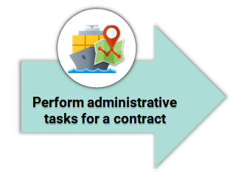
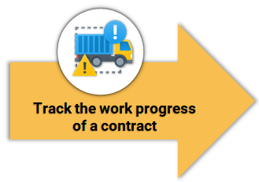
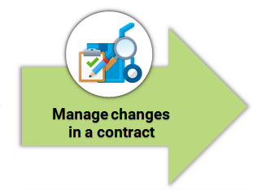
Execute contracts (post award)
SMAT Implementation
Notes:
Continuous tracking prevents late surprises and is essential for proper risk management. It is even more important in case of outsourced work.
Updating the contract to reflect scope or schedule changes
Contract administration is important from legal point of view. It involves tracking conversations and requests for information.

Slide 23
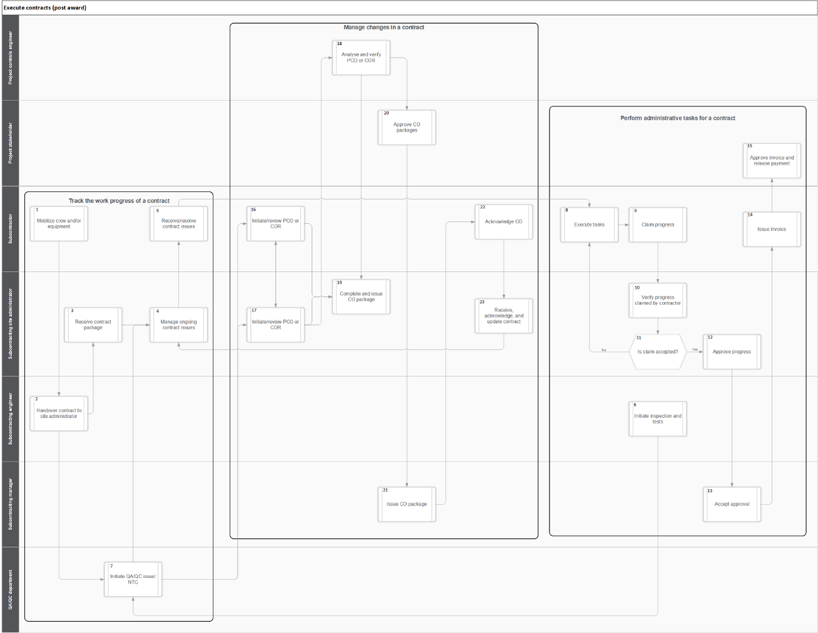
Execute contracts (post award)
SMAT Implementation

Slide 24



SMAT old environment
Database server
App-01 server
App-02 server
SMAT Implementation
Reporting server

Slide 25
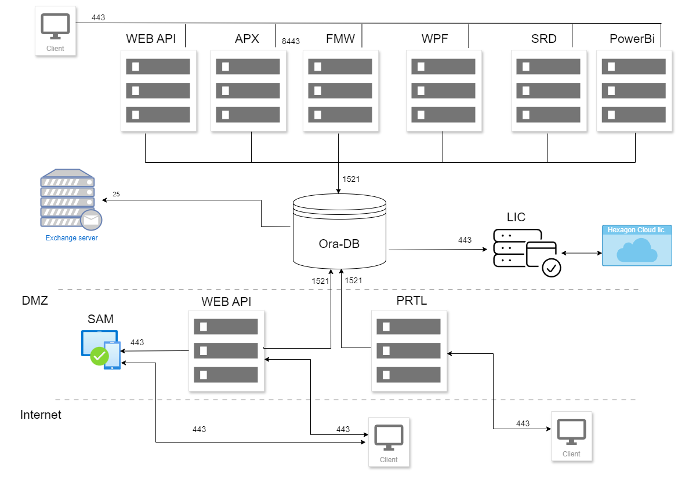
SMAT New environment
SMAT Implementation

Slide 26
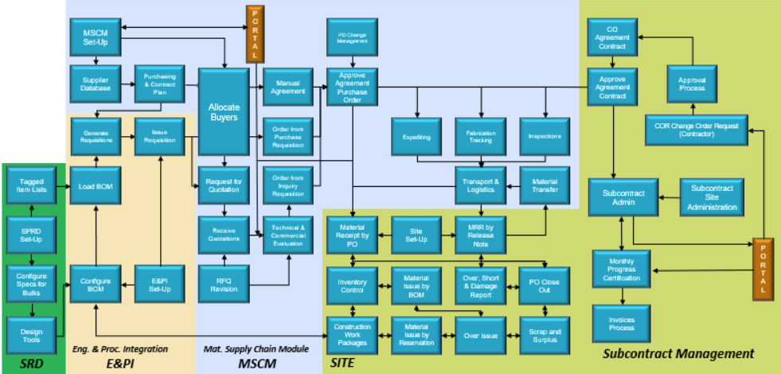
SMAT Workflow
SMAT Implementation

Slide 27
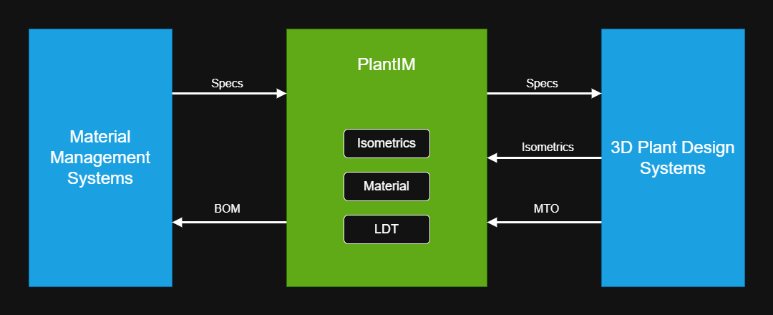
Engineering Integration
SMAT Implementation

Slide 28
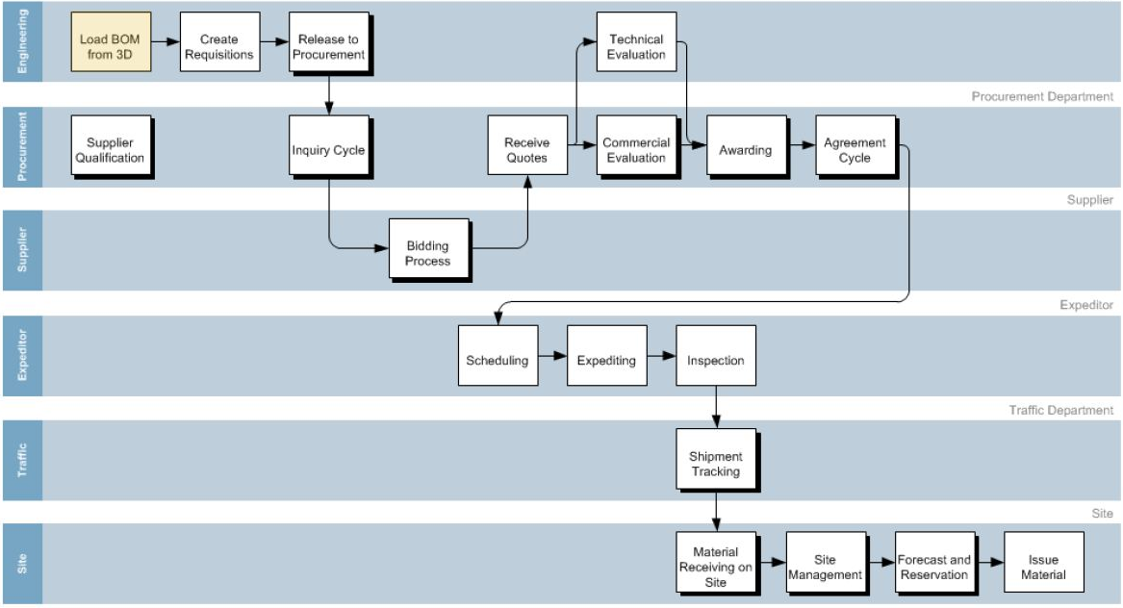
SMAT Workflow
SMAT Implementation

Slide 29
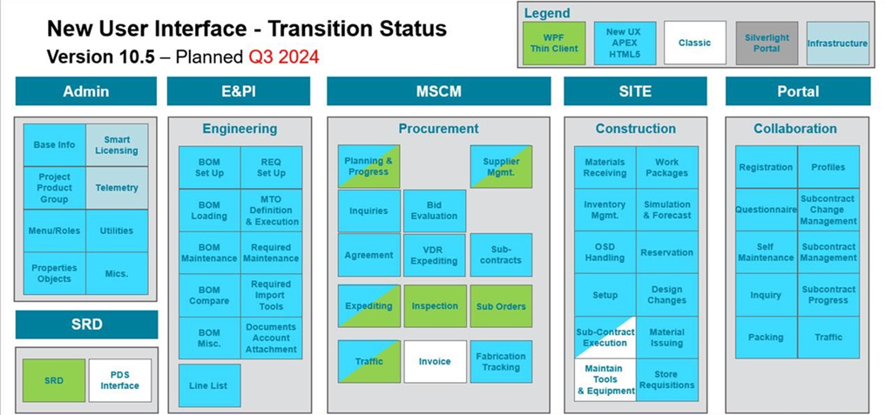
SMAT User Interface - Transition Status
SMAT Implementation

Slide 30
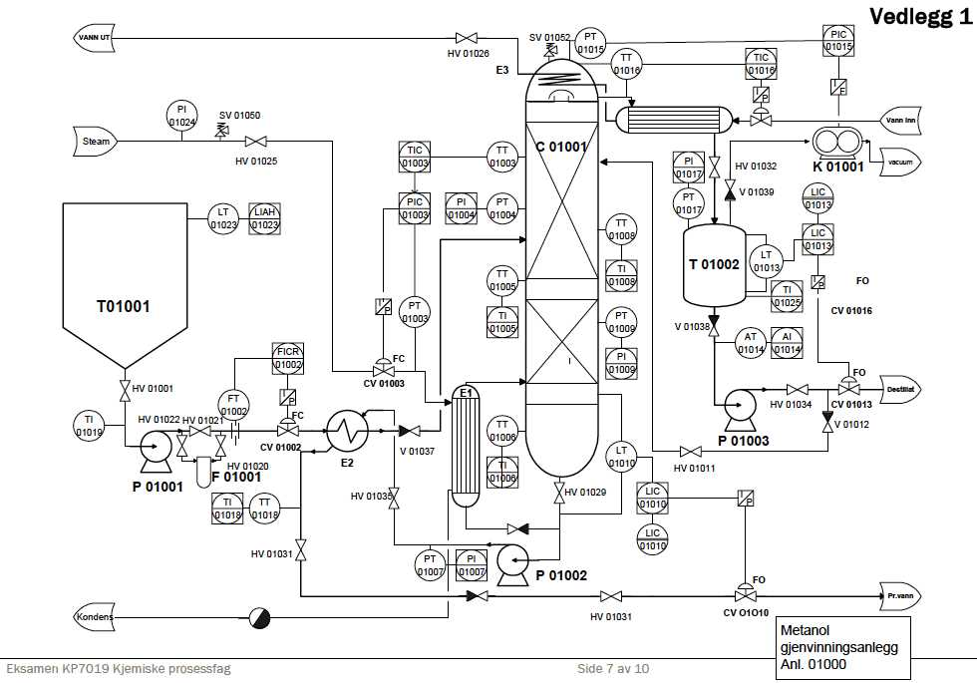
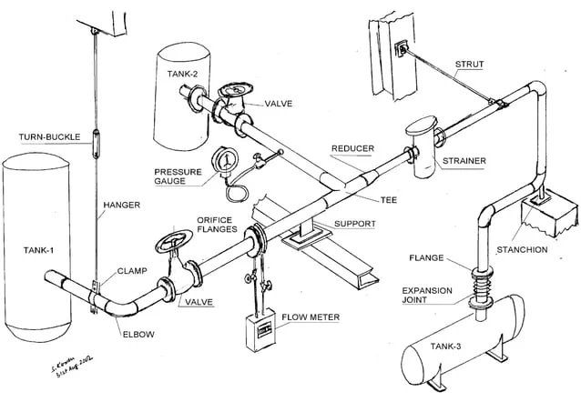
BOM & Material Requisitions
SMAT Implementation

Slide 31
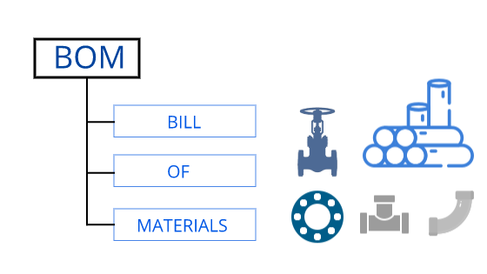
BOM & Material Requisitions
MRPs
MRQs
MRP-1-1
MRQ-1
MRP-1-2
SMAT Implementation
MRQ-2
Inquiry
MRP-2
MRQ-3
MRQ-4
MRP-3
MRP-4

Slide 32
BOM & Material Requisitions
MRQs
MRQ-1
MRP-1-1
MRQ-2
Inquiry
SMAT Implementation
MRP-1-2
MRQ-3
MRQ-4
MRP-2

Slide 33
Inquiry
  Inquiry options
    Include more than one revision for same MRQ.
    Summarize MRQ Line Items with different delivery designation.
    Merge more than one MRQ.
    Include not purchased items
SMAT Implementation

Slide 34
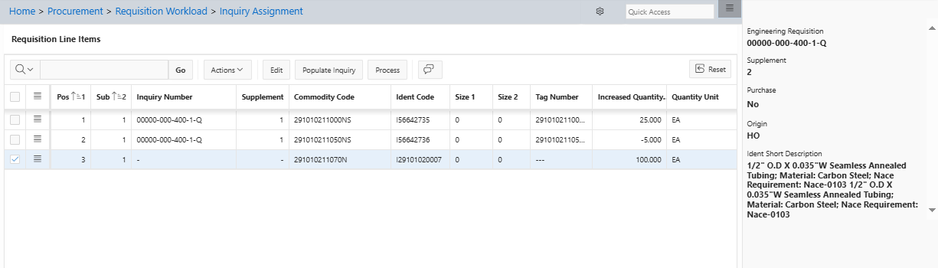
Inquiry Assignment
SMAT Implementation

Slide 35
Title (Font 18 Trebuchet MS)
  Font 16 Trebuchet MS
  Font 14 Trebuchet MS
SMAT Implementation

Slide 36

Title (Font 18 Trebuchet MS)
Font 14 Trebuchet
Font 12 Trebuchet
Division or Project Name

Slide 37
Font 40 Trebuchet MS
(Separators)

